Slide 1
Adaptive Content Safety System
System Architecture, Decision Logic, Cost Strategy & API Comparison
Group: Nexus Prime

Slide 2
1. System Architecture
High-Level Flow:
React Frontend → FastAPI Backend
Stage 1: Metadata Analysis
Stage 2: Partial Content Analysis
Stage 3: Deep Analysis (if escalated)
Decision Engine → Human Queue (20/hr limit) → Response

Slide 3
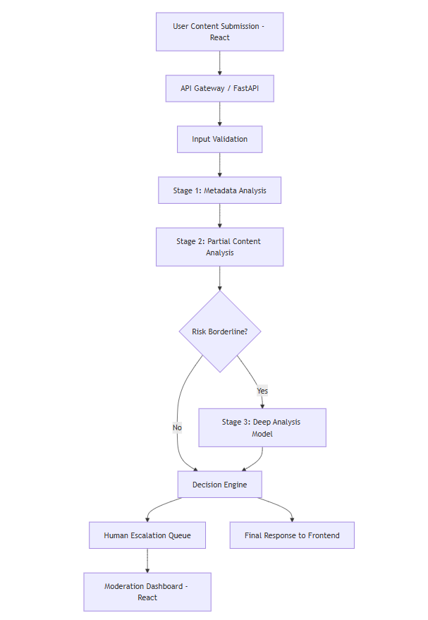

Slide 4
Major Components & Data Flow
Input Validation (Pydantic)
Contextual Heuristics Signal
Semantic ML Signal
Signal Decay Engine (Adaptive)
Cost-Aware Routing
Decision Engine (Allow / Flag / Escalate / Delay)

Slide 5
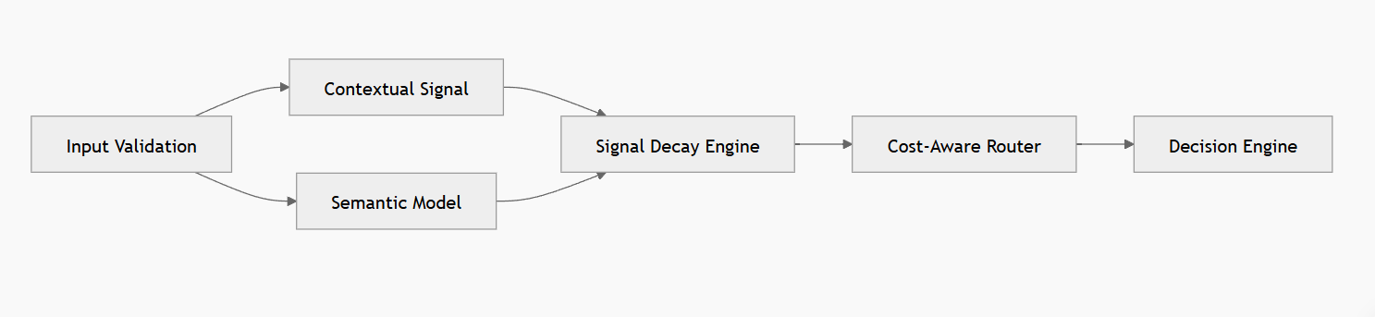

Slide 6
2. Decision Logic
Low Risk + High Confidence → Allow
High Risk + High Confidence → Auto-Flag
Medium Confidence → Escalate (Human Review)
Low Confidence → Delay (Wait for More Context)
Ambiguous multilingual content → Prefer escalation

Slide 7

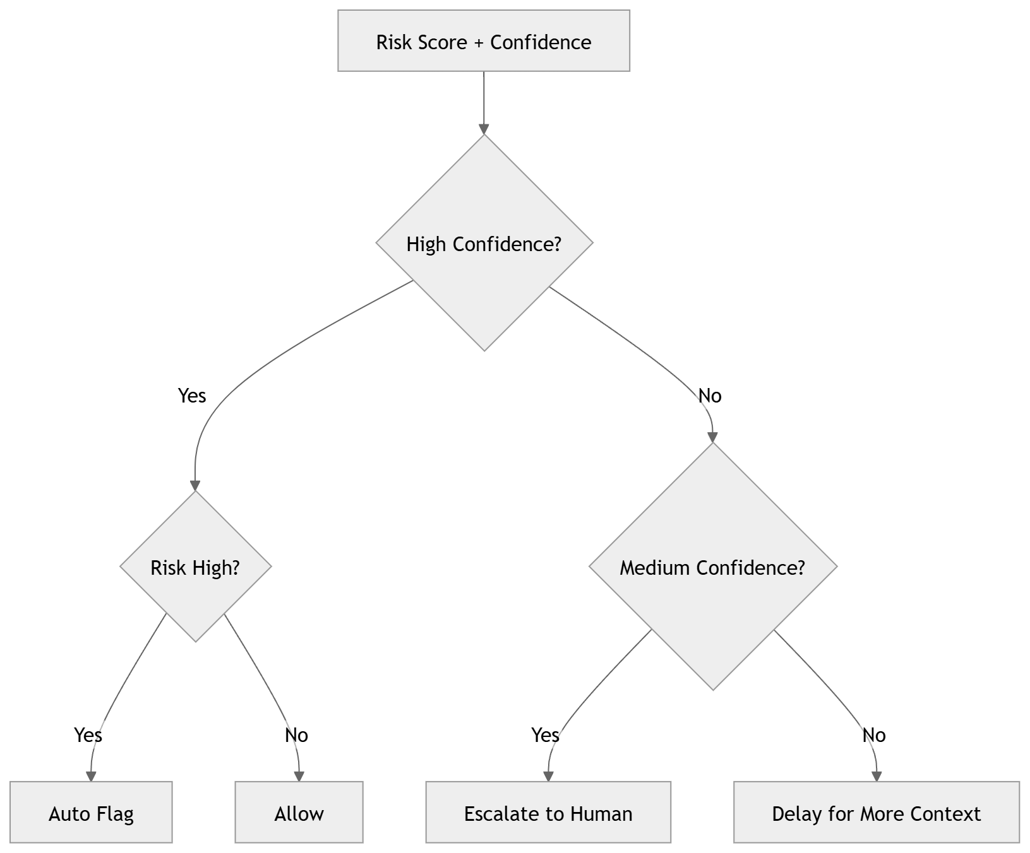

Slide 8
3. Cost & Latency Strategy
Monthly Budget: PKR 50,000
Fast Path (<150ms) for clear cases
Deep Model (<800ms) for borderline cases only
Estimated Cost Allocation:
• Semantic Models: ~20,000 PKR
Deep Models: ~15,000 PKR
Infra & Logging: ~15,000 PKR

Slide 9
4. Adaptation Strategy
Signal Decay (3% per use, floor at 0.3)
Randomized model weighting
Shadow evaluation pipeline
Noise injection into thresholds
Budget-triggered degraded mode

Slide 10
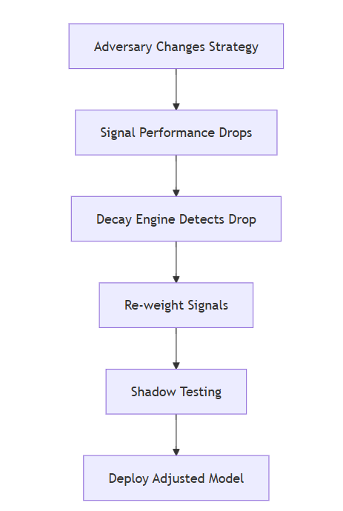

Slide 11
5. Failure Mode Declaration
1. Ambiguous Content Misclassification
Impact: Trust loss, false flags
Containment: Escalation + confidence gating
2. Label Poisoning (15% noise)
Impact: Model drift
Containment: Re-review sampling + disagreement alerts
3. Budget Exhaustion
Impact: Deep model disabled
Containment: Throttle at 80% budget + degraded mode

Slide 12
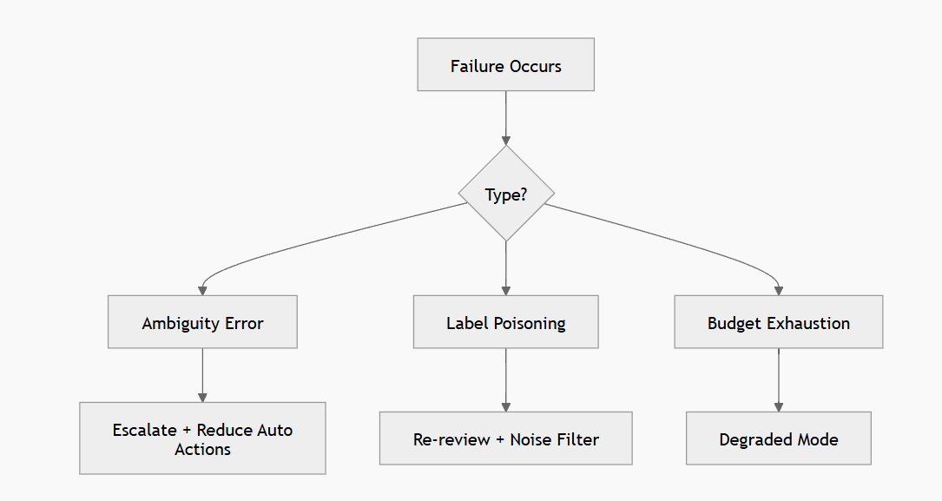

Slide 13
Hugging Face Model Overview
facebook/roberta-hate-speech-dynabench-r4-target → Robust English
cardiffnlp/twitter-roberta-base-hate-latest → Social media optimized
unitary/toxic-bert → General toxicity detection
unitary/unbiased-toxic-roberta → Bias-reduced classifier
minuva/MiniLMv2-toxic-jigsaw → Lightweight, low-compute

Slide 14
Multilingual & Specialized Models
pysentimiento/bert-it-hate-speech → Italian
pysentimiento/robertuito-hate-speech → Spanish
HateXplain BERT → Explainable labels
dehatebert-mono-english → English focused
Combine English + language-specific models for ensemble

Slide 15
API & Model Comparison Overview
Self-Hosted Open Source → Truly Free, Setup Required
Hugging Face Free Models → Easy, Limited Tier
OpenAI Moderation → Low Cost, High Accuracy
Replicate → Free Credits Monthly
AWS Comprehend → Free Tier (12 Months)
RapidAPI → Mixed Quality Free APIs

Slide 16
Quick Comparison
Self-Hosted: Free, No Hosted API, Medium Setup
Hugging Face: Partial Free, Hosted, Easy Integration
OpenAI Moderation: Low Cost, Strong Multilingual
AWS: Flexible, Cloud Heavy Setup
Replicate: Great for Hackathon Credits

Slide 17
Recommended Hybrid Strategy
Primary Backbone → Hugging Face Free Models
Backup → Self-Hosted Open Source Models
Ambiguous Cases → OpenAI Moderation
Avoid Google Perspective (Sunsetting)
Result: Low Cost + High Coverage + Adaptive Defense

