Slide 1
Multiple Schlerosis
A Machine Learning Approach Using Python
Balu S Unny

Slide 2
Problem Statement
To develop a predictive model that can accurately classify patients into two groups: "CDMS" (Chronic Disseminated Multiple Sclerosis) and "non-CDMS."

Slide 3
Objectives
Understand the data
Preprocess the data into a form suitable for modeling
Perform Exploratory Data Analysis to extract insights
Model training using suitable machine learning algorithms
Evaluate the model performance using prediction metrics
Selecting the best model for the problem

Slide 4
Understanding the Problem
Multiple sclerosis is the most common disease, in which the insulating covers of nerve cells in the brain and spinal cord are damaged.
Specific symptoms can include double vision, visual loss, muscle weakness, and trouble with sensation or coordination.
Multiple sclerosis (MS) begins with an acute clinical attack (clinically isolated syndrome) in approximately 85% of patients.
The need is to identify the build a predictive model that anticipate conversion from CIS to MS

Slide 5
Data Description
1. ID: Patient id
2. Age: Age of the patient (in years)
3. Schooling: Time the patient spent in school (in years)
4. Gender:
1: Male
2: Female
5. Breastfeeding:
1: Yes
2: No
3: Unknown
6. Varicella (Chickenpox):
1: Positive
2: Negative
3: Unknown

Slide 6
7. Initial Symptoms:
A combination of visual, sensory, motor, and other symptoms with various codes:
1: Visual
2: Sensory
3: Motor
4: Other
5: Visual and Sensory
6: Visual and Motor
7: Visual and Others
8: Sensory and Motor
9: Sensory and Other
10: Motor and Other
11: Visual, Sensory, and Motor
12: Visual, Sensory, and Other
13: Visual, Motor, and Other
14: Sensory, Motor, and Other
15: Visual, Sensory, Motor, and Other

Slide 7
8. Mono or Polysymptomatic:
1: Monosymptomatic
2: Polysymptomatic
3: Unknown
9. Oligoclonal Bands:
0: Negative
1: Positive
2: Unknown
10. Diagnostic Test Results:
LLSSEP
ULSSEP
VEP (Visual Evoked Potentials)
BAEP (Brainstem Auditory Evoked Potentials)
11. Imaging Results:
Periventricular MRI
Cortical MRI
Infratentorial MRI
Spinal Cord MRI

Slide 8
12. Clinical Progression:
Initial EDSS: (Provide definition)
Final EDSS: (Provide definition)
13. Group
1: CDMS (Chronic Disseminated Multiple Sclerosis)
2: Non-CDMS

Slide 9
12. Clinical Progression:
Initial EDSS: (Provide definition)
Final EDSS: (Provide definition)
13. Group
1: CDMS (Chronic Disseminated Multiple Sclerosis)
2: Non-CDMS

Slide 10
Data at first glance
Dimensions: 273 x 20
Variables: Categorical - 16, Discrete - 3
Target Class: Group (1 or 0)

Slide 11
Data at first glance
Dimensions: 273 x 20
Variables: Categorical - 16, Discrete - 3
Target Class: Group (1 or 0)

Slide 12
Preprocessing
Imputed Missing Values (Schooling) by Mean
Dropped (Unnamed: 0) that provides no significance for the analysis
Dropped (Initial_EDSS, Final_EDSS)
Formatted datatypes
Encoded categorical variables
Applied One Hot Encoding on Features with Multiple Domain Values
Scaled the Numerical Values to a form suitable for modeling

Slide 13
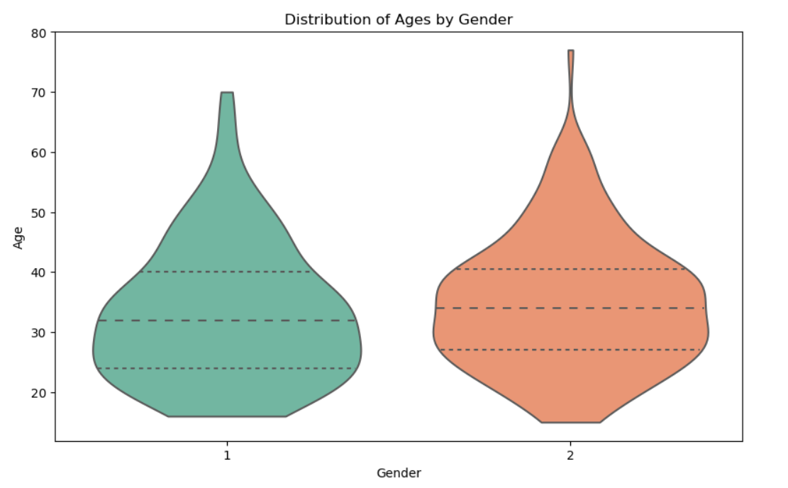
Visualizations

Slide 14
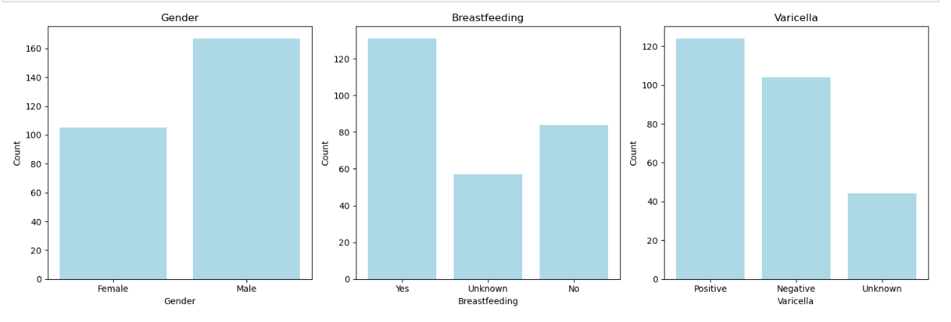

Slide 15
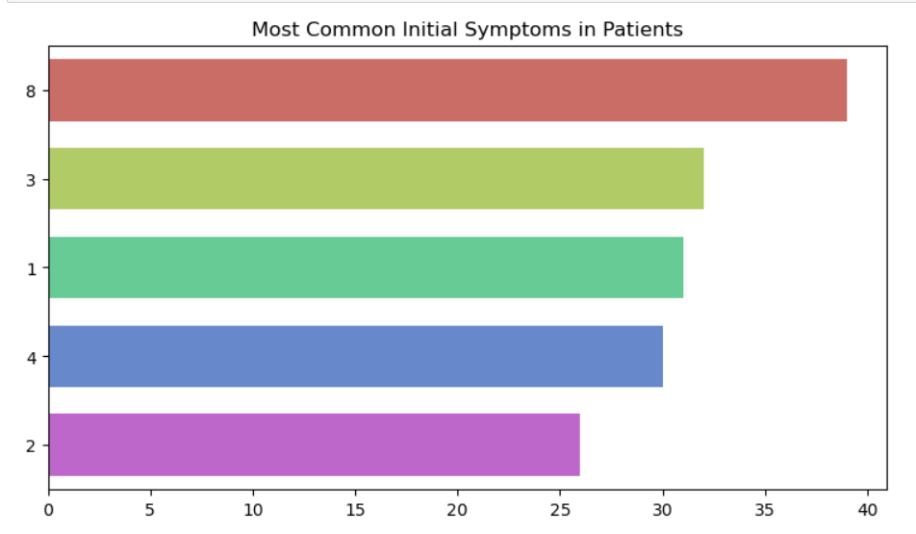

Slide 16
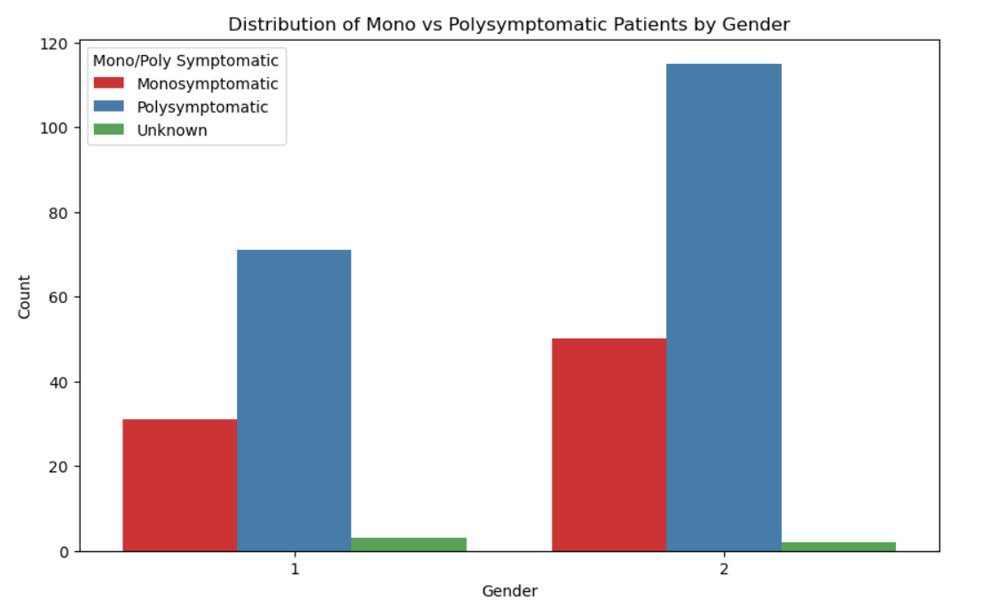

Slide 17
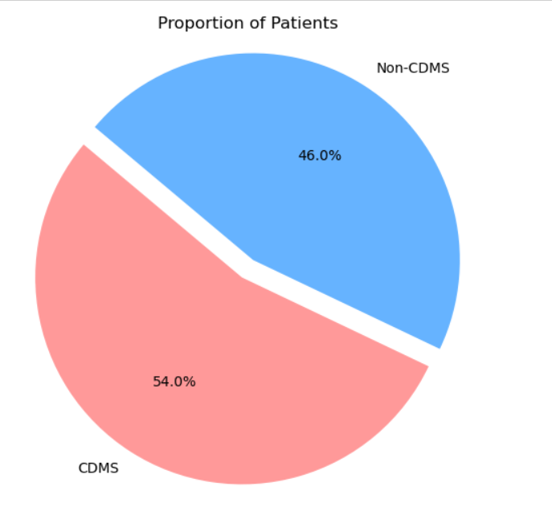

Slide 18
Model Performance

Slide 19
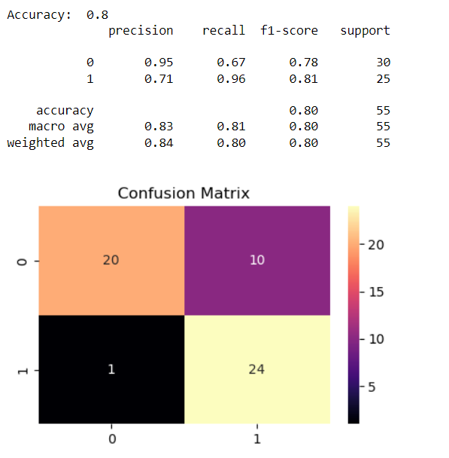
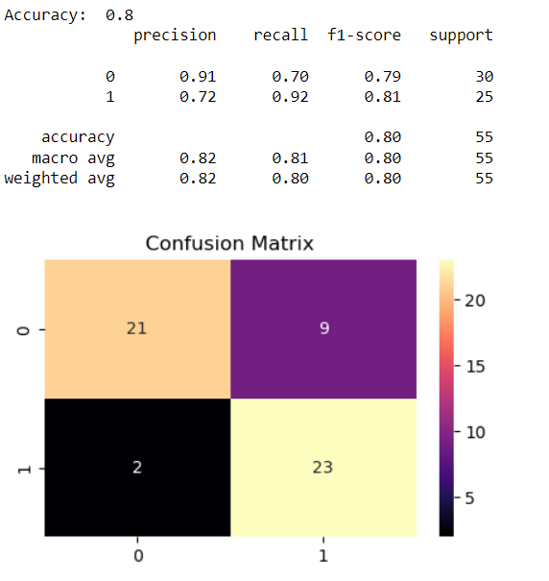
Logistic Regression
Decision Tree

Slide 20
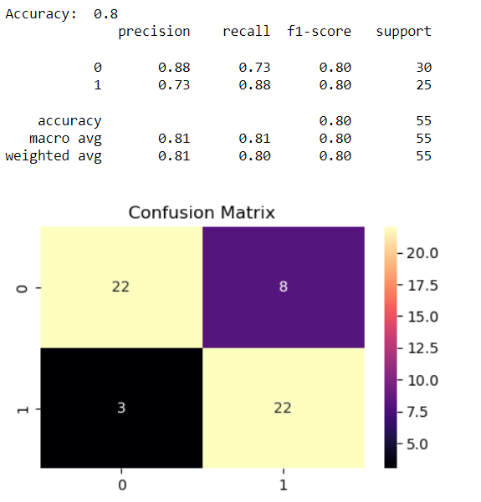
Random Forest

Slide 21
Conclusion
All three algorithms (Logistic Regression, Decision Tree, and Random Forest) have the same accuracy of 0.80.
The F1-scores for both classes (0 and 1) are similar for all three algorithms, indicating a balanced performance in terms of precision and recall.

