Slide 1

1
Hotel Reservation
A Web Application using Laravel
Balu S Unny

Slide 2
Introduction
2
The Laravel-based Hotel Reservation System Project is a sophisticated digital solution, enabling guests to effortlessly book accommodations online whenever they please. This system not only facilitates efficient management of your establishment but also contributes to heightened office productivity and enhanced profitability. In contrast to the time-consuming nature of manual booking procedures, a user-friendly design ensures that online room reservations are a seamless, straightforward, and enjoyable experience.

Slide 3
Roles
3
Adminstrator
User
Manage Rooms
Manage Users
Search Rooms
Booking Management
Manage Categories
Manage Customers
Manage Countries
Search Rooms for bookings
Password Change
Manage Customer
Login Logout

Slide 4
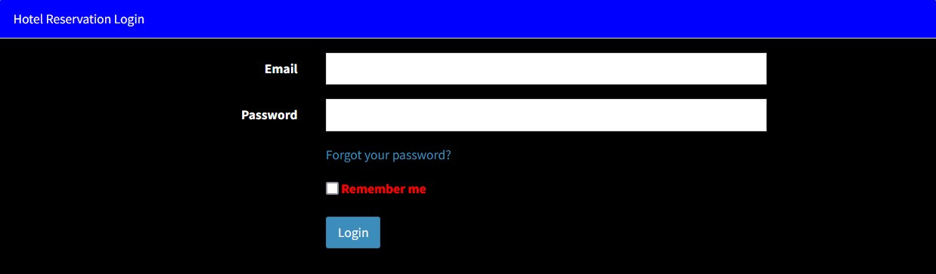
Application Workflow
4
The Login page allows the customers and the administrator to enter the webpage

Slide 5
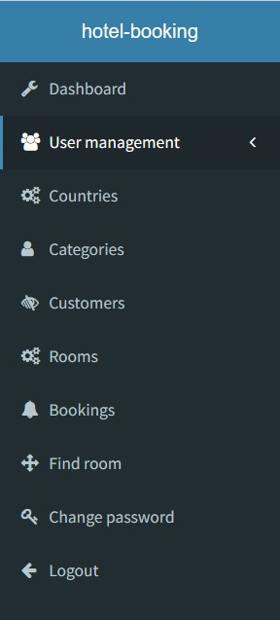
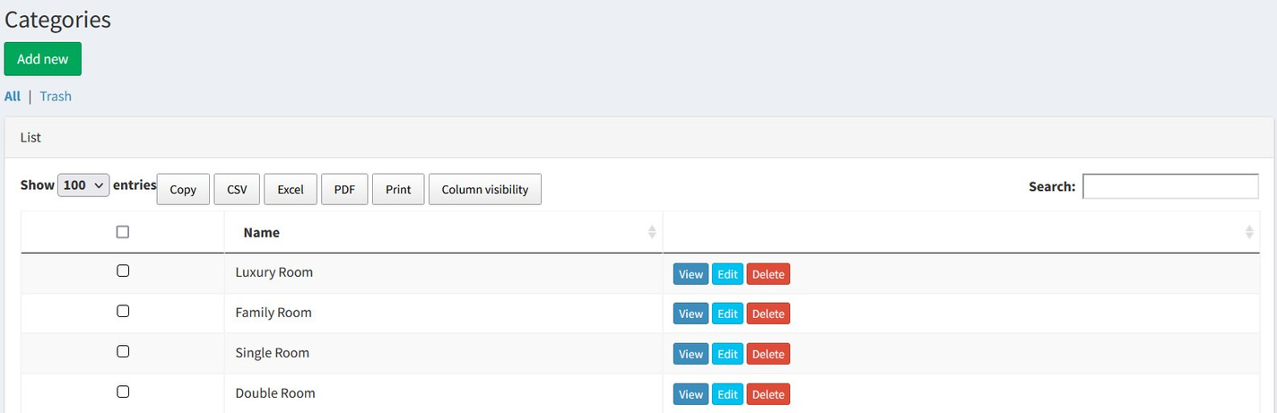
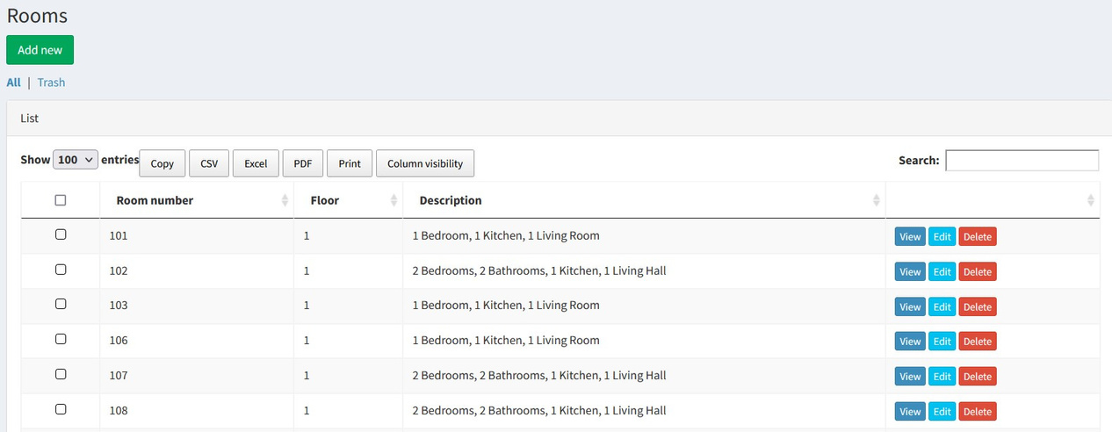
ADMINSTRATOR
5

Slide 6
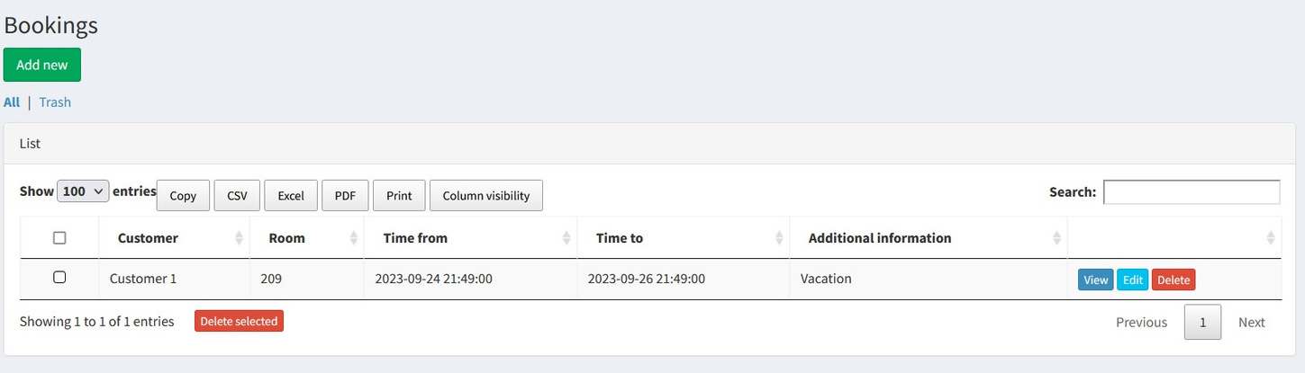
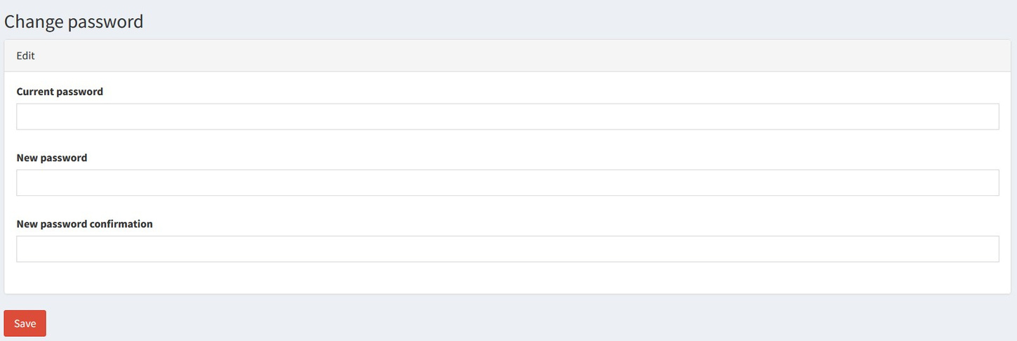
ADMINSTRATOR
6

Slide 7
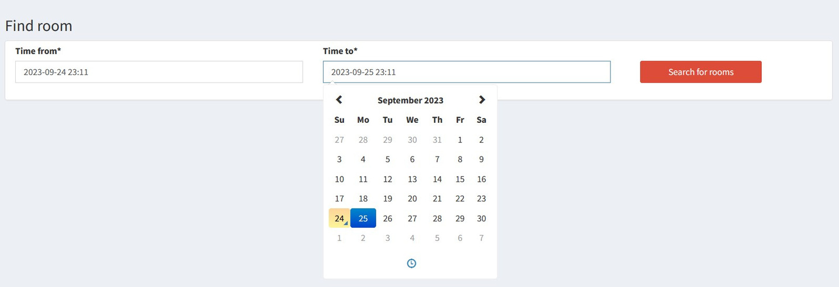
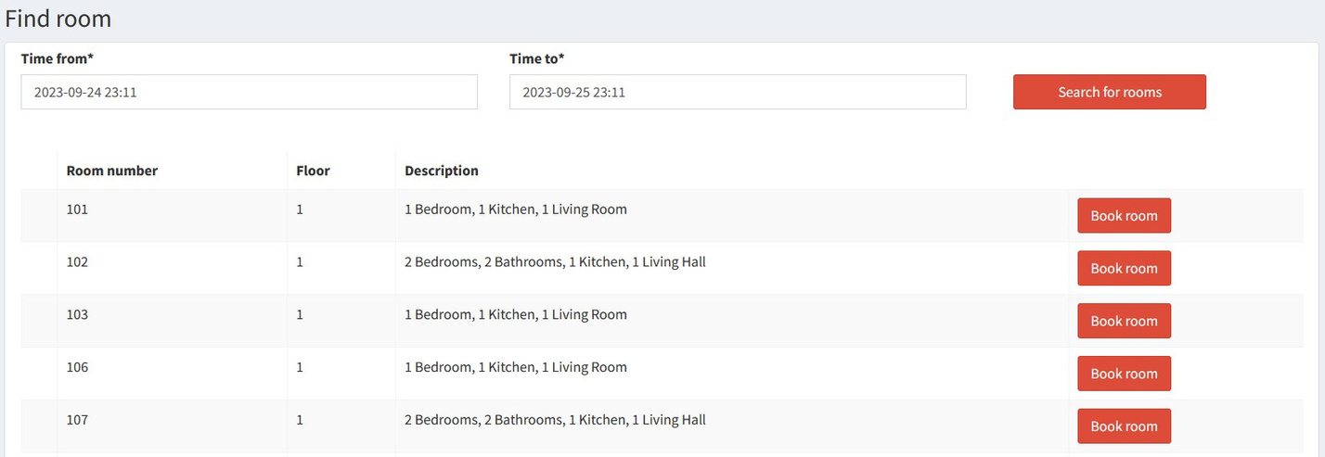
USER
7

Slide 8
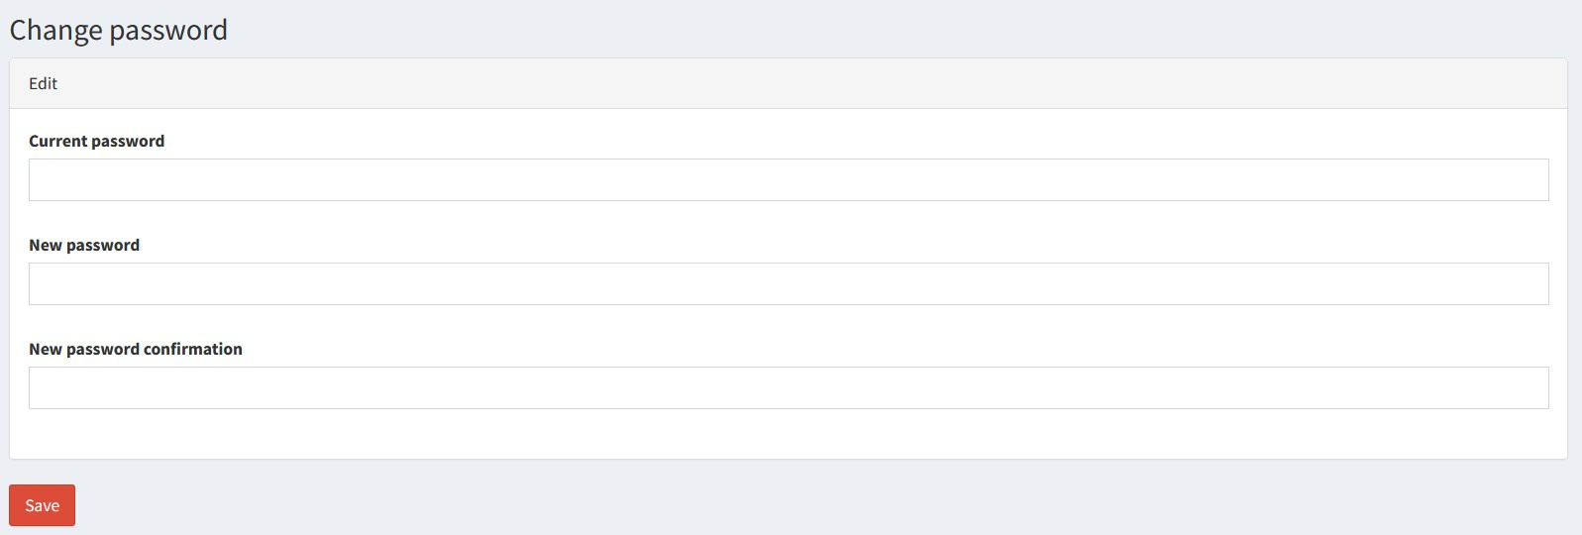
USER
8

Slide 9
9
Thank You

