Slide 1


AB TESTING SEMI-ONLINE PIPELINE
TEACHER: PROFESSOR Peter B. Panfilov. HSE Graduate School of Business / Department of Business Informatics.
Student: Maxim Movshin, group 213.

Slide 2
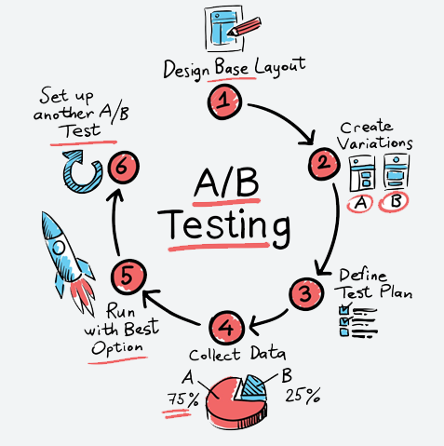
ABOUT THE PROJECT
AB-tesing

Slide 3
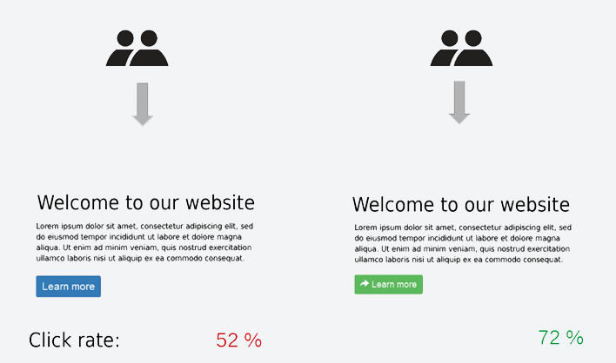
ABOUT THE PROJECT
AB-tesing

Slide 4

ABOUT THE PROJECT
Goal:
01
A/B TESTING INFRASTRUCTURE
02
REAL TIME DATA
03
FRIENDLY UI FOR BI

Slide 5

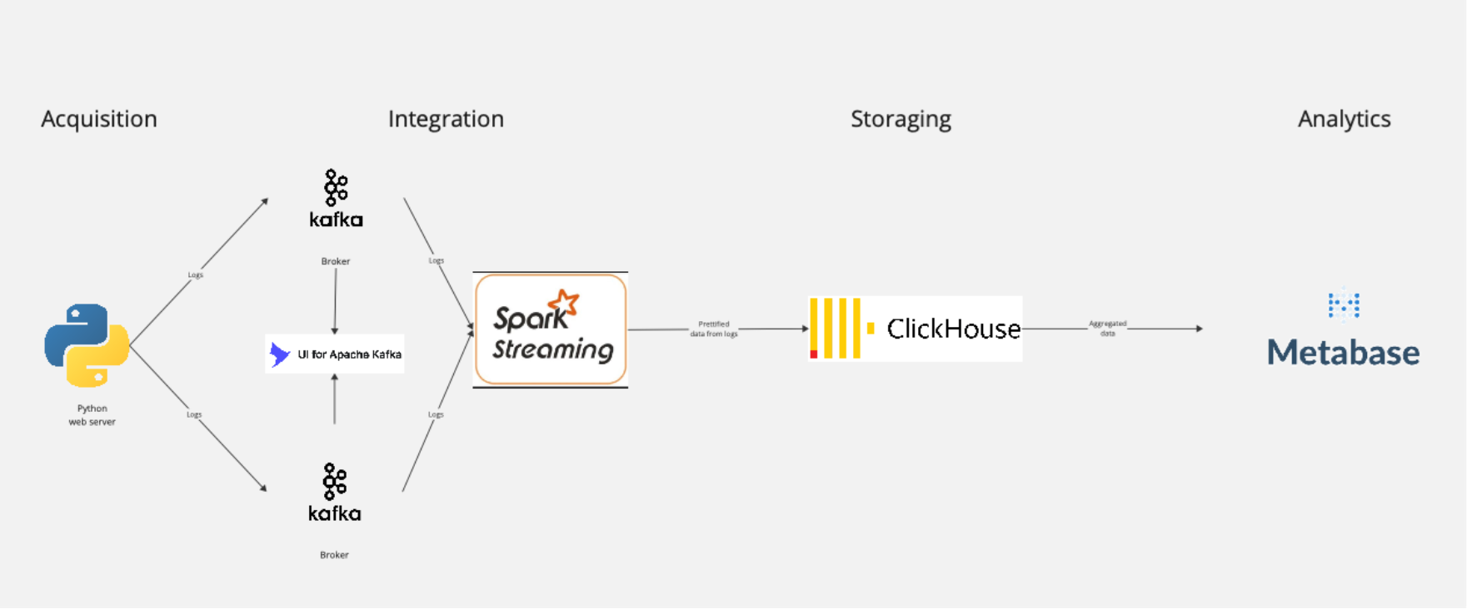
PIPELINE ARCHITECTURE

Slide 6
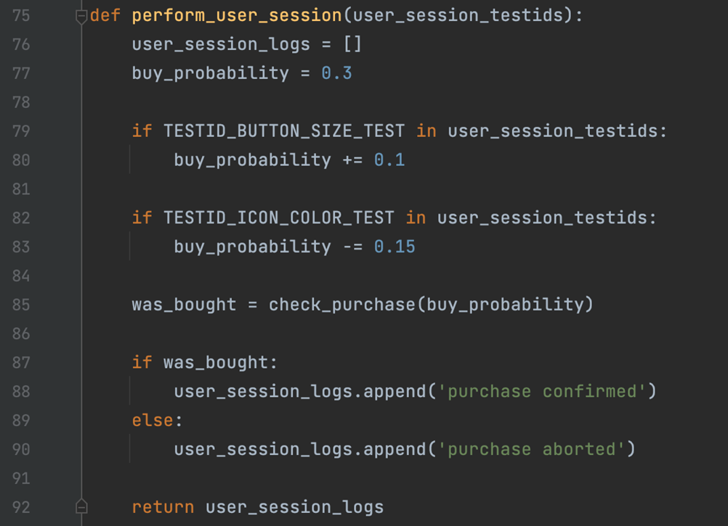
PIPELINE ARCHITECTURE

Slide 7
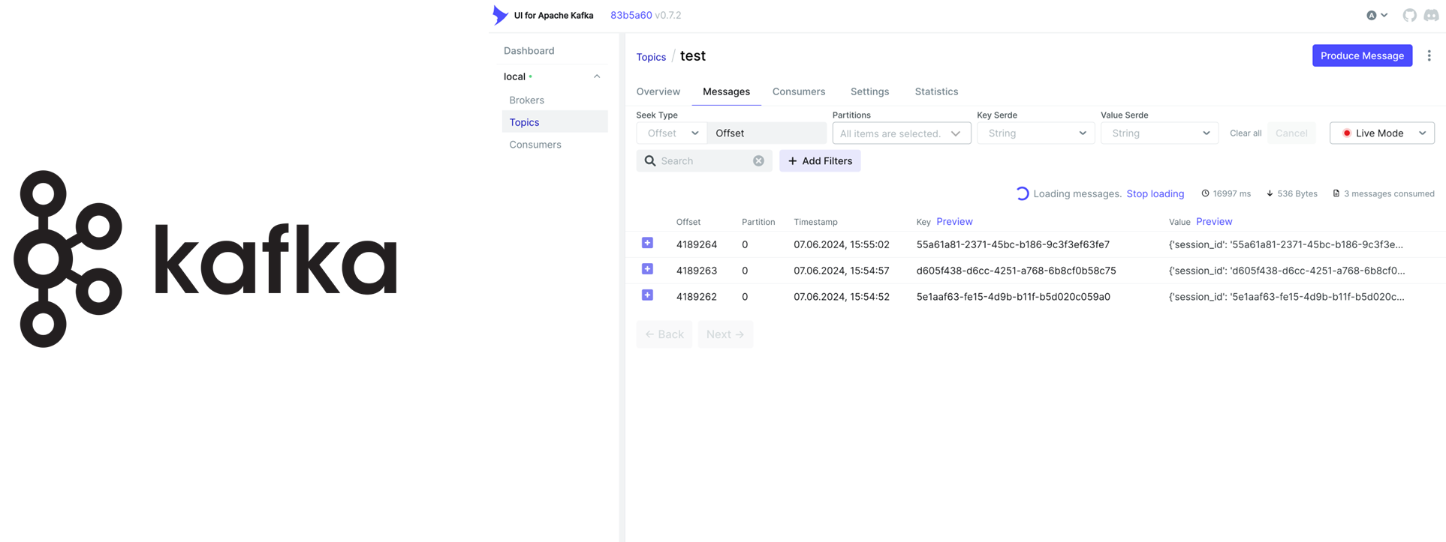
PIPELINE ARCHITECTURE

Slide 8
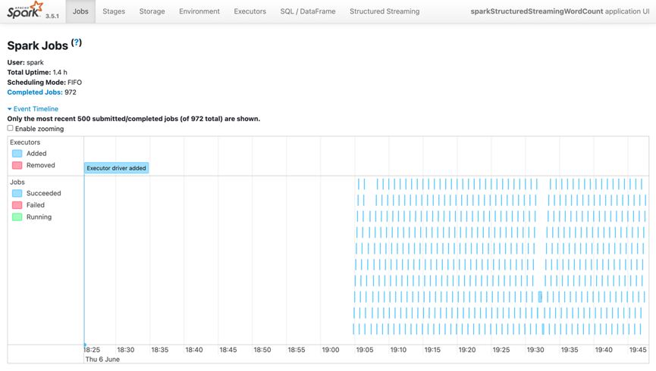

PIPELINE ARCHITECTURE
Microbatches – 5 seconds window

Slide 9

PIPELINE ARCHITECTURE
01
COLUMN DB
02
OK TO WORK WITH REALTIME/UNAGREGATED DATA
ClickHouse
03
OPEN SOURCE - SET IN YOUR OWN CLOUD

Slide 10
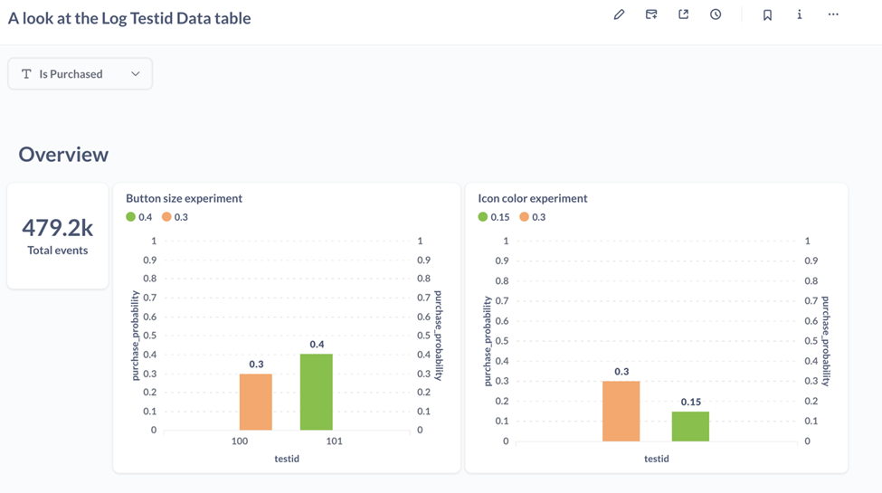

PIPELINE ARCHITECTURE
Open source
Plugin for ClickHouse

Slide 11
POSSIBLE IMPROVEMENTS AND EXTENSIONS
Cloud deployment, k8s
Replication for db and some other
Airflow DAG + Spark cluster for deeper log transformation

Slide 12
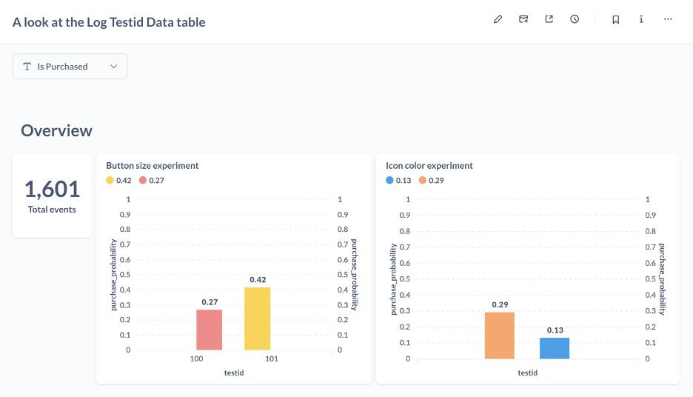
BEFORE

Slide 13
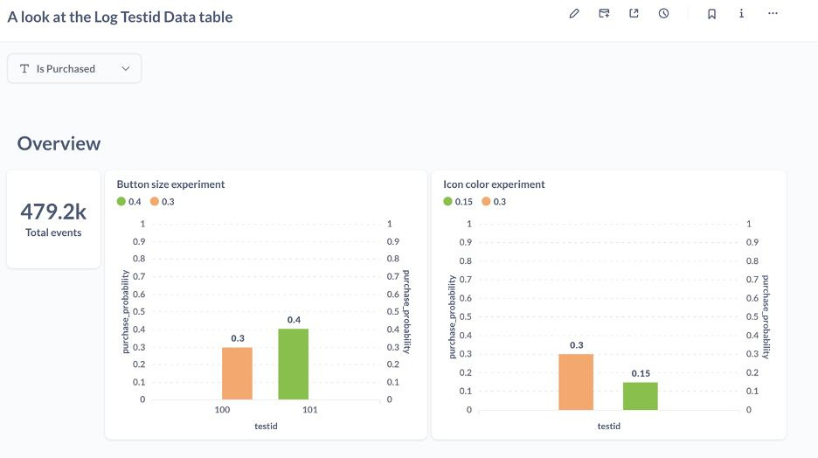
AFTER

Slide 14
THANK'S FOR YOUR ATTENTION
Maksim Movshin
Moscow, 2024

