Slide 1

Virtual private networks
Calavaro Marco (0295233)
Caliandro Pierciro (0299815)
Falcone Gian Marco (0300251)

Slide 2
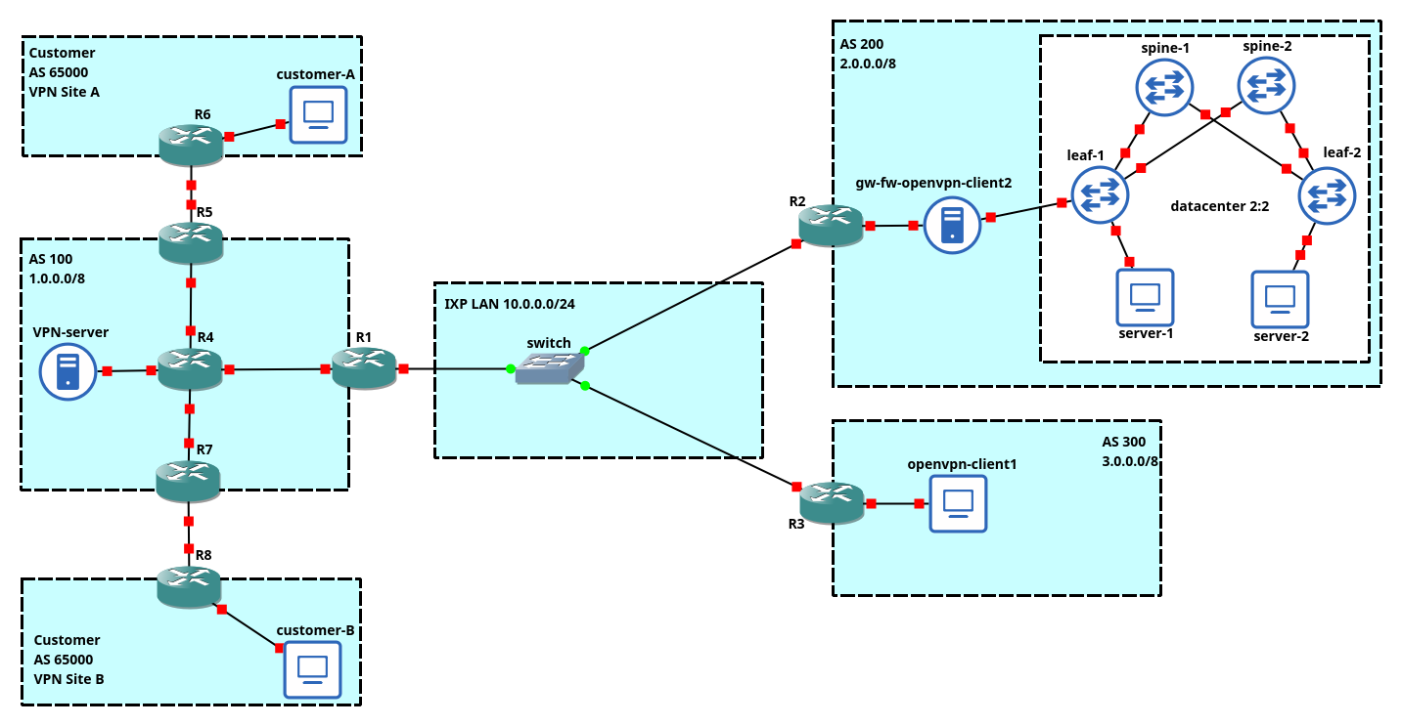

Slide 3

Ebgp configuration

Slide 4
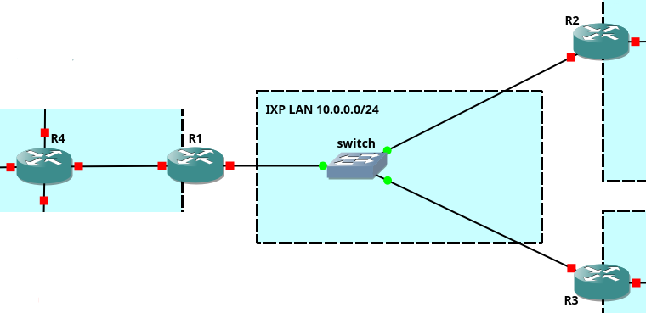
eBGP between AS100, AS200, AS300​

Slide 5
IP Configuration​
interface GigabitEthernet0/0
ip address 10.0.0.1 255.255.255.0
no shutdown
!
interface GigabitEthernet1/0
ip address 1.0.96.1 255.255.255.252
no shutdown
!
interface Loopback0
ip address 1.255.0.1 255.255.255.255
!
ip route 1.255.0.0 255.255.224.0 1.0.96.2

Slide 6
​
interface GigabitEthernet0/0
ip address 10.0.0.2 255.255.255.0
no shutdown
!
interface Loopback0
ip address 2.0.0.1 255.0.0.0
!
interface Loopback0
ip address 1.255.0.2 255.255.255.255
!
interface GigabitEthernet0/0
ip address 1.0.96.2 255.255.255.252
no shutdown
!
interface GigabitEthernet1/0
ip address 1.2.0.1 255.255.255.252
no shutdown
!
interface GigabitEthernet2/0
ip address 1.3.0.1 255.255.255.252
no shutdown
!
ip route 1.0.0.0 255.0.0.0 null0
interface GigabitEthernet0/0
ip address 10.0.0.3 255.255.255.0
no shutdown
!
interface Loopback0
ip address 3.0.0.1 255.0.0.0
!

Slide 7
eBGP Configuration​
router bgp 100
neighbor 1.0.96.2 remote-as 100
neighbor 1.0.96.2 next-hop-self
neighbor 1.0.96.2 route-map comm in
neighbor ixp-peer peer-group
neighbor ixp-peer send-community
neighbor ixp-peer route-map comm out
neighbor 10.0.0.2 remote-as 200
neighbor 10.0.0.2 peer-group ixp-peer
neighbor 10.0.0.2 prefix-list pl-peer200 in
neighbor 10.0.0.3 remote-as 300
neighbor 10.0.0.3 peer-group ixp-peer
neighbor 10.0.0.3 prefix-list pl-peer300 in
ip prefix-list pl-peer200 seq 5 permit 2.0.0.0/8
ip prefix-list pl-peer300 seq 5 permit 3.0.0.0/8
route-map comm permit 10
match community 10
ip bgp-community new-format
ip community-list 10 permit 100:1000

Slide 8
​
eBGP Configuration​
router bgp 200
network 2.0.0.0 mask 255.0.0.0
neighbor 10.0.0.1 remote-as 100
neighbor 10.0.0.3 remote-as 300
router bgp 100
network 1.0.0.0 mask 255.0.0.0 route-map comm
neighbor 1.0.96.1 remote-as 100
neighbor 1.0.96.1 next-hop-self
neighbor 1.0.96.1 send-community
route-map comm permit 10
set community 100:1000
router bgp 300
network 3.0.0.0 mask 255.0.0.0
neighbor 10.0.0.1 remote-as 100
neighbor 10.0.0.2 remote-as 200

Slide 9
OSFP-MPLS in AS 100

Slide 10
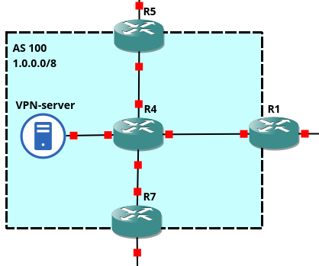
​
OSPF – MPLS in AS100​

Slide 11
​
IP Configuration​
interface Loopback0
ip address 1.255.0.3 255.255.255.255
!
interface GigabitEthernet0/0
ip address 1.2.0.2 255.255.255.252
mpls ip
no shutdown
!
interface GigabitEthernet1/0
ip address 1.2.1.1 255.255.255.252
no shutdown
!
interface Loopback0
ip address 1.255.0.4 255.255.255.255
!
interface GigabitEthernet0/0
ip address 1.3.0.2 255.255.255.252
mpls ip
no shutdown
!
interface GigabitEthernet1/0
ip address 1.3.1.1 255.255.255.252
no shutdown
!

Slide 12
​
IP Configuration (2)​
interface GigabitEthernet0/0
mpls ip
!
interface GigabitEthernet1/0
mpls ip
!
interface GigabitEthernet2/0
mpls ip
!
interface GigabitEthernet1/0
mpls ip
!

Slide 13
​
OSPF Configuration​
router ospf 1
router-id 1.255.0.1
network 1.255.0.1 0.0.0.0 area 0
network 1.0.96.0 0.0.0.3 area 0
router ospf 1
router-id 1.255.0.3
network 1.255.0.3 0.0.0.0 area 0
network 1.2.0.0 0.0.0.3 area 0
router ospf 1
router-id 1.255.0.2
network 1.255.0.2 0.0.0.0 area 0
network 1.0.96.0 0.0.0.3 area 0
network 1.2.0.0 0.0.0.3 area 0
network 1.3.0.0 0.0.0.3 area 0
router ospf 1
router-id 1.255.0.4
network 1.255.0.4 0.0.0.0 area 0
network 1.3.0.0 0.0.0.3 area 0

Slide 14
BGP/MPLS Vpn

Slide 15
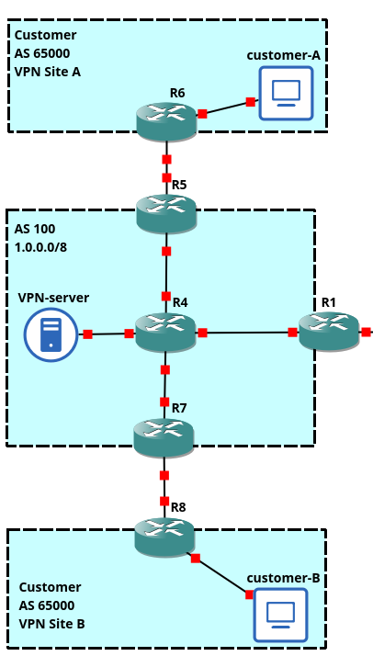
BGP/MPLS VPN
Between site a and site b

Slide 16
IP configuration
interface GigabitEthernet1/0
ip address 6.5.1.1 255.255.255.0
no shutdown
!
interface GigabitEthernet0/0
ip address 1.2.1.2 255.255.255.252
no shutdown
!
interface GigabitEthernet1/0
ip address 6.5.2.1 255.255.255.0
no shutdown
!
interface GigabitEthernet0/0
ip address 1.3.1.2 255.255.255.252
no shutdown
!

Slide 17
Define VRF and
Enable vrf forwarding
ip vrf vpnA
rd 65000:1
route-target both 65000:1
!
interface GigabitEthernet1/0
ip vrf forwarding vpnA
!
ip vrf vpnA
rd 65000:1
route-target both 65000:1
!
interface GigabitEthernet1/0
ip vrf forwarding vpnA
!

Slide 18
eBGP
router bgp 65000
neighbor 1.2.1.1 remote-as 100
network 6.5.1.0 mask 255.255.255.0
ip route 0.0.0.0 0.0.0.0 1.2.1.1
router bgp 100
address-family ipv4 vrf vpnA
neighbor 1.2.1.2 remote-as 65000
exit-address-family
!
router bgp 100
address-family ipv4 vrf vpnA
neighbor 1.3.1.2 remote-as 65000
exit-address-family
!
router bgp 65000
neighbor 1.3.1.1 remote-as 100
network 6.5.2.0 mask 255.255.255.0
ip route 0.0.0.0 0.0.0.0 1.3.1.1

Slide 19
Vpnv4 AF
router bgp 100
neighbor 1.255.0.4 remote-as 100
neighbor 1.255.0.4 update-source Loopback0
address-family vpnv4
neighbor 1.255.0.4 activate
neighbor 1.255.0.4 send-community extended
exit-address-family
router bgp 100
neighbor 1.255.0.3 remote-as 100
neighbor 1.255.0.3 update-source Loopback0
address-family vpnv4
neighbor 1.255.0.3 activate
neighbor 1.255.0.3 send-community extended
exit-address-family

Slide 20
AS 200

Slide 21
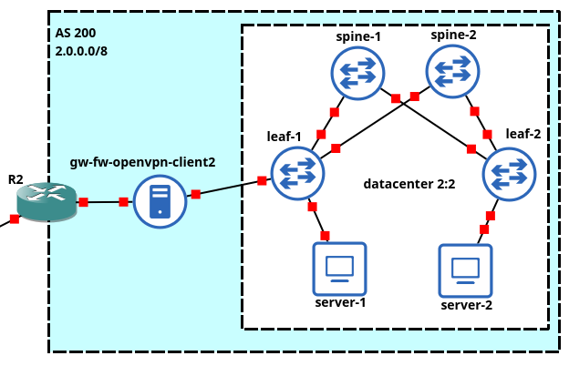
​
AS 200 CONFIGURATION

Slide 22
​
AS 200CONFIGURATION
System requirements for AS200
Datacenter access GW with Linux (+ Firewall)
EVPN/VXLAN inside the datacenter:
only one tenant in the Datacenter with 2 broadcast domains (vlan 10, vlan 20)
each server has two VMs belonging to the two BDs
vlan 100 between linux GW and access leaf
Datacenter reachable through overlay VPN

Slide 23
​
EVPN/VXLAN CONFIGURATION - GATEWAY
ip link set enp0s8 up
ip link add link enp0s8 name enp0s8.100 type vlan id 100
ip addr add 10.3.3.1/16 dev enp0s8.100
ip link set enp0s8.100 up
ip route add 10.0.0.0/24 via 10.3.3.254 dev enp0s8.100
ip route add 10.1.1.0/24 via 10.3.3.254 dev enp0s8.100
echo 1 > /proc/sys/net/ipv4/ip_forward

Slide 24
​
EVPN/VXLAN CONFIGURATION - FIREWALL
echo 1 > /proc/sys/net/ipv4/ip_forward
iptables -A POSTROUTING -t nat -o enp0s3 -j MASQUERADE
iptables -A POSTROUTING -t nat -o enp0s8.100 -j MASQUERADE
iptables -F
iptables -P FORWARD DROP
iptables -P INPUT DROP
iptables -P OUTPUT DROP
iptables -A INPUT -i enp0s3 -p udp -m udp --sport 1194 -j ACCEPT
iptables -A OUTPUT -o enp0s3 -p udp -m udp --dport 1194 -j ACCEPT
iptables -A FORWARD -m state --state ESTABLISHED -j ACCEPT
iptables -A INPUT -p udp -m udp --dport 1194 -j ACCEPT

Slide 25
​
EVPN/VXLAN CONFIGURATION - spines​
net add interface swp1 ip add 10.1.1.2/30
net add interface swp2 ip add 10.2.1.2/30
net add loopback lo ip add 4.4.4.4/32
net add interface swp1 ip add 10.1.2.2/30
net add interface swp2 ip add 10.2.2.2/30
net add loopback lo ip add 5.5.5.5/32

Slide 26
​
EVPN/VXLAN CONFIGURATION - spines​
net add ospf router-id 4.4.4.4
net add ospf network 10.1.1.2/30 area 0
net add ospf network 10.2.1.2/30 area 0
net add ospf network 4.4.4.4/32 area 0
net add bgp autonomous-system 65000
net add bgp router-id 4.4.4.4
net add bgp neighbor swp1 remote-as external
net add bgp neighbor swp2 remote-as external
net add bgp evpn neighbor swp1 activate
net add bgp evpn neighbor swp2 activate

Slide 27
​
EVPN/VXLAN CONFIGURATION - spines​
net add ospf router-id 5.5.5.5
net add ospf network 10.1.2.2/30 area 0
net add ospf network 10.2.2.2/30 area 0
net add ospf network 5.5.5.5/32 area 0
net add bgp autonomous-system 65000
net add bgp router-id 5.5.5.5
net add bgp neighbor swp1 remote-as external
net add bgp neighbor swp2 remote-as external
net add bgp evpn neighbor swp1 activate
net add bgp evpn neighbor swp2 activate

Slide 28
​
EVPN/VXLAN CONFIGURATION - LEAVES
net add bridge bridge ports swp1,swp4
net add bridge bridge pvid 1
net add bridge bridge vids 10,20,100
net add interface swp2 ip add 10.1.1.1/30
net add interface swp3 ip add 10.1.2.1/30
net add loopback lo ip add 1.1.1.1/32
net add vlan 10 ip address 10.1.1.254/24
net add vlan 20 ip address 10.0.0.254/24
net add vlan 50
net add vlan 100 ip address 10.3.3.254/16

Slide 29
​
EVPN/VXLAN CONFIGURATION - LEAVES
net add ospf router-id 1.1.1.1
net add ospf network 10.1.1.1/30 area 0
net add ospf network 10.1.2.1/30 area 0
net add ospf network 1.1.1.1/32 area 0
net add bgp autonomous-system 65001
net add bgp router-id 1.1.1.1
net add bgp neighbor swp2 remote-as 65000
net add bgp neighbor swp3 remote-as 65000
net add bgp evpn neighbor swp2 activate
net add bgp evpn neighbor swp3 activate
net add bgp evpn advertise-all-vni

Slide 30
​
EVPN/VXLAN CONFIGURATION - LEAVES
net add vxlan vni-100 vxlan id 100
net add vxlan vni-100 vxlan local-tunnelip 1.1.1.1
net add vxlan vni-100 bridge access 10
net add vxlan vni-200 vxlan id 200
net add vxlan vni-200 vxlan local-tunnelip 1.1.1.1
net add vxlan vni-200 bridge access 20

Slide 31
​
EVPN/VXLAN CONFIGURATION - LEAVES
net add vlan 100 ip address 10.3.3.254/16
net add vxlan vni-1000 vxlan id 1000
net add vxlan vni-1000 vxlan local-tunnelip 1.1.1.1
net add vxlan vni-1000 bridge access 100
net add vlan 50
net add vxlan vni-1020 vxlan id 1020
net add vxlan vni-1020 vxlan local-tunnelip 1.1.1.1
net add vxlan vni-1020 bridge access 50

Slide 32
​
EVPN/VXLAN CONFIGURATION - LEAVES
net add vrf TEN1 vni 1020
net add vlan 100 vrf TEN1
net add vlan 50 vrf TEN1
net add vlan 20 vrf TEN1
net add vlan 10 vrf TEN1

Slide 33
​
EVPN/VXLAN CONFIGURATION - LEAVES
net add bridge bridge pvid 1
net add bridge bridge vids 10,20,100
net add interface swp2 ip add 10.2.1.1/30
net add interface swp3 ip add 10.2.2.1/30
net add loopback lo ip add 2.2.2.2/32
net add vlan 10 ip address 10.1.1.254/24
net add vlan 20 ip address 10.0.0.254/24
net add vlan 50
net add vlan 100 ip address 10.3.3.254/16

Slide 34
​
EVPN/VXLAN CONFIGURATION - LEAVES
net add ospf router-id 2.2.2.2
net add ospf network 10.2.1.1/30 area 0
net add ospf network 10.2.2.1/30 area 0
net add ospf network 2.2.2.2/32 area 0
net add bgp autonomous-system 65002
net add bgp router-id 2.2.2.2
net add bgp neighbor swp2 remote-as 65000
net add bgp neighbor swp3 remote-as 65000
net add bgp evpn neighbor swp2 activate
net add bgp evpn neighbor swp3 activate
net add bgp evpn advertise-all-vni

Slide 35
​
EVPN/VXLAN CONFIGURATION - LEAVES
net add vxlan vni-100 vxlan id 100
net add vxlan vni-100 vxlan local-tunnelip 1.1.1.1
net add vxlan vni-100 bridge access 10
net add vxlan vni-200 vxlan id 200
net add vxlan vni-200 vxlan local-tunnelip 1.1.1.1
net add vxlan vni-200 bridge access 20

Slide 36
​
EVPN/VXLAN CONFIGURATION - LEAVES
net add vlan 100 ip address 10.3.3.254/16
net add vxlan vni-1000 vxlan id 1000
net add vxlan vni-1000 vxlan local-tunnelip 1.1.1.1
net add vxlan vni-1000 bridge access 100
net add vlan 50
net add vxlan vni-1020 vxlan id 1020
net add vxlan vni-1020 vxlan local-tunnelip 1.1.1.1
net add vxlan vni-1020 bridge access 50

Slide 37
​
EVPN/VXLAN CONFIGURATION - LEAVES
net add vrf TEN1 vni 1020
net add vlan 100 vrf TEN1
net add vlan 50 vrf TEN1
net add vlan 20 vrf TEN1
net add vlan 10 vrf TEN1

Slide 38
​
EVPN/VXLAN CONFIGURATION - Servers
ip netns add vmD​
ip link add link enp0s8 name enp0s8.10 type vlan id 10​
ip link set enp0s8.10 netns vmD​
ip netns exec vmD ip addr add 10.1.1.2/24 dev enp0s8.10​
​
ip netns exec vmD ip link set enp0s8.10 up​
ip netns exec vmD ip route add default via 10.1.1.254
ip netns add vmB
ip link add link enp0s8 name enp0s8.10 type vlan id 10
ip link set enp0s8.10 netns vmB
ip netns exec vmB ip addr add 10.1.1.1/24 dev enp0s8.10
ip netns exec vmB ip link set enp0s8.10 up
ip netns exec vmB ip route add default via 10.1.1.254

Slide 39
​
EVPN/VXLAN CONFIGURATION - Servers
ip netns add vmC
ip link add link enp0s8 name enp0s8.20 type vlan id 20
ip link set enp0s8.20 netns vmC
ip netns exec vmC ip addr add 10.0.0.2/24 dev enp0s8.20
ip netns exec vmC ip link set enp0s8.20 up
ip netns exec vmC ip route add default via 10.0.0.254
ip netns add vmA
ip link add link enp0s8 name enp0s8.20 type vlan id 20
ip link set enp0s8.20 netns vmA
ip netns exec vmA ip addr add 10.0.0.1/24 dev enp0s8.20
ip netns exec vmA ip link set enp0s8.20 up
ip netns exec vmA ip route add default via 10.0.0.254

Slide 40
CERTIFICATE MANAGEMENT

Slide 41
Generate key for Certification authority (CA)
In order to manage our VPN CA, we need to create a certification authority mechanism for trusting connection between the OpenVPN server and clients.
We use the easy-rsa tool to create a Public Key Infrastructure.
First step initialize the PKI using:
Second generate server.key and server.crt using:
Third generate clients key and certificate using:
Building Diffie-Hellman parameter using:
$ ./easyrsa init-pki
$ ./easyrsa build-server-full server nopass
$ ./easyrsa build-client-full client1(2) nopass
$ ./easyrsa gen-dh

Slide 42
Certificate table
Filename | Installation machine
ca.crt | Server + clients
ca.key | Machine who generate certificates
dh.pem | Server
server.crt | Server
server.key | Server
client1.crt | Client1
client1.key | Client1
client2.crt | Client2
client2.key | Client2

Slide 43
NETWORK CONFIGURATION

Slide 44
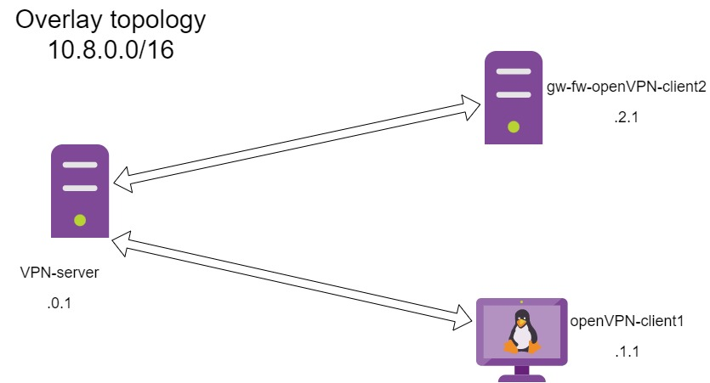
Overlay VPN Topology

Slide 45
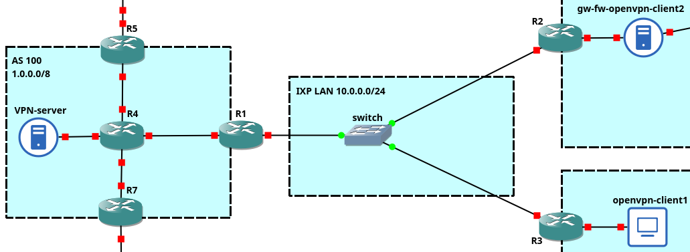
Network Topology

Slide 46
Network Configuration
ip link set enp0s3 up
ip addr add 2.0.0.2/8 dev enp0s3
ip route add default via 2.0.0.1
ip link set enp0s3 up
ip addr add 1.1.0.2/16 dev enp0s3
ip route add default via 1.1.0.1
echo 1 > /proc/sys/net/ipv4/ip_forward
iptables -A POSTROUTING -t nat -o enp0s3 –j MASQUERADE
ip link set enp0s3 up
ip addr add 3.0.0.100/8 dev enp0s3
ip route add default via 3.0.0.1

Slide 47
Network Configuration SERVER FIREWALL
iptables –F
iptables -P FORWARD DROP
iptables -P INPUT DROP
iptables -P OUTPUT DROP
iptables -A INPUT -p udp -m udp --dport 1194 -j ACCEPT
iptables -A INPUT -i tun0 -j ACCEPT
iptables -A FORWARD -i tun0 -j ACCEPT
iptables -A FORWARD -o tun0 -j ACCEPT
iptables -A OUTPUT -p udp -m udp --sport 1194 -j ACCEPT
iptables -A OUTPUT -o tun0 -j ACCEPT

Slide 48
OVERLAY VPN CONFIGURATION

Slide 49
VPN Server
#in file ccd/client1
ifconfig-push 10.8.1.1 10.8.1.2
port 1194
proto udp
dev tun
ca ca.crtcert
server.crtkey
server.key
dh dh.pem
server 10.8.0.0 255.255.0.0
push "route 2.1.0.0 255.255.0.0“
route 2.1.0.0 255.255.0.0
route 10.8.1.0 255.255.255.0
route 10.8.2.0 255.255.255.0
push "route 10.0.0.0 255.255.255.0"
push "route 10.1.1.0 255.255.255.0"
client-config-dir ccd
client-to-client
#in file ccd/client2
ifconfig-push 10.8.2.1 10.8.2.2
iroute 2.1.0.0 255.255.0.0
iroute 10.0.0.0 255.255.255.0
iroute 10.1.1.0 255.255.255.0

Slide 50
VPN Client
client
dev tun
proto udp
remote 1.1.0.2 1194
resolv-retry infinite
nobind
ca ca.crt
cert client2.crt
key client2.key
remote-cert-tls server
cipher AES-256-CBC
client
dev tun
proto udp
remote 1.1.0.2 1194
resolv-retry infinite
nobind
ca ca.crt
cert client1.crt
key client1.key
remote-cert-tls server
cipher AES-256-CBC

