Slide 1
TCO for 5 years
Case study: Credit Card (CC) Transaction for a Bank
Pierciro Caliandro
Universit`a degli studi di Roma Tor Vergata
April 3, 2021
Pierciro Caliandro TCO for 5 years

Slide 2
Use case description
The use case presented is a CC transaction for a bank. For each transaction, the sequent operations have to be completed:
check if the CC is valid
check the POS is valid
check the money amount is valid (for single transaction and for other limits such as monthly or daily limits)
check if the transaction is suspect
check if the POS type requires a second identification step:
- if so, run that step and check that it is completed successfully
issue OK or abort storing the attempt
In this presentation, there are two configruations, using x86 and LinuxONE commodities.
Pierciro Caliandro TCO for 5 years

Slide 3
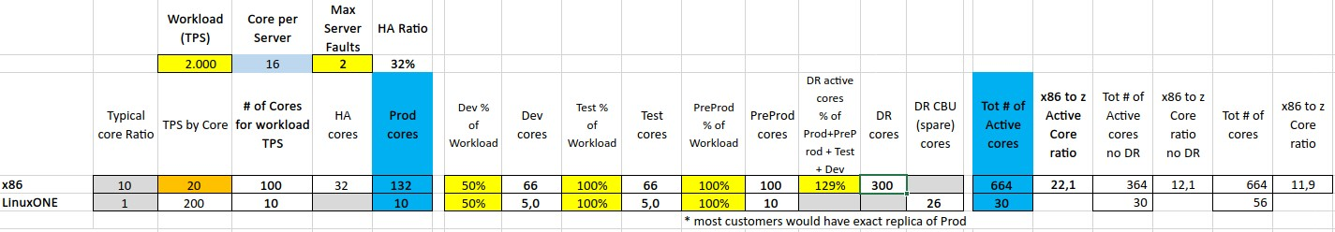
Sizing
The input of TPS is the average, that is 2000 TPS.
Figure: sizing of x86 and LinuxONE environments
To deal with an HA of 99.999%, it would be necessary to make a more sophisticated analysis. Referring to the fact that annual server downtime is very low in many x86 commercial servers, the sizing includes 2 servers for HA, as conservative hypotesis
LinuxONE platform offers HA intrinsically, so there is no need to add extra cores
Pierciro Caliandro TCO for 5 years

Slide 4
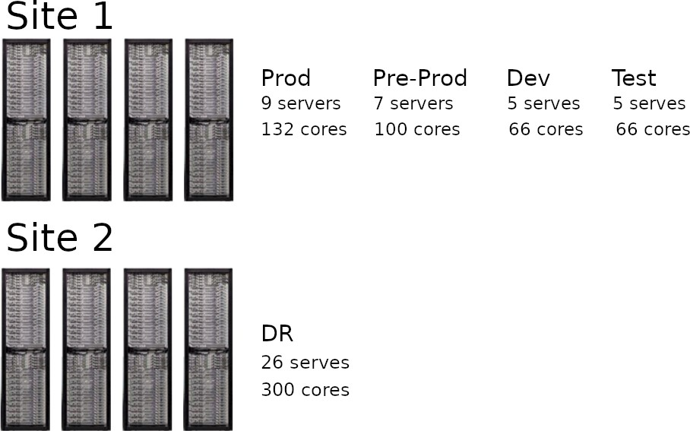
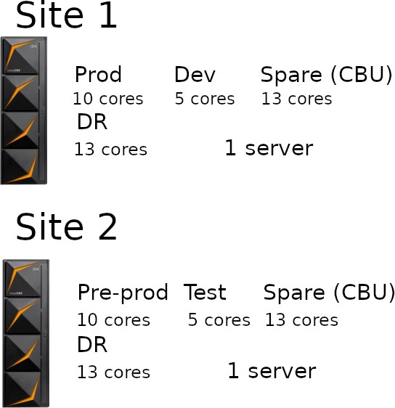
Technical architecture
x86 server organization:
LinuxONE server organization:
For the x86 architecture, the DR environment is kept separated from the others beacuse often industries’ rules require so. The dimension is given by the sum of Production + Pre-Production cores + 50% of Test and Development cores.
In both cases, the dimension of Dev is 50% of the full production environment and the Test’s one is the same size of Dev, where ”full Production environment” is considered, for the x86 architecture, as Production + HA
Pierciro Caliandro TCO for 5 years

Slide 5
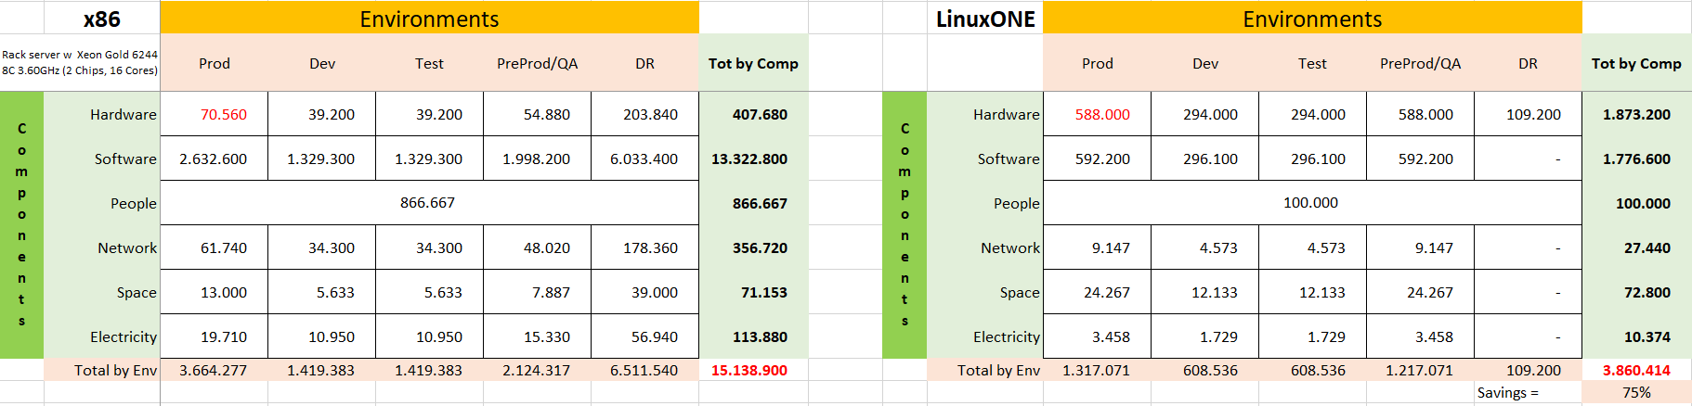
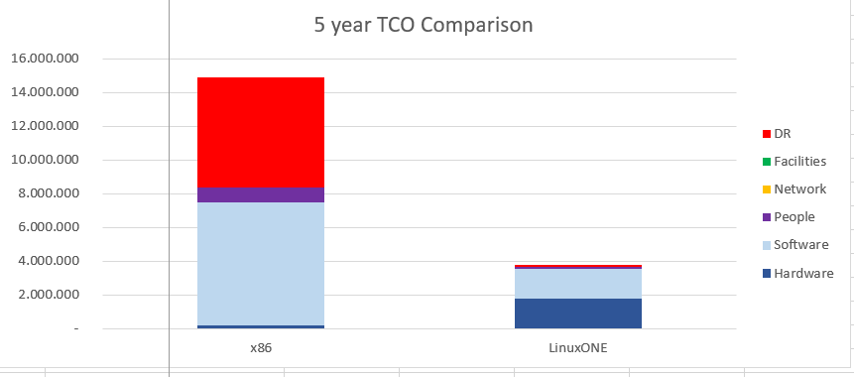
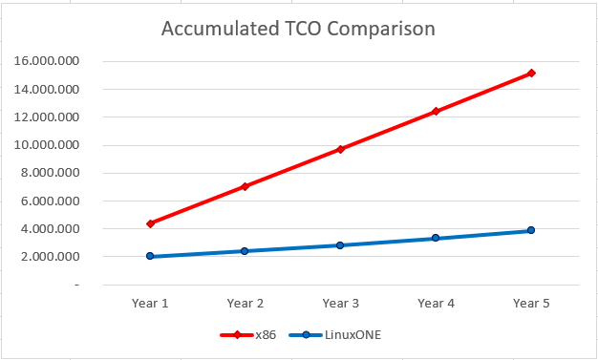
TCO over 5 years
Figure: Year TCO for x86 and LinuxONE
Figure: Component distribution for total cost
Figure: Costs per year
Pierciro Caliandro TCO for 5 years

Slide 6
x86 TCO assumptions
x86 hardware assumptions:
Rack server w Xeon Gold 5115 10C 2.40GHz (2 Chips, 20 Cores)
Acquisition cost: 10000€ - 30% discount with 3 years of support
Support from 4th year, the cost is 20% of the
acquisition price
Network:
7000€ per server-30% discount + maintenance cost from 2nd year, that is 10% of the acquisition cost
Facilities:
Space: 10729€, fully loaded cost of space per sq meter of 2600€
People: 1 TFE for 30 servers, 100000€ of average yearly fully cost
Electricity: 0.10€ per kW
x86 software assumptions:
OS: free acquisition cost, 2000€ for maintenance starting from 1st year. Discount of 20% per socket VM: 5000€, discount of 20% per socket.
Maintenance cost of 1000€ from 2nd year Application server: Oracle Jboss Enterprise, free acquistion cost. Maintenance yearly for 12000€ per core, discount of 75%
Database: mySQL enterprise, 5000€ of cost. 24/7
support, 1000€ per core with 75% of discount, starting from 2nd year
Data replication tool: included with the license of
the DB
Monitoring tool: 5000€ per server, maintenance cost is 20% of the acquisiiton cost, starting from 2nd year
Security tool: 5000€ per server, maintaince cost of
1000€ (20%) starting from 2nd year.
Software impacts on the cost for the 88%
Pierciro Caliandro TCO for 5 years

Slide 7
LinuxONE TCO assumptions
LinuxONE hardware assumptions:
780500€ per server for the first tree years with 30% discount
Maintenance: 156000€ (≈ 20%) from 4th year
People:
1 FTE covers 10 servers, so the total FTE required is 0.2. The average yearly fully loaded cost of IT Staff is 100000€
Network:
14000€ per server, with an average discount of 30%, maintenance cost is the 10% starting from 2nd year
Facilities:
Space: fully loaded cost per squear meter of
2800€, each server has a footprint of 2.6m² Electricity: 0.10€ per kW, each server requires
LinuxONE software assumptions:
OS: subscription 6000€/year per core, with 20% discount
VM: included in harwdare
Application server: Oracle Jboss Enterprise, free acquistion cost. Maintenance yearly for 12000€ per core, discount of 50%
Database: mySQL enterprise, 5000€ of cost. 24/7
support, 1000€ per core with 50% of discount, starting from 2nd year
Data replication tool: included with the license of
the DB
Monitoring tool: 5000€ per server, maintenance cost is 20% of the acquisiiton cost, starting from 2nd year
Security tool: 5000€ per server, maintaince cost of
1000€ (20%) starting from 2nd year.
15000 kW
Hardware and software have a similar impact on cost, 47.59% for hardware and 46% for software.
Pierciro Caliandro TCO for 5 years

Slide 8
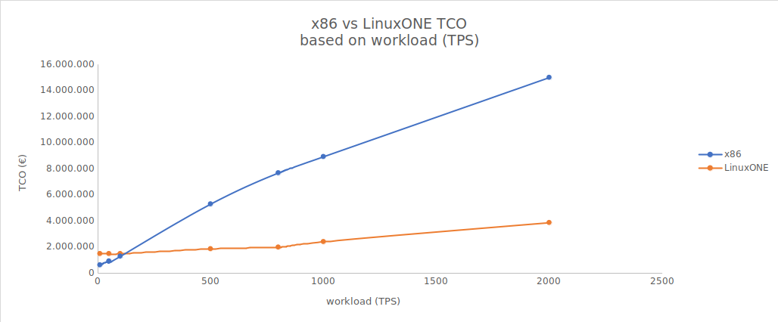
Comparison between x86 and LinuxONE
As shown in the chart, for a small number of TPS the x86 solution is the most convenient
The TPS for which the two architectures are equivalent is ≈ 109 TPS
It is interest to note that for a small number of TPS (< 500) the cost of the LinuxONE platform remains constant
Pierciro Caliandro TCO for 5 years

Slide 9
Considerations on workload peaks
With the LinuxONE configuration, it is possible to handle the peak of < 8000 TPS, because the server is designed to work at 90-95 % of utilization. Also, thanks to statistical multiplexing, it is possible to consolidate variable workloads on the single servers, to handle TPS peaks
To deal with peaks on x86, it would be necessary to oversize the architecture, so for the purpose of this presentation only the average case has been considered.
For the reasons above, when stressing the system at TPS peaks before putting any release in production, it is expected that the LinuxONE platform will have better performances then x86.
Pierciro Caliandro TCO for 5 years

