Slide 1
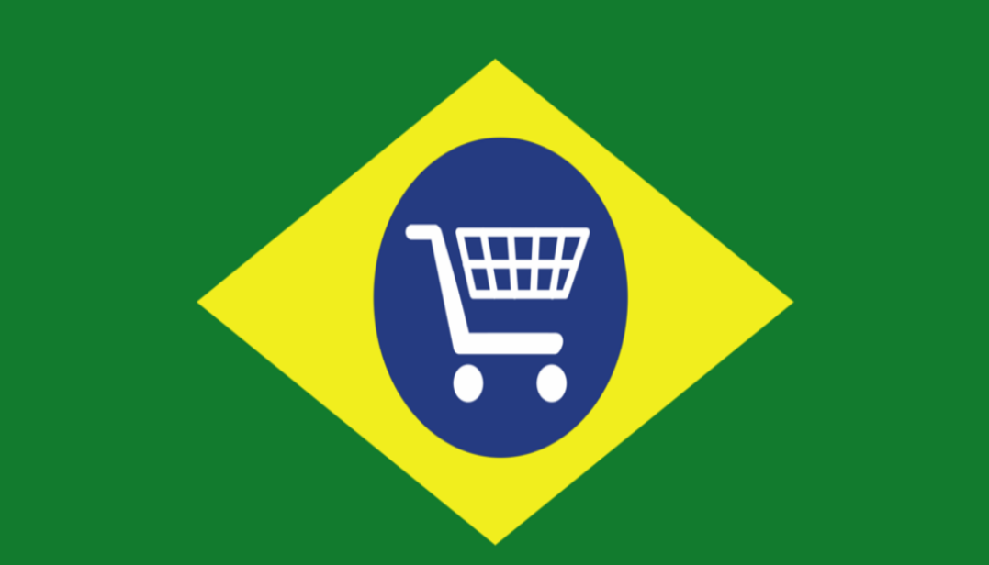

Brazilian Economic Trends

Slide 2


Slide 3
Brandon Shimamoto
Adam Brush
Fatima Baig
Wendy Pollinger

Slide 4
Core message
To analyze the Market cap of the BOVESPA against online consumer spending in Brazil amongst a variety of product categories. We expect overall consumer spending to rise as total market cap rises.
To observe any economic trends between 2016 and 2018 based on e-commerce spending habits by Brazilian citizens.

Slide 5

Questions
What are the products consumers bought in Brazil?
Where are products being purchased?
What factors contribute to consumer spending?

Slide 6
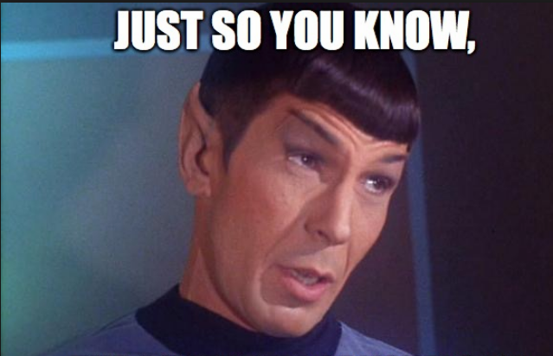

Slide 7
Product Data
We analyzed 112,000 rows of product data between 9/3/2016 - 10/16/2018
Kaggle data was composed of 6 CSVs.
olist_order_items_dataset.csv
olist_orders_dataset.csv
olist_products_dataset.csv
product_category_name_translation.csv
olist_customers_dataset.csv
olist_geolocation_dataset.csv
BOVESPA data pulled from Quandl API
API - "https://www.quandl.com/api/v3/datasets/BCB/7.json

Slide 8
Data clean up process
Data for Black Friday was removed.
Removed all days with $0 in total revenue.
Total product categories was reduced from 72 to 10.

Slide 9
Bar graph

Slide 10
maps

Slide 11

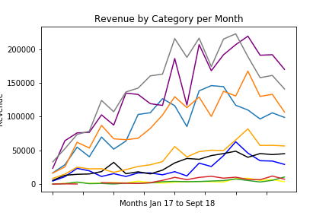
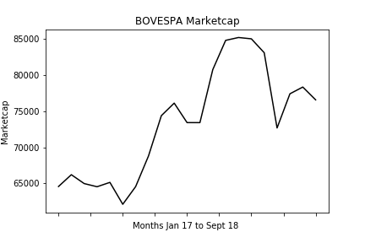

Correlation Between Consumer Spending and the BOVESPA
Line 1: June 2017
Line 2: November 2017
Line 3: February 2018

Slide 12
regression

Slide 13
Post Mortem

Slide 14

Question & answer

