Slide 1


SECURITY CONFERENCE · AARHUS
BSides Aarhus 2026
JUNE 20, 2026 · INCUBA NEXT, KATRINEBJERG · BSIDESAARHUS.DK

Slide 2

JOIN THE CONVERSATION
Scan to open the BSides Aarhus channel — invite link at bsidesaarhus.dk
Agenda
JUNE 20, 2026 · INCUBA NEXT, KATRINEBJERG
TRACK 1 · STORE AUD
TRACK 2 · LILLE AUD
09:00
Breakfast
10:00
Malware & Monsters: Contain It Before It Evolves
Klaus Agnoletti
WebAuthn: How to get rid of passwords.
Joost van Dijk
11:00
Alert Fatigue Therapy: Fixing Broken Detection Rules
Marvin Ngoma
Remote Cold Execution
Tom Kern
11:45
Lunch
12:45
We Scanned 10,000 Danish Orgs Without Sending a Single Packet
Morten von Seelen
Trustless Consensus Manipulation Through Bribing Contracts
Bence Soóki-Tóth
13:50
RTFM - Read The Fatal Manual: When Documentation Creates Critical Misconfiguration
Martin Sohn Christensen
An introduction to Post-Quantum Cryptography for the practitioner
Kasper Hald
14:50
Side Quest: "Whodunit?" – Unintentional System Compromise
Mikkel Ole Rømer
Build your own IDS
Eleni Ioakeim
15:30
Networking session
16:30
Continue at Fredagscaféen
BSides Aarhus 2026 · June 20 · INCUBA Next, Aarhus
Agenda

Slide 3

SECTION
Section title goes here
Optional one-line description for this section.
BSides Aarhus 2026 · June 20 · INCUBA Next, Aarhus

Slide 4
Slide title
▍ Primary point — short, declarative, one idea per line
▍ Supporting detail with concrete example
▍ Evidence, data, or reference
▍ Takeaway or call to action
BSides Aarhus 2026 · June 20 · INCUBA Next, Aarhus
Content

Slide 5
SPEAKER
Speaker Name
Role · Company
[ Photo ]
Short bio. Two or three sentences about background, specialization, and what the audience will take away from the talk. Keep it conversational and specific.
@handle · speaker.example.com
BSides Aarhus 2026 · June 20 · INCUBA Next, Aarhus
Speaker

Slide 6









Thank You to Our Sponsors
BSides Aarhus 2026 · June 20 · INCUBA Next, Aarhus

Slide 7
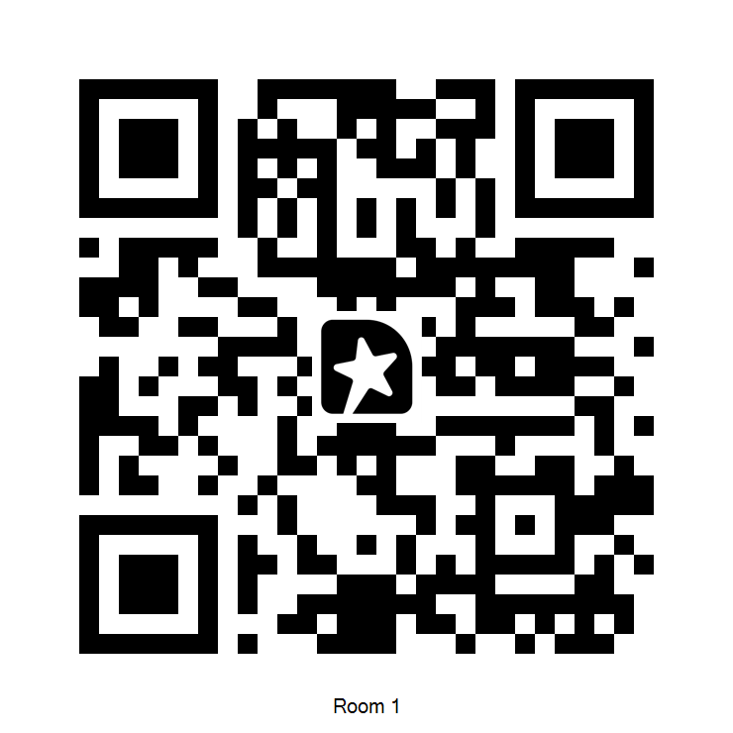
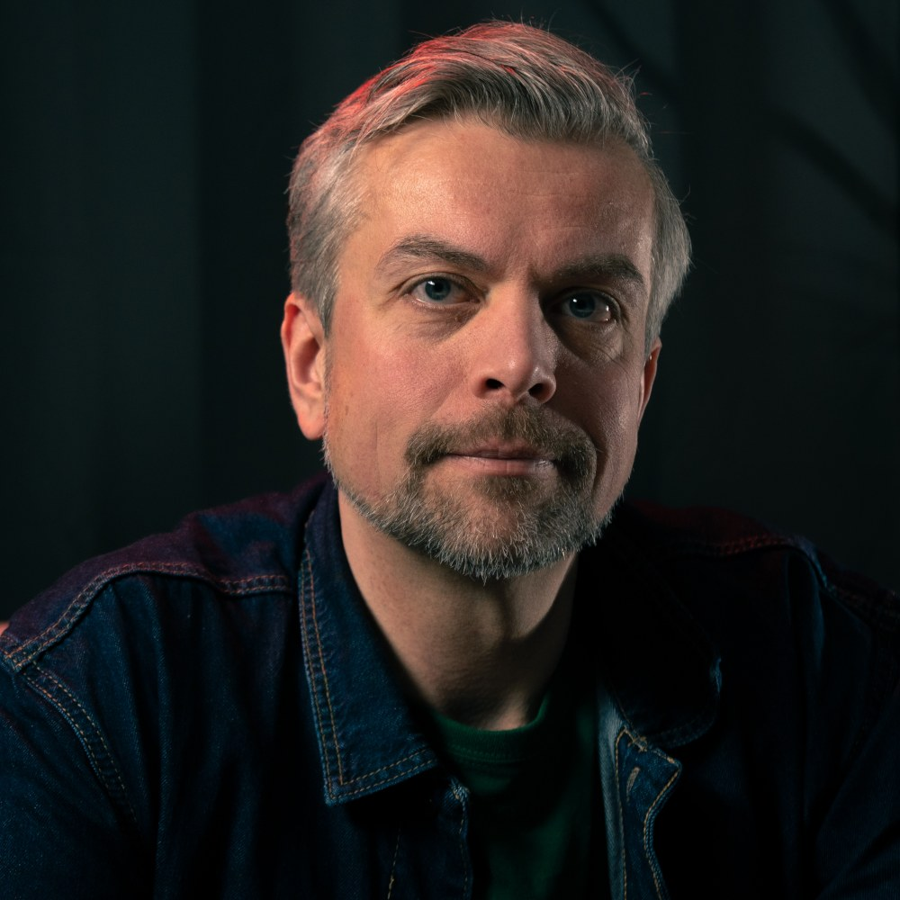
SPEAKER
Klaus Agnoletti
Storytelling Cyber Security Advisor, Relations Security
Klaus Agnoletti has been an all-round infosec professional since 2004. He co-founded BSides København in 2019. Recently he started out as an infosec freelancer focusing on storytelling in marketing, employer branding, game-based learning or wherever new ideas bring him.
linkedin.com/in/agnoletti
BSides Aarhus 2026 · June 20 · INCUBA Next, Aarhus
Speaker

Slide 8
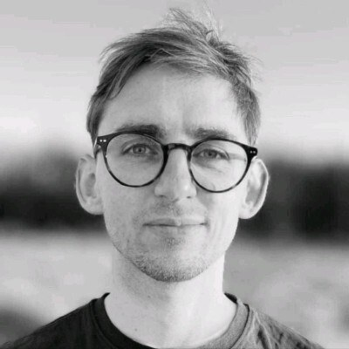
SPEAKER
Martin Sohn Christensen
Security Researcher, SpecterOps
Martin is a Security Researcher at SpecterOps in Copenhagen, specializing in Microsoft technologies with expertise in Active Directory, identity attack paths, and secure system configuration. His perspective on security risks and challenges is shaped by a background spanning system administration, an information security degree, and information security consultancy. He is a frequent contributor to the community through online engagement and talks.
linkedin.com/in/martinsohn · martinsohn.dk
BSides Aarhus 2026 · June 20 · INCUBA Next, Aarhus
Speaker

Slide 9
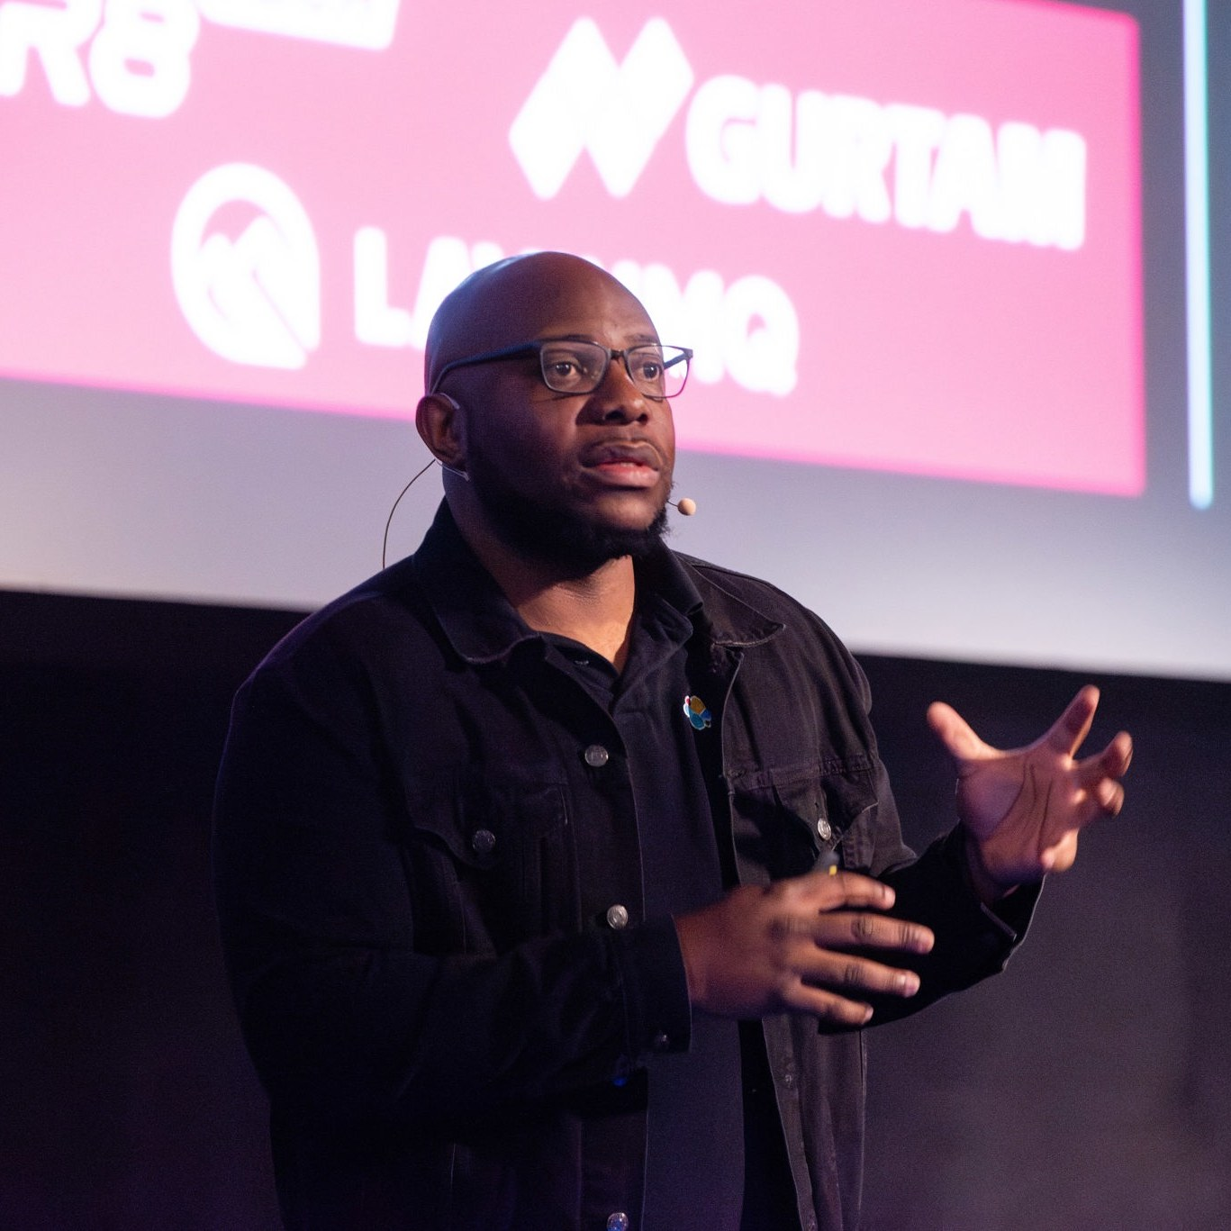
SPEAKER
Marvin Ngoma
Principal Security Architect, Security Evangelist, Elastic
Marvin is a Principal Security Architect and Security Evangelist at Elastic, and a seasoned consultant with a strong passion for helping organizations succeed in their cybersecurity programs. He has led many projects in both the private and public sectors — architecting and building Security Operations and Intelligence capabilities, and unifying tools, processes, and people. Before Elastic, he was a security consultant at IBM and the primary SME for QRadar in the Nordics.
linkedin.com/in/tyolani · www.elastic.co/blog/author/marvin-ngoma
BSides Aarhus 2026 · June 20 · INCUBA Next, Aarhus
Speaker

Slide 10
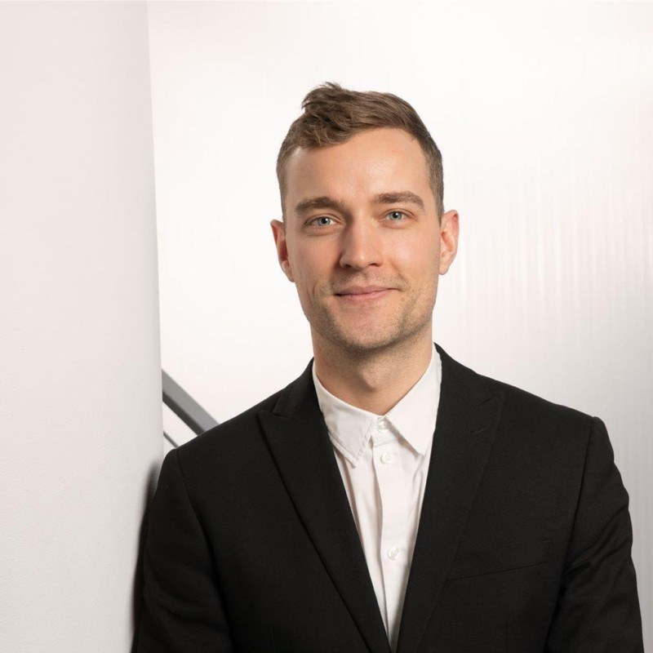
SPEAKER
Mikkel Ole Rømer
Head of Offensive Security, Truesec
Cyber Security Expert - I am mainly engaged with adversary simulation for breach prevention. This experience includes penetration testing and adversary emulation within highly complex infrastructures of some of the largest national and international companies. Besides offensive cyber engagements I have led and designed thorough security analysis exercises of enterprise applications, including review and guidance within secure development practices.
linkedin.com/in/mikkel-r%C3%B8mer · sessionize.com/mikkel-ole-romer
BSides Aarhus 2026 · June 20 · INCUBA Next, Aarhus
Speaker

Slide 11
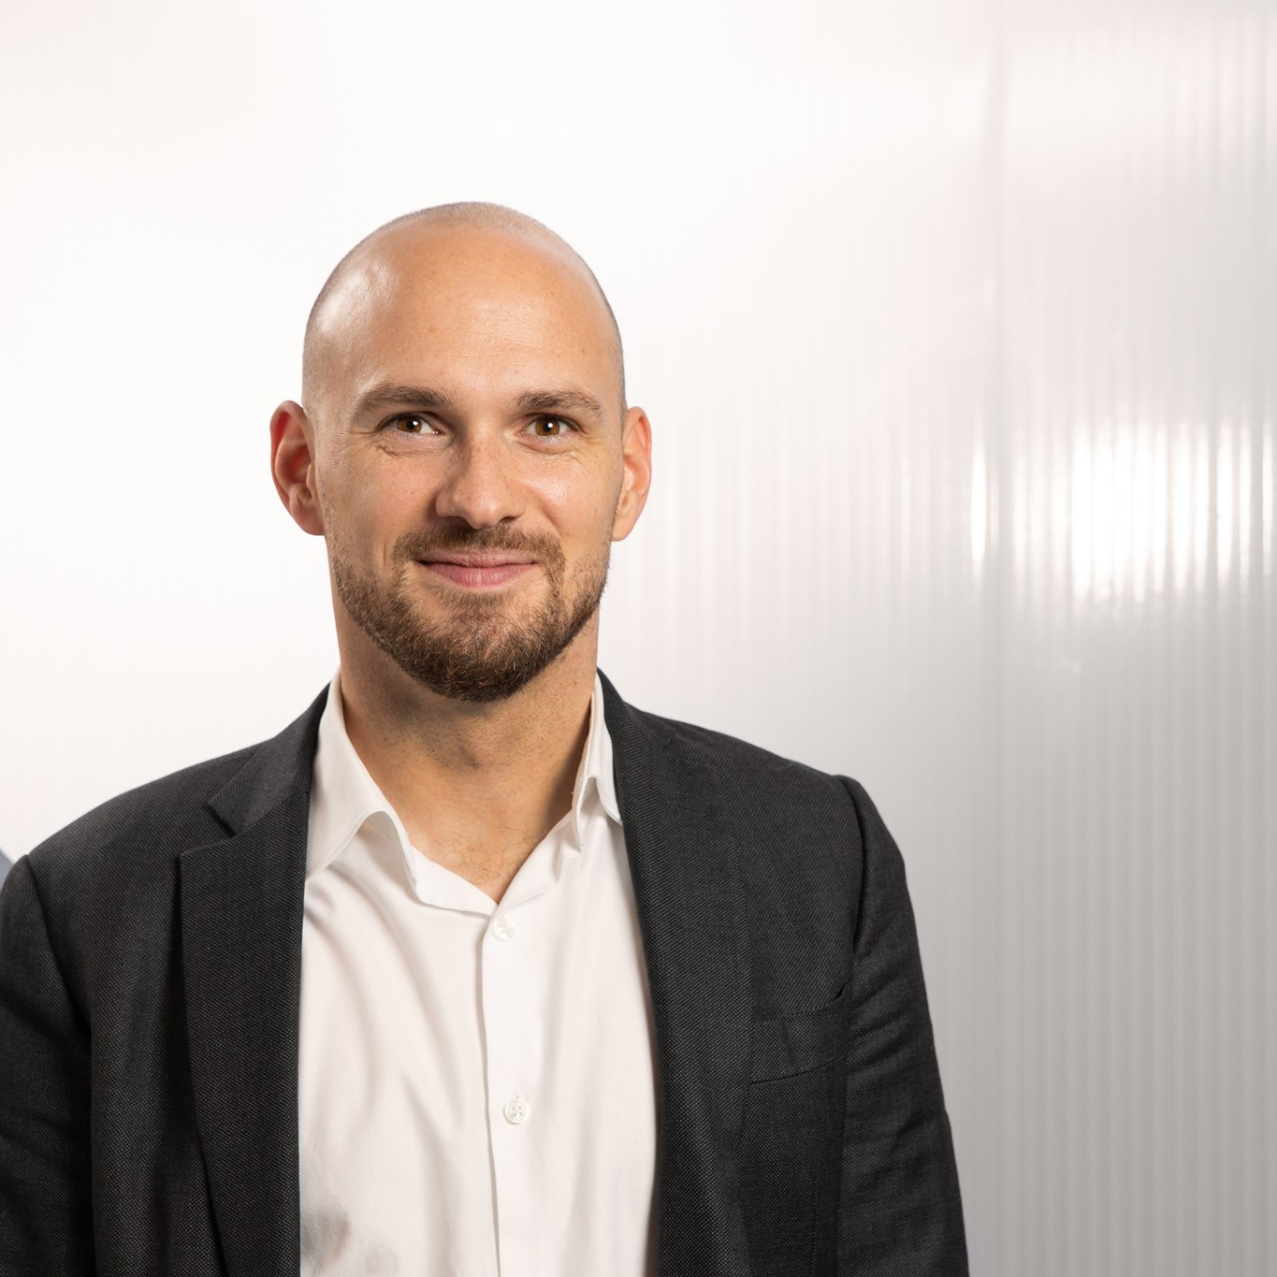
SPEAKER
Morten von Seelen
Vice President, Truesec
Morten is Vice President at Truesec in Aarhus and builds cool companies. His work focuses on turning outside-in signals about real organizations into actionable risk insight at national scale.
linkedin.com/in/vonseelen · tinyurl.com/MvSeeBlog
BSides Aarhus 2026 · June 20 · INCUBA Next, Aarhus
Speaker

Slide 12
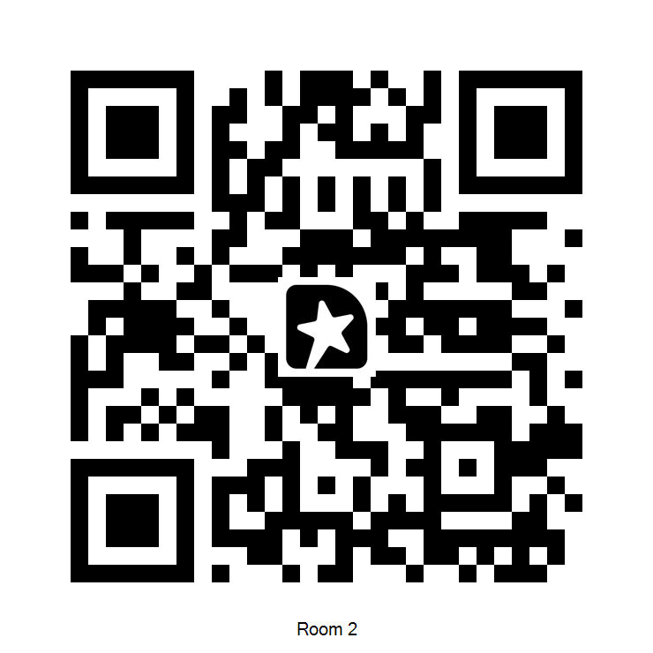
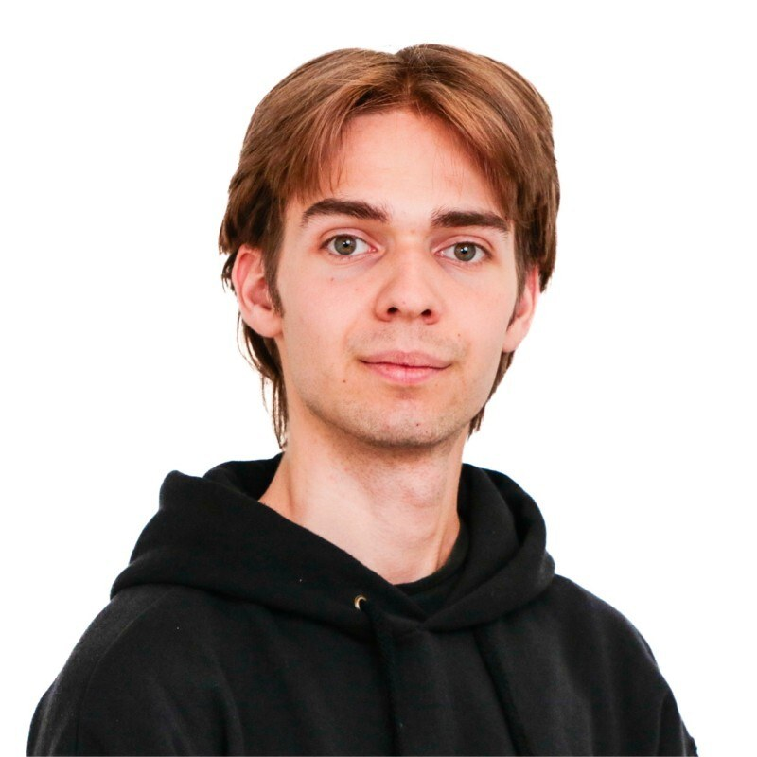
SPEAKER
Bence Soóki-Tóth
Master's Student, Aarhus University
Bence is a Master's student at Aarhus University and a research assistant at Eötvös Loránd University, working at the intersection of cryptography, game theory, and consensus protocols.
linkedin.com/in/stbence · 0xsooki.github.io
BSides Aarhus 2026 · June 20 · INCUBA Next, Aarhus
Speaker

Slide 13
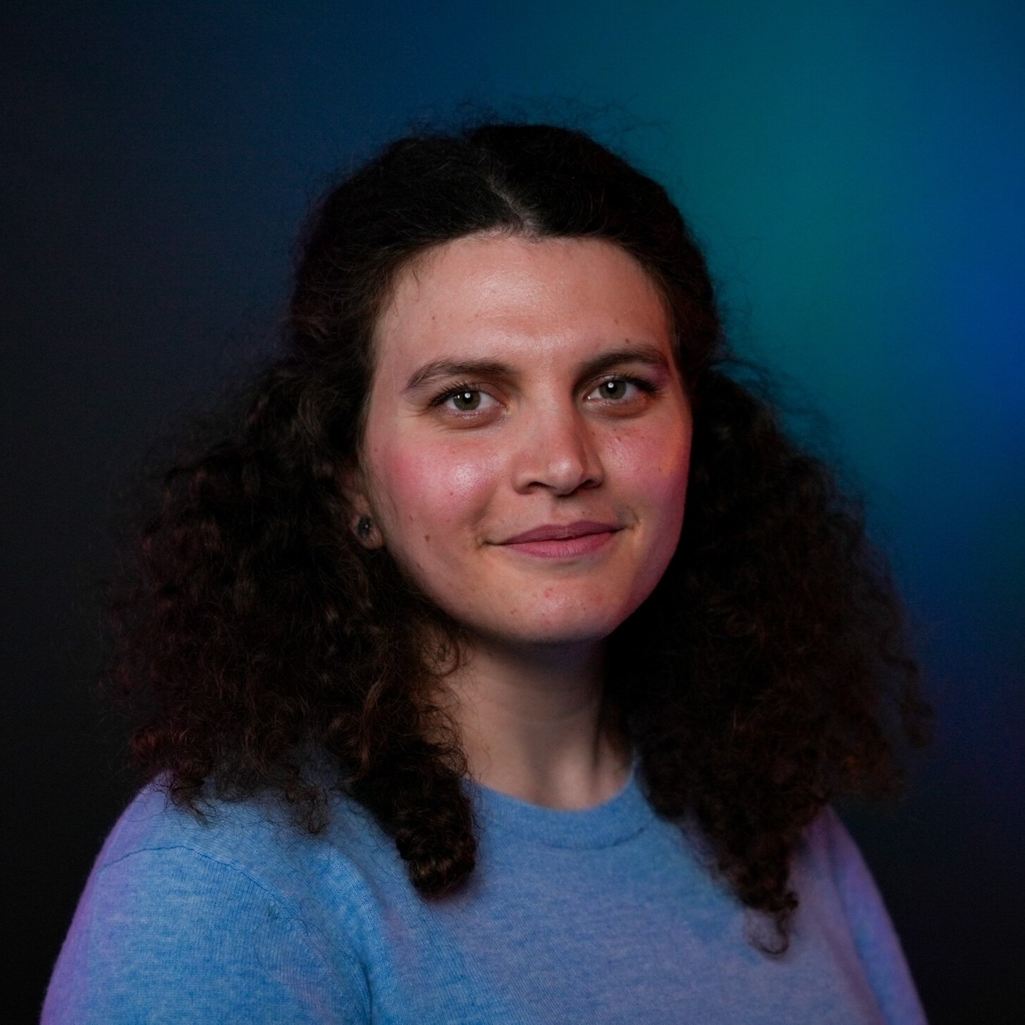
SPEAKER
Eleni Ioakeim
OT Threat Analyst, Truesec
Eleni is an OT Threat Analyst at Truesec SOC in Copenhagen, with expertise in OT network security monitoring. Her work contributes to improving SOC processes and detection capabilities for ICS environments.
linkedin.com/in/eleni-ioakeim-9bb262aa
BSides Aarhus 2026 · June 20 · INCUBA Next, Aarhus
Speaker

Slide 14
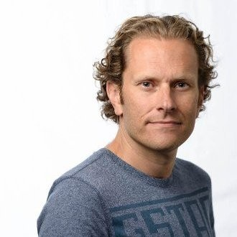
SPEAKER
Joost van Dijk
Developer Advocate, Yubico
Joost is a Developer Advocate at Yubico and a security and privacy professional with deep expertise in federated single sign-on, multi-factor authentication, FIDO, passkeys, PKI, TLS, and hardware security.
linkedin.com/in/joostd
BSides Aarhus 2026 · June 20 · INCUBA Next, Aarhus
Speaker

Slide 15
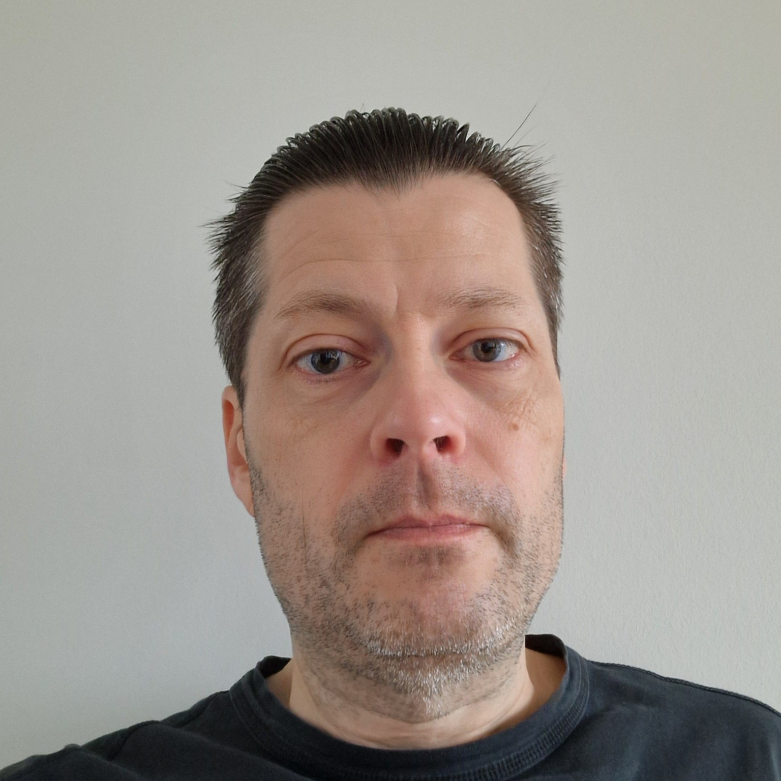
SPEAKER
Kasper Hald
Freelance Consultant, ApplSec Consult
With an educational background in quantum theory and 20+ years within application security, this topic is where Kasper's past and present meet.
linkedin.com/in/kasper-hald-6622623
BSides Aarhus 2026 · June 20 · INCUBA Next, Aarhus
Speaker

Slide 16
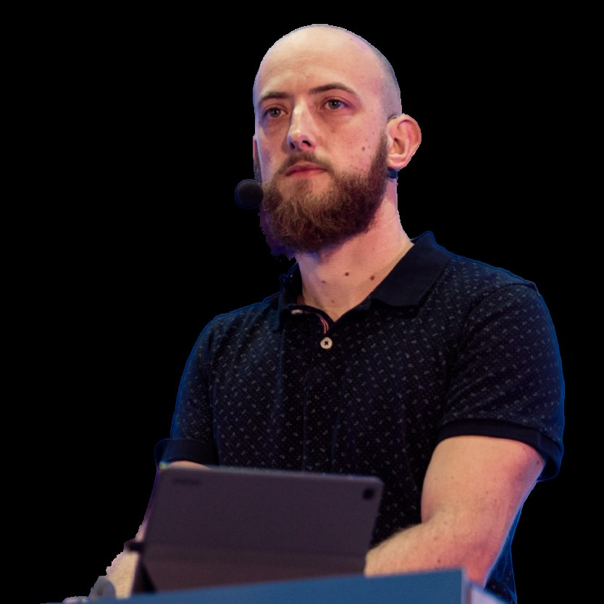
SPEAKER
Tom Kern
SecOps Automation Lead, Conscia MDR
Tom is a founding member of Conscia's Managed Detection and Response service, now protecting over 250,000 endpoints across Europe. As SecOps Automation Lead, his contributions include technical architecture, detection engineering, and automating security operations.
linkedin.com/in/kerntom · truly-smart.eu
BSides Aarhus 2026 · June 20 · INCUBA Next, Aarhus
Speaker

