Slide 1

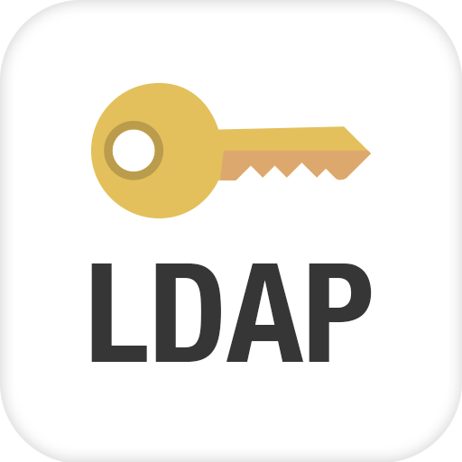


LDAPPER AD LDAP interrogation tool for the rest of us
By Shelby Spencer (shellster)

Slide 2




Obligatory WHOAMI?
Current:
Redteamer
Pentester
Developer
Electrical Circuits Nerd (bad at it)
CEO
Past:
Ex-Blueteamer
Ex-Sysadmin (unless you count client networks)
Definitely really far in the past:
Fun at parties

Slide 3
What WAS LDAP?
Lightweight Directory Access Protocol
A open, vendor-neutral, industry standard application protocol
Invented by Tim Howes, Steve Kille, Colin Robins, and Wengyik Yeong around 1993 as a replacement to DIXIE and DAS (DAP). Was much more “lightweight” in terms of traffic

Slide 4
What IS LDAP
Lightweight Directory Access Protocol
It is not “lightweight” in terms of functionality
A open, vendor-neutral, industry standard application protocol
A open-ish, vendor-mangled, protocol that industry wishes was standardized
Think of it kind of like a SQL:
It’s a database of customizable schemas which follow a somewhat standardized layout, with a somewhat standardized query language. The exact authentication mechanism, where and how data is stored, and, to some extent, the exact syntax of the query language is left up to the implementor.
We only care about LDAP as implemented by Microsoft

Slide 5
Why You Should Care
Contains almost all information AD (NTLM hashes are a notable exception)
Contains lots of information that you cannot find elsewhere in AD
Often times it is not monitored (or at least as closely) as more common AD enumeration techniques like net commands.
Microsoft ATA
We can write very targeted queries for the data we want.

Slide 6
Why You Should Care II
Lots of third-parties store interesting things in LDAP schemes (like multifactor tokens and credentials)
I have completed full compromise chains using only LDAP enumeration (before the final attack)
Can be easily queried by systems that are not domain-joined.

Slide 7
Current Tools (and why they suck)
Command line tools:
OpenLDAP ldapsearch
Must know full OU to user accounts (Simple bind auth)
Cannot rate-limit results
TLS support is terrible
Cannot correctly page AD LDAP results (only first 1000 results)
Terribly output formatting
Clunky command syntax
PowerView (does not suck)
Does lots of non-ldap stuff, much of it not opsec safe
Does not provide direct access to LDAP
Powershell (or C#) directly
Generally clunky.
Lousy separation of what’s LDAP and what’s not.

Slide 8
Current Tools (and why they suck) II
GUI Tools:
Sysinternals AD Explorer
Clunky interface
No easy way to pull results out to an easily parse-able file
Slow
Windows Only
Softerra LDAP Browser
Same issues as AD Explorer (minus being slow)
Not opensource.

Slide 9
LDAPPER: 3 easy payments of $19.99
Python (2 and 3 compatible)
Can authenticate using normal Domain\User + Password (and BaseDN)
Handles MS proprietary LDAP paging cookie (get all the results)
Complete control on how much and how fast you pull data.
Pre-baked queries for common, useful enumeration (continually adding to list)
Output data in an easily readable format or JSON
Force TLS (If you want)
Be more attractive to the opposite sex…
(of snakes and other small reptiles)
Satisfaction not guaranteed. NO REFUNDS!

Slide 10
Simple Command Line Interface
usage: LDAPPER.py [-h] [--domain DOMAIN] [--user USER] [--password PASSWORD]
[--server SERVER] [--basedn BASEDN] [--search SEARCH] [--maxrecords MAXRECORDS] [--pagesize PAGESIZE] [--delay DELAY] [--format {plain,json,json_tiny}] [--encryption {1,2,3}] [attribute [attribute ...]]
positional arguments:
attribute Attributes to return (defaults to all)
optional arguments:
--server SERVER, -S SERVER DC IP or resolvable name (comma-delimited list for round-robin)
--search SEARCH, -s SEARCH LDAP search string or number indicating custom search from "Custom Searches" list.
--maxrecords MAXRECORDS, -m MAXRECORDS Maximum records to return (Default is 100
means all.
--pagesize PAGESIZE, -p PAGESIZE Number of records to return on each pull (Default is 10). Should be <= max records.
--delay DELAY, -d DELAY Millisecond delay between paging requests (Defaults to 0).
--format {plain,json,json_tiny}, -f {plain,json,json_tiny} Format of output (Default is "plain).
--encryption {1,2,3}, -n {1,2,3}

Slide 11
Pre-baked Queries
Custom Searches:
Get all users
Get all groups (and their members)
Get all printers
Get all computers
Search for Unconstrained SPN Delegations (Potential Priv-Esc)
Search for Accounts where PreAuth is not required. (ASREPROAST)
All User SPNs (KERBEROAST)
* Show All LAPS LA Passwords (that you can see)
Show All Quest Two-Factor Seeds (if you have access)
Oracle "orclCommonAttribute" SSO password hash
* Oracle "userPassword" SSO password hash
* Starred items have never been tested in an environment where they could be verified so please let me know if they work.

Slide 12
Future Improvements
This project is actively developed (new features will be coming as I discover them or they are suggested).
Merge requests actively encouraged.
Currently Planned Improvements:
Better error messages (right now it kinda just blows up on you).
Stricter JSON formatting
Trusts
Possible Future Enhancements:
Py2Exe build scripts or PyInstaller
Second order queries
More customization of pre-baked queries (possibly store them in external config).
<Insert your item here>

Slide 13
Where to find it (and me)
The project is here: https://github.com/shellster/LDAPPER
You can find me around the internets as “shellster”
Check out keybase.io if you want to chat
Not Twitter.
After the talk ⬅

Slide 14

Questions?

