Slide 1

HAMSTER companion
Ana, Brock, & Ellie

Slide 2


Cage (w/ multiple mice)
Magnet
Hamster Wheel
Raspberry Pi Device
Mouse implanted with RFID chip
Short Range RFID Reader
Hall Effect Sensor

Slide 3
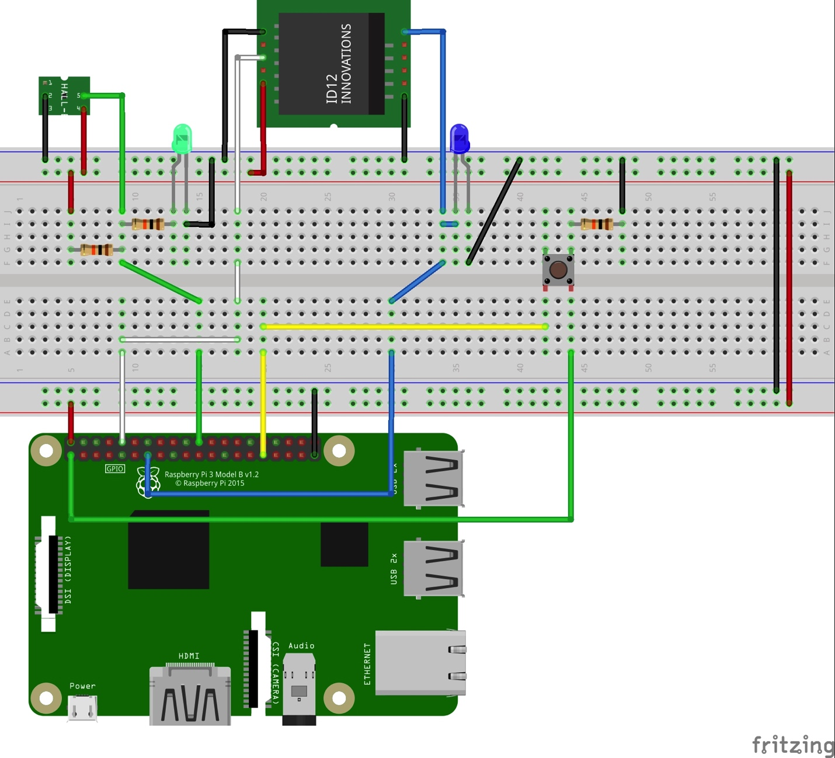
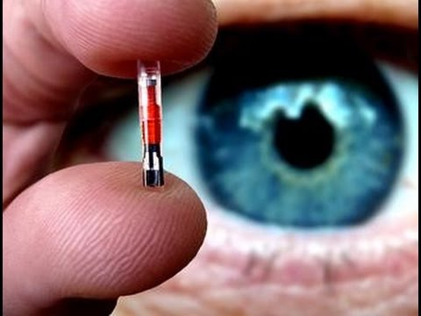
Hardware
RFID Chip
Raspberry Pi Device Schematic

Slide 4











Hardware Component
(digital I/O pins)
Local Backend Server
(runs hardware)
Device Frontend
Primary Backend Server
PostgreSQL Database
Client Frontend

