Slide 1
How the drone flies the course
AI-GrandPrix, physical qualifier. Start to finish, no prior knowledge assumed.

Slide 2
The one-minute version
- The organizers published where every gate stands. We trust that map.
- Before the race a planner draws the fastest line through the gates that our camera and drone can handle.
- In the air there is no GPS. The drone counts its steps with the flight controller's motion sensors: eyes closed.
- When the camera sees the next gate where the map says it must be, it opens its eyes and corrects.
- A follower steers along the planned line and sends stick commands 50 times a second.
- A human on the radio arms it and can take over at any moment.

Slide 3
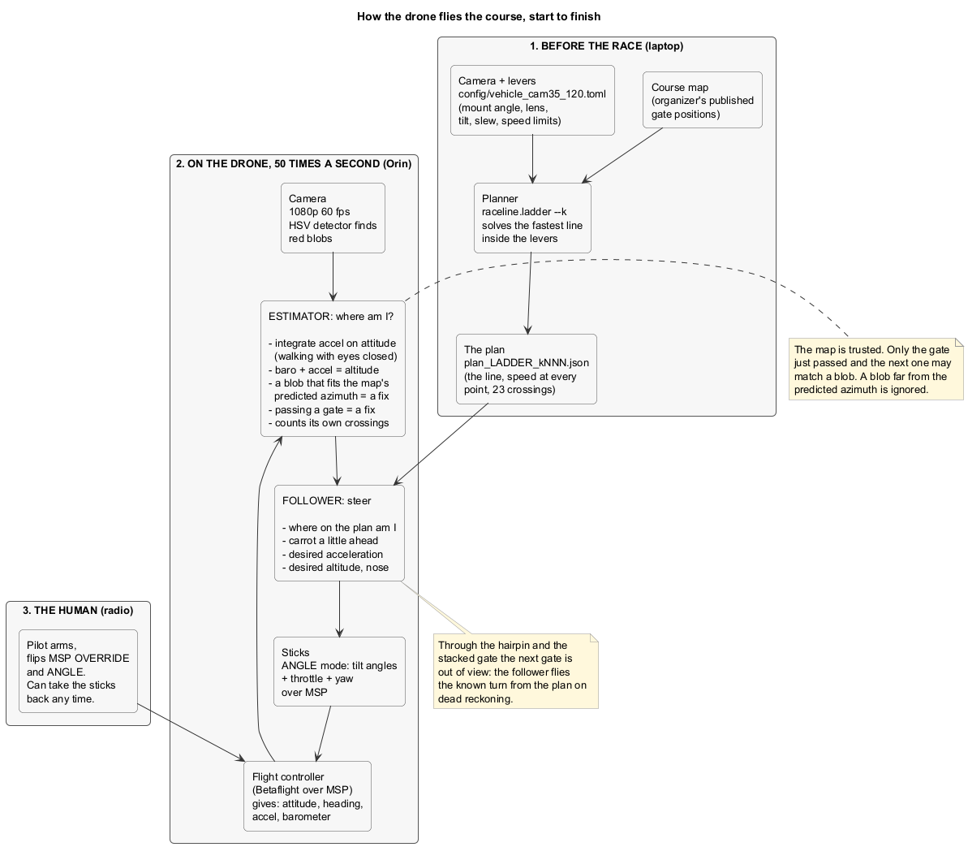
The whole loop on one page

Slide 4
1. The map
- data/course_map.json: the organizer's table. 10 gates, position, crossing direction, height.
- Gate 9 is a double: through the top at 4 m, U-turn, back through the bottom at 1.35 m.
- Two laps = 23 crossings. The start line is 7 m behind gate 1.
- Nothing is surveyed at the venue. The map is the truth we plan on.

Slide 5
2. The levers
- config/vehicle_cam35_120.toml holds everything the planner needs to know about the drone:
- the camera: mount angle and lens field of view, measured on the drone with hardware.camcal
- the limits: max tilt, how fast it may roll into a turn, lateral margin, top speed, climb rate
- One number k moves all limits together: k = 0 is the safe floor, k = 1 the race values.
- No target time anywhere. The time is whatever the solve gives.

Slide 6
3. The planner
- python -m raceline.ladder --k 0.5 --config ../config/vehicle_cam35_120.toml
- Draws a smooth line through the gate centres, then a speed profile inside the limits.
- Refuses to lean the drone so far that the camera would lose the next gate on the approach.
- Writes the plan: out/plans/plan_LADDER_k050.json, the line, the speed at every point, the 23 crossings.
- Prints the model time. k = 0.33 gives about 56 s, k = 0.5 about 49 s, k = 1 about 30 s.

Slide 7
4. What the flight controller gives us
- Betaflight 4.4.3 on the Archer, talked to over a serial link (MSP), about 50 times a second:
- attitude (how tilted), heading (which way the nose points)
- accelerometer (how hard it is pushed), barometer (altitude)
- No GPS, no position, no magnetometer. Heading is gyro-integrated and zeroed on the start line.
- Measured from the organizers' own flight logs: accel scale 2048 counts per g, baro noise 2.5 cm.

Slide 8
5. Knowing where you are: dead reckoning
- Rotate the accelerometer into the world with the attitude, subtract gravity, integrate twice.
- Velocity and position come out. They drift: a few tenths of a metre every few seconds.
- Altitude: accelerometer and barometer blended. Each alone is bad, together they are good.
- Run on the organizers' real 82 s flight log this drifts 0.14 m/s^2, which the sim tolerates.

Slide 9
6. Knowing where you are: the camera
- The detector finds red blobs. It does not know which blob is which gate.
- The estimator knows, from the map and its own position, exactly where the next gate must appear.
- A blob at that azimuth with the right apparent size is the gate. Its bearing and size give a position fix.
- Only the gate just passed and the next one may ever match. Everything else is ignored.
- Range comes from the blob width. The real gate has a header board, so the width, not the height.

Slide 10
7. Knowing where you are: the crossing itself
- When the estimate crosses a gate plane, the estimator counts the crossing itself. No referee on the drone.
- At that instant the drone was inside a 1.5 m opening, so the lateral estimate is pulled to the gate centre.
- Every blind turn therefore starts from a known point.
- Through the hairpin and the stacked gate the next gate is out of view for 1 to 2 s; the follower flies the known turn from the plan.

Slide 11
8. Steering: the follower
- Where on the line am I. Aim at a carrot a little ahead. Acceleration to get there, plus the plan's own acceleration.
- That becomes a tilt angle (ANGLE mode: the flight controller levels itself), a throttle for altitude, a yaw for the nose.
- The nose is pointed at the next gate through the turns so the camera looks where the gate must be.
- Sticks go over MSP. The flight controller does the fast attitude loop itself.

Slide 12
9. The human
- MSP override covers the four sticks only (msp_override_channels_mask = 15, set once in the CLI).
- The pilot arms, flips MSP OVERRIDE and ANGLE on the radio.
- The runtime waits for both before the plan clock starts.
- The pilot can flip override off and have the sticks back, or disarm, at any moment.

Slide 13
10. Race day
- Bench: bench info, rc-test, arm-test, drift; camcal on a real gate; dry run on the start line.
- Fly the lowest k that was clean in the sim. Clean twice, jump to the fastest k brought. Fail, fly the midpoint.
- A complete slow run scores above any incomplete fast one.

Slide 14
11. Proven and not proven
- Sim, noisy synthetic detector, no ground truth: k 0.4 to 0.5 completes about 2 runs in 3 at 47 to 50 s.
- Slower rungs complete nearly always. The 30 s plan does not complete on vision.
- Never flown on the real drone. The follower gains have never met the real airframe.
- The cage flight answers what the sim cannot.

