Slide 1

Qlassifier: Trainable Classical-Quantum Hybrid Convolutional Neural Network
Boseong Kim, Dongok Kim, Hojun Lee, Jaehoon Hahm, Yunseo Kim

Slide 2
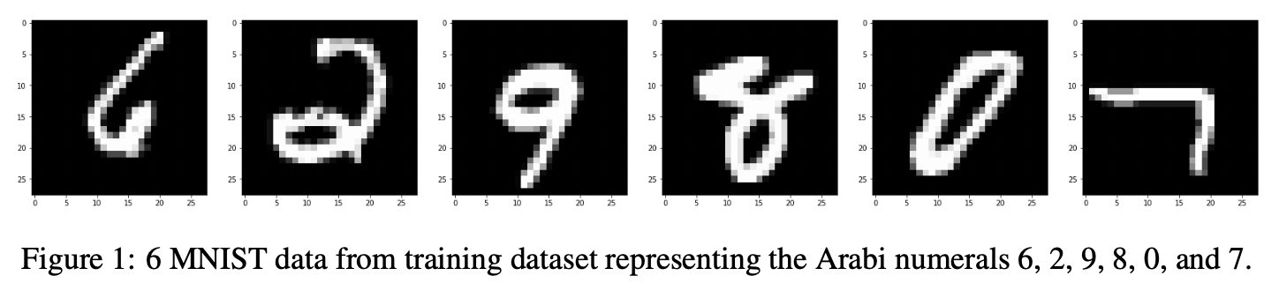
Quantum Version of CNN: What is Quanvolution?

Slide 3
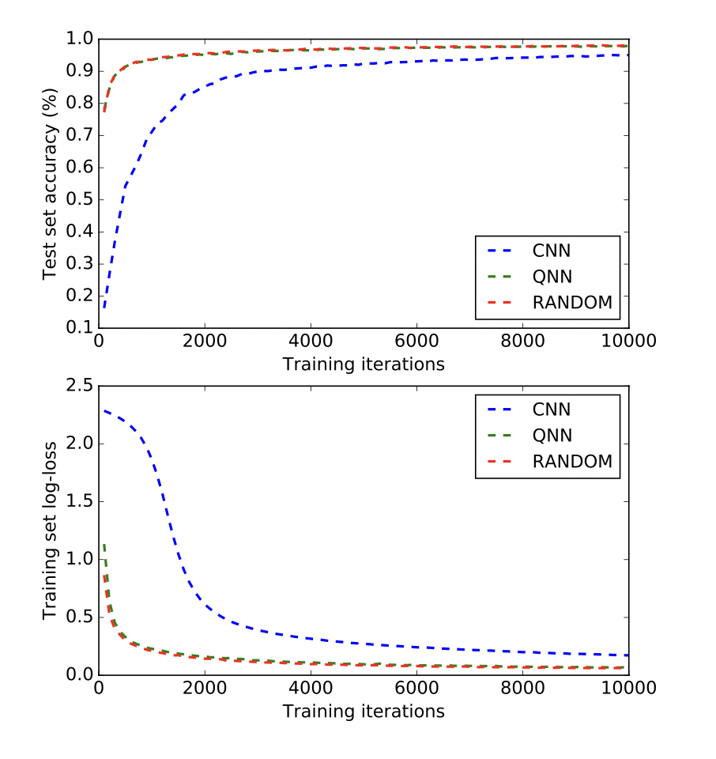
Preceding Research
Are there any quantum feature that we can take advantage by using Quanvolutional layer to extract such feautre efficiently?
Notes:
In existing studies, the qnn model performed better than the cnn model, but did not beat the random model.

Slide 4
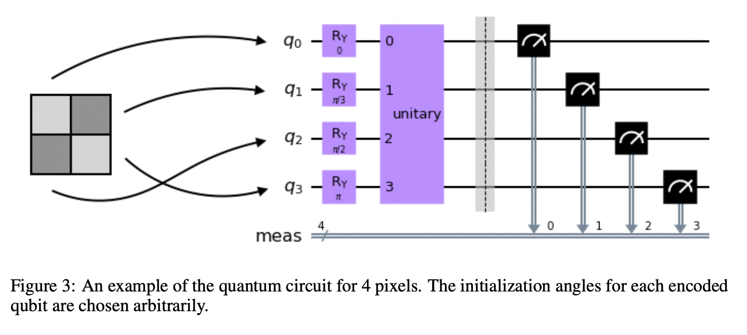


Quanvolutional Layer: Encoding
Encoding Method

Slide 5
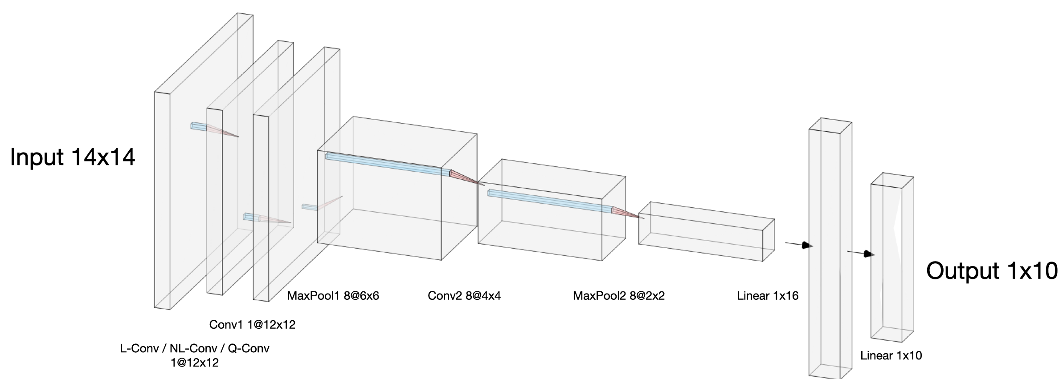
Strucutre of our Hybrid Convolutional Neural Network
Make this convolution part in quantum circuit = "Quanvolution"
Notes:
We compared the performance of three models: Linear-conv, Non-linear-conv, Quantum-conv. The structure of the model is the same as shown on the screen, except that the first convolution layer was different.

Slide 6
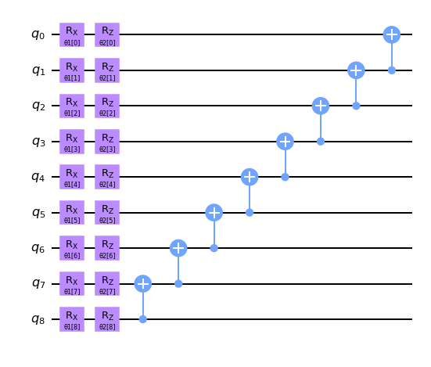
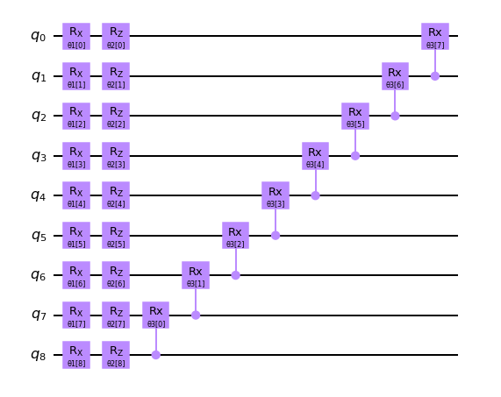
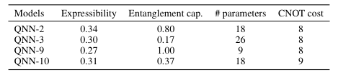
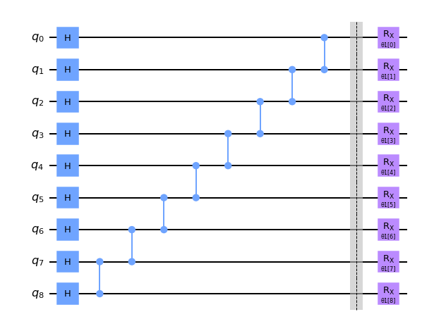
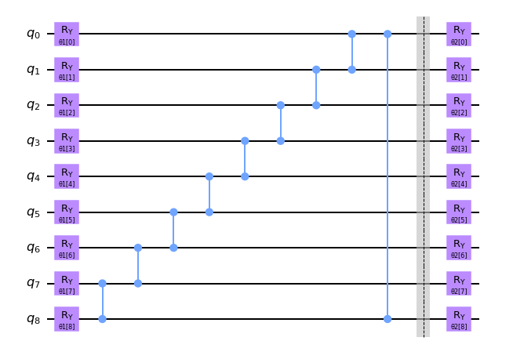
Expressibility, Entanglement Capability of quantum circuits
Q. What is the relation between (expressibility, entanglement capability) and trainability?
Notes:
We chose four pqc as the screen, and circuit descriptors are the same as the table. I chose the ones with high and low expressibility, and the ones with high and low entangling capability.
However, due to the time limit, we only experimented with QNN-9.

Slide 7
Experiment
CNN vs. Nonlinear-CNN vs. Quanvolutional-CNN
CNN : Classical CNN
Nonlinear-CNN : CNN model with preceding preprocessing (via nonlinear random polynomial model)
Quanvolutional-CNN: CNN model with preceding Quanvolution layer
Q. Would there be any enhancement in training by the preceding additional layer (nonlinear, quanvolutional)?

Slide 8
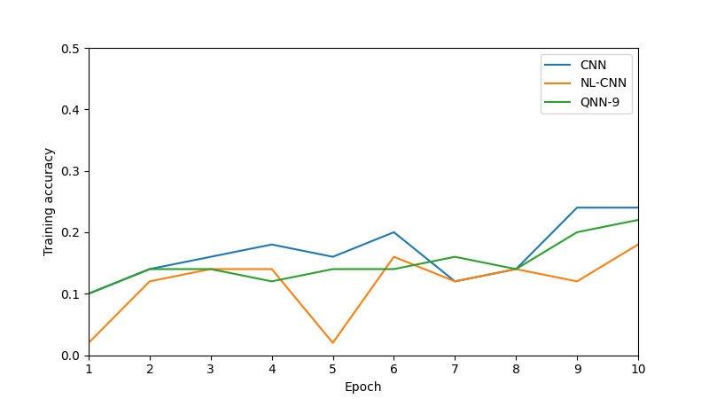
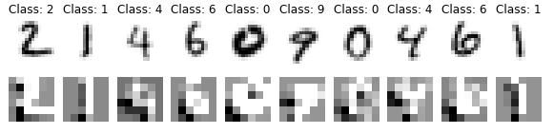
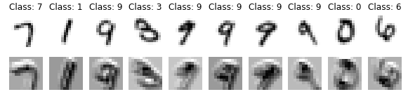
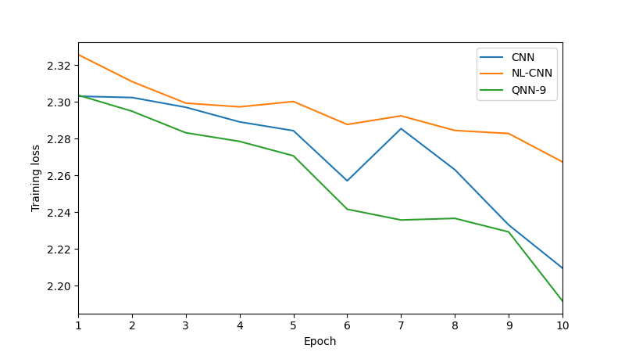
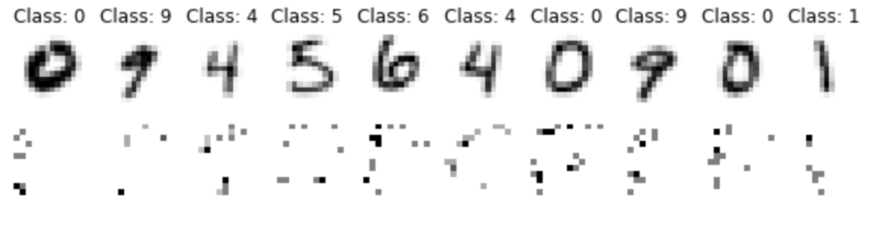
Result
CNN
NL-CNN
QNN-9
Notes:
The two graphs on the left compare the accuracy and loss of CNN, NL-CNN, and QNN-9, respectively. Because the number of epochs is limited due to time problems, we could not confirm a significant advantage over the existing CNN in terms of accuracy. However, in terms of loss, QNN-9 actually performed better than CNN.

Slide 9
Conclusion
Accuracy (higher is better)
NL-CNN < QNN-9 < CNN
Loss (lower is better)
QNN-9 < CNN < NL-CNN
With more epochs we can expect more difference!

