Slide 1
hidden1
bn1
Bn1_act
X
…
hidden1
bn1
Bn1_act
…

Slide 2
hidden1
bn1
bn1_act
X
…
hidden2
logits_before_bn
bn2
bn2_act
logits
…

Slide 3
hidden1
bn1
bn1_act
X
…
hidden2
logits_before_bn
bn2
bn2_act
logits
y(?)
…

Slide 4
Data Set
Input or output Layer
Hidden Layer with nonlinear activation
Dynamic (batch-wise) Normalization
Connection Weights
hidden1
bn1
bn1_act
X
…
hidden2
logits_before_bn
bn2
bn2_act
logits
y(?)
…

Slide 5
Data Set
Input or output Layer
Hidden Layer with nonlinear activation
Dynamic (batch-wise) Normalization
Connection Weights
hidden1
bn1
bn1_act
X
…
hidden2
logits_before_bn
bn2
bn2_act
logits
outputs
…

Slide 6
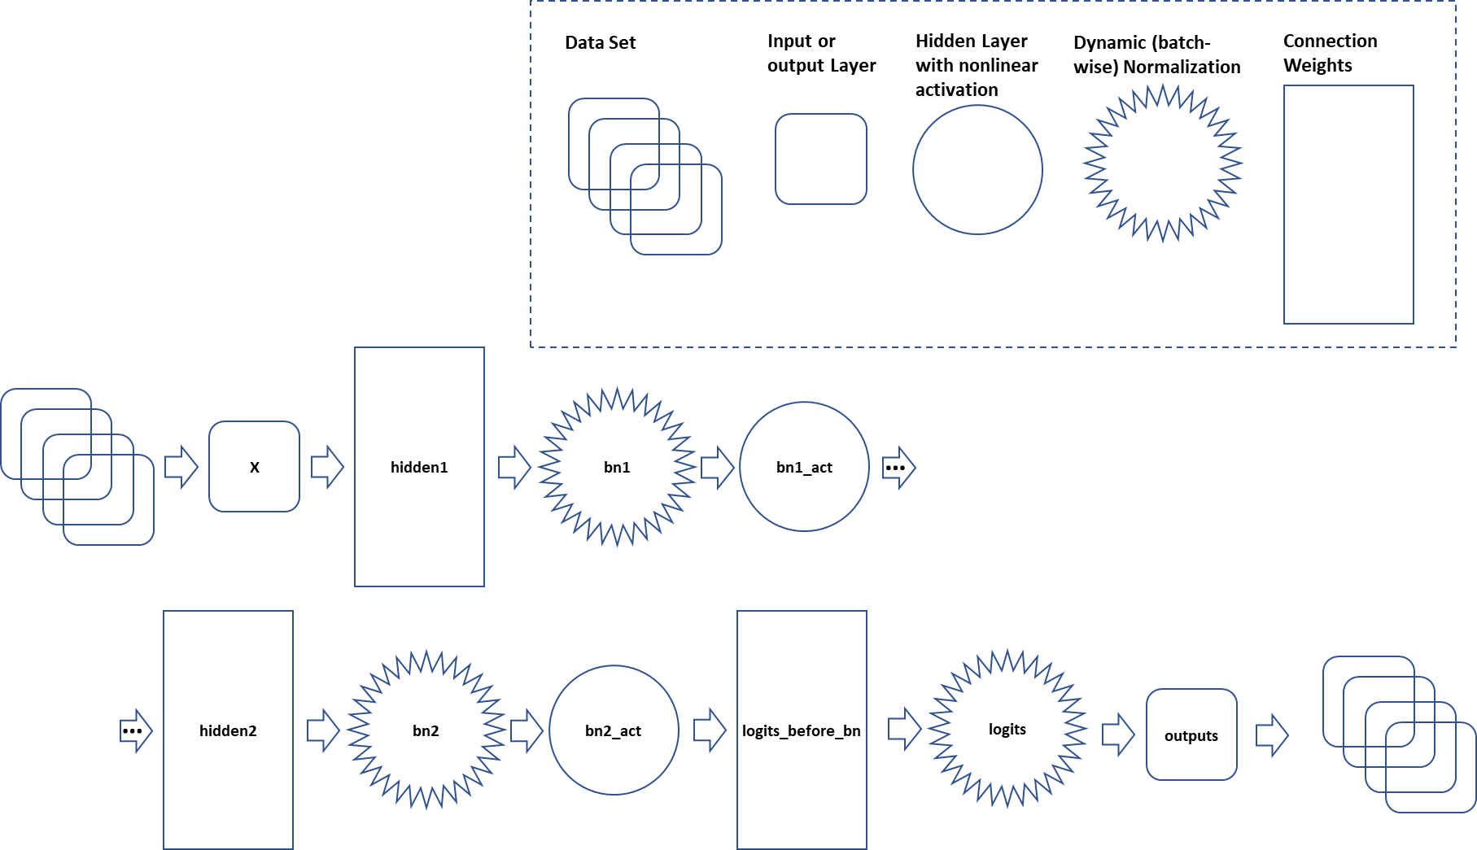
11_NOTES-FIG-01

