Slide 1
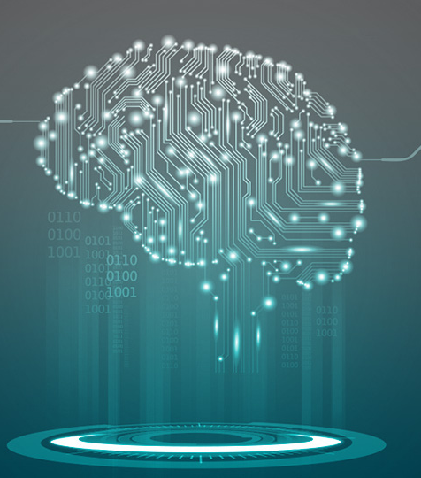


Creativity, Science and Innovation Introduction to Machine Learning for Time Series analysis
November 14th, 2024
Alessandro Verosimile
alessandro.verosimile@polimi.it

Slide 2
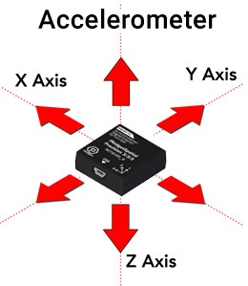
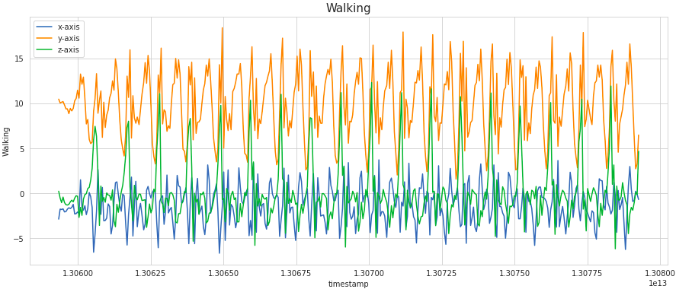
Machine Learning tasks with Time Series: Use case
Objective: classify the activity (walking, running, going upstairs, etc) of a person given data from an accelerometer

Slide 3
Machine Learning tasks with Time Series: Use case
1
Steps to train a ML model on this task:
Collect a dataset with time series (x, y, and z from accelerometer). Each time series has an associated label that indicates the activity performed.
Train an ML model that learns to predict the Label given X, Y, and Z
When you have the final model, you will be able to use it in inference mode on new data coming from the device
X | Y | Z | Label
[2,-1,4,...] | [12,5,8,...] | [9,5,8,...] | Walking (0)
[2,-2,4,...] | [11,2,9,...] | [4,1,5,...] | Running (1)
[1,3,-1,...] | [10,5,7,...] | [4,1,5,...] | Walking (0)
[2,-1,1,...] | [8,11,8,...] | [5,5,7,...] | Walking (0)
[1,5,3,...] | [9,5,8,...] | [8,2,8,...] | Going up (2)
[2,-1,4,...] | [5,5,7,...] | [2,3,4,...] | Walking (0)
[4,5,9,...] | [4,5,9,...] | [4,1,5,...] | Walking (0)

Slide 4

Machine Learning tasks with Time Series: Use case
1
Steps to train a ML model on this task:
Collect a dataset with time series (x, y, and z from accelerometer). Each time series has an associated label that indicates the activity performed.
Train an ML model on such data. The model will learn to predict the Label given X, Y, and Z
When you have the final model, you will be able to use it in inference mode on new data coming from the device
X | Y | Z | Label
[2,-1,4,...] | [12,5,8,...] | [9,5,8,...] | Walking (0)
[2,-2,4,...] | [11,2,9,...] | [4,1,5,...] | Running (1)
[1,3,-1,...] | [10,5,7,...] | [4,1,5,...] | Walking (0)
[2,-1,1,...] | [8,11,8,...] | [5,5,7,...] | Walking (0)
[1,5,3,...] | [9,5,8,...] | [8,2,8,...] | Going up (2)
[2,-1,4,...] | [5,5,7,...] | [2,3,4,...] | Walking (0)
[4,5,9,...] | [4,5,9,...] | [4,1,5,...] | Walking (0)
2
ML model

Slide 5
Machine Learning tasks with Time Series: Use case
1
Steps to train a ML model on this task:
Collect a dataset with time series (x, y, and z from accelerometer). Each time series has an associated label that indicates the activity performed.
Train an ML model on such data. The model will learn to predict the Label given X, Y, and Z
When you have the final model, you will be able to use it in inference mode on new data coming from the device
X | Y | Z | Label
[2,-1,4,...] | [12,5,8,...] | [9,5,8,...] | Walking (0)
[2,-2,4,...] | [11,2,9,...] | [4,1,5,...] | Running (1)
[1,3,-1,...] | [10,5,7,...] | [4,1,5,...] | Walking (0)
[2,-1,1,...] | [8,11,8,...] | [5,5,7,...] | Walking (0)
[1,5,3,...] | [9,5,8,...] | [8,2,8,...] | Going up (2)
[2,-1,4,...] | [5,5,7,...] | [2,3,4,...] | Walking (0)
[4,5,9,...] | [4,5,9,...] | [4,1,5,...] | Walking (0)
2
3
ML model
Prediction

Slide 6
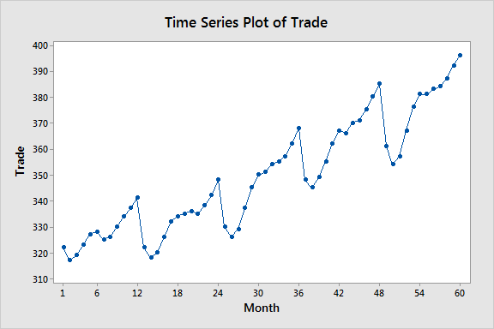
Machine Learning tasks with Time Series
Forecasting: You have n values of the time series in input, and you want to predict the value at time n+1. (example: bitcoin forecasting, weather forecasting)
Classification: You have n values of the time series in input, and you want to predict the class it belongs to. (example: activity recognition from accelerometer data)

Slide 7
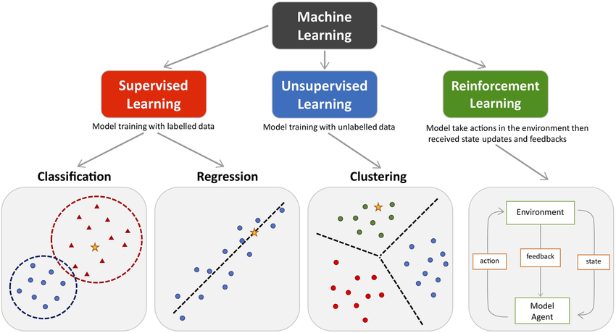
Machine Learning categories

Slide 8
Supervised Machine Learning: an example
 | Weight | Blood Pr.
Patient 1 | 54 | 112
Patient 2 | 68 | 130

Slide 9
Supervised Machine Learning: an example
 | Weight | Blood Pr.
Patient 1 | 54 | 112
Patient 2 | 68 | 130
Blood Pr = W₁ * Weight + W₀
112 = W₁ * 54 + W₀
130 = W₁ * 68 + W₀
9

Slide 10
Supervised Machine Learning: an example
 | Weight | Blood Pr.
Patient 1 | 54 | 112
Patient 2 | 68 | 130
130
112
Blood Pr = W₁ * Weight + W₀
54
68
112 = W₁ * 54 + W₀
130 = W₁ * 68 + W₀
10

Slide 11
Supervised Machine Learning: an example
 | Weight | Blood Pr.
Patient 1 | 54 | 112
Patient 2 | 68 | 130
Patient 3 | 57 | 115
Patient 4 | 56 | 116
Patient 5 | 77 | 132
Patient 6 | 81 | 138
Patient 7 | 74 | 130
Patient 8 | 66 | 122
11

Slide 12
Supervised Machine Learning: an example
 | Weight | Blood Pr.
Patient 1 | 54 | 112
Patient 2 | 68 | 130
Patient 3 | 57 | 115
Patient 4 | 56 | 116
Patient 5 | 77 | 132
Patient 6 | 81 | 138
Patient 7 | 74 | 130
Patient 8 | 66 | 122
12

Slide 13
Supervised Machine Learning: an example
 | Weight | Blood Pr.
Patient 1 | 54 | 112
Patient 2 | 68 | 130
Patient 3 | 57 | 115
Patient 4 | 56 | 116
Patient 5 | 77 | 132
Patient 6 | 81 | 138
Patient 7 | 74 | 130
Patient 8 | 66 | 122
112 = W₁ * 54 + W₀
130 = W₁ * 68 + W₀
?
…
122 = W₁ * 66 + W₀
13

Slide 14
Supervised Machine Learning: an example
 | Weight | Blood Pr.
Patient 1 | 54 | 112
Patient 2 | 68 | 130
Patient 3 | 57 | 115
Patient 4 | 56 | 116
Patient 5 | 77 | 132
Patient 6 | 81 | 138
Patient 7 | 74 | 130
Patient 8 | 66 | 122
112 = W₁ * 54 + W₀
130 = W₁ * 68 + W₀
No solution, but…
…
122 = W₁ * 66 + W₀
14

Slide 15
Supervised Machine Learning: an example
 | Weight | Blood Pr.
Patient 1 | 54 | 112
Patient 2 | 68 | 130
Patient 3 | 57 | 115
Patient 4 | 56 | 116
Patient 5 | 77 | 132
Patient 6 | 81 | 138
Patient 7 | 74 | 130
Patient 8 | 66 | 122
112 = W₁ * 54 + W₀
130 = W₁ * 68 + W₀
…
122 = W₁ * 66 + W₀
15

Slide 16
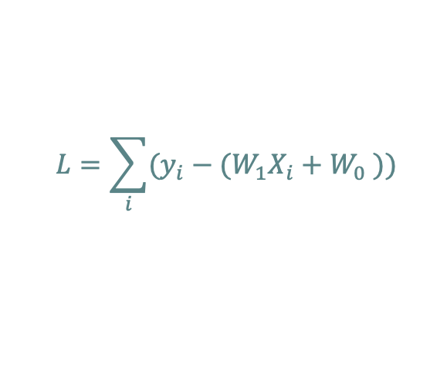
Supervised Machine Learning: an example
 | X = Weight | Y = Blood Pr.
Patient 1 | 54 | 112
Patient 2 | 68 | 130
Patient 3 | 57 | 115
Patient 4 | 56 | 116
Patient 5 | 77 | 132
Patient 6 | 81 | 138
Patient 7 | 74 | 130
Patient 8 | 66 | 122
112 = W₁ * 54 + W₀
130 = W₁ * 68 + W₀
$$L=\sum_{i}{(y_{i}−{(W}_{1}X_{i}+W_{0} ))}$$
…
Some mathematical algorithms allow to find the
weights that minimize such quantity, called
loss function
122 = W₁ * 66 + W₀
16

Slide 17
Supervised Machine Learning: an example
 | Weight | Blood Pr.
Patient 1 | 54 | 112
Patient 2 | 68 | 130
Patient 3 | 57 | 115
Patient 4 | 56 | 116
Patient 5 | 77 | 132
Patient 6 | 81 | 138
Patient 7 | 74 | 130
Patient 8 | 66 | 122
112 = W₁ * 54 + W₀
130 = W₁ * 68 + W₀
Can we do better?
…
122 = W₁ * 66 + W₀
17

Slide 18
Supervised Machine Learning: an example
 | Weight | Weight² | Blood Pr.
Patient 1 | 54 | 54² | 112
Patient 2 | 68 | 68² | 130
Patient 3 | 57 | 57² | 115
Patient 4 | 56 | 56² | 116
Patient 5 | 77 | 77² | 132
Patient 6 | 81 | 81² | 138
Patient 7 | 74 | 74² | 130
Patient 8 | 66 | 66² | 122
112 = W₂ * 54² W₁ * 54 + W₀
130 = W₂ * 68² W₁ * 68 + W₀
So increasing the degree of the polynomial will always be better, right?
…
122 = W₂ * 66² W₁ * 66 + W₀
18

Slide 19
Supervised Machine Learning: an example
 | Weight | Weight² | Blood Pr.
Patient 1 | 54 | 54² | 112
Patient 2 | 68 | 68² | 130
Patient 3 | 57 | 57² | 115
Patient 4 | 56 | 56² | 116
Patient 5 | 77 | 77² | 132
Patient 6 | 81 | 81² | 138
Patient 7 | 74 | 74² | 130
Patient 8 | 66 | 66² | 122
112 = W₂ * 54² W₁ * 54 + W₀
130 = W₂ * 68² W₁ * 68 + W₀
NO, overfitting!
…
122 = W₂ * 66² W₁ * 66 + W₀
19

Slide 20
Supervised Machine Learning: an example
 | Weight | Weight² | Blood Pr.
Patient 1 | 54 | 54² | 112
Patient 2 | 68 | 68² | 130
Patient 3 | 57 | 57² | 115
Patient 4 | 56 | 56² | 116
Patient 5 | 77 | 77² | 132
Patient 6 | 81 | 81² | 138
Patient 7 | 74 | 74² | 130
Patient 8 | 66 | 66² | 122
New data points
112 = W₂ * 54² W₁ * 54 + W₀
130 = W₂ * 68² W₁ * 68 + W₀
NO, overfitting!
…
122 = W₂ * 66² W₁ * 66 + W₀
20

Slide 21
Supervised Machine Learning: an example
 | Weight | Weight² | Blood Pr.
Patient 1 | 54 | 54² | 112
Patient 2 | 68 | 68² | 130
Patient 3 | 57 | 57² | 115
Patient 4 | 56 | 56² | 116
Patient 5 | 77 | 77² | 132
Patient 6 | 81 | 81² | 138
Patient 7 | 74 | 74² | 130
Patient 8 | 66 | 66² | 122
New data points
112 = W₂ * 54² W₁ * 54 + W₀
130 = W₂ * 68² W₁ * 68 + W₀
NO, overfitting!
…
To be sure to avoid this situation, we always need to take some data apart to validate our model
122 = W₂ * 66² W₁ * 66 + W₀
21

Slide 22
Some important rules
Always split your dataset to be able to evaluate the model and control overfitting. Usually, for ML tasks, you use 70% of the data for the training, 10% for the validation, and 20% for the test set. More complex strategies to better utilize your data are K-Fold Cross Validation or Leave One Out
To avoid overfitting you use regularization techniques; some models in the online libraries such as Scikit Learn use regularization techniques by default.
The validation set is used to choose the best hyperparameters (for instance, the grade of the polynomial in the simple example before). In complex models you have a huge number of parameters and you have tu carefully choose them.
Be careful to the difference between parameters and hyperparameters. The parameters are learnt from the model (the coefficients W_{i} of the previous linear regression), the hyperparameters determine the model’s shape and complexity, and they are decided by the developer (the degree of the polynomial).
22

Slide 23
Supervised Machine Learning: classification
 | Weight | Blood Pr | Pathology
Patient 1 | 54 | 54² | True
Patient 2 | 68 | 68² | False
Patient 3 | 57 | 57² | False
Patient 4 | 56 | 56² | False
Patient 5 | 77 | 77² | True
Patient 6 | 81 | 81² | False
Patient 7 | 74 | 74² | False
Patient 8 | 66 | 66² | True
True
False
23

Slide 24
Supervised Machine Learning: classification
 | Weight | Blood Pr | Pathology
Patient 1 | 54 | 54² | True
Patient 2 | 68 | 68² | False
Patient 3 | 57 | 57² | False
Patient 4 | 56 | 56² | False
Patient 5 | 77 | 77² | True
Patient 6 | 81 | 81² | False
Patient 7 | 74 | 74² | False
Patient 8 | 66 | 66² | True
True
False
24

Slide 25
Most famous ML models that work with tabular data
Classification
Logistic regression
Decision Tree based models and ensembles (Random Forests, Xgboost, ecc)
K-Nearest-neighbours
Support Vector Machines
Naive Bayes
Regression
Linear regression, and all its regularized variants (Ridge regression, Lasso regression, ecc)
Decision Tree based models and ensembles (Random Forests, Xgboost, ecc)
K-Nearest-neighbours
25

Slide 26
Most famous ML models that work with tabular data
Classification
Logistic regression
Decision Tree based models and ensembles (Random Forests, Xgboost, ecc)
K-Nearest-neighbours
Support Vector Machines
Naive Bayes
Regression
Linear regression, and all its regularized variants (Ridge regression, Lasso regression, ecc)
Decision Tree based models and ensembles (Random Forests, Xgboost, ecc)
K-Nearest-neighbours
Coding time
26

Slide 27
How can we use this models for dealing with Time series?
27

Slide 28
How can we use this models for dealing with Time series?
1st alternative
Extract features: Mean, Standard Deviation, etc…
Build a tabular dataset
Apply the previously mentioned models
28

Slide 29
How can we use this models for dealing with Time series?
1st alternative
Extract features: Mean, Standard Deviation, etc…
Build a tabular dataset
Apply the previously mentioned models
Coding again!
29

Slide 30
How can we use this models for dealing with Time series?
1st alternative
Extract features: Mean, Standard Deviation, etc…
Build a tabular dataset
Apply the previously mentioned models
2nd alternative
Use models that directly take as input the data in the format of a time series.
Which models can do this?
30

Slide 31
How can we use this models for dealing with Time series?
1st alternative
Extract features: Mean, Standard Deviation, etc…
Build a tabular dataset
Apply the previously mentioned models
2nd alternative
Use models that directly take as input the data in the format of a time series.
Which models can do this? Neural Networks
31

Slide 32
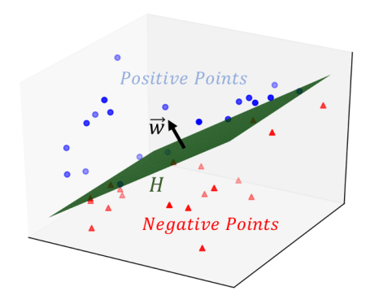
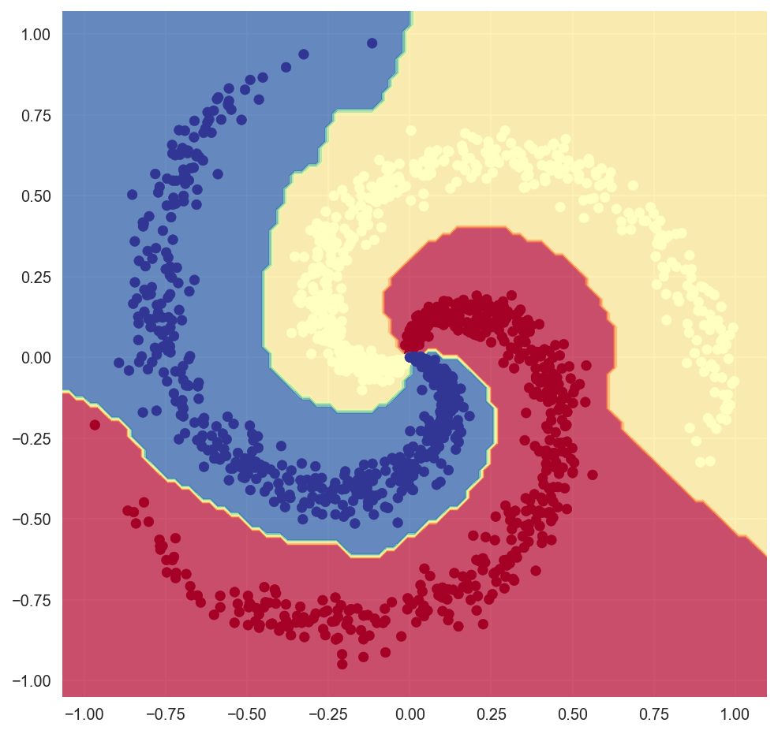
Supervised Machine Learning: Neural networks
All the models we have seen until now are linear in the feature space.
The main characteristic of Neural Networks is the introduction of Non-linearities
32

Slide 33
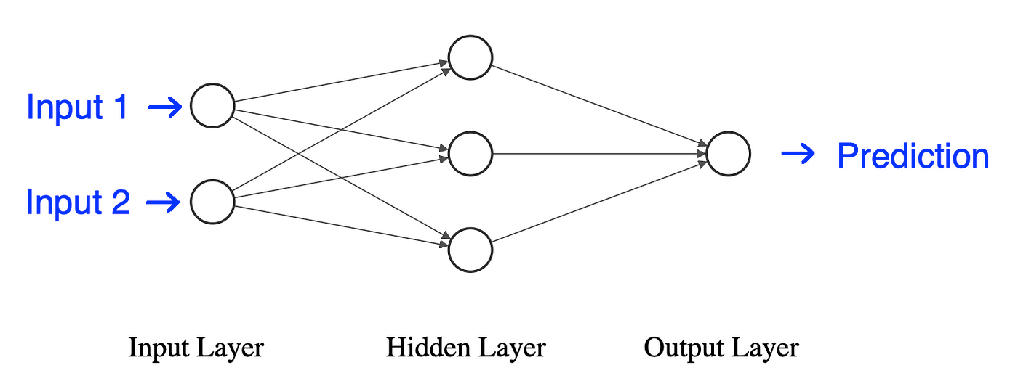
Supervised Machine Learning: Neural networks
How is this linearity introduced?
Bias term
1
w₀
Systolic BP
Weight
w₁
Classical Linear Regression
33

Slide 34
Supervised Machine Learning: Neural networks
How is this linearity introduced?
W₁
W₂
Bias term
1
w₀
Bias term
1
Systolic BP
Systolic BP
Weight
w₁
Weight
Classical Linear Regression
Non-linear?
34

Slide 35
Supervised Machine Learning: Neural networks
How is this linearity introduced?
W₁
W₂
Bias term
1
w₀
Bias term
1
Systolic BP
Systolic BP
Weight
w₁
Weight
Classical Linear Regression
Non-linear?
No!
W₁ is a 2x3 matrix
W₂ is a 3x1 matrix
In the end, the result is just a 2x1 matrix, just the two same parameter of the classical linear regression
35

Slide 36
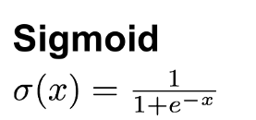
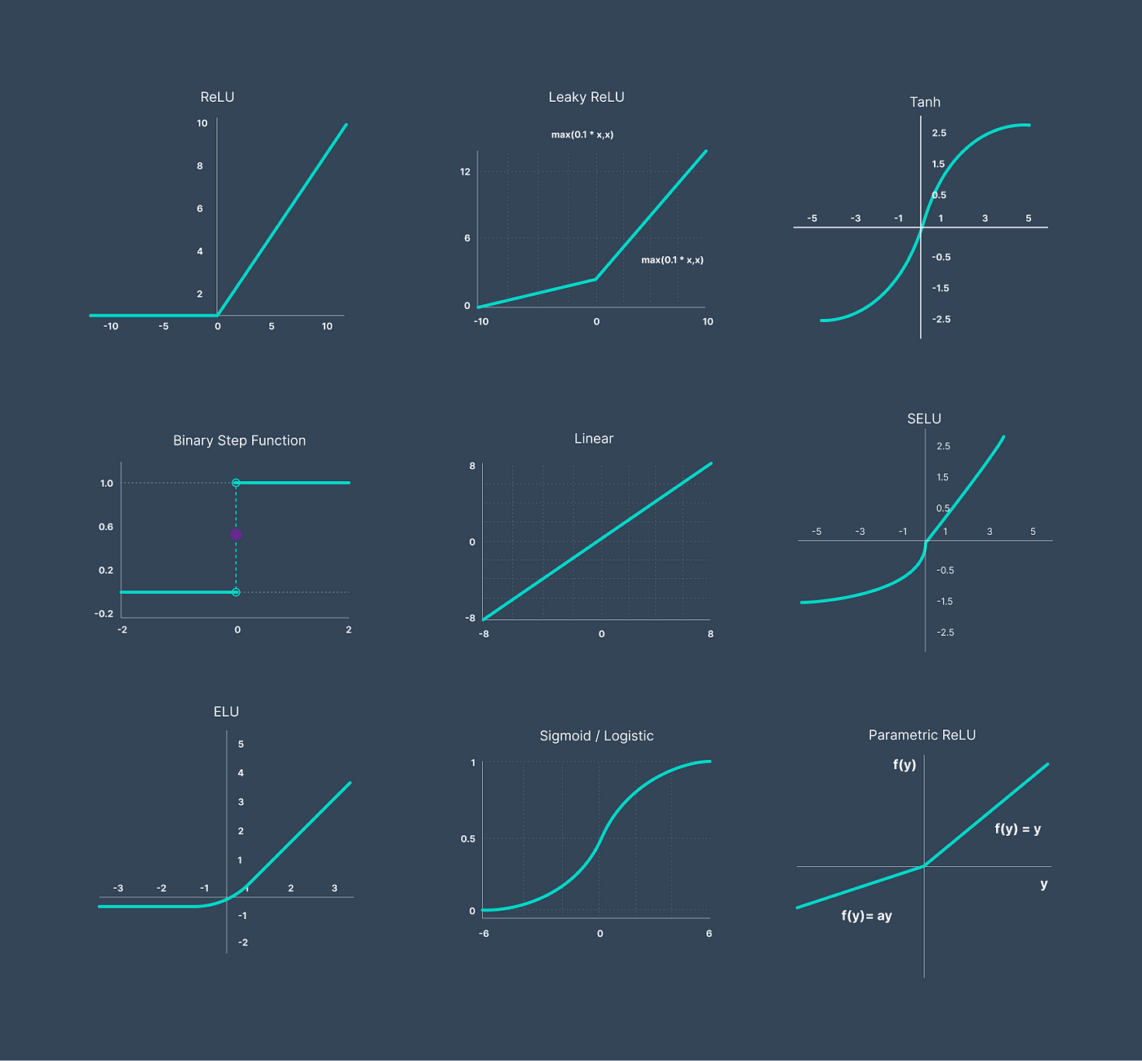
Supervised Machine Learning: Neural networks
How is this linearity introduced?
The nonlinearity comes from a new element that is introduced in the hidden neurons, called activation function
W₁
W₂
Bias term
1
Systolic BP
Weight
36

Slide 37
Supervised Machine Learning: Neural networks
How is this linearity introduced?
The nonlinearity comes from a new element that is introduced in the hidden neurons, called activation function
W₁
W₂
Bias term
1
Systolic BP
Weight
Neural networks can learn complex and nonlinear patterns.
However, you have to be careful: they tend to overfit much easier and, therefore, need a lot of data and careful regularization techniques to work well.
37

Slide 38
Best Deep Learning models for time series
Many variants of classical Neural Networks exist to deal with complex and structured data (such as images, graphs, or time series). These are the most suitable for the latter:
Recurrent Neural Networks (RNN)
1D Convolutional Neural Networks (1D CNN)
Long-Short Time Memory (LSTM)
Bidirectional LSTM
Gated Recurrent Units (GRU)
38

Slide 39
Creativity, Science and Innovation Thank you for your attention
November 14th, 2024
Alessandro Verosimile
alessandro.verosimile@polimi.it

Slide 40
40

Slide 41
41

Slide 42
42

Slide 43
43

Slide 44
44

