Slide 1
Credit Default Prediction
An End-to-End ML Pipeline
Training → Selection → Inference → Monitoring → Governance
Airflow
PySpark
MLflow
Evidently AI
Docker
Benny Teo

Slide 2




BACKGROUND & OBJECTIVE
Background — To predict whether a loan applicant will default, at the point of application, so credit decisions are data-driven and risk is minimized.
Objective — To develop an end-to-end machine learning (ML) model that performs the following:
Train ML models, evaluates and selects the best model for storage in model registry
Retrieves best ML model to predict whether a loan applicant will default or not at the point of application
Monitors the performance and stability of the model
01
02
03
04
Training
Selection
Inference
Monitoring & Governance
This deck focuses on the design decisions
Models training with metrics logged onto MLflow
Champion model selection based on AUC score
Monthly batch predictions with calibrated probabilities
PSI & CSI drift, performance monitoring, drift-triggered retrain

Slide 3
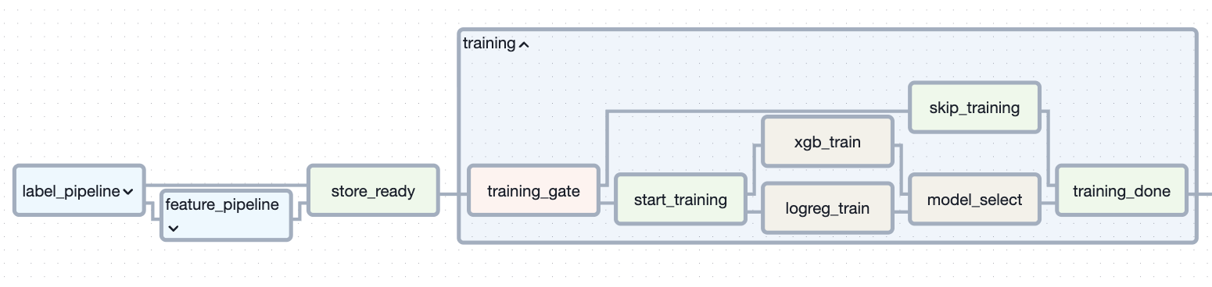

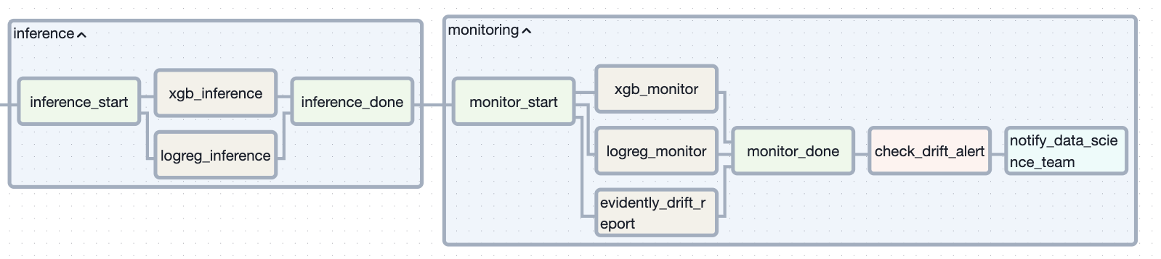

ORCHESTRATION
The end-to-end ML pipeline is orchestrated using Apache Airflow
Recap: Data pipelines (Features + Labels)
Bronze → Silver → Gold, per snapshot month
Training (branch)
Bootstrap once, then drift-triggered only
Inference
Prediction performed by Champion model
Monitoring
PSI / CSI / AUC Tracking + Monthly Report
Single DAG: Emphasis on Operational simplicity; Train → Infer → Monitor is enforced within every run, guaranteeing monitoring never reads stale predictions.
Parallel Training: Two models (XGBoost, Logistic Regression) are trained in parallel. Champion model will be selected based on AUC score, and monitoring will be performed subsequently.

Slide 4

TRAINING STRATEGY
Dataset: Spans Jan 23 to Dec 24. Based on application date, data from Jun 24 onwards, has no labels. Dates stated below are based on label / observed date.
Train · 10 mth
Test · 2 mth
OOT1 · 2 mth
For inference · 4 mth
Jun 23 → Apr 24
May 24 → Jun 24
Jul 24 → Aug 24
Sep 24 → Dec 24
Train/ Test / OOT Split
Considerations
Chronological split
No shuffling — prevents leakage of the future into the past.
OOT1 is the final pre-deployment checkpoint
Decides the champion model.
Considers recency to capture changing trends / model degradation (if any).
Label Lag
With MOB=6, labels will be revealed only 6 months later.
Training Gate
Training is first triggered on 1 Sep 24 (bootstrap month), training on dataset with labels from Jun 23 to Apr 24.
Retraining to be performed manually only after proper root cause analysis.
Model Selection
Logistic Regression: Higher Interpretability, Computationally more efficient.
XGBoost: Captures non-linear patterns better, Strong performance on structured/ tabular data, Robust to class imbalance, missing values and outliers.
XGBoost (0.92) scored higher than Logistic Regression (0.87) during our model training, hence selected as Champion model.

Slide 5

MODEL SELECTION
Results (OOT1) — XGBoost vs Logistic Regression
Why AUC?
Threshold Independence
Measures model’s ability to rank-order defaulters above non-defaulters, instead of setting a threshold which may differ during risk-averse periods vs risk-seeking periods.
The threshold to determine default will be a business decision, i.e. allows business to adjust its risk appetite independently of the model.
Robust against Class imbalance (~20% label rate)
Independent of class distribution of dataset.
Fair comparison between both models
XGBoost outputs scores based on decision tree margins instead of probabilities of default, unlike Logistic Regression (output true probabilities).
Calibration to be applied to XGBoost after selection for production use.
XGBoost wins on AUC (0.9217 vs 0.8712)
and is selected as the Champion model.

Slide 6

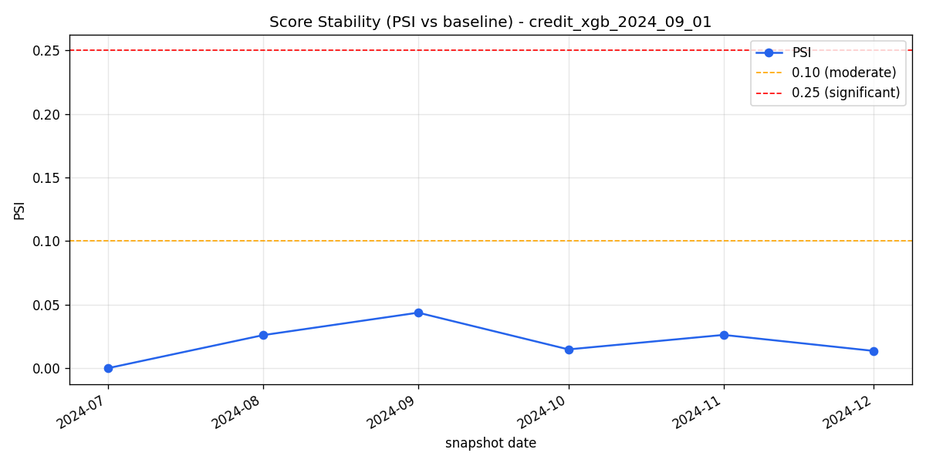
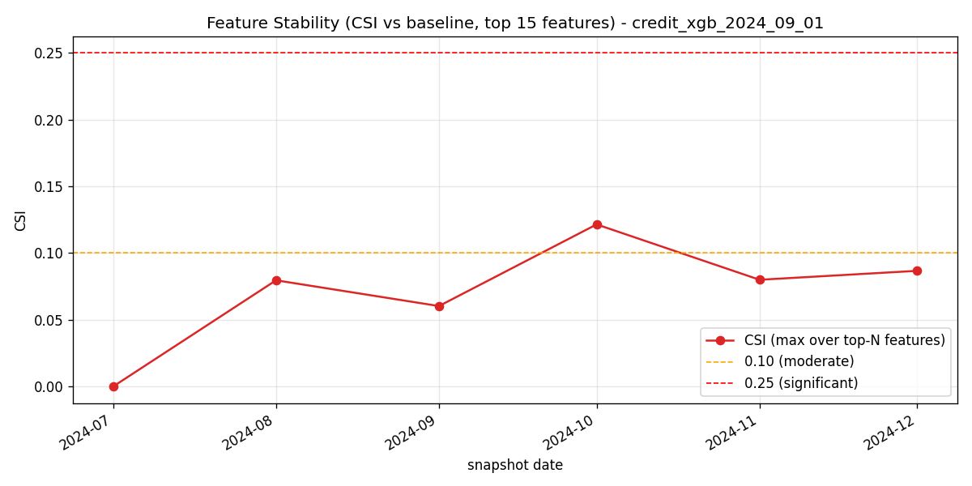
MONITORING. DRIFT
Tracks model and features behavior post-deployment (inference)
PSI — Model Drift
CSI — Feature Drift
Has the model's predicted-score distribution shifted vs the reference month (validated)?
Have the top 15 features' distribution shifted vs the reference month (validated)?
In the event of PSI / CSI exceeding threshold (0.25), the data science team will be notified via email by Apache Airflow. Investigation / Root cause analysis to be performed by the data science team before deciding to retrain the model.

Slide 7
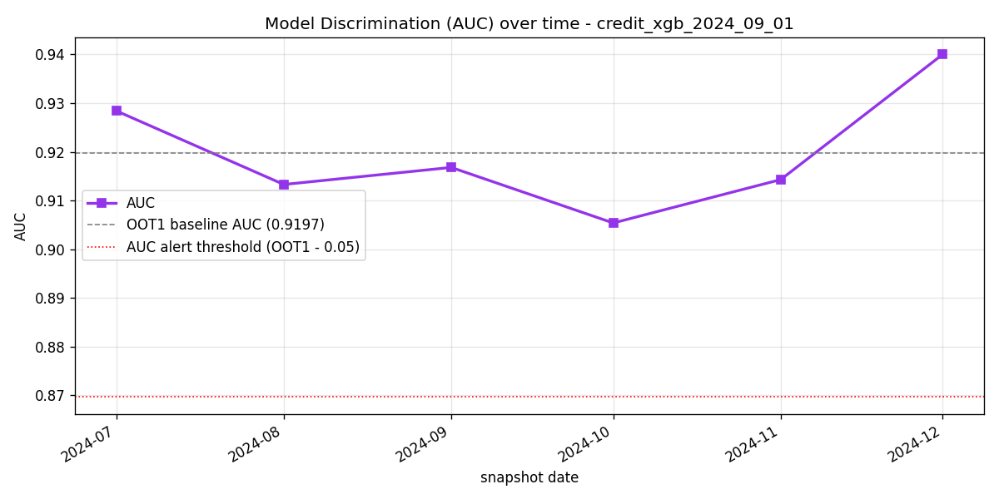
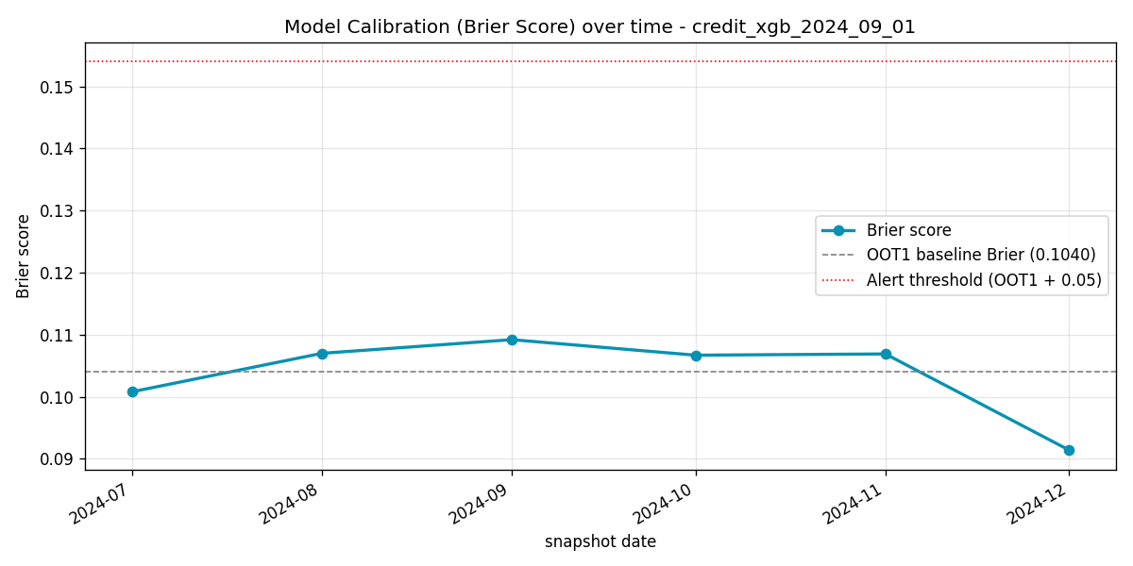
MONITORING. PERFORMANCE
Tracks model performance post-deployment (inference)
Performance Metrics – AUC and Brier Score
AUC Score
Measures rank-ordering capability, i.e. how clean is the separation between defaulters and non-defaulters.
Benchmark set as OOT1; Trigger alerts if drops by 0.05.
Brier Score
Measures the closeness of predicted probabilities to actual outcomes, i.e. how accurate and confident is the model’s estimates?
Benchmark set as OOT1; Trigger alerts if increase by 0.05 (lower the better).
XGBoost uses calibrated probabilities, while Logistic Regression uses raw probabilities.

Slide 8
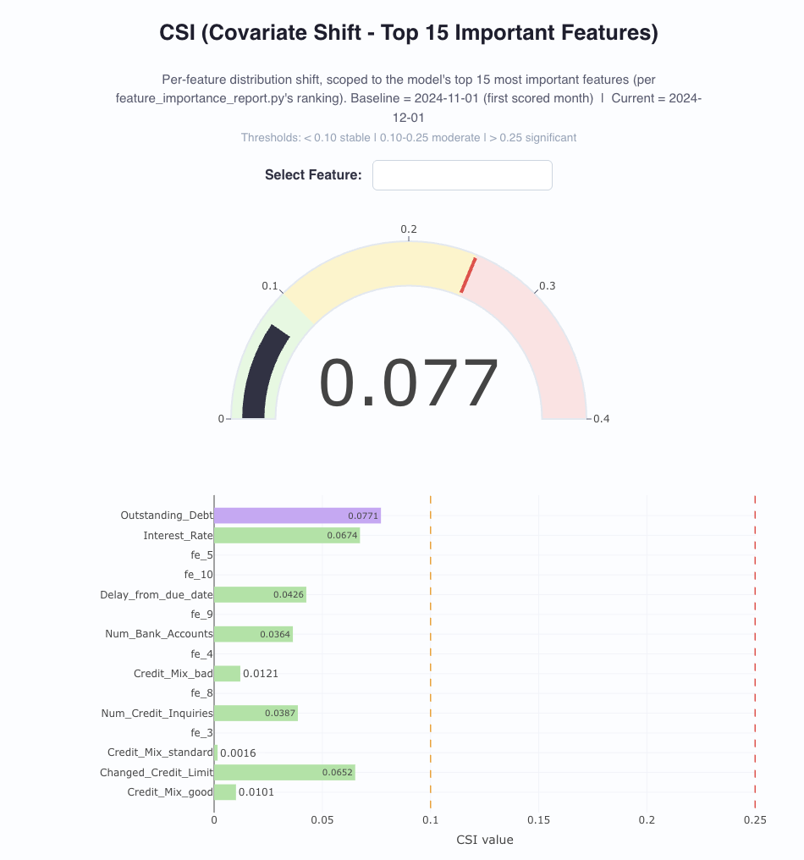

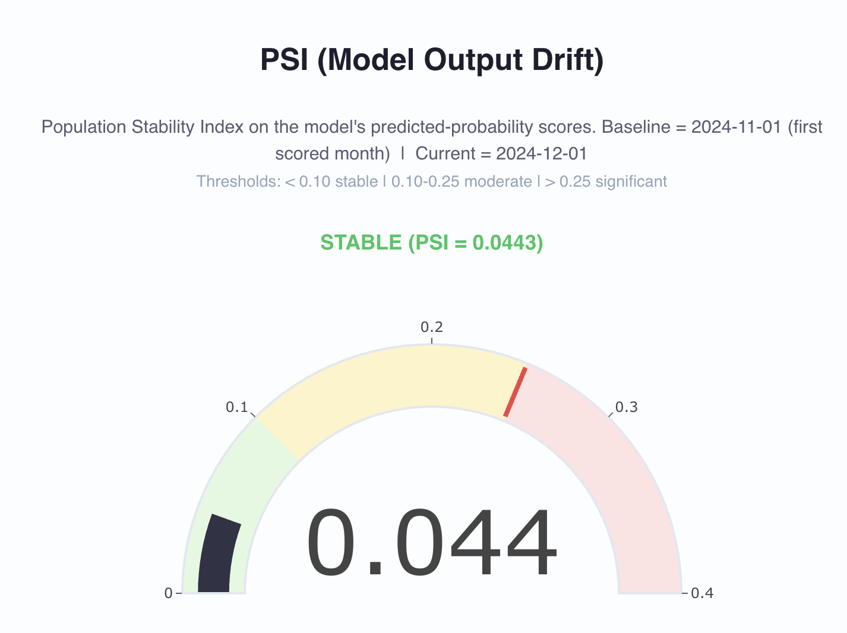
MONITORING · REPORTING
Evidently AI Reports
Evidently AI Reports
A polished, interactive HTML layer for presentation (PSI gauge, per-feature CSI, data summary) – allows high-level appreciation of model’s drift, features’ drift, data statistics such as mean, min, max, etc.

Slide 9

MODEL GOVERNANCE
Ensures proper management of deployed models in production environment with clear SOPs for evaluation, retraining and deployment.
Oct
Model Governance Framework
Nv
Retraining SOP
Dec
Deployment Strategy
Model Registry
Management of models with versions tracked using MLflow
Ensures reproducibility, auditability and history tracking
Model Selection
Champion is selected based on highest AUC during training stage
Model’s performance monitored after defined period, and alerts will be triggered if threshold is exceeded
Artifact Management
Model artifacts (pkl files) are stored in established and standardized storage
Criteria for Model Retraining
Model’s drift and performance will be continuously monitored
PSI / CSI drift > 0.25
AUC score drops by 0.05 or Brier score increases by 0.05 from defined date
Alert will be triggered to notify Data Science team for investigation / root cause analysis
Onus to retrain model lies in Head of Data Science (manual)
Business decisions such as regulation changes, requirement changes, e.g. integration of new tools or products.
Inference
Batch inference (monthly), threshold set to 0.5 with the flexibility to modify based on macro-economic conditions.
Deployment
Orchestrated via Apache Airflow
Supported by Data Science team with the flexibility to conduct various deployment strategies such as Blue/ Green, Canary, A/B or Shadow deployment.

Slide 10
CONCLUSION
End to end ML pipeline
Model Selection
Data pipeline → Model pipeline → Inference → Monitor
Champion model selection independent of macro-economic conditions
Automated alerts
Inference
Automated alert triggers if model degrades over time
Monthly batch inference to predict default
Performance Tracking
Operational simplicity
PSI, CSI, AUC and Brier Scores are monitored continuously
One DAG to orchestrate pipeline
Benny Teo · Credit Default ML Pipeline

