Slide 1

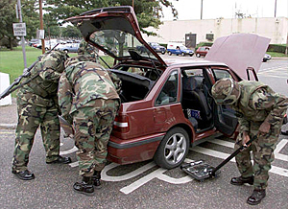
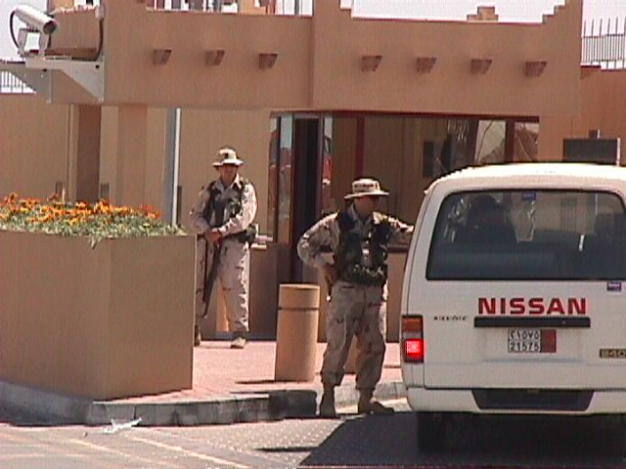
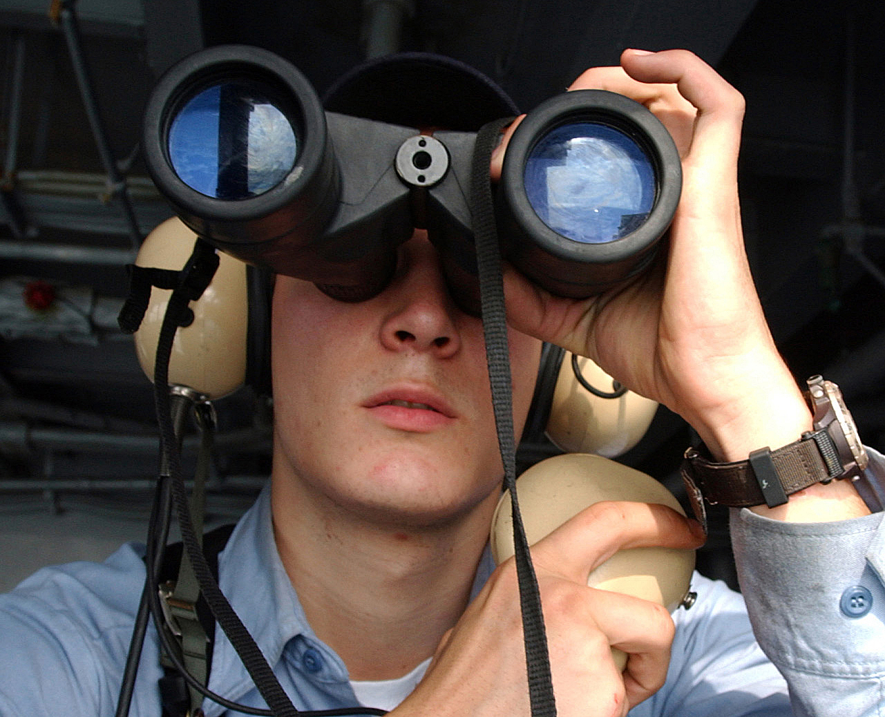
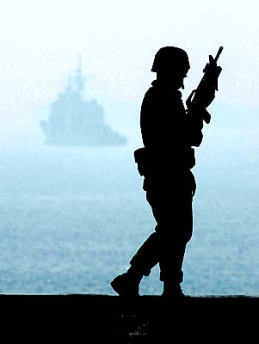
Force Protection Watches
301 - 305

Slide 2
Required Items for Sentry
- Must NOT have a record of Domestic Violence convictions or pending charges, and will be required to sign a statement of no domestic convictions (DD Form 2760, Dec. 2002),
- Must be physically fit and must have passed the last Physical Fitness Assessment (PFA) in accordance with OPNAVINST 6110.1 (series).

Slide 3
Required Items for Sentry
- Must have all 9mm and rifle weapons qualifications IAW OPNAVINST 3591.1 (series), i.e. NHQC, PWC, HLLC, RQC, and RLLC within the last year.

Slide 4
Force Protection
Force
  To do violence.
  To compel by physical or intellectual means.
  To achieve or win by strength in struggle or violence.
Deadly Force
  Force that a person uses causing, or that a person knows or should know, would create a substantial risk of causing death or serious bodily harm.

Slide 5
Force Protection
Serious Bodily Harm
  Does not include minor injuries, such as a black eye or a bloody nose, but does include fractured or dislocated bones, deep cuts, torn members of the body, serious damage to the internal organs and other life-threatening injuries.
Imminent
  The determination of whether a particular threat or danger is “imminent” is based on assessment of all circumstances known at the time.
    Imminent does not necessarily mean “immediate” or “instantaneous”.

Slide 6
Mental Preparation
Combat Mindset – Training of mental preparation is the foundation to a successful outcome in a conflict.
  You must recognize the real dangers inherent with armed or physical confrontations and the importance of being mentally prepared.
    Always plan for worst-case scenario.
  Training prepares us to properly react to situations or violent confrontation, which may require the Use of Force up to, and including, Deadly Force.

Slide 7
Combat Mindset cont.
Alertness – Remain focused on any possible threat to avoid surprise; always be prepared for worst case, and aware of what is around you (i.e., behind you).
  Mentally prepared for a violent confrontation.
  Looking for violent confrontation.
  Expecting a violent confrontation.
  Ready to react to a violent confrontation.

Slide 8
Combat Mindset cont.
Decisiveness – Determine a course of action and follow through with that decision.
  Never hesitate when the “Use of Force” or “Deadly Force” has been decided upon (Act/React).
Aggressiveness – Once the decision is made for the “Use of Force”, don’t stop until you have gained control of the situation.

Slide 9
Combat Mindset cont.
Speed of Action – Your actions should be deliberate, smooth, and fast; end the action before the subject (adversary) knows its over.
Self Control – Stay focused, having a mental presence of mind to deal with one problem at a time.
  If loss of control occurs; potential for loss of life is great.
  Aggressive force does not mean excessive force.
  Be calm, controlled and precise.

Slide 10
Combat Mindset Cont.
Determination – Is the ability to use power and resources without reservation to stop the threat.
  Actions must be IAW rules for the “Use of Force”.
  Once force has been decided upon, don’t be kind, be tough and determined. Above all…
  Be in control!

Slide 11
Types of Subjects
Personnel may encounter two general types of subjects:
  PASSIVE - Person does NOT physically resist.
  ACTIVE - Person who physically resists.

Slide 12
Types of Subjects
Passive Compliant
  Will follow task directions.
  Subject is cooperative and complies.
  Likelihood of a physical response is low.
  Controlled through presence & verbalization.
Passive Resistor
  Will not follow task direction; non-responsive/uncooperative.
  Passively or defensively resists; but, shows no physical actions to interfere (i.e., dead weight/peaceful protest).
  May require physical contact to elicit compliance.

Slide 13
Types of Subjects
Active Resistor
  Will not follow task direction.
  Physically resists; but DOES NOT ATTACK.
    Active resistance and/or aggression.
  Subject exhibits physical defiance and is attempting to interfere with security force actions.
    Inflicting pain or physical injury to security force member without a weapon or object.
      Bracing, pulling away, kicking, scratching, etc.

Slide 14
Types of Subjects
Active Aggressor
  Will not follow task direction; Physically Attacks.
  Assault or Threat of Assault:
    Subject assumes a fighting stance and/or charges.
    Verbally/physically indicates intent to commit assault.
  Life Threatening Assault:
    Commits an attack using an object/weapon.
    Commits an empty hand assault, wherein the security force member reasonably believes the assault will result in serious physical injury and/or death.

Slide 15
Ladder of Force
M-9 PISTOL
M-16 RIFLE
SHOTGUN
PASSIVE SUBJECT
MACH TAKEDOWNTECHNIQUE
OC-SPRAY
EMPTY HAND STRIKES
BATON
MWD
6. DEADLY FORCE
ESCORTS
HANDCUFFS
FLEXI-CUFFS
5. INTERMEDIATE WEAPON
4. HARD CONTROL
PERSONAL COMMS SKILLS
3. SOFT
CONTROL
ACTIVE SUBJECT
UNIFORM
U.S. FLAG
2. VERBAL COMMANDS
1. PRESENCE

Slide 16
Ladder of Force
Level 1 – Presence
  Display of Authority – Interview stance
  Physical presence compels compliance (e.g., body language, demeanor, and manner of approach).
  Uniform appearance (armed watch-stander).
  Warship presence (U.S. Flag)
  Non-verbal communications skill.

Slide 17
Ladder of Force
Level 2 – Verbal Commands
  Voice commands given by an individual in an attempt to control a situation.
    (e.g., personal communication skills).
  Always include Consequences for non-compliant personnel with instructions.
    (i.e., “If you don’t …, I will be forced to …”)
  Be reasonable in your commands.
  Use a clear, authoritative voice.
  Commands should be easily understood.

Slide 18
Ladder of Force
Level 3 – Soft Control (Restraining/Detaining)
  Soft Control Techniques are intended to bring a subject under control with a low probability of causing soft or connective tissue damage, lacerations of the skin, or bone fractures.
  Examples may include:
    Laying hands on a subject to gain control; an escort position or control hold (joint manipulation).
    Application of restraints; flexi-cuffs, leg restraints, and steel handcuffs.

Slide 19
Ladder of Force
Level 4 – Hard Control (Compliance Techniques)
  Hard Control techniques are intended to bring a subject under control with a probability of causing soft or connective tissue damage, lacerations of the skin or bone fractures.
  Examples may include:
    OC-Spray, MACH takedown techniques and/or empty hand punches, strikes, kicks, etc.
    May involve an intermediate weapon in control type configuration (i.e., MACH Baton Technique).
      NOT as an impact weapon!

Slide 20
Ladder of Force
Level 5 – Intermediate Weapons
  Intermediate weapon techniques are intended to bring a subject under control with a high probability of causing soft or connective tissue damage, lacerations of the skin or bone fractures.
  Examples may include:
    Expandable Baton
    Military Working Dog (MWD)

Slide 21
Ladder of Force
Level 6 – Deadly Force
Last Resort!
1
2
CAPABILTY
12 Ga Shotgun
OPPORTUNITY
M-9 Pistol
M-16 Rifle
INTENT
3

Slide 22
Deadly Force Triangle
Capability – The ability or means to inflict death or serious bodily harm, or the “hands-on” ability to place or attach explosives on vital assets, or High Value Assets (HVA).
  A hostile, dangerous or suspicious person possess the actual ability to inflict death or serious bodily harm to another person; such as…
GUN KNIFE CLUB
  Or, an object which can be utilized in a manner resulting in death or serious bodily harm to personnel, or damage to vital assets.

Slide 23
Deadly Force Triangle
Opportunity – Is established when a weapon or explosive device is in effective range to cause death or serious bodily harm to DoD personnel or designated assets; i.e.,
  U.S. Navy personnel, another service member or High Value Asset (HVA) is in the effective range of a weapon, weapon system, or IED.

Slide 24
Deadly Force Triangle
Intent – Demonstrated through aggressive actions or lack of compliance the desire or willingness to cause death, serious bodily harm or damage to vital assets; i.e.,
  A hostile, dangerous, or suspicious person demonstrates through aggressive actions or display of a weapon in a threatening manner the willingness to cause death or serious bodily harm.
  Indicators that may help in determining hostile intent;
    Intelligence reports
    Failure to respond or react to hails/warnings
    Evading Security Forces
    Driving at high speed toward HVA or ECP
    Displaying weapons

Slide 25
Guidance for the use of Firearms
In case of holstered weapons, a weapon should not be removed from the holster unless there is reasonable expectation that use of the weapon may be necessary.
  NOTE: Drawing the weapon (although drawn with reasonable expectation of use) does not mean the individual MUST use the weapon.
  Anytime your weapon is drawn, it must be document and reported IAW the unit’s “Rules, Regulations, and Procedures (RRP).

Slide 26
Conditions for the use of Deadly Force
Self-Defense and Defense of Others.
Assets Vital to National Security.
Assets NOT Involving National Security but Inherently Dangerous to Others.
Serious Offenses Against Persons.
National Critical Infrastructure
  Protect Public Health or Safety.
Escape.
Arrest or Apprehension.

Slide 27
Personnel Search
Entry Control Point
  Arrange a covert code with your cover sentry.
  Establish reactionary zone.
  Establish triangulation position in relation to person.
  Monitor person's) eye/body movements.

Slide 28
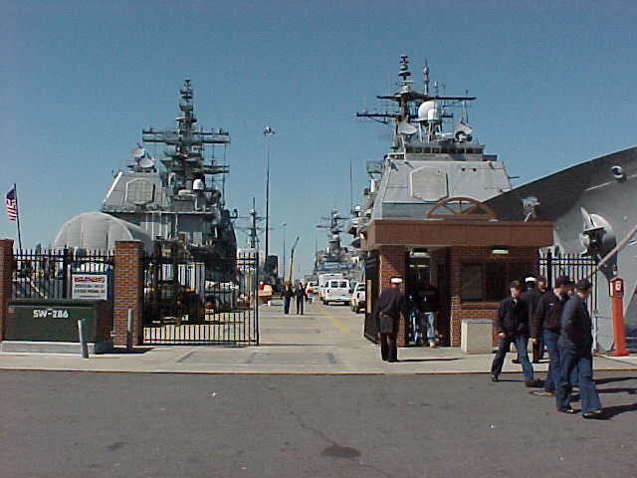
Initial Contact
Initial Contact
  Make eye contact.
  Signal person to halt.
  Greet pedestrian; inform them that a personnel inspection is being conducted.
Direct the person to inspection point.
Ask for Identification (ID) of person.
  Check ID.
  Match picture on ID to bearer.
  Ensure ID is authentic.
  DO NOT return ID card until inspection complete.

Slide 29
Initial Contact

Slide 30
Initial Contact
Ask person if there is anything that should be declared prior to starting the inspection.
Have person open all carried items.
Direct person to step away from the baggage.
Note time inspection starts; then begin search.

Slide 31
Inspection
Utilize a systematic search procedure
  Instruct individual to remove jacket, hat and any items in remaining clothing, including their pockets or items that are attached to clothing.
    Place all removed items on the table.
    Have person step back away from table.

Slide 32
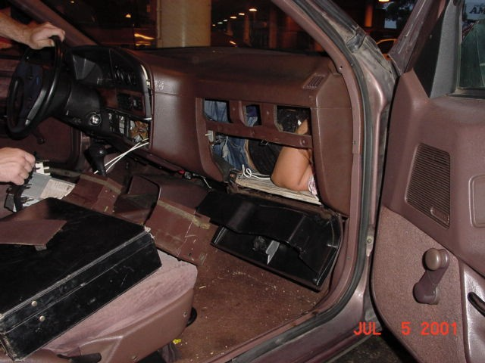
Inspections

Slide 33
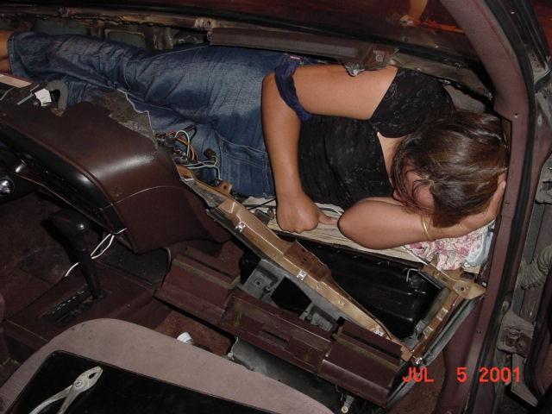
Inspections

Slide 34
Inspection
Squeeze Search
  Direct individual to turn facing away from you.
    Raise arms to shoulder height, palms up.
    Feet spread shoulder width apart.
    Individual will remain in this position until the search is complete.
  While standing = Facing the back of the individual.
    Inspect the collar/neck area of the clothing.
    Place thumbs inside collar, using a squeezing motion move around the entire neck area of the garment.

Slide 35
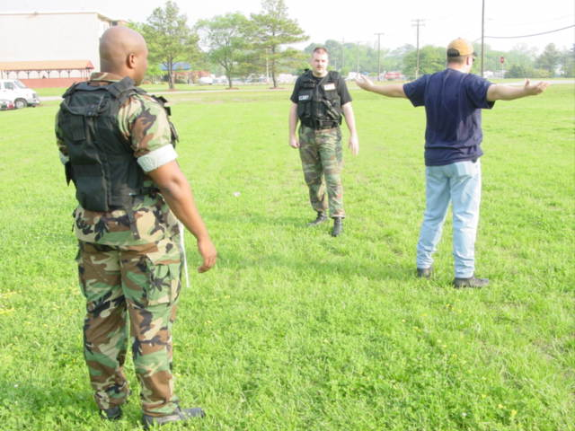

Inspection
Squeeze Search (Cont…)
  Move hands out and over the shoulders.
    Move down the arms.
    Then back underneath arms.
    Stopping after inspecting armpits.
  Move hands over the upper torso of the body.
    Begin with upper chest
    Moving around to upper back.

Slide 36
Inspection
Squeeze Search (Cont…)
  Search individual’s lower abdomen.
    Slowly moving around to the small of the back.
  Inspect beltline.
    Place thumbs inside beltline; using a squeezing motion inspect the entire beltline from back to front.
    Check front pockets, hips, rear pockets, & tailbone area.
  Inspect crotch area.

Slide 37
Inspection
Squeeze Search (Cont…)
  Inspect one leg at a time.
    Start with one hand on buttocks just below beltline and one hand in front (mid-body) just above beltline.
    Slowly move down each leg using squeezing motion on all sides to the cuffs.
  Be aware of anything unusual in the shoes.
  Note time of inspection completion.

Slide 38
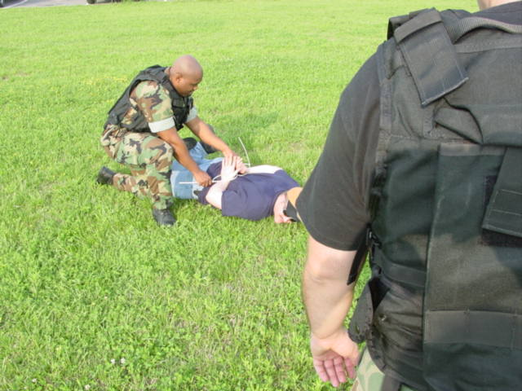
Inspection
If something is found:
  Alert cover man (Covertly)
  Note time of inspection completion.
  Notify Chief of the Guard.
  Secure the person.
  Secure and evacuate the area (if applicable)
  Make appropriate log book entries as necessary.

Slide 39
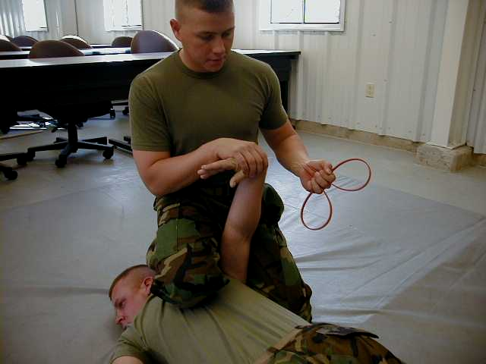
Inspection

Slide 40
Inspection
If nothing is found:
  Return the individuals ID card.
  Thank the person for their cooperation.
  Note time of inspection completion.
  Make appropriate log book entries as necessary.

Slide 41
Review and Summary
Requirements for Sentry
Combat Mindset
Deadly Force Triangle
Inspections
Ladder of Force
Watch Standing

Slide 42

Questions

