Slide 1
CashFusion
Flexible Arbitrary-input Consolidation COinJoinS**

Slide 2
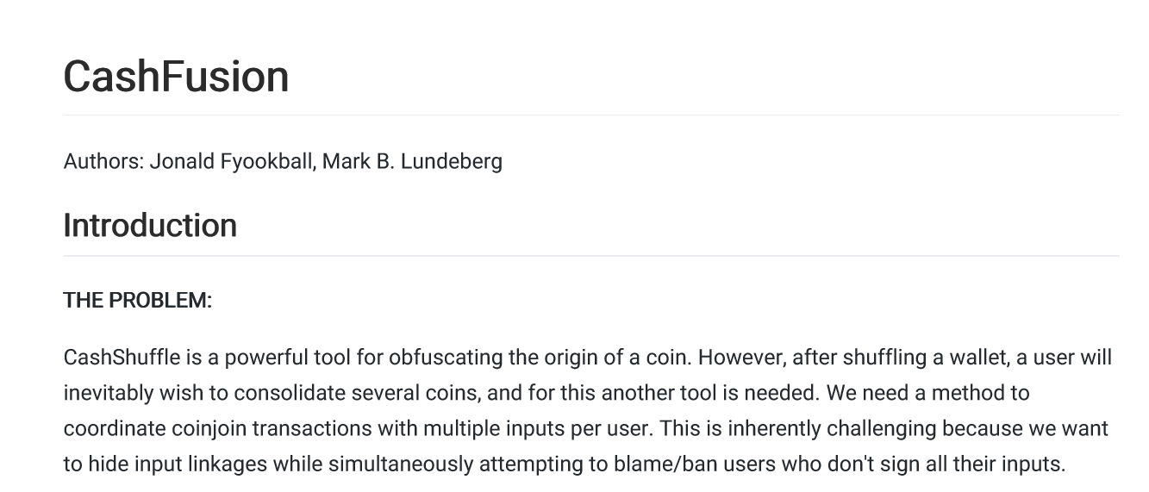
Fyookball and Lundeberg (2019)
https://github.com/cashshuffle/spec/blob/master/CASHFUSION.md

Slide 3
Wasabi Research Club
January 6th, 2020 – Knapsack CoinJoin
January 13th, 2020 – SNICKER
January 20th, 2020 – CoinShuffle
January 27th, 2020 – Dining Cryptographer Networks
February 3rd, 2020 – CoinShuffle ++ (Part 1)
Feburary 10th, 2020 – CoinShuffle ++ (Part 2, w/ Tim Ruffing)
Feburary 17th, 2020 – CashFusion
February 24th, 2020 – TBD
https://github.com/zkSNACKs/WasabiResearchClub

Slide 4
The last three weeks- CoinShuffle(++)
One issue with CoinJoin implementations is the reliance on a central coordinator. Removing the coordinator would require a secure method of participants declaring their anonymous addresses
We can replace the coordinator with a CoinShuffle, where each participant onion-encrypts their address with the public keys of the latter participants. They then decrypt and shuffle all encrypted addresses they have received with their own address, and proceed to hand off the encrypted addresses to the next participant.
Scales poorly with many participants, ElectronCash(5)
CoinShuffle++ adds to the protocol by introducing a DC-nets protocol that can handle collisions and disruptions in just 4+2f rounds, given f peers.

Slide 5
The problem(s)
When users CoinJoin with CashShuffle (or any protocol for that matter) they typically get many coins of equal denominations.
We need a private way for users to consolidate arbitrary number of coins without revealing input ownership.
The protocol should not rely on a central coordinator.
The protocol should allow for arbitrary outputs of arbitrary amounts.

Slide 6
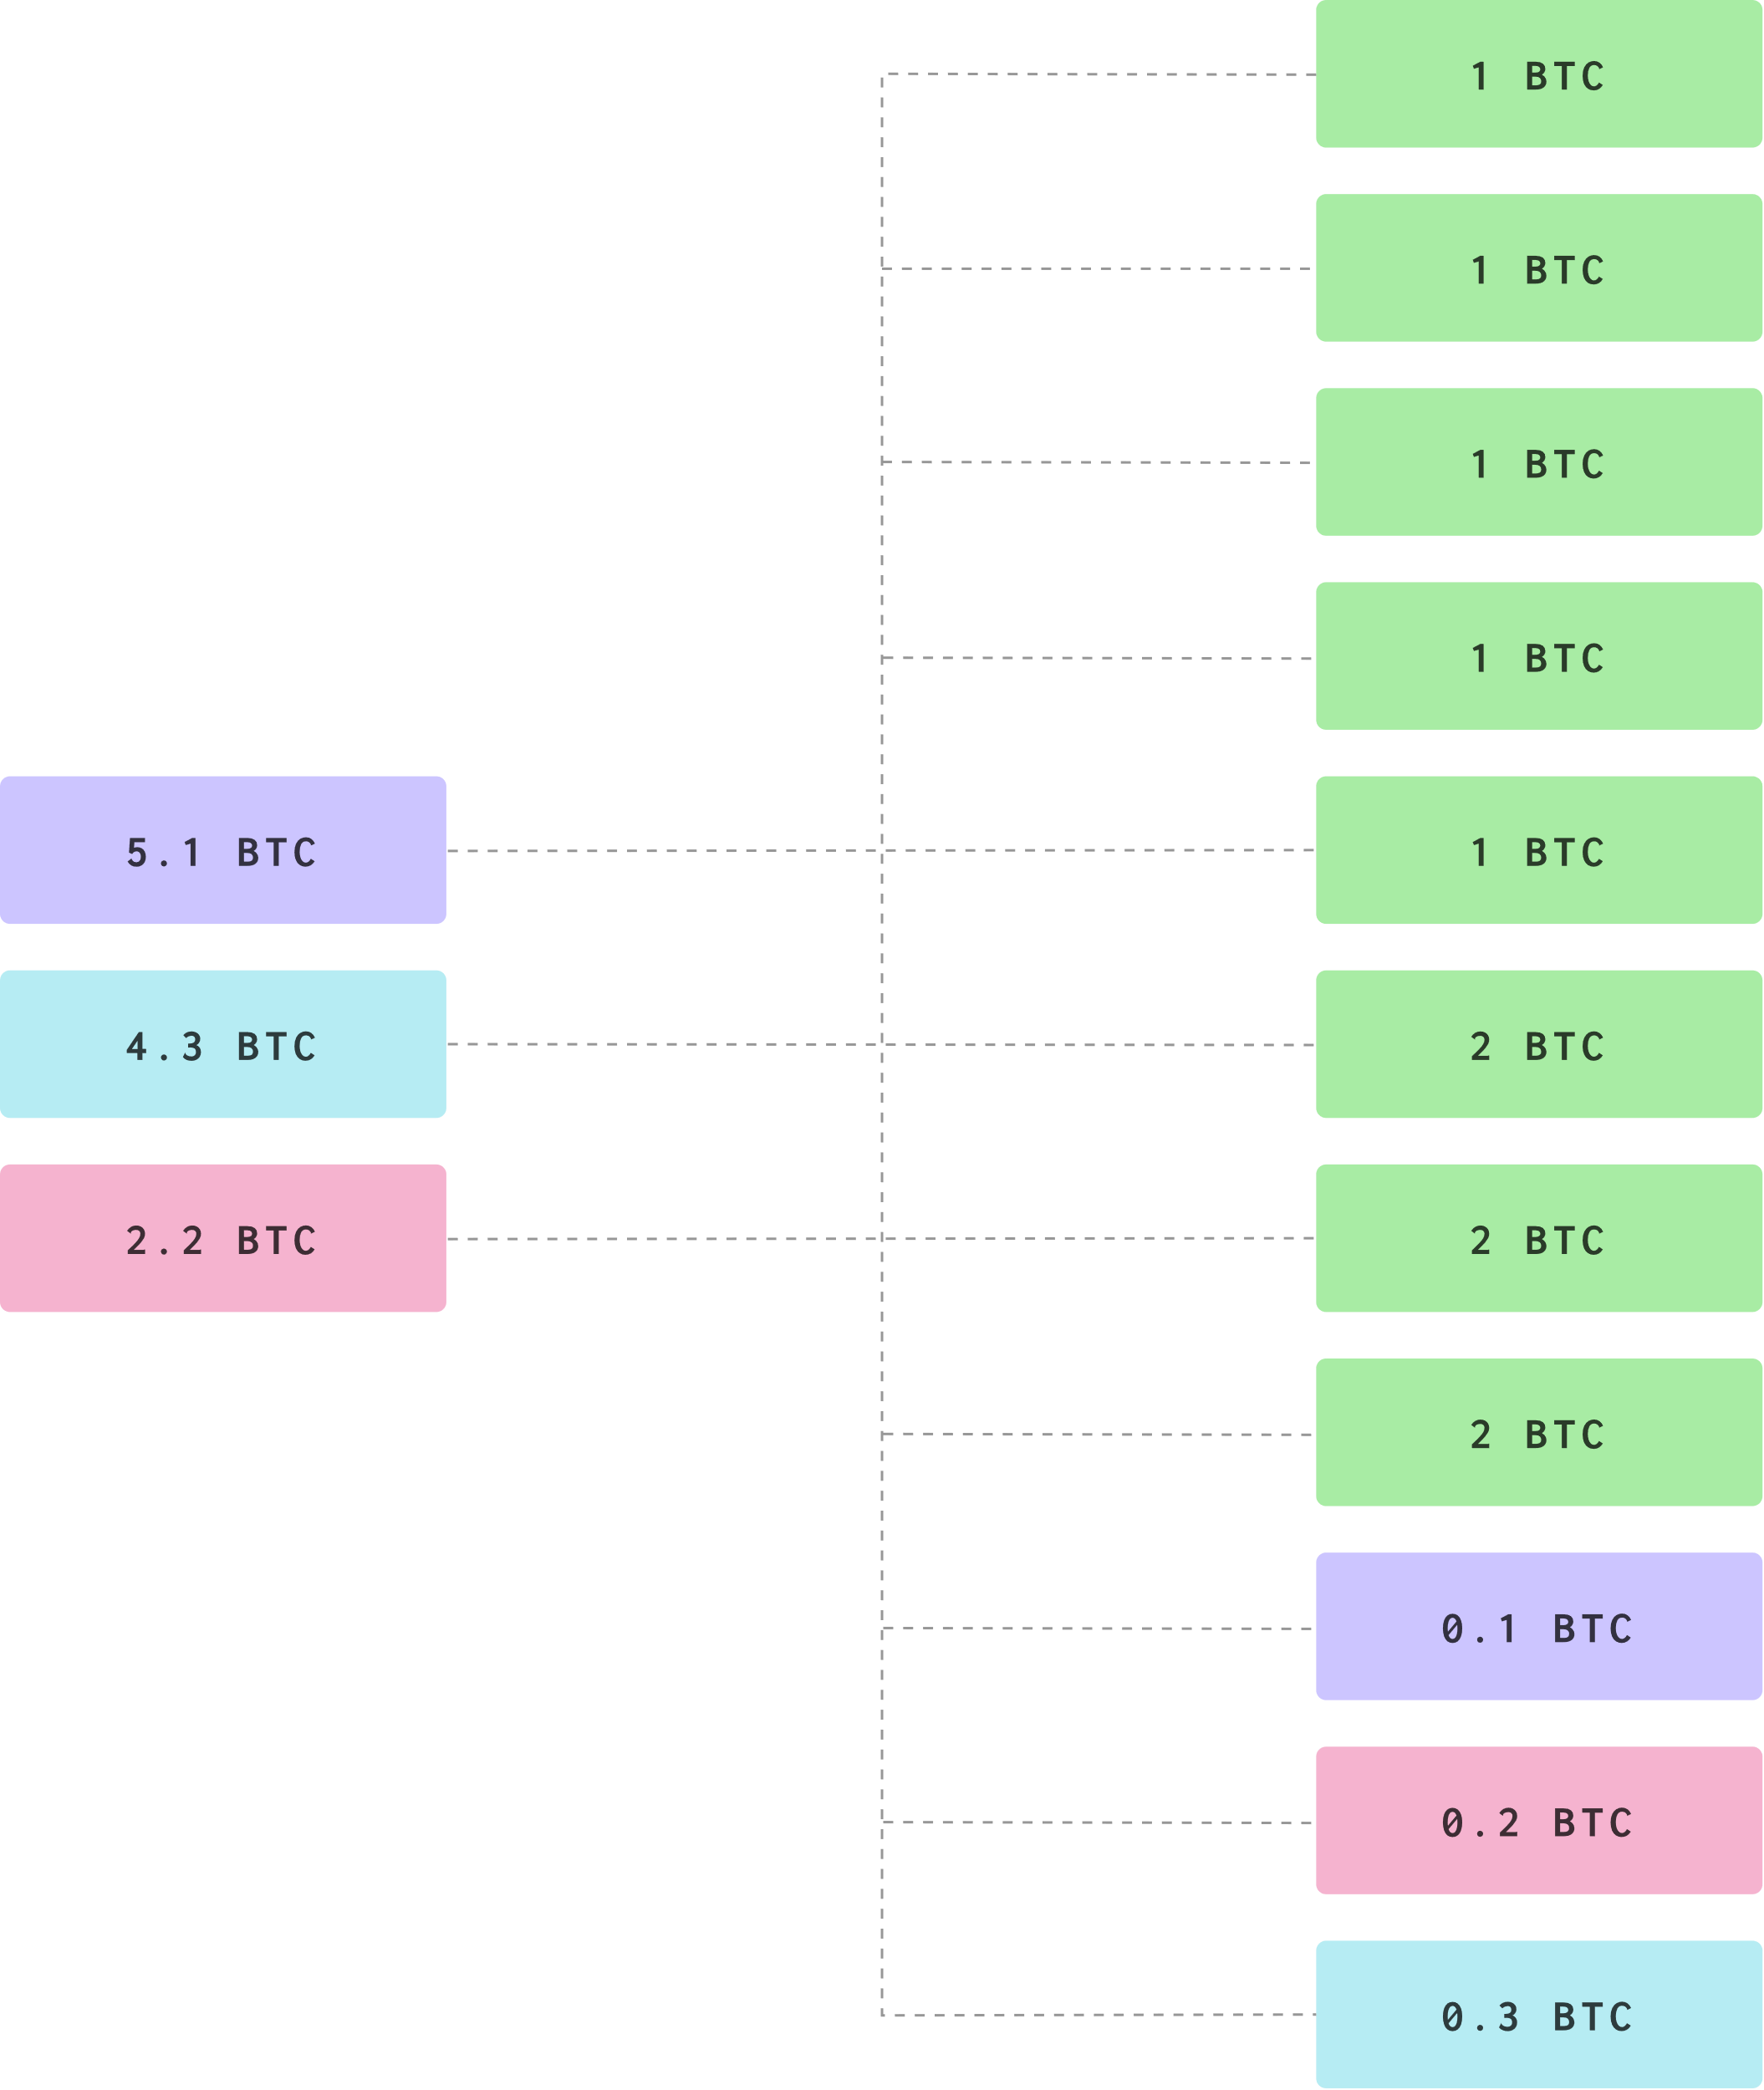
The problem(s)

Slide 7
The problem(s)

Slide 10
The problem(s)
${CJ}_{0},{CJ}_{1}$ ${CJ}_{2},{CJ}_{3},…,{CJ}_{n−2}{CJ}_{n−1},{CJ}_{n}$

Slide 11
The problem(s)
${CJ}_{0},{CJ}_{1}$ ${CJ}_{2},{CJ}_{3},…,{CJ}_{n−2}{CJ}_{n−1},{CJ}_{n}$

Slide 12
The problem(s)
${CJ}_{0},{CJ}_{1}$ ${CJ}_{2},{CJ}_{3},…,{CJ}_{n−2}{CJ}_{n−1},{CJ}_{n}$

Slide 13
The problem(s)
${CJ}_{0},{CJ}_{1}$ ${CJ}_{2},{CJ}_{3},…,{CJ}_{n−2}{CJ}_{n−1},{CJ}_{n}$

Slide 14
The problem(s)
${CJ}_{0},{CJ}_{1}$ ${CJ}_{2},{CJ}_{3},…,{CJ}_{n−2}{CJ}_{n−1},{CJ}_{n}$

Slide 15

The problem(s)
${CJ}_{0},{CJ}_{1}$ ${CJ}_{2},{CJ}_{3},…,{CJ}_{n−2}{CJ}_{n−1},{CJ}_{n}$
$$P_{0}=\left\{{CJ}_{i};i∈\{0,1,3,n−2\}\right\}$$

Slide 16

The problem(s)
${CJ}_{0},{CJ}_{1}$ ${CJ}_{2},{CJ}_{3},…,{CJ}_{n−2}{CJ}_{n−1},{CJ}_{n}$
$$P_{0}=\left\{{CJ}_{i};i∈\{0,1,3,n−2\}\right\}$$

Slide 17
The problem(s)
${CJ}_{0},{CJ}_{1}$ ${CJ}_{2},{CJ}_{3},…,{CJ}_{n−2}{CJ}_{n−1},{CJ}_{n}$
$$P_{0}=\left\{{CJ}_{i};i∈\{0,1,3,n−2\}\right\}$$

Slide 18
The problem(s)
${CJ}_{0},{CJ}_{1}$ ${CJ}_{2},{CJ}_{3},…,{CJ}_{n−2}{CJ}_{n−1},{CJ}_{n}$
$$P_{0}=\left\{{CJ}_{i};i∈\{0,1,3,n−2\}\right\}$$

Slide 19
The problem(s)
${CJ}_{0},{CJ}_{1}$ ${CJ}_{2},{CJ}_{3},…,{CJ}_{n−2}{CJ}_{n−1},{CJ}_{n}$
$$P_{0}=\left\{{CJ}_{i};i∈\{0,1,3,n−2\}\right\}$$

Slide 20
The problem(s)
${CJ}_{0},{CJ}_{1}$ ${CJ}_{2},{CJ}_{3},…,{CJ}_{n−2}{CJ}_{n−1},{CJ}_{n}$
$$P_{0}=\left\{{CJ}_{i};i∈\{0,1,3,n−2\}\right\}$$

Slide 21

The problem(s)
${CJ}_{0},{CJ}_{1}$ ${CJ}_{2},{CJ}_{3},…,{CJ}_{n−2}{CJ}_{n−1},{CJ}_{n}$
$$P_{0}=\left\{{CJ}_{i};i∈\{0,1,3,n−2\}\right\}$$
$$P_{1}=\left\{{CJ}_{i};i∈\{1,2,3,n−1,n\}\right\}$$

Slide 22



The problem(s)
The problem(s)
${CJ}_{0},{CJ}_{1}$ ${CJ}_{2},{CJ}_{3},…,{CJ}_{n−2}{CJ}_{n−1},{CJ}_{n}$
$$P_{0}=\left\{{CJ}_{i};i∈\{0,1,3,n−2\}\right\}$$
$$P_{1}=\left\{{CJ}_{i};i∈\{1,2,3,n−1,n\}\right\}$$
$$P_{2}=\left\{{CJ}_{i};i∈\{1, 3,n−2,n\}\right\}$$

Slide 23





The problem(s)
The problem(s)
${CJ}_{0},{CJ}_{1}$ ${CJ}_{2},{CJ}_{3},…,{CJ}_{n−2}{CJ}_{n−1},{CJ}_{n}$
$$I=\left\{{CJ}_{i};i∈\{2,3,n−1\}\right\}$$
$$O$$
$$P_{0}=\left\{{CJ}_{i};i∈\{0,1,3,n−2\}\right\}$$
$$P_{1}=\left\{{CJ}_{i};i∈\{1,2,3,n−1,n\}\right\}$$
$$P_{2}=\left\{{CJ}_{i};i∈\{1, 3,n−2,n\}\right\}$$

Slide 24

The problem(s)
The problem(s)
${CJ}_{0},{CJ}_{1}$ ${CJ}_{2},{CJ}_{3},…,{CJ}_{n−2}{CJ}_{n−1},{CJ}_{n}$
$$I=\left\{{CJ}_{i};i∈\{2,3,n−1\}\right\}$$
$$O$$
$$P_{0}=\left\{{CJ}_{i};i∈\{0,1,3,n−2\}\right\}$$
$$P_{1}=\left\{{CJ}_{i};i∈\{1,2,3,n−1,n\}\right\}$$
$$P_{2}=\left\{{CJ}_{i};i∈\{1, 3,n−2,n\}\right\}$$

Slide 25
The problem(s)
The problem(s)
${CJ}_{0},{CJ}_{1}$ ${CJ}_{2},{CJ}_{3},…,{CJ}_{n−2}{CJ}_{n−1},{CJ}_{n}$
$$I=\left\{{CJ}_{i};i∈\{2,3,n−1\}\right\}$$
$$O$$
$$P_{0}=\left\{{CJ}_{i};i∈\{0,1,3,n−2\}\right\}$$
$$P_{1}=\left\{{CJ}_{i};i∈\{1,2,3,n−1,n\}\right\}$$
$$P_{2}=\left\{{CJ}_{i};i∈\{1, 3,n−2,n\}\right\}$$

Slide 26
Fyookball and Lundeberg (2019)
https://github.com/cashshuffle/spec/blob/master/CASHFUSION.md

Slide 27
Questions?

Slide 28
The problem(s)
${CJ}_{0},{CJ}_{1}$ ${CJ}_{2},{CJ}_{3},…,{CJ}_{n−2}{CJ}_{n−1},{CJ}_{n}$

Slide 29

The problem(s)
$W_{0},W_{1}$ $W_{2},W_{3},…,W_{n−2}W_{n−1},W_{n}$
o = 9
i = 21
o = 10
i = 19
o = 10
i = 10
o = 10
o = 11
Use the public key from a previous transaction

