Slide 1
CoinShuffle
Practical Decentralized Coin Mixing for Bitcoin

Slide 2
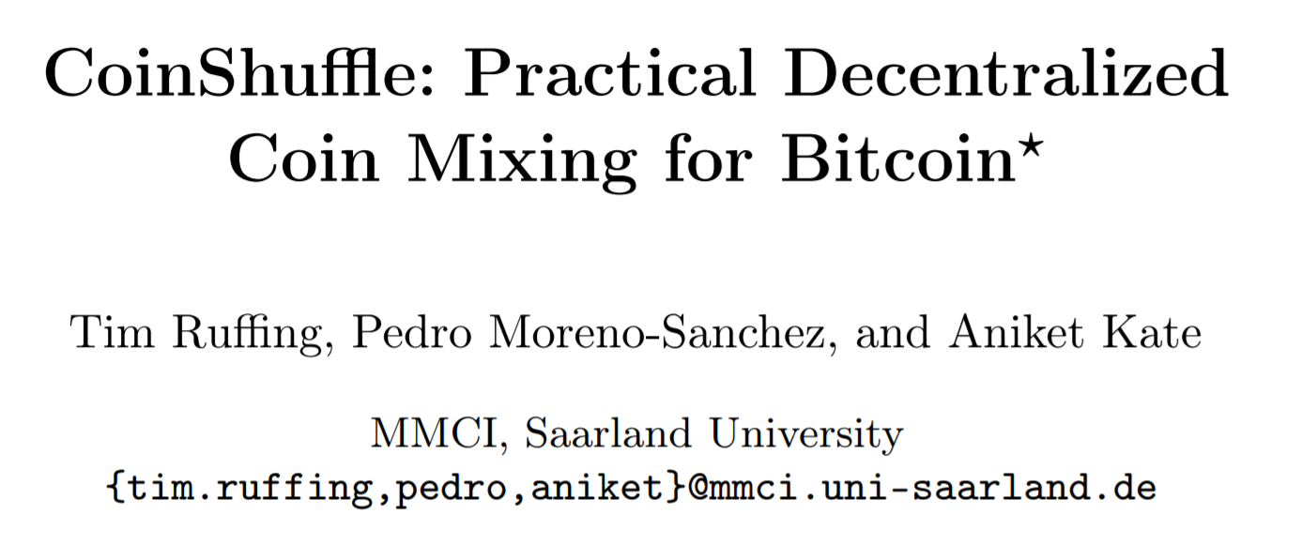
CoinShuffle (2014) Ruffing, Moreno-Sanchez and Kate
https://petsymposium.org/2014/papers/Ruffing.pdf

Slide 3
Last week – SNICKER Coinjoin
Summary of SNICKER CoinJoin idea:
Non-interactive CoinJoins are possible between two participants if the proposer assumes likely UTXOs and tweaks a revealed public key with a Diffie-Hellman shared secret. PSBT of this form can be broadcast to a public forum and then signed when possible by the other party.

Slide 4
Wasabi Research Club
January 6th, 2020 – Knapsack CoinJoin
January 13th, 2020 – SNICKER
January 20th, 2020 – CoinShuffle
January 27th, 2020 – TBD
https://github.com/zkSNACKs/WasabiResearchClub

Slide 5
Problem with current CoinJoins
Interactive (requires a server)
Could reduce the privacy of users
Difficult to coordinate many participants
Fragile to attack (central point of failure)

Slide 6
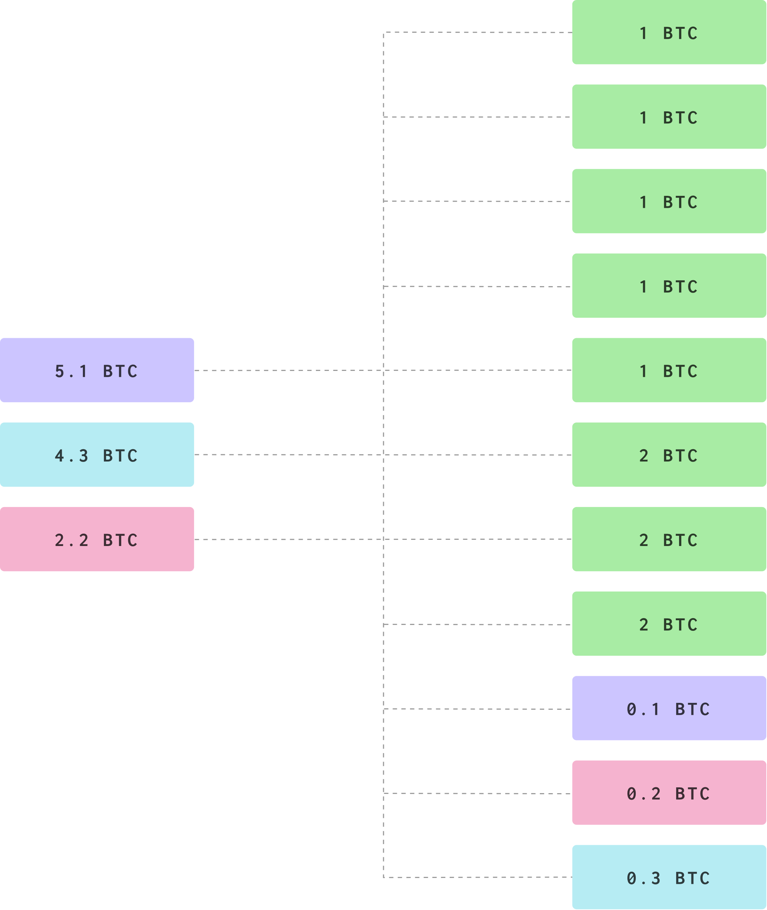
Could a CoinJoin be done without a central Coordinator?
What requires coordination?
Inputs
Outputs*
Signatures
*Output must be anonymous!

Slide 7
Review of Wasabi Coordinator
Step 1 – Register Inputs, change outputs and blinded output
Step 2 – Server accepts and returns blind signed output
Step 3 – Connection confirmed at time of CoinJoin
Step 4 – Outputs are unblinded and posted to the Server
Step 5 – CoinJoin Transaction is constructed and given to participants
Step 6 – Signed by all participants and returned to server
Step 7 – Signatures are collected and a signed CJ transaction is broadcast

Slide 8
CoinShuffle – Wasabi without the coordinator
Using DISSENT protocol for communicating anonymous outputs by participants.

Slide 9
CoinShuffle

Slide 10
CoinShuffle

Slide 11
CoinShuffle
6 Ordered Participants

Slide 12
CoinShuffle
Anonymous CJ Outputs
6 Ordered Participants

Slide 13
CoinShuffle

Slide 14
CoinShuffle

Slide 15
CoinShuffle

Slide 16
CoinShuffle

Slide 17
CoinShuffle

Slide 18
CoinShuffle

Slide 19
CoinShuffle

Slide 20
CoinShuffle

Slide 21
CoinShuffle

Slide 22
CoinShuffle

Slide 23
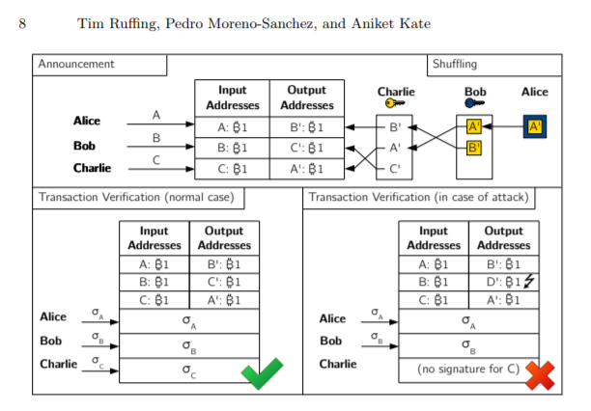
CoinShuffle

Slide 24
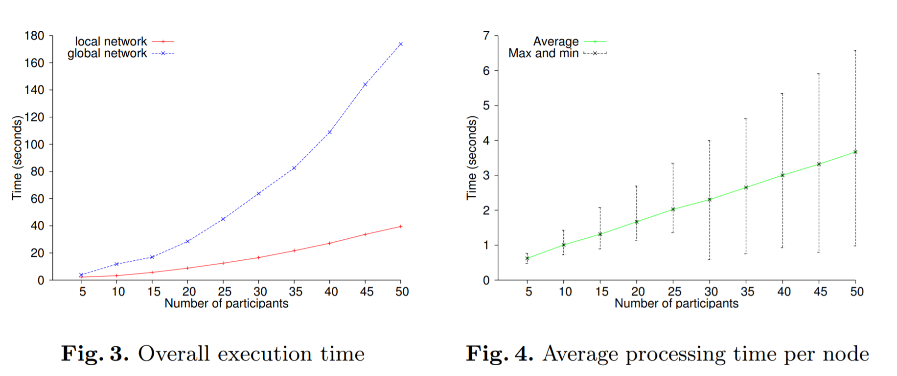
CoinShuffle - Performance

Slide 25
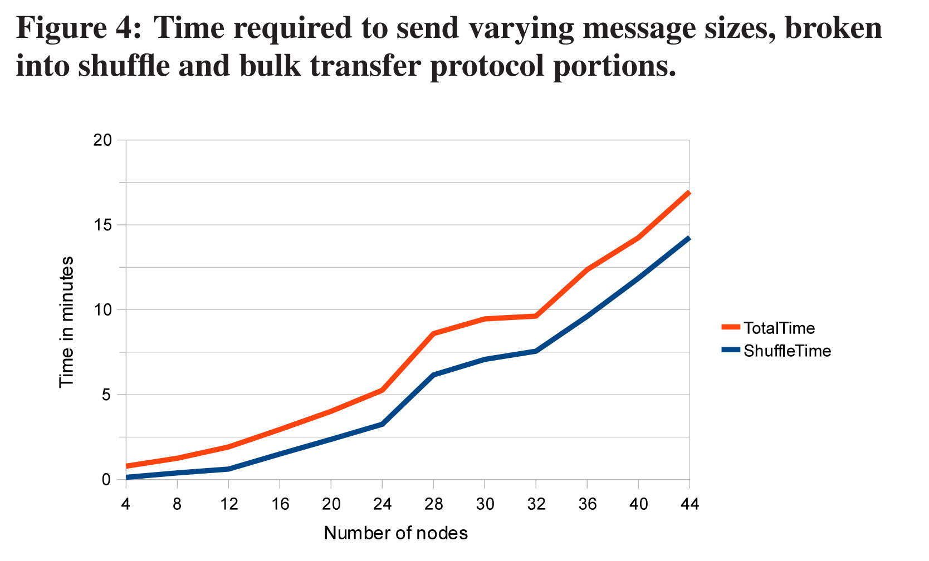
Dissent - Performance

Slide 26
CoinShuffle - Summary
Rather than have a Secure Multi-Party Computation with a coordinator, CoinShuffle aims to solve the problem of constructing a CoinJoin with just the participants themselves.
Using the Dissent messaging protocol, CoinShuffle participants shuffle their anonymous outputs until all outputs are made available to all participants, without a link from any participant to an output.
Biggest drawback is the time cost as number of participants grow
Biggest advantage is that there is no coordinator to DOS

Slide 27
CoinShuffle - Discussion

