Slide 1
SNICKER
Simple Non-interactive Coinjoin with Keys for Encryption Reused

Slide 2
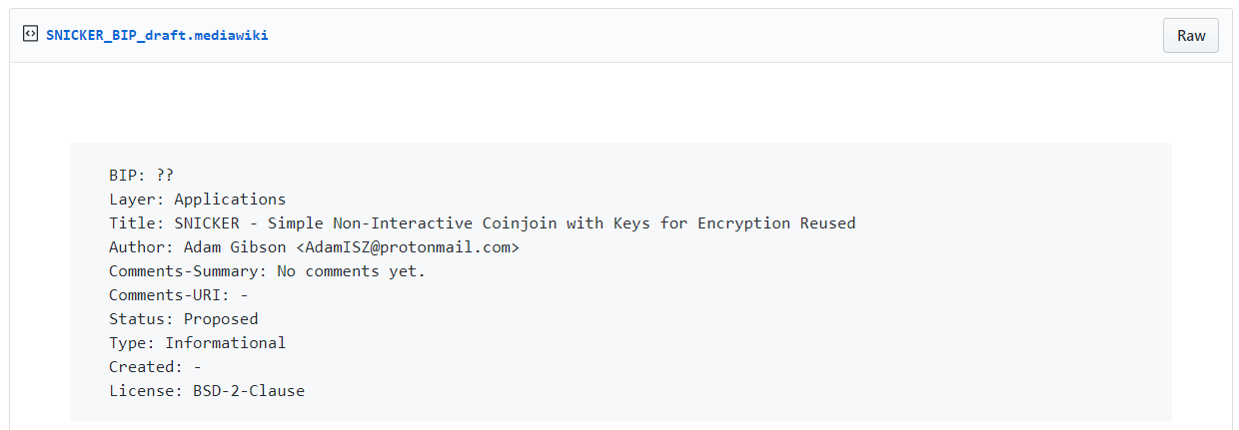
SNICKER (BIP Draft, 2020) Adam Gibson (u/waxwing)
https://gist.github.com/AdamISZ/2c13fb5819bd469ca318156e2cf25d79

Slide 3
Last week – Knapsack Coinjoin
Summary of Knapsack CoinJoin idea:
We can allow for users to mix arbitrary values if we further break down the outputs in a tactical way. By considering the ways that a CoinJoined transaction can be broken down, we can optimize the break down of outputs by increasing the number possible ways a CoinJoined transaction can be interpreted by an outsider. Anonymity of coins and their origins is achieved by having a multiplicity of possible links between any two coins in this scheme.

Slide 4
Wasabi Research Club
January 6th, 2020 – Knapsack CoinJoin
January 13th, 2020 – SNICKER
January 20th, 2020 - TBD
https://github.com/zkSNACKs/WasabiResearchClub

Slide 5
Problem with current CoinJoins
Interactive (requires a server)
Could reduce the privacy of users
Difficult to coordinate many participants
Fragile to attack (central point of failure)

Slide 6
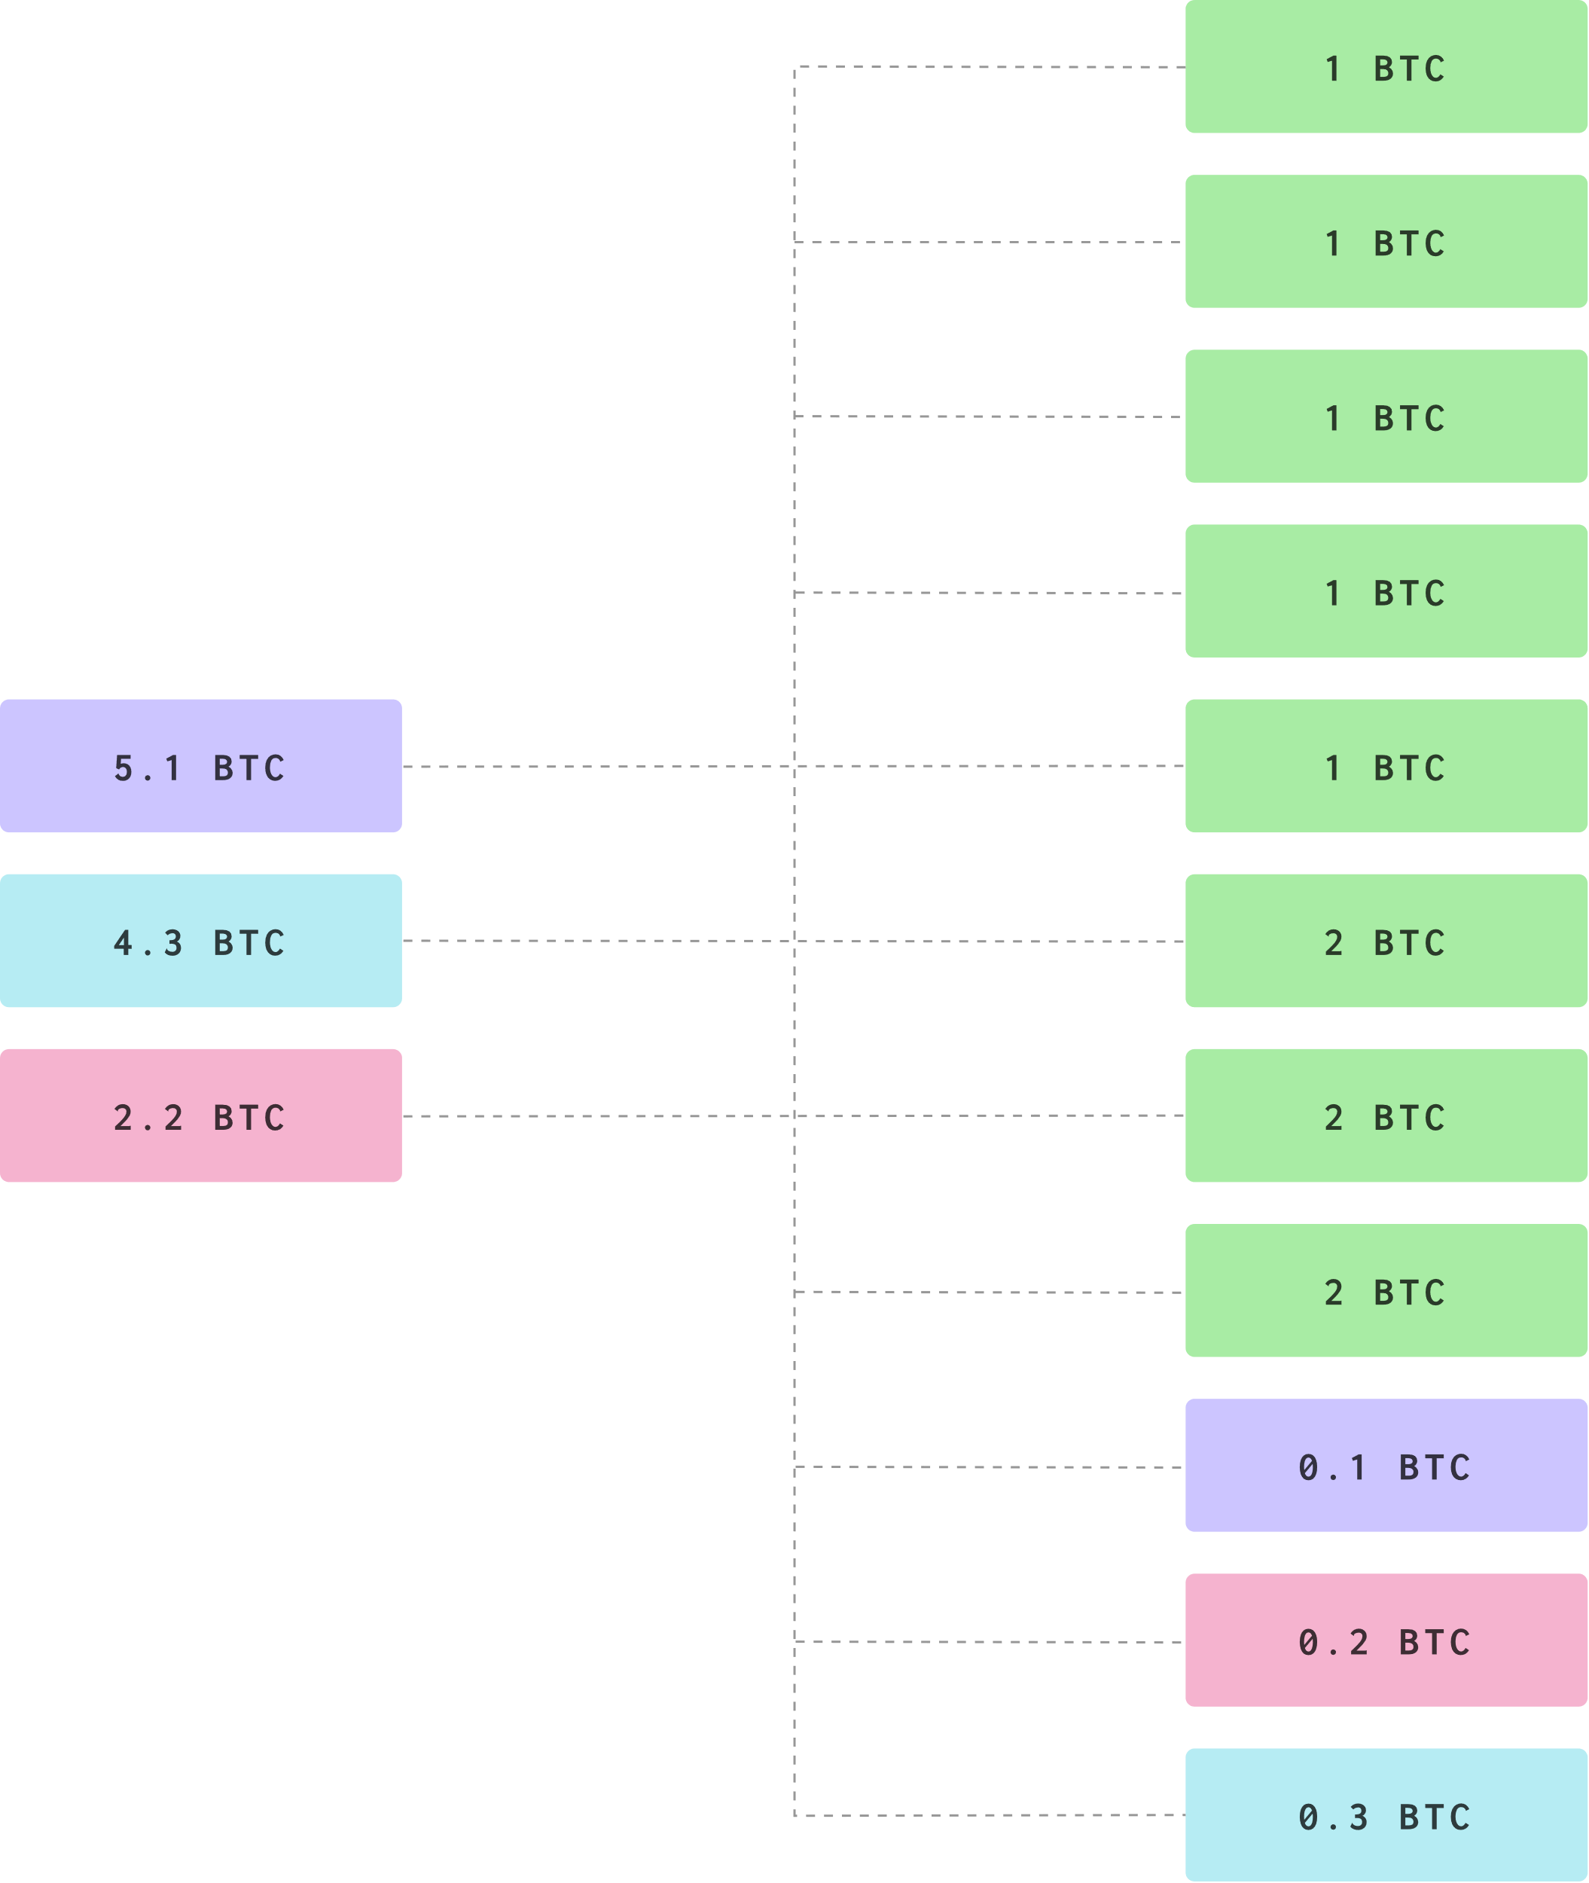
Could a CoinJoin be done without Coordination?
What requires coordination?
Inputs
Outputs
Signatures

Slide 7
Part 1 – Inputs
A proposer knows their own input, but they don’t know the input of a potential CoinJoin buddy.
So the proposer simply guesses which UTXOs on the blockchain might be the most likely to be interested.
Perhaps UTXOs involved in Joinmarket type transactions
Or UTXOs at random that are recent
Later UTXOs from previous SNICKER Coinjoins

Slide 8
Part 1 – Inputs
i = 9
i = 19
i = 16
i = 3
i = 21
i = 5
i = 15
i = 20
i = 11

Slide 9
Part 1 – Inputs
i = 9
i = 19
i = 16
i = 3
i = 21
i = 5
i = 15
i = 20
i = 11

Slide 10
Part 1 – Inputs
i = 21
o = 20
i = 20
o = 20
o = 1

Slide 11
Part 1 – Inputs
i = 9
i = 19
i = 16
i = 3
i = 21
i = 5
i = 15
i = 20
i = 11

Slide 12
Part 1 – Inputs
i = 9
i = 19
i = 16
i = 3
i = 21
i = 5
i = 15
i = 20
i = 11

Slide 13
Part 1 – Inputs
i = 21
o = 19
i = 19
o = 19
o = 2

Slide 14
Part 2 – Outputs
A proposer knows their own address, and they know their own unused fresh addresses.
But how will a proposer figure out a fresh address that belongs to the other party that is participating in the same transaction?
They aren’t communicating!

Slide 15

Part 2 – Outputs
How will a proposer figure out a fresh address that belongs to the other party that is participating in the same transaction?
i = 21
o = 19
i = 19
o = 19
o = 2

Slide 16
Part 2 – Outputs
Naïve Solution – Just copy the same address used by that UTXO!
i = 21
o = 19
i = 19
o = 19
o = 2

Slide 17
Part 2 – Outputs
Smart Solution – Use an address that is tweaked from the public key of the UTXO, by a common shared secret between parties.
i = 21
o = 19
i = 19
o = 19
o = 2

Slide 18
Part 2 – Outputs
Smart Solution – Use an address that is tweaked from the public key of the UTXO, by a common shared secret between parties.
All you know about the mystery UTXO is that it possesses the private key to the public key that holds the funds.
But the public key is not explicitly written in the UTXO! Only the hash of the public key is offered.
Unless… the individual with the UTXO has spent from that address in the past – in which case the signature would reveal the public key.
Thus the proposer must only consider UTXOs which belong to addresses that have been re-used at least once (SNICKER V. 0 )

Slide 19
Part 2 – Outputs
But how will we teak the public key of the receiver?
With a shared secret!
i = 21
o = 19
i = 19
o = 19
o = 2

Slide 20
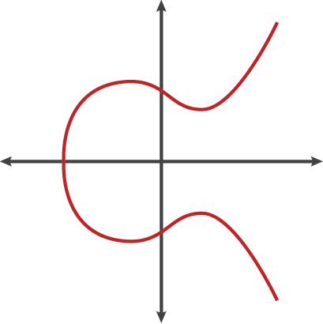

Elliptic Curve Primitives, Diffie Hellman
$p∙G=P$
$k∙G=K$
$p∙K=p∙\left(k∙G\right)=$ $k∙\left(p∙G\right)=k∙P$
$p∙K=S$
$k∙P=S$
Diffie Hellman Key Exchange (S)

Slide 21

Part 2 – Outputs
Let’s take the proposer and receiver public key and use it to create a shared secret (c), then let’s shift the receiver’s public key by c to create a fresh address!
i = 21
o = 19
i = 19
o = 19
$$\left(k+c\right)∙G=c∙K=K"$$
o = 2

Slide 22
Part 2 – Outputs
So far
Selected a bunch of candidate UTXOs
Re-used addresses
Amount smaller than ours
Create recipient address with DH tweak (c)
But what about signatures?

Slide 23
Part 3 – Signatures
A proposer can sign their own input, and can validate that all of the information in the CoinJoin is valid. How can the proposer get the signature of the participant?
A proposer could first sign the CoinJoin and then present the partially signed bitcoin transaction (PSBT) to the receiver.
Perhaps there is a message board
Or in a more P2P fashion (Directly send PSBT clusters to active users)

Slide 24




Part 3 – Signatures
i = 21
o = 19
i = 19
o = 19
$$\left(k+c\right)∙G=c∙K=K"$$
o = 2
i = 21
o = 12
i = 12
o = 12
$$\left(k+c\right)∙G=c∙K=K"$$
o = 9
i = 21
o = 20
i = 20
o = 20
$$\left(k+c\right)∙G=c∙K=K"$$
o = 1

Slide 25



Part 3 – Signatures
i = 21
o = 19
i = 19
o = 19
$$\left(k+c\right)∙G=c∙K=K"$$
o = 2
i = 21
o = 12
i = 12
o = 12
$$\left(k+c\right)∙G=c∙K=K"$$
o = 9
i = 21
o = 20
i = 20
o = 20
$$\left(k+c\right)∙G=c∙K=K"$$
o = 1

Slide 26


Part 3 – Signatures
i = 21
o = 19
i = 19
o = 19
$$\left(k+c\right)∙G=c∙K=K"$$
o = 2

Slide 27
Part 3 – Signatures
i = 21
o = 19
i = 19
o = 19
$$\left(k+c\right)∙G=c∙K=K"$$
o = 2

Slide 28
Part 3 – Signatures
A receiver can verify the contents of the PSBT, and can validate that the Diffie Hellman tweaked public key.
Then the receiver may choose to sign and broadcast
Note that the UTXO may or may not already be consumed by another UTXO that was selected by the proposer, but this doesn’t matter as there is no loss of funds.
Further, observe that if the PSBT is not encrypted against the public key of the UTXOs it attempts to join, a malicious listener could intercept a PSBT and map inputs to outputs.

Slide 29
SNICKER V. 0 Summary
A proposer selects potential UTXOs from re-used addresses that have values smaller than his own.
The proposer then constructs outputs by tweaking the receivers public key with a DH key exchange.
The proposer then broadcasts an encrypted PSBT to public forum or to peers directly.
The receiver can decrypt the PSBT and chose to sign and broadcast.

Slide 30
SNICKER V. 0 Summary
A proposer selects potential UTXOs from re-used addresses that have values smaller than his own.
The proposer then constructs outputs by tweaking the receivers public key with a DH key exchange.
The proposer then broadcasts an encrypted PSBT to public forum or to peers directly.
The receiver can decrypt the PSBT and chose to sign and broadcast.

Slide 31
SNICKER V. 0 Summary (Note)
SNICKER is a deterministic protocol, and a user restoring their wallet with their seed words should be able to find all of the SNICKER outputs.
Non-interactive! The receiver only participates at the very last stage, having had no prior interactions with the proposer.

Slide 32
SNICKER V. 1
How can we implement SNICKER without requiring address re-use? That is, without requiring the receiver to reveal their pubkey?

Slide 33
SNICKER V. 1
Solution – the proposer can guess co-ownership of used addresses and UTXOs sitting in un-used address.
For example:
o = 9
i = 19
o = 10
Likely the change output
Likely the same owner

Slide 34
SNICKER V. 1
Solution – the proposer can guess co-ownership of used addresses and UTXOs sitting in un-used address.
For example:
o = 9
i = 21
o = 10
i = 19
o = 10
i = 10
o = 10
o = 11
Use the public key from a previous transaction

Slide 35
SNICKER Summary
Non-interactive CoinJoins are possible between two participants by leveraging:
Either re-used addresses or co-ownership
A public board for posting PSBT

Slide 36
Discussion Time

Slide 37
SNICKER
Simple Non-interactive Coinjoin with Keys for Encryption Reused

