Slide 1
Dining Cryptographer Networks
Unconditional Sender and Recipient Untraceability

Slide 2
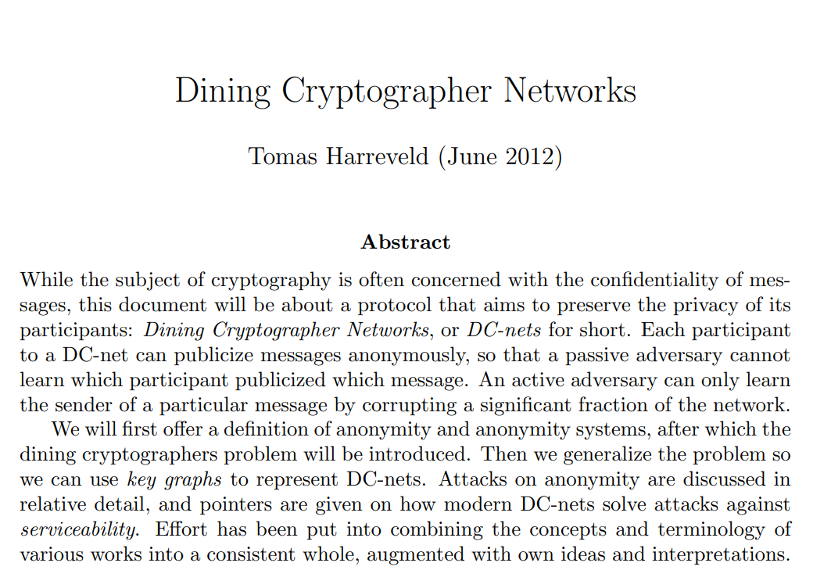
Harreveld (2012)

Slide 3
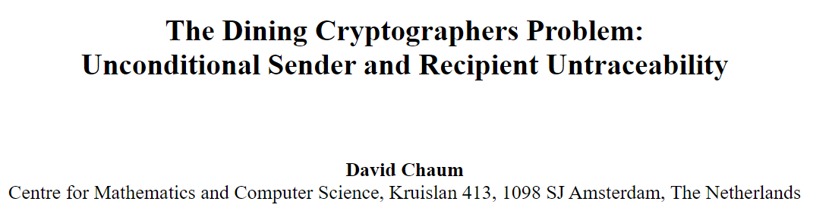
Chaum (1988)
http://homepages.herts.ac.uk/~comqjs1/Dining.pdf
http://www.cs.cornell.edu/people/egs/herbivore/dcnets.html

Slide 4
Last Week – CoinShuffle
One issue with CoinJoin implementations is the reliance on a central coordinator. Removing the coordinator would require a secure method of participants declaring their anonymous addresses
We can replace the coordinator with a CoinShuffle, where each participant onion-encrypts their address with the public keys of the latter participants. They then decrypt and shuffle all encrypted addresses they have received with their own address, and proceed to hand off the encrypted addresses to the next participant.
Scales poorly with many participants, ElectronCash(5)

Slide 5
Wasabi Research Club
January 6th, 2020 – Knapsack CoinJoin
January 13th, 2020 – SNICKER
January 20th, 2020 – CoinShuffle
January 27th, 2020 – Dining Cryptographer Networks
February 3rd, 2020 - TBD
https://github.com/zkSNACKs/WasabiResearchClub

Slide 6
The Premise – The Cryptographers at Dinner
Three cryptographers are sitting down to dinner at their favorite three-star restaurant. Their waiter informs them that arrangements have been made with the maitre d'hotel for the bill to be paid anonymously. One of the cryptographers might be paying for the dinner, or it might have been NSA (U.S. National Security Agency). The three cryptographers respect each other's right to make an anonymous payment, but they wonder if NSA is paying. They resolve their uncertainty fairly by carrying out the following protocol-

Slide 7
The Premise – The Cryptographers at Dinner
Participants are trustworthy
Participants want to be able to tell if someone in the group paid
Participants don’t want to ‘out’ the payer, because he/she deserves the right to be able to pay anonymously

Slide 8
The Premise – The Cryptographers at Dinner

Slide 9
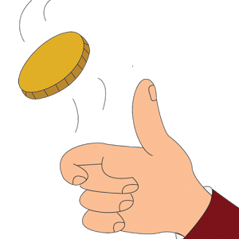
The Premise – The Cryptographers at Dinner

Slide 10
The Premise – The Cryptographers at Dinner
1

Slide 11
The Premise – The Cryptographers at Dinner
1

Slide 12
The Premise – The Cryptographers at Dinner
0
1

Slide 13
The Premise – The Cryptographers at Dinner
0
1

Slide 14
The Premise – The Cryptographers at Dinner
1
0
1

Slide 15
The Premise – The Cryptographers at Dinner
1
0
1 XOR 0 = 1
1

Slide 16
The Premise – The Cryptographers at Dinner
1 XOR 0 = 1
1
0
1 XOR 1 = 0
1 XOR 0 = 1
1

Slide 17
The Premise – The Cryptographers at Dinner
1
1
0
0
1
1

Slide 18
The Premise – The Cryptographers at Dinner
1+1+0=2
1
0
1+1+0=2
1+1+0=2
1

Slide 19
The Premise – The Cryptographers at Dinner
The NSA!
1
0
The NSA!
The NSA!
1

Slide 20
The Premise – The Cryptographers at Dinner
1
1
0
1
1
1

Slide 21
The Premise – The Cryptographers at Dinner
1+1+1=3
1
0
1+1+1=3
1+1+1=3
1

Slide 22
The Premise – The Cryptographers at Dinner
One of us!
1
0
One of us!
One of us!
1

Slide 23
Why does this work?

Slide 24
Why does this work?
0
1

Slide 25
Why does this work?
1
0
1
1
1

Slide 26
Why does this work?
0
1+1+1=3
1

Slide 27
Why does this work?
0
Someone paid!
1

Slide 28
Why does this work?
0
Was it Alice or Bob?
1

Slide 29
Why is it always even?
1
0

Slide 30
Why is it always even?
1
0

Slide 31
Why is it always even?
1
0

Slide 32
Summary of the Protocol (1 bit of information)
Phase 1 – a 1 bit secret must be shared between each participant and their 2 neighbors, regardless of how many participants there are.
Phase 2 – Each participant must XOR their two shares secrets and then broadcast the resulting 1 bit message.
Phase 2’ – If you are the payer, simply flip the result of the XOR and broadcast the resulting 1 bit message
Phase 3 – All messages are collected by all participants and if the sum of the bits is even, the message is 0, otherwise 1.

Slide 33
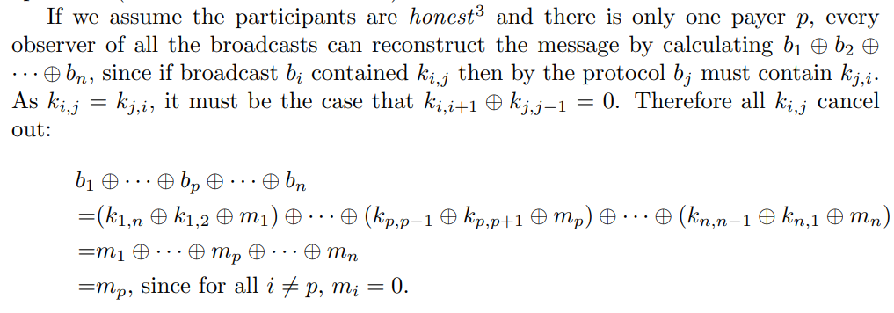
Generalizing Dining Cryptographer Networks
Harreveld Pg.2

Slide 34
Logisim Example

Slide 35
Issues with DCNets
They demand a lot of bandwidth from the network. To propagate a message of size m with n participants it requires at a minimum n*m bits to be broadcast and 2m secret bits to be shared.
They can only allow for 1 participant to message the group per round, otherwise the messages interfere with each other.
They are easy to break with a single un-cooperative participant.

Slide 36
Summary of DC Nets
By following a strict protocol of 3 phases per round, we can establish a truly anonymous communication for any of the participants, so long as their shared secrets remain secret.
Benefits: We could use DC Nets for CoinJoin participants who want to anonymously broadcast their outputs to the group.
Downsides – Very fragile system, easily broken by malicious participants, and also quite a bit slower.

Slide 37
Discussion

