Slide 1
Coinshuffle++
P2P Mixing and Unlinkable Bitcoin Transactions

Slide 2
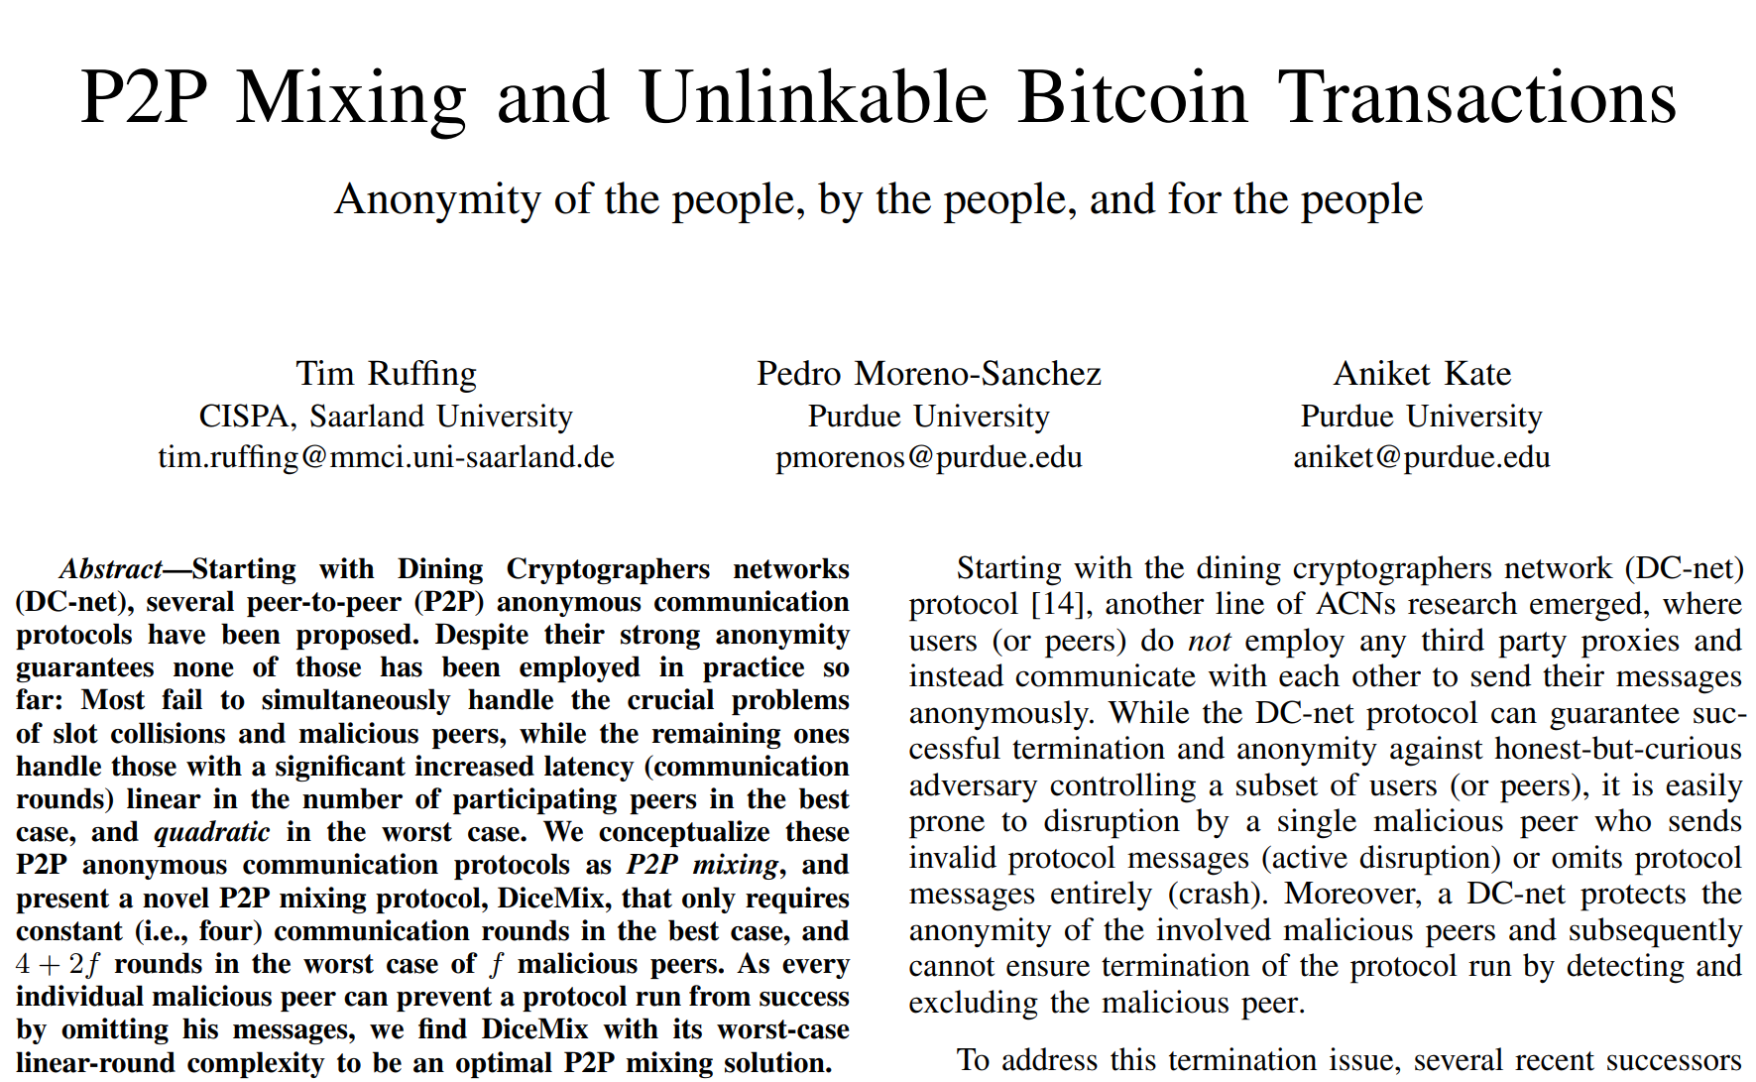
Ruffing, Moreno-Sanchez and Kate (2017)

Slide 3
Two Weeks ago - CoinShuffle
One issue with CoinJoin implementations is the reliance on a central coordinator. Removing the coordinator would require a secure method of participants declaring their anonymous addresses
We can replace the coordinator with a CoinShuffle, where each participant onion-encrypts their address with the public keys of the latter participants. They then decrypt and shuffle all encrypted addresses they have received with their own address, and proceed to hand off the encrypted addresses to the next participant.
Scales poorly with many participants, ElectronCash(5)

Slide 4
Wasabi Research Club
January 6th, 2020 – Knapsack CoinJoin
January 13th, 2020 – SNICKER
January 20th, 2020 – CoinShuffle
January 27th, 2020 – Dining Cryptographer Networks
February 3rd, 2020 – CoinShuffle ++
Feburary 10th, 2020 - TBD
https://github.com/zkSNACKs/WasabiResearchClub

Slide 5
Wasabi Research Club
January 6th, 2020 – Knapsack CoinJoin
January 13th, 2020 – SNICKER
January 20th, 2020 – CoinShuffle
January 27th, 2020 – Dining Cryptographer Networks
February 3rd, 2020 – CoinShuffle ++
Feburary 10th, 2020 - TBD
https://github.com/zkSNACKs/WasabiResearchClub

Slide 6
Dining Cryptographers Recap
Three cryptographers are sitting down to dinner at their favorite three-star restaurant. Their waiter informs them that arrangements have been made with the maitre d'hotel for the bill to be paid anonymously. One of the cryptographers might be paying for the dinner, or it might have been NSA (U.S. National Security Agency). The three cryptographers respect each other's right to make an anonymous payment, but they wonder if NSA is paying. They resolve their uncertainty fairly by carrying out the following protocol- (Chaum, 1988)

Slide 7
Dining Cryptographers Recap
Anonymous communication among honest peers.
Protocol is resistant to traffic analysis, in contrast to something like Tor which is not.

Slide 8
The Premise – The Cryptographers at Dinner

Slide 9
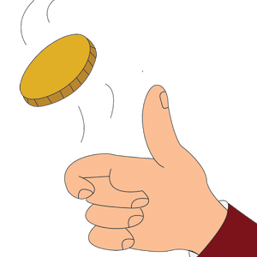
The Premise – The Cryptographers at Dinner

Slide 10
The Premise – The Cryptographers at Dinner
1

Slide 11
The Premise – The Cryptographers at Dinner
1

Slide 12
The Premise – The Cryptographers at Dinner
0
1

Slide 13
The Premise – The Cryptographers at Dinner
0
1

Slide 14
The Premise – The Cryptographers at Dinner
1
0
1

Slide 15
The Premise – The Cryptographers at Dinner
1
0
1 XOR 0 = 1
1

Slide 16
The Premise – The Cryptographers at Dinner
1 XOR 0 = 1
1
0
1 XOR 1 = 0
1 XOR 0 = 1
1

Slide 17
The Premise – The Cryptographers at Dinner
1
1
0
0
1
1

Slide 18
The Premise – The Cryptographers at Dinner
1+1+0=2
1
0
1+1+0=2
1+1+0=2
1

Slide 19
The Premise – The Cryptographers at Dinner
Even = NSA!
1
0
Even = NSA!
Even = NSA!
1

Slide 20
The Premise – The Cryptographers at Dinner
1
1
0
1
1
1

Slide 21
The Premise – The Cryptographers at Dinner
1+1+1=3
1
0
1+1+1=3
1+1+1=3
1

Slide 22
The Premise – The Cryptographers at Dinner
Odd = One of us!
1
0
Odd = One of us!
Odd = One of us!
1

Slide 23
Why does this work?

Slide 24
Why does this work?
0
1

Slide 25
Why does this work?
1
0
1
1
1

Slide 26
Why does this work?
0
1+1+1=3
1

Slide 27
Why does this work?
0
Someone paid!
1

Slide 28
Why does this work?
0
Was it Alice or Bob?
1

Slide 29
Why is it always even?
1
0

Slide 30
Why is it always even?
1
0

Slide 31
Why is it always even?
1
0

Slide 32
Problems with DC Nets

Slide 33
Problem 1 – Collision of Messages

Slide 34
Problem 1 – Collision of Messages
0
1
0
1
1
1

Slide 35
Problem 1 – Collision of Messages
0
1
0
1
1
1

Slide 36
The Premise – The Cryptographers at Dinner
The NSA?!
1
0
The NSA?!
The NSA!
1

Slide 37

Problem 2 – Kicking Disruptors
1
0
1

Slide 38
Problem 2 – Kicking Disruptors
0
1
0
1
1
1

Slide 39
The Premise – The Cryptographers at Dinner
Who disrupted my message?
1
0
:D
What message?
1

Slide 40
Problem 2 – Kicking Disruptors
0
?
1

Slide 41
Coinshuffle ++
We conceptualize P2P mixing as a natural generalization of DC-Nets. A P2P mixing protocol enables a set of mutually distrusting peers to publish their messages simultaneously and anonymously without requiring any trusted or untrusted third-party anonymity proxy. (pg. 2)
DiceMix Protocol: DiceMix builds on the original DC-net protocol. P2P Mixing Protocol handles collisions by redundancy, and disruption by revealing session secrets to expose malicious peers. DiceMix requires only 4+2f rounds in the presence of f malicious peers, i.e., only four rounds if every peer behaves honestly
CoinShuffle++ Protocol: Applying DiceMix to Bitcoin transactions to create decentralized and anonymous CoinJoins.
Generic Attack on P2P Mixing Protocols

Slide 42
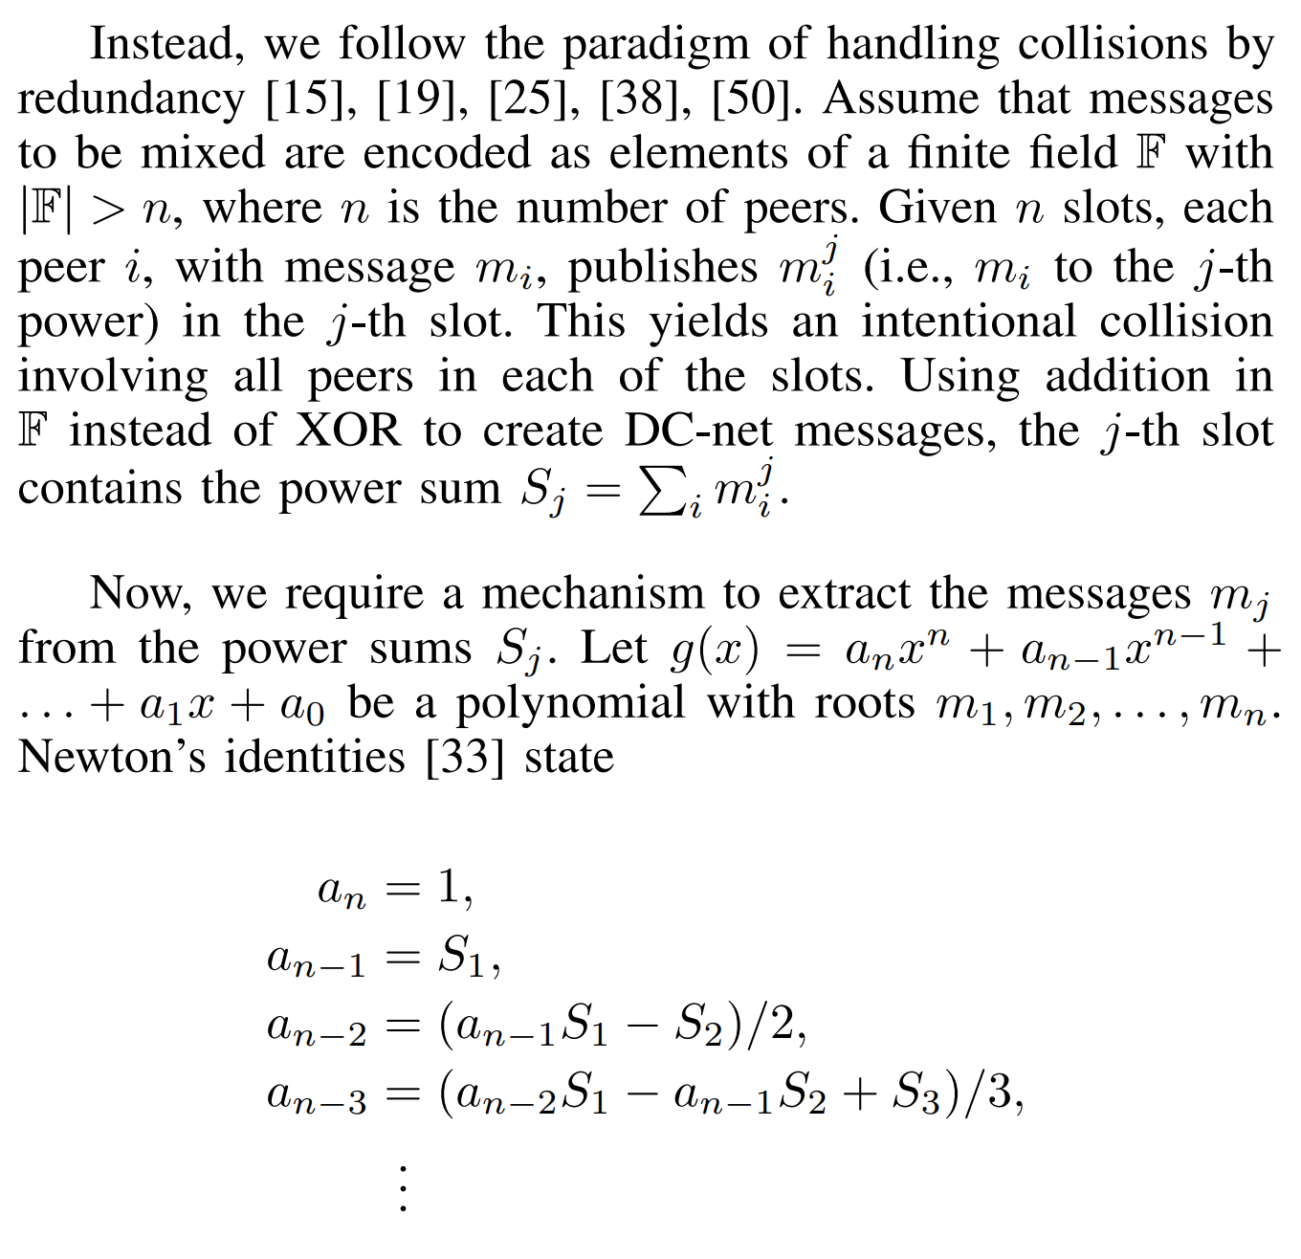
DiceMix – A Better DC Net Protocol

Slide 43
DiceMix – A Better DC-Net Protocol
Key Exchange (KE) : Diffie-Hellman Key-exchange between participants
Commitment (C) : Commitment phase to Message
DC-Net (DC): DC-Net protocol using power-sums over a finite field
Confirmation (CF): The end of a successful mix – messages are available
Reveal Secret Key (SK): Ephemeral keys revealed
Reveal Pads (RV): Shared Secrets Revealed

Slide 44
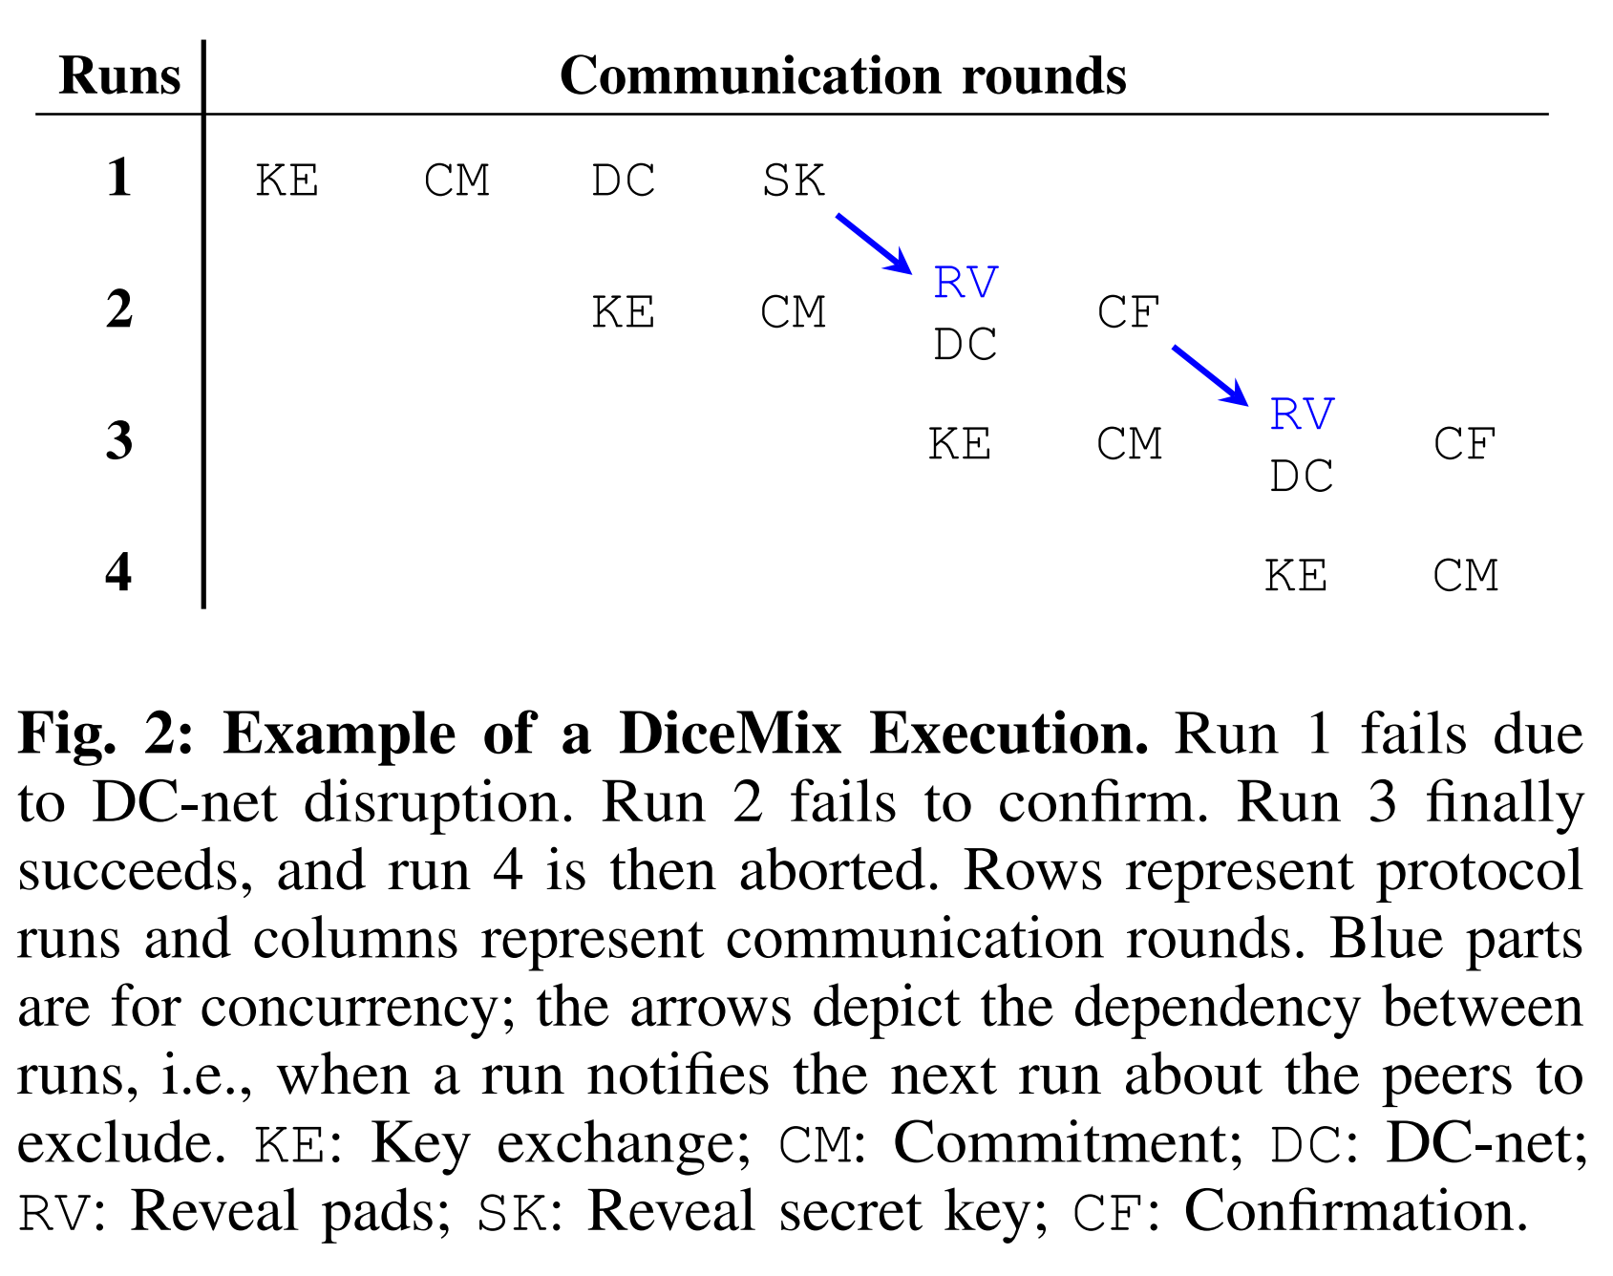
DiceMix – A Better DC Net

Slide 45
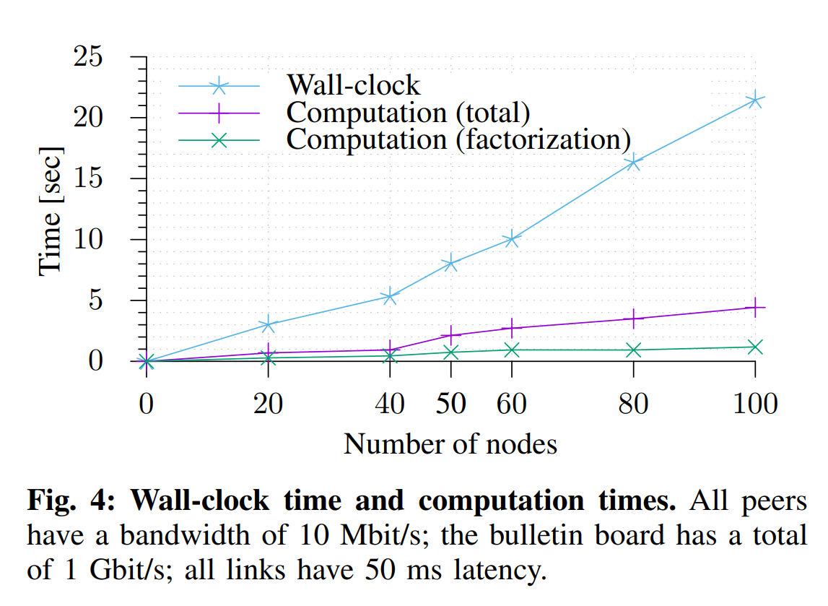
DiceMix – A Better DC Net

Slide 46
Coinshuffle ++ Summary
By using the DiceMix protocol instead of the original DC-Net, we can achieve guaranteed finality of the message protocol in 4+2f rounds, where users anonymously post their equal-output fresh addresses. Collisions and disruption are both effectively dealt with.
This protocol can scale efficiently to allow for 50+ participants without computation costs or rapidly increasing time cost.
The authors claim that is a substantial improvement to CoinShuffle, which required users to pass encrypted messages sequentially across the entire set of participants, and thus scaled very poorly.

Slide 47
Questions

Slide 48
Questions
In an interview, Pedro Moreno-Sanchez said that the CashShuffle implementation of CoinShuffle was not correctly written. In what way, and is this still the case today?

Slide 49
Questions
In what way is CoinShuffle++ more desirable to ZeroLink?

Slide 50
Questions
DiceMix uses power sets to construct messages. Can you explain how this works and why it was chosen as a mechanism to avoid collisions?
Could you offer an example for us to observe the process?

Slide 51
Questions
In every failed round of DiceMix, the users must reveal which message they sent, does this mean that addresses can never be used again in this protocol? If so, this presents challenges for wallets that are recovered.

