Slide 1
Knapsack CoinJoin
Anonymous CoinJoin Transactions with Arbitrary Values

Slide 2
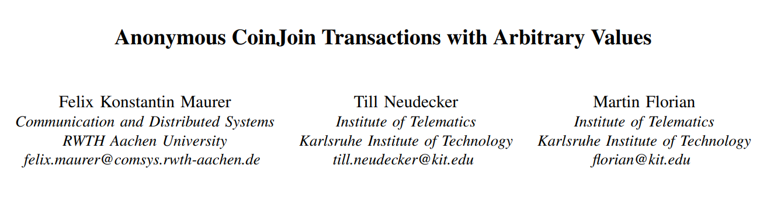
Anonymous CoinJoin Transactions with Arbitrary Values (2017)
https://www.comsys.rwth-aachen.de/fileadmin/papers/2017/2017-maurer-trustcom-coinjoin.pdf
Knapsack Coinjoin Anonymity Analysis (2019), Lucas Ontivero (PDF Available upon request)

Slide 3
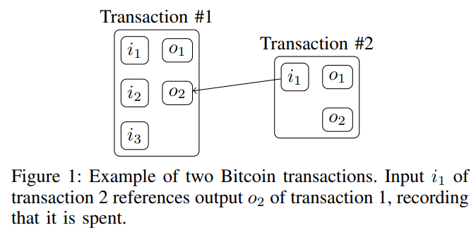
The privacy problem with Bitcoin
Transactions are public
Transactions point to previous transactions
Transactions (can) leak future spending

Slide 4
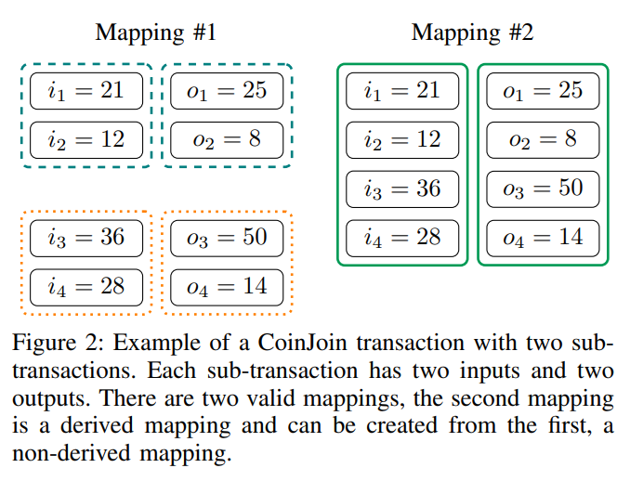
Idea #1 – Joining Transactions

Slide 5
Idea #1 – Joining Transactions
i₁ = 21
o₁ = 25
i₁ = 21
o₁ = 25
i₂ = 12
o₂ = 8
i₂ = 12
o₂ = 8
i₁ = 36
o₁ = 50
i₃ = 36
o₃ = 50
i₂ = 28
o₂ = 14
i₄ = 28
o₄ = 14

Slide 6
Idea #1 – Joining Transactions
i₁ = 21
o₁ = 25
i₂ = 12
o₂ = 8
i₃ = 36
o₃ = 50
i₄ = 28
o₄ = 14

Slide 7
Idea #1 – Joining Transactions
i₁ = 21
o₁ = 25
i₂ = 12
o₂ = 8
i₃ = 36
o₃ = 50
i₄ = 28
o₄ = 14

Slide 8
Idea #1 – Joining Transactions
i₁ = 21
o₁ = 25
i₂ = 12
o₂ = 8
i₃ = 36
o₃ = 50
i₄ = 28
o₄ = 14

Slide 9
Idea #1 – Joining Transactions
i₁ = 21
o₁ = 25
i₂ = 12
o₂ = 8
i₃ = 36
o₃ = 50
i₄ = 28
o₄ = 14

Slide 10
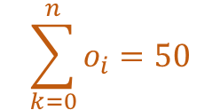
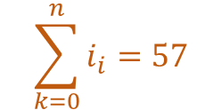
Idea #1 – Joining Transactions
$$\sum_{k=0}^{n}{i_{i}}=57$$
i₁ = 21
o₁ = 25
i₂ = 12
o₂ = 8
$$\sum_{k=0}^{n}{o_{i}}=50$$
i₃ = 36
o₃ = 50
i₄ = 28
o₄ = 14

Slide 11
Idea #1 – Joining Transactions
i₁ = 21
o₁ = 25
i₂ = 12
o₂ = 8
i₃ = 36
o₃ = 50
i₄ = 28
o₄ = 14

Slide 12
Idea #1 – Joining Transactions
i₁ = 21
o₁ = 25
i₂ = 12
o₂ = 8
i₃ = 36
o₃ = 50
i₄ = 28
o₄ = 14

Slide 13
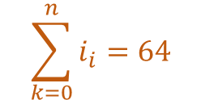
Idea #1 – Joining Transactions
i₁ = 21
o₁ = 25
i₂ = 12
o₂ = 8
$$\sum_{k=0}^{n}{i_{i}}=64$$
i₃ = 36
o₃ = 50
i₄ = 28
o₄ = 14

Slide 14
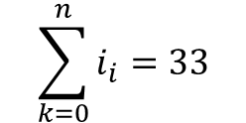
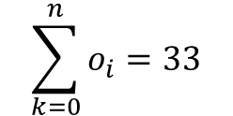
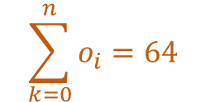
Idea #1 – Joining Transactions
$$\sum_{k=0}^{n}{i_{i}}=33$$
i₁ = 21
o₁ = 25
$$\sum_{k=0}^{n}{o_{i}}=33$$
i₂ = 12
o₂ = 8
$$\sum_{k=0}^{n}{i_{i}}=64$$
i₃ = 36
o₃ = 50
$$\sum_{k=0}^{n}{o_{i}}=64$$
i₄ = 28
o₄ = 14

Slide 15
Idea #1 – Joining Transactions
i₁ = 21
o₁ = 25
i₂ = 12
o₂ = 8
i₃ = 36
o₃ = 50
i₄ = 28
o₄ = 14

Slide 16
Idea #1 – Joining Transactions
i₁ = 21
o₁ = 25
i₂ = 12
o₂ = 8
i₃ = 36
o₃ = 50
i₄ = 28
o₄ = 14

Slide 17
Idea #1 – Joining Transactions
How good is the anonymity provided by this simple model?
Can we improve upon it?

Slide 18





Formal Definitions
Coinjoin Transaction
Inputs
Outputs
Coins
$$T=\left(I, O, v\right)$$
$$I=\left\{i_{1}, …,i_{m}\right\}$$
$$O=\left\{o_{1}, …,o_{m}\right\}$$
$$C=I∪O$$
$$\sum_{i∈I}{v\left(i\right)=\sum_{o∈O}{v(o)}}$$

Slide 19
Formal Definitions
A CoinJoin transaction consists of sub-transactions tk, … there must be at least one way of partitioning all inputs and outputs, so that each subset of inputs has exactly one corresponding subset of outputs with which it forms a sub-transaction. We call this a mapping, as it maps inputs to outputs.

Slide 20





Formal Definitions
5. Set of all partitions
6. Set of all Input Partitions
7. Set of all output Partitions
8. Set of all mappings
$$Φ(S)$$
$$Ο∈ Φ(O)$$
$$I∈ Φ(I)$$
$$Μ$$
$$Μ=\left\{m:I→O s.t. ∀I∈I, \sum_{i∈I}{v\left(i\right)=\sum_{o∈m(I)}{v\left(o\right)}}\right\}$$

Slide 21
In simpler terms
We want to be able to break a transaction down into subtransactions which are combinations of inputs and outputs that add up to the same value. A subtransaction that consists of smaller subtransactions is called a derived subtransaction. We will concern ourselves with non-derived sub transactions.

Slide 22
Anonymity in this framework
The probability that an input coin and an output coin belong to the same transaction are as follows. It is deﬁned as the number of mappings where the input coin is in a subset of the input partition that is assigned to the subset of the output partition of which the output coin is an element, divided by the total number of mappings.

Slide 23
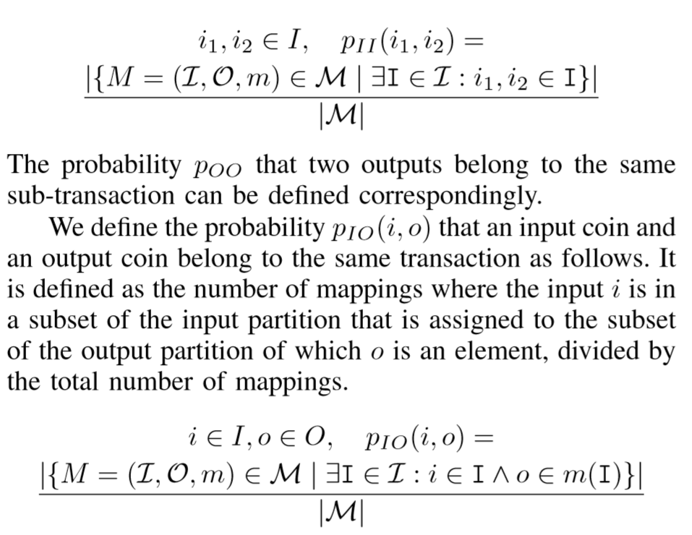
Anonymity in this framework

Slide 24
Idea #1 – Joining Transactions
i₁ = 21
o₁ = 25
i₂ = 12
o₂ = 8
i₃ = 36
o₃ = 50
i₄ = 28
o₄ = 14

Slide 25
Idea #1 – Joining Transactions
i₁ = 21
o₁ = 25
i₂ = 12
o₂ = 8
i₃ = 36
o₃ = 50
i₄ = 28
o₄ = 14

Slide 26
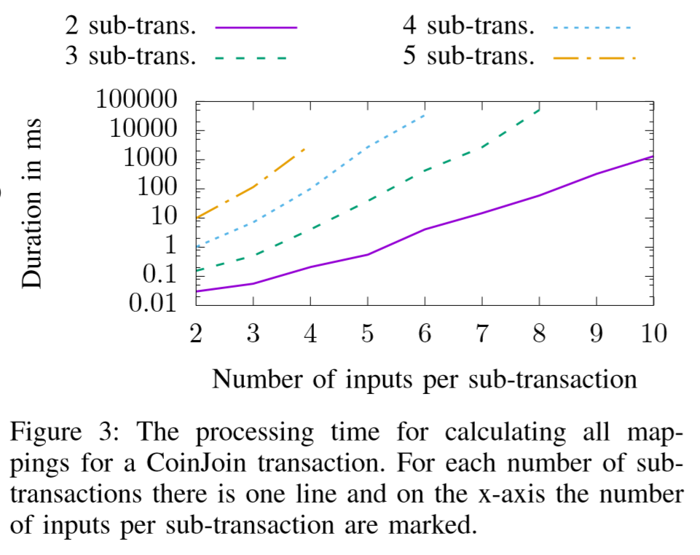
Evaluation of Joined Transactions
Processing Time

Slide 27
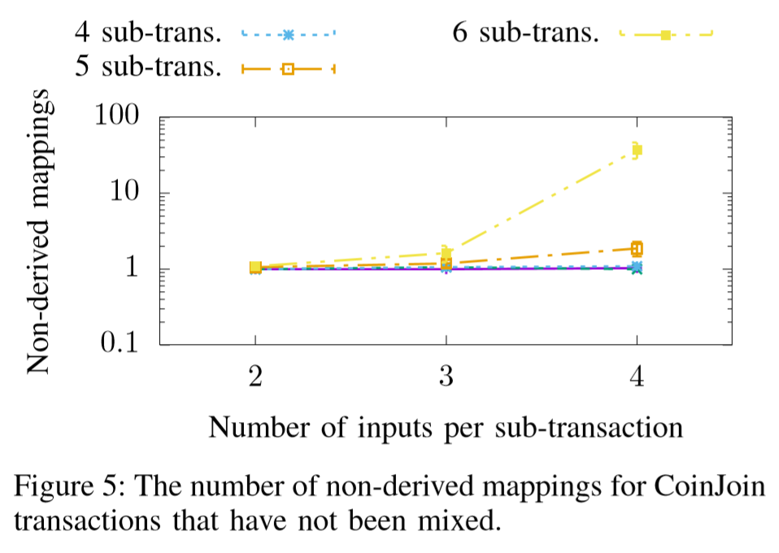
Evaluation of Joined Transactions
Non-Derived Mappings

Slide 28
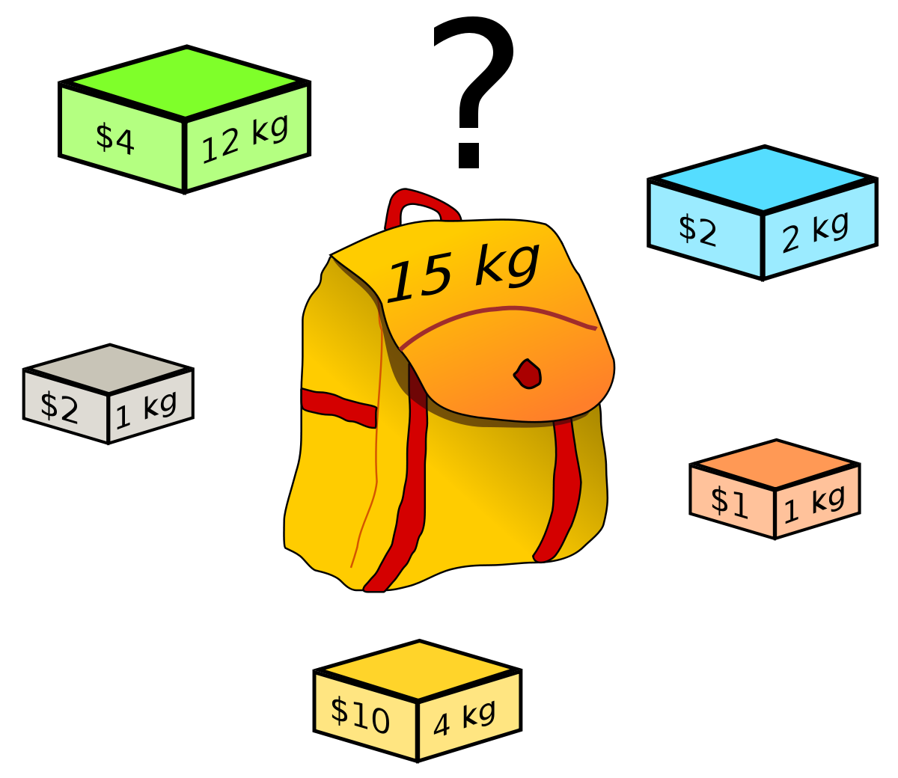
Idea #2 – Knapsack Mixing

Slide 29
Idea #2 – Knapsack Mixing
i₁ = 21
o₁ = 25
i₁ = 21
o₁ = 25
i₂ = 12
o₂ = 8
i₂ = 12
o₂ = 8
i₁ = 36
o₁ = 50
i₃ = 36
o₃ = 50
i₂ = 28
o₂ = 14
i₄ = 28
o₄ = 14

Slide 30
Idea #2 – Knapsack Mixing
i₁ = 21
o₁ = 25
i₂ = 12
o₂ = 8
o_{1a} = 31
i₁ = 36
o₁ = 50
o_{1b} = 19
i₂ = 28
o₂ = 14

Slide 31
Idea #2 – Knapsack Mixing
i₁ = 21
o₁ = 25
i₁ = 21
o₁ = 25
i₂ = 12
o₂ = 8
i₂ = 12
o₂ = 8
i₁ = 36
o_{1a} = 31
i₃ = 36
o_{3a} = 31
i₂ = 28
o_{1b} = 19
i₄ = 28
o_{3b} = 19
o₂ = 14
o₄ = 14

Slide 32
Idea #2 – Knapsack Mixing
i₁ = 21
o₁ = 25
i₂ = 12
o₂ = 8
i₃ = 36
o_{3a} = 31
i₄ = 28
o_{3b} = 19
o₄ = 14

Slide 33
Idea #2 – Knapsack Mixing
i₁ = 21
o₁ = 25
i₂ = 12
o₂ = 8
i₃ = 36
o_{3a} = 31
i₄ = 28
o_{3b} = 19
o₄ = 14

Slide 34
Idea #2 – Knapsack Mixing
i₁ = 21
o₁ = 25
i₂ = 12
o₂ = 8
i₃ = 36
o_{3a} = 31
i₄ = 28
o_{3b} = 19
o₄ = 14

Slide 35
Idea #2 – Knapsack Mixing
i₁ = 21
o₁ = 25
i₂ = 12
o₂ = 8
i₃ = 36
o_{3a} = 31
i₄ = 28
o_{3b} = 19
o₄ = 14

Slide 36
Idea #2 – Knapsack Mixing
i₁ = 21
o₁ = 25
i₂ = 12
o₂ = 8
i₃ = 36
o_{3a} = 31
i₄ = 28
o_{3b} = 19
o₄ = 14

Slide 37
Idea #2 – Knapsack Mixing**
i₁ = 21
o₁ = 25
i₂ = 12
o₂ = 8
i₃ = 36
o_{3a} = 31
i₄ = 28
o_{3b} = 19
o₄ = 14

Slide 38
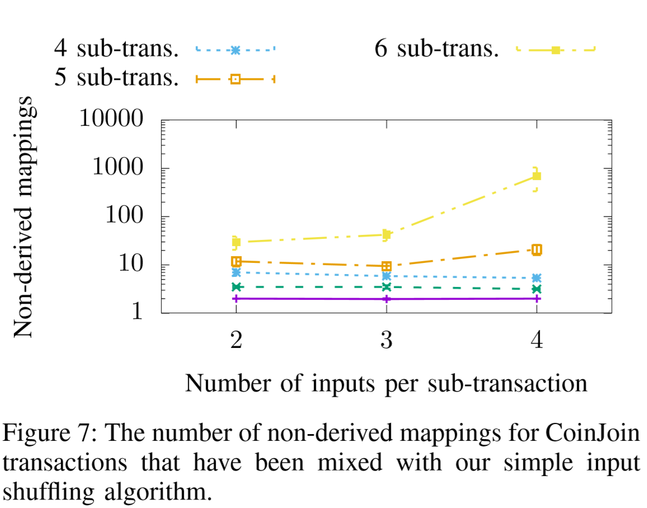
Evaluation

Slide 39
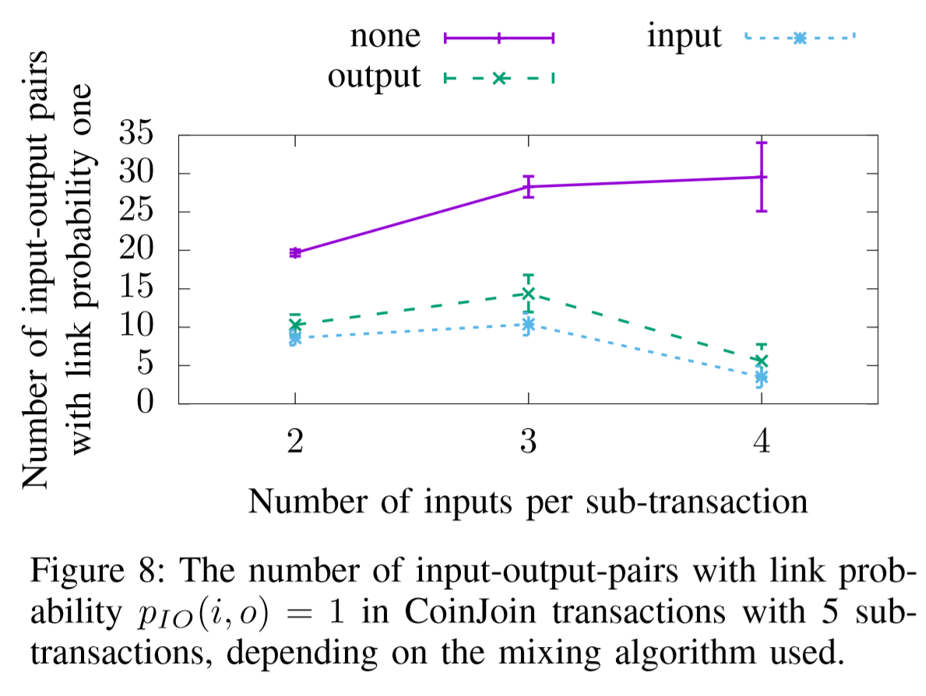
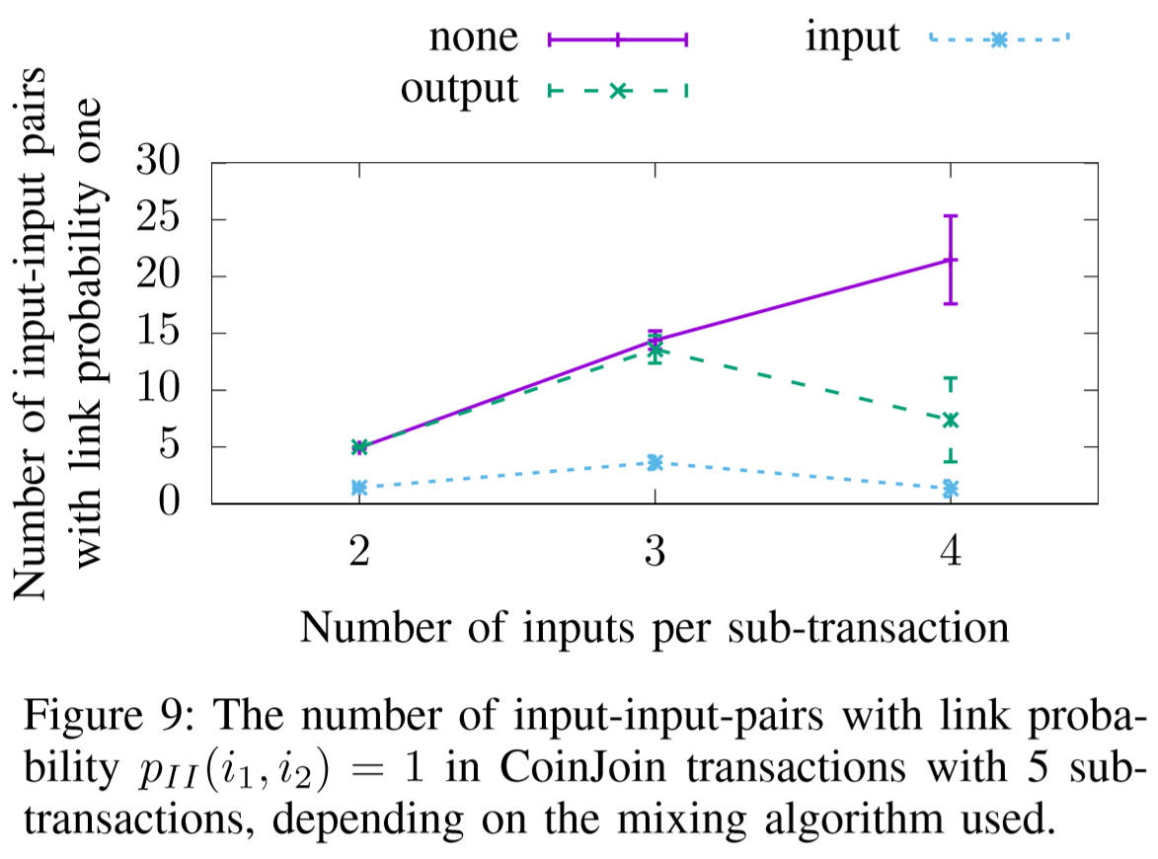
Evaluation

Slide 40
Concluding Thoughts
Anonymity in Computational Complexity
Link between inputs, outputs or both still exist
The entire sub-transaction partition must be known in order to apply the algorithm
Upper bound anonymity is still current ZeroLink
Algorithm relies on increasing number of inputs and outputs (costly)

Slide 41
Now let’s talk ideas
Wasabi should apply Knapsack against the change in ZeroLink mixes.
We should think deeply about Wasabi as a mixing service vs. a sending service
To what extent can we improve trust-lessness?

Slide 42
Knapsack CoinJoin
Anonymous CoinJoin Transactions with Arbitrary Values

