Slide 1
Use Cases and Scenarios

Slide 2
Use Cases
What is a Use Case
  A formal way of representing how a business system interacts with its environment
  Illustrates the activities that are performed by the users of the system
  A scenario-based technique in the UML
  A sequence of actions a system performs that yields a valuable result for a particular actor.

Slide 3
Use Case Analysis
What is an Actor?
  A user or outside system that interacts with the system being designed in order to obtain some value from that interaction
Use Cases describe scenarios that describe the interaction between users of the system (the actor) and the system itself.

Slide 4
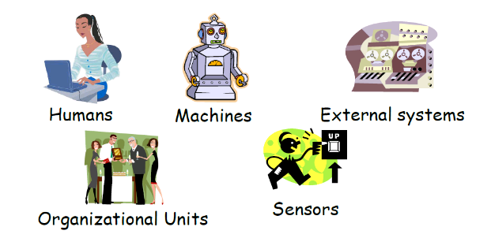
Actors
External objects that produce/consume data:
• Must serve as sources and destinations for data
• Must be external to the system

Slide 5
What is a user story?
An abbreviated description of a use case. Used in
agile development
1.Who? As a <type of user>,
2.Does what? I want <some behavior from the
system>
3. And why? so that <some value is achieved>

Slide 6
A picture describes how actors relate to use cases
and use cases relate to one another.
•Diagrams are not essential. They are helpful in giving an overview, but only secondary in importance to the textual description.
•They do not capture the full information of the
actual use cases
•In contrast, text is essential.
Developed by analysts and domain experts.

Slide 7
Goals and Interactions
Understand what the system shall do
  Capture the user goals
Understand how the user will achieve the goals
  Capture user interactions
  Sequences of user interactions
Thus, start with the user goals and then refine the user goals into several (many) user interactions

Slide 8
Extends
A use-case is similar to another one but does a little bit more
Put the normal behavior in one use-case and the exceptional behavior somewhere else
Example: one UC calls Another under certain condition; think of if-then decision points.

Slide 9
The Home Heating System
*
Temp Sensor
Water Pump
Water Valve
Hot Water
Home
Controller
Burner
Fuel Valve
90
80
70
60
50
Off
On
Fuel
Control Panel
Temp Sensor

Slide 10
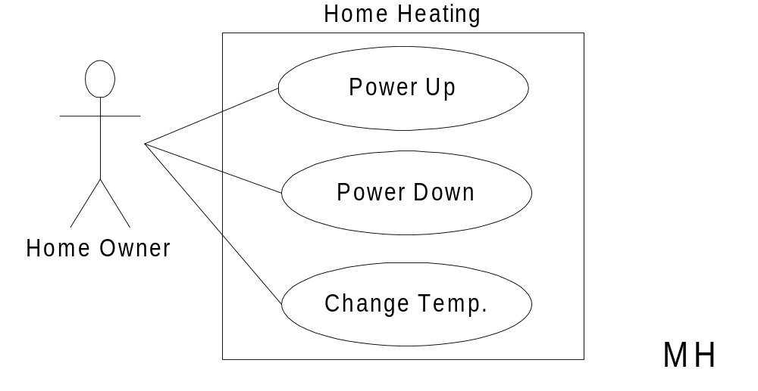
Home Heating Use-Case Diagram

Slide 11
Home Heating Use-Cases
Use case: Power Up
Actors: Home Owner (initiator)
Type: Primary and essential
Description: The Home Owner turns the power on. Each room
is temperature checked. If a room is below the
the desired temperature the valve for the room is
opened, the water pump started. If the water temp falls below threshold, the fuel valve is
opened, and the burner ignited.
If the temperature in all rooms is above the desired
temperature, no actions are taken.
Cross Ref.: Requirements XX, YY, and ZZ
Use-Cases: None

Slide 12
Includes
You have a piece of behavior that is similar across many use cases
Break this out as a separate use-case and let the other ones “include” it
Examples include: Login UC includes User Authentication UC

Slide 13
Modified Home Heating
Home Heating
Power Up
Temp. High
«includes»
«includes»
Power Down
Adjust Temp
Home Owner
«includes»
«includes»
Change Temp.
Temp. Low
MH

Slide 14
Modified:
Home Heating Use-Cases
*
Use case: Power Up
Actors: Home Owner (initiator)
Type: Primary and essential
Description: The Home Owner turns the power on.
Perform Adjust Temp. If the temperature
in all rooms is
above the desired temperature, no actions are taken.
Cross Ref.: Requirements XX, YY, and ZZ
Use-Cases: Perform Adjust Temp

Slide 15
Modified:
Home Heating Use-Cases
*
Use case: Adjust Temp
Actors: System (initiator)
Type: Secondary and essential
Description: Check the temperature in each room. For each room:
Below target: Perform Temp Low
Above target: Perform Temp High
Cross Ref.: Requirements XX, YY, and ZZ
Use-Cases: Temp Low, Temp High

Slide 16
Modified:
Home Heating Use-Cases
*
Use case: Temp Low
Actors: System (initiator)
Type: Secondary and essential
Description: Open room valve, start pump if not started.
If water temp falls below threshold,
open fuel value and ignite burner.
Cross Ref.: Requirements XX, YY, and ZZ
Use-Cases: None

Slide 17
Scenarios -- One Use Case
Power-up
All temps OK
Power-up
All temps too low
Open valves
Ignite burner
Open fuel valve
Start pump

Slide 18
Scenarios -- One Use Case
Power-up
All temps too low
Open valves
Ignite burner
Open fuel valve
Start pump
Burner fails
Shut off fuel
Stop pump
Notify error

Slide 19
HACS
Homework assignment and collection are an integral part of any educational system. Today, this task is performed manually. What we want the homework assignment distribution and collection system (HACS for short) to do is to automate this process.
HACS will be used by the instructor to distribute the homework assignments, review the students’ solutions, distribute suggested solution, and distribute student grades on each assignment.
HACS shall also help the students by automatically distributing the assignments to the students, provide a facility where the students can submit their solutions, remind the students when an assignment is almost due, remind the students when an assignment is overdue.

Slide 20
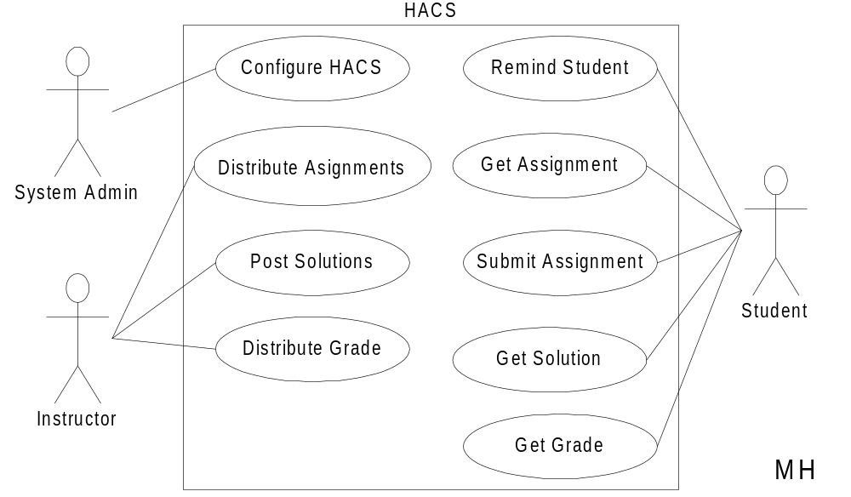
HACS Use-Case Diagram

Slide 21
HACS Use-Cases
Use case: Distribute Assignments
Actors: Instructor (initiator)
Type: Primary and essential
Description: The Instructor completes an assignment and submits
it to the system. The instructor will also submit the
due date and the class the assignment is assigned for.
Cross Ref.: Requirements XX, YY, and ZZ
Use-Cases: Configure HACS must be done before any user
(Instructor or Student) can use HACS

Slide 22
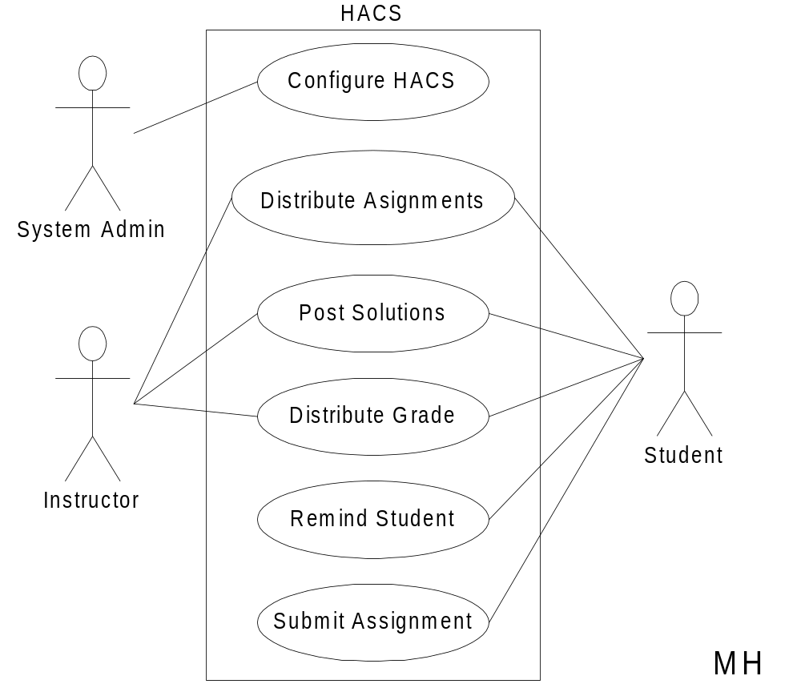
Alternate HACS

Slide 23
Alternate HACS Use-Cases
Use case: Distribute Assignments
Actors: Instructor (initiator), Student
Type: Primary and essential
Description: The Instructor completes an assignment and submits
it to the system. The instructor will also submit the
delivery date, due date, and the class the assignment
is assigned for. The system will at the due date mail
the assignment to the student.
Cross Ref.: Requirements XX, YY, and ZZ
Use-Cases: Configure HACS must be done before any user
(Instructor or Student) can use HACS

Slide 24
When to use Use-Cases
In short, always!!!
Requirements is the toughest part of software development
  Use-Cases is a powerful tool to understand
    Who your users are (including interacting systems)
    What functions the system shall provide
    How these functions work at a high level
Spend adequate time on requirements and in the elaboration phase

