Slide 1
Table of Contents
Introduction
  Manual Testing (MT) and Automation Testing (AT)
  Why Automation?
  Do Always Automation Works?
  Need, Benefits and Cons of AT
  History
Component of Selenium
  Selenium IDE
  Selenium WebDriver
  Selenium RC
  Selenium Grid

Slide 2
Introduction

Slide 3
Introduction
As development is becoming Agile with the changing trend the testing has change its face from Manual to Automation.
Agile development: In the sequential or waterfall model the product coding starts after the gathering whole information and then changes are made after the product is build that takes more time
In Agile the information gathering, coding and changes are done at same time that saves time and money.

Slide 4
Automation Testing (AT) and Manual Testing (MT)
MT: The tester takes over the role of an end-user and tests the software.
AT: The tester writes scripts and uses automated tools to test the validation of the product.

Slide 5
Why Automation?
Repeated test cases
Aids in testing a large test matrix
Enables parallel execution
Encourages unattended execution
Improves accuracy thereby reducing human generated errors
Saves time and money
Faster GoTo market

Slide 6
Do Always Automation Works?
Automation testing cannot be used in following cases:
If user interface change in the near future then any automation cannot be rewritten anyway.
If an application has a very tight or less deadline and there is no time for creating the automation test then manual testing is the best solution.

Slide 7
Need, Benefits and Cons of AT
Need: For regression, repetitive and fast testing.
Benefits: It increases the test coverage, improves accuracy, saves time and money, parallel execution.
Cons: User Experience (UX) and User Interface (UI) can’t be determine by AT.

Slide 8
What to Automate?
Regression Testing: For re-testing preexisting application functions that are being carried forward to new versions (usually the majority, unless app is brand new)
•Smoke Testing: For getting a quick high-level assessment on the quality of a build and making go / no-go decision on deeper testing
•Static & Repetitive Tests: For automating testing tasks that are repetitive and relatively unchanging from one test cycle to the next
•Data Driven Testing: For testing application functions where the same functions needs to be validated with lots of different inputs & large data sets (i.e. login, search)
•Load & Performance Testing: No viable manual alternative exists

Slide 9
Best Practicies of Automation
Best Practice #1: Plan for Test Automation as Early as Possible
Best Practice #2: Plan to Automate Tests for Both Functional and Non-Functional Requirements
Best Practice #3: Establish a Test Automation Architecture
Best Practice #4: Keep Functional Test Automation Out of the Critical Path
Best Practice #5: Design Manual Tests in Collaboration with Test Automation Engineers
Best Practice #6: Use Keyword-Based Test Design Techniques
Best Practice #7: Use PageObjects Pattern
Best Practice #8: Provide for Fast Data-Reset Capabilities
Best Practice #9: Choose the right tool
Best Practice #10: Create reusable and maintainable automated tests

Slide 10
Web application automation tools
Selenium
Katalon Studio
TestCafe
CasperJS
Screenster
SoapUI
Sahi
Watin
Watir
QTP (UFT)

Slide 11
Selenium

Slide 12
Selenium
It is AT suites provide web based AT.
Why Selenium?
  It’s open source
  Can integrate with Test Management tools like Testlink and xstudio.
  Has active repository developments
  Not Expensive.

Slide 13
History
Jason Huggins developed a Javascript library in 2004 that interact with webpage and automatically rerun tests against multiple browsers.
That library eventually became Selenium Core
Selenium Core later then become base of Selenium Remote Control (RC) and Selenium IDE.
Huggins and Google joined in 2007 and ThoughtWorks developed WebDriver without Huggins.
In 2008 ThoughtWorks developed Selenium Grid.
In 2009 Google and ThouhtWorks merge the two projects Selenium RC and WebDriver together known as Selenium 2.0. Selenium RC alone known as Selenium 1.
Mercury poisoning can be cure taking Selenium.

Slide 14
Cons in Selenium
Selenium supports only web based applications
It does not support the Bitmap comparison
For any reporting related capabilities have to depend on third party tools
No vendor support for tool compared to commercial tools like HP UFT
As there is no object repository concept in Selenium, maintainability of objects becomes difficult

Slide 15
Components of Selenium

Slide 16
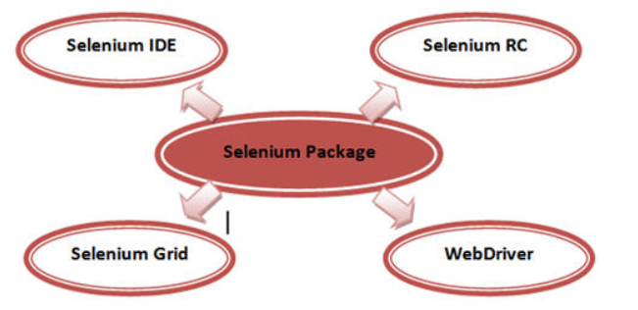

Slide 17
Cons in Selenium IDE
Exceptional handling is not present
Selenium IDE uses only HTML languages
External databases reading is not possible with IDE
Reading from the external files like .txt, .xls is not possible
Conditional or branching statements execution like if,else, select statements is not possible

Slide 18
Selenium RC
Selenium-RC worked the same way for each supported browser. It ‘injected’ javascript functions into the browser when the browser was loaded and then used its javascript to drive the AUT within the browser.
WebDriver does not use this technique. Again, it drives the browser directly using the browser’s built in support for automation.

Slide 19
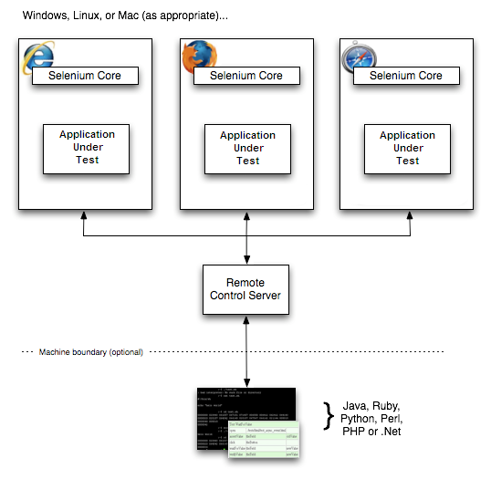

Slide 20
Selenium Server receives Selenium commands from your test program, interprets them, and reports back to your program the results of running those tests.
Selenium-Core is a JavaScript program, actually a set of JavaScript functions which interprets and executes Selenese commands using the browser’s built-in JavaScript interpreter.
http://www.seleniumhq.org/docs/05_selenium_rc.jsp

Slide 21
Cons of Selenium RC
RC means Remote Control, while executing tests using Selenium RC it is obvious to have Selenium RC Server between Application under test & Test Automation Suite. This methodology of Client Server architecture of Selenium RC makes it slower then Selenium Web Driver.
Redundancy of commands
RC cannot support headless browser but WebDriver can.
  No support to listeners
  Cant handle Ajax calls and navigations efficiently.

Slide 22
Selenium WebDriver
Created by Simon Stewart
No JavaScript required make the test case light.
Supports web-based and web based mobile testing.
Pure object oriented framework.
Supports a wide range of web browsers and programming languages.
Fastest of all the other tools in Selenium tool.

Slide 23
Language Support
Java
C#
Ruby
Python
JavaScript
Perl
PHP
Haskell
Object-C
R
Dart
Tcl

Slide 24
Browser Support
Google Chrome Driver
IE
SafariDriver
Opera
GhostDriver
Firefox

Slide 25
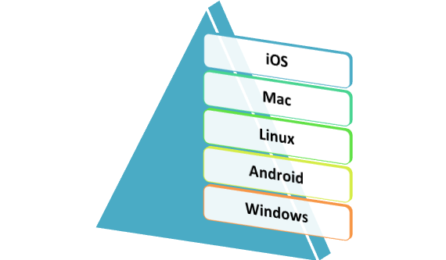

Slide 26

Architecture
Selenium-WebDriver makes direct calls to the browser using each browser’s native support for automation.
How these direct calls are made, and the features they support depends on the browser you are
using.

Slide 27
for each Selenium command, a HTTP request is created and sent to the browser driver
the browser driver uses a HTTP server for getting the HTTP requests
the HTTP server determines the steps needed for implementing the Selenium command
the implementation steps are executed on the browser
the execution status is sent back to the HTTP server
the HTTP server sends the status back to the automation script

Slide 28
Pros:
  Fast
  Purely object oriented
  Support Web and Mobile-web based testing.
  Cannot enter value into disabled elements like Selenium RC
  Support HtmlUnit browser
  Web Driver commands are easy and less complex then Selenium RC

Slide 29
Cons
  Complex
  No built in test result generator like Selenium RC
  Does support new brosers readily
  User should know a programming language.
  Does not support flash objects.

Slide 30
Selenium 1 vs Selenium 2
Handling multiple frames, pop ups , multiple browser windows and alerts
Page navigation and drag & drop
Ajax based UI elements
Multi browser testing including improved functionality for browser not well supported by Selenium 1.0

Slide 31
Changes between Selenium 2.0 and Selenium 3.0
The big change is that the old Selenium Core libraries will be omitted in 3.0. The focus is shift completely to the WebDriver API. The reason they're retiring the Selenium Core is because it's becoming increasingly hard to test modern web applications using a pure JavaScript approach.
The Selenium Java APIs: The Selenium Java APIs will be broken into three packages: selenium-java (WebDriver classes), Selenium 3 server (command line remote server), and leg-rc, which will provide the current Selenium interface and client-side classes allowing execution of existing Selenium tests. Instead of Selenium Core, the leg-rc is backed by the WebDriver implementation.
The browser vendors will own drivers: The browser providers will accept responsibility for the implementation of the WebDriver API. The vendors have access to the internal implementation of their browsers, so putting this spec in their hands will allow for more advanced WebDriver implementations. It also will open up more sophisticated features for Selenium in particular by moving much of the workload off of the open-source contributors and into the hands of the browser vendors. They'll be able to do things and use their own technologies to improve Selenium in ways that the general open-source community could never have

Slide 32
W3C WebDriver specification:The WebDriver API has grown to be relevant outside of Selenium. It is used in multiple tools for automation. For example, it's used heavily in mobile testing through tools such as Appium and iOS Driver. The W3C standard will encourage compatibility across different software implementations of the WebDriver API.
There are some other changes that you might need to be aware of:
You’ll need to be running Java 8 to use the Java pieces of Selenium.
Support for Firefox is via Mozilla’s geckodriver.
Support for Safari is provided on macOS (Sierra or later) via Apple’s own safaridriver.
Support for Edge is provided by MS through their webdriver server.
Only versions 9 or above of IE are supported. Earlier versions may work, but are no longer supported as MS no longer supports them.

Slide 33
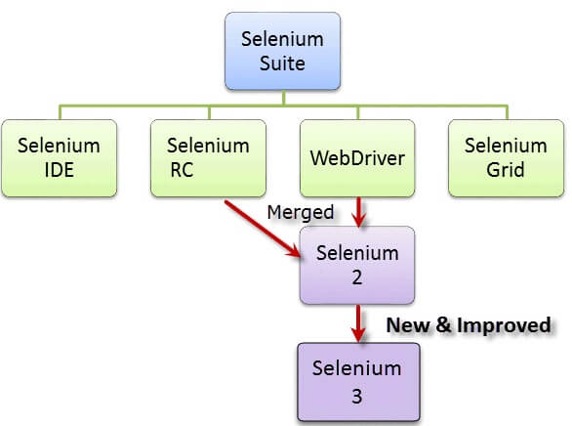

Slide 34
How To Write Maintainable Tests
Use the Page Object & Page Factory design patterns. These will ensure you keep your driver navigation type code in one place and will greatly enhance code maintainability, readability, and reusability.
Your automation code should be treated as production-quality code. Use proper Object Oriented design.
If your test data is represented in objects (which it should be) which will minimise your code to create objects, and provides your objects with default data. (Don’t pollute your tests with data that is irrelevant)
Depending on the audience of your tests, consider using something like Concordion, Cucumber, or JBehavecreates a “human readable” test to form part of Living Documentation to aid Behaviour Driven Development (BDD).
It’s also worth considering using a comprehensive framework, such as Thucydides which already addresses many of the best practices and provides a wealth of bonus functionality including integration with JIRA and reporting.

Slide 35
Selenium Grid
Selenium Grid was introduced by Pat Lightbody in order to address the need for executing the test suites on multiple platforms simultaneously.

Slide 36
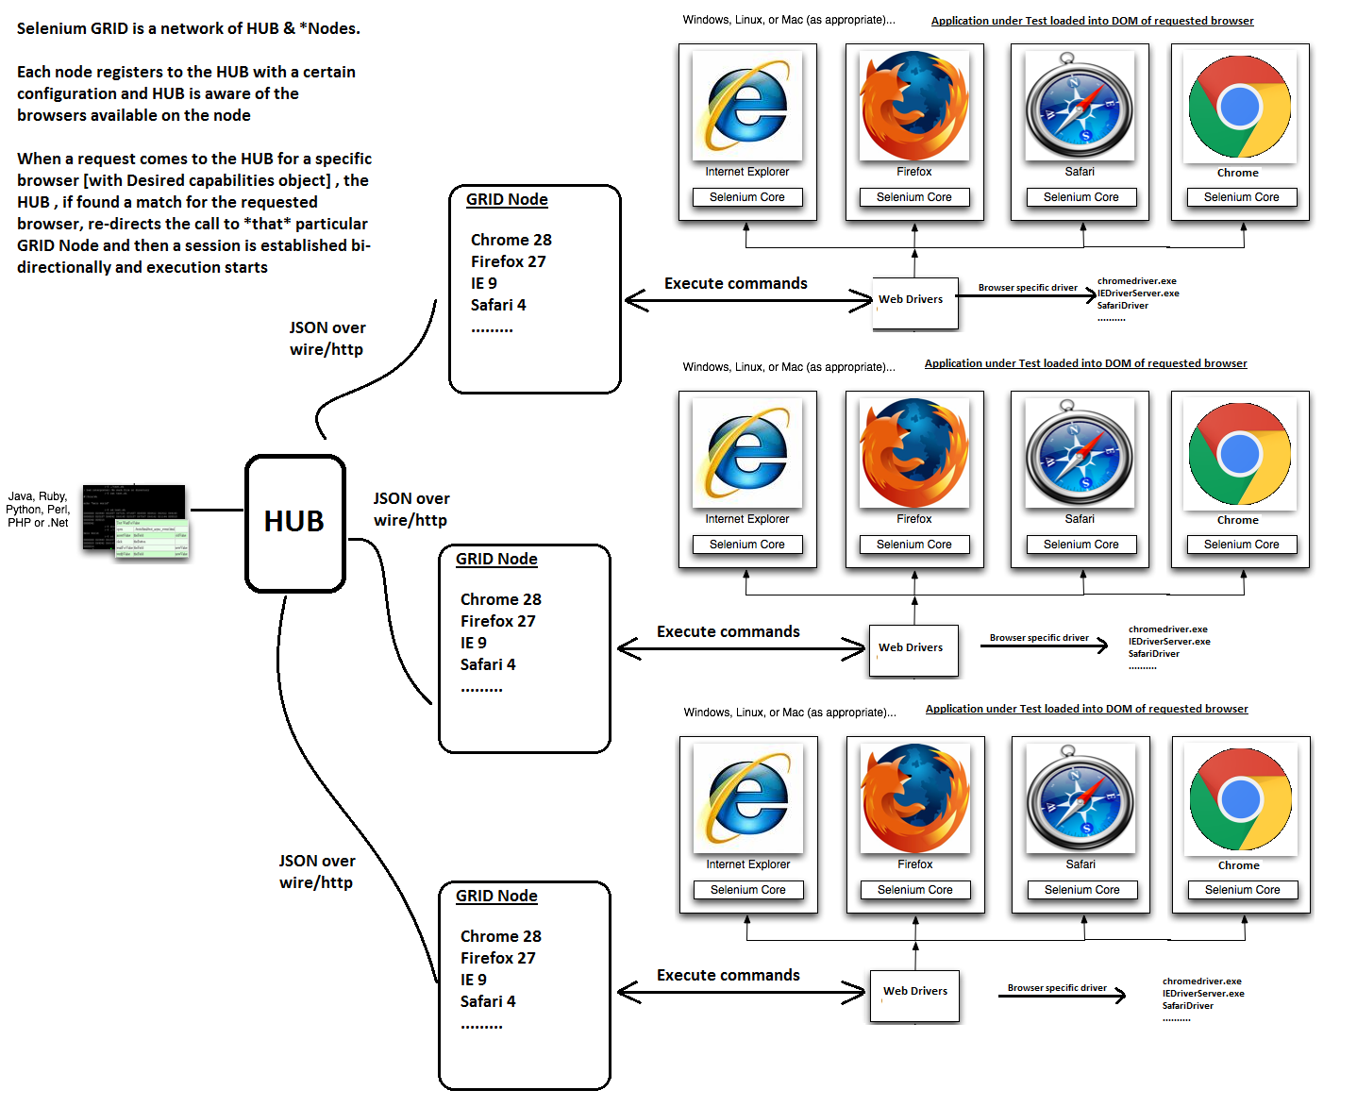

Slide 37
Tools don’t test. Only people test. Tools only perform actions that “help” people test.
--“James Bach”

