Slide 1
A Presentation on
Java Programs & Puzzles
Created By: Ankit Sehgal

Slide 2
WAP TO PRINT IF NUMBER IS PRIME OR NOT.
public class HelloWorld
{
public static void main(String []args)
{
int i=0; int num=4;
for(i=2;i<num;i++)
{
if(num%i==0)
{
System.out.println("Number is not prime");
break;
}
else
System.out.println("Number is prime");
break; }}}
// OUTPUT:- Number is not prime

Slide 3
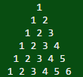
WAP TO PRINT PYRAMID OF NUMBERS WITH ALTERNATE NUMBER IN CONSECUTIVE ROWS.
public class HelloWorld
{
public static void main(String []args)
{
int i=0; int x;int z=1; row=6;
for(x=row;x>=1;x--) // No. of rows
{
for(z=1;z<=x;z++)
{
System.out.print(" ");
}
for(i=0;i<=row-x;i++)
System.out.print(i+1+ " " );
System.out.println(); }}}

Slide 4
WAP TO GENERATE FIBONACCI SERIES
class HelloWorld
{
public static void main(String args[])
{
int n1=0,n2=1,n3=0,i;
System.out.print(n1+" "+n2); //printing 0 and 1
for(i=2;i<12;i++) //loop starts from 2 because 0 and 1 are already printed
{
n3=n1+n2;
System.out.print(" "+n3);
n1=n2; //n1=1
n2=n3; // n2=1
}}}
OUTPUT:- 0 1 1 2 3 5 8 13 21 34

Slide 5
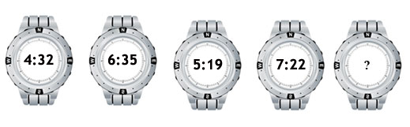
FIND THE TIME IN THE LAST WATCH?

Slide 6
Explanation:
Answer: 6:06
From Left to Right,
The time on the watches increases by 2 hours 3 minutes,
then decreases by 1 hour 16 minutes, alternately.

Slide 7
How many people are there in the theater?
15 people entered a theater before Sujit. 7 people entered the theater between Sujit and Suraj and 20 people entered the theater after Suraj.
A. 28
B. 36
C. 44
D. 40
E. Cannot be determined.

Slide 8
Explanation:
Answer: Option E
If Sujit entered before Suraj then the number of people will be 15 + 1(Sujit) + 7 + 1(Suraj) + 20 = 44.
If Suraj entered before Sujit then number of people will be 7 + 1(Suraj) + 7 + 1(Sujit) + 12 = 28.
So, the number of people in the theater cannot be determined.

Slide 9
THANK YOU

