Slide 1
A Presentation on
Puzzles
Created By: Ankit Sehgal

Slide 2
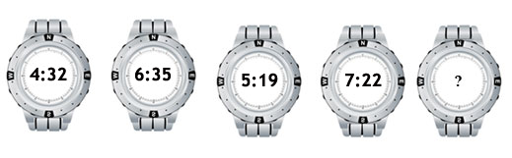
FIND THE TIME IN THE LAST WATCH?

Slide 3
Explanation:
Answer: 6:06
From Left to Right,
The time on the watches increases by 2 hours 3 minutes,
then decreases by 1 hour 16 minutes, alternately.

Slide 4
How many people are there in the theater?
15 people entered a theater before Sujit. 7 people entered the theater between Sujit and Suraj and 20 people entered the theater after Suraj.
A. 28
B. 36
C. 44
D. 40
E. Cannot be determined.

Slide 5
Explanation:
Answer: Option E
If Sujit entered before Suraj then the number of people will be 15 + 1(Sujit) + 7 + 1(Suraj) + 20 = 44.
If Suraj entered before Sujit then number of people will be 7 + 1(Suraj) + 7 + 1(Sujit) + 12 = 28.
So, the number of people in the theater cannot be determined.

Slide 6
THANK YOU

