Slide 1
Presentation on String Programs
Search a word in String
Reverse the String without using Reverse function
Find the frequency of each letter/ alphabet on a String
Puzzles
Submitted by:
Savita Singla
Reg-ID- 10468

Slide 2
Program to search a word in String
import java.util.Scanner;
class ss2{
public static void main(String a[]){
String s1,s2,s3;
Scanner s=new Scanner(System.in);
System.out.println("Enter any string");
s1=s.nextLine();
System.out.println("Enter any word");
s2=s.nextLine();
if(s1.contains(s2))
System.out.println(" Word is present in string");
else
System.out.println(" Word is not present in string");
}}

Slide 3
Reverse the String without using the reverse function
import java.util.Scanner;
public class reverse{
public static void main(String a[]){
String s1,s2=" ";
Scanner s=new Scanner(System.in);
System.out.println("Enter any string");
s1=s.nextLine();
for (int i=s1.length()-1;i>=0;i--)
s2=s2+s1.charAt(i);
System.out.println(" The reverse of string is " + s2);
}
}

Slide 4
Program to find the frequency of each letter/ alphabet on a string
import java.util.Scanner;
class frequency{
public static void main (String a[]){
String s1;
int count=0,i=0;
char s2;
boolean flag=true;
String s3="";
Scanner s=new Scanner(System.in);
System.out.println(" Enter any string");
s1=s.nextLine();
for(int k=0;k<s1.length();k++)
{
for(int p=0;p<s3.length();p++)

Slide 5
if(s3.charAt(p)==s1.charAt(k))
flag=false;
if(flag==true)
{
s2= s1.charAt(k);
for (int j=0;j<s1.length();j++)
{
if(s2==s1.charAt(j))
{
count++;
}
}
System.out.println(" The" + s1.charAt(k)+ "letter/alphabet comes "+ count +" times in string");
count=0;
s3=s3+s1.charAt(k);
}
flag=true;
}
}
}

Slide 6
Puzzles

Slide 7
Puzzle 1:
You have 3 bags with you – one with oranges only, one with apples only and one with a mix of both . But, the labels on all three bags are wrong. What is the minimum number of draws you would need to make, in order to identify all three bags correctly.

Slide 8
Answer: Only 1 time

Slide 9
Puzzle 2: There are 25 horses among which you need to find out the fastest 3 horses. You can conduct race among at most 5 to find out their relative speed. At no point you can find out the actual speed of the horse in a race. Find out how many races are required to get the top 3 horses.

Slide 10
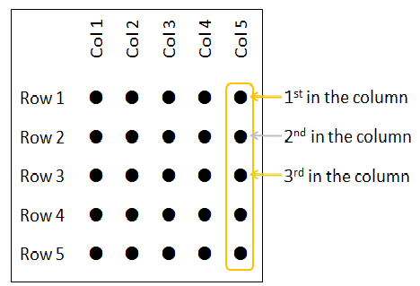
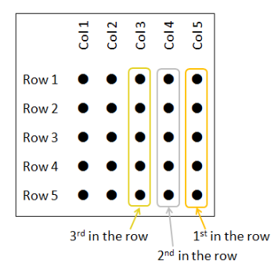
The Answer is 7.

Slide 11
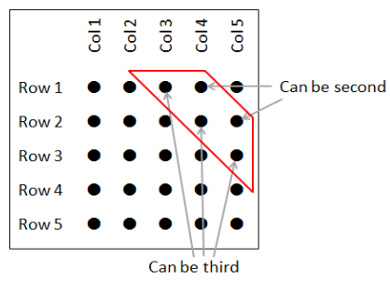

Slide 12
Thank you

