Slide 1


NAMASTEY!
Lets go for the Assignment.

Slide 2
WAP to find the sum of any digit?
public class Sumofdigit
{
public static void main(String[] args)
{
int a=512;int c=0;
int sum = 0,d=0;
for(d=a;d>0;)
{
c = d % 10;
sum=sum+c;
d = d/10;
}
System.out.println("sum "+sum);
}
}
ANSWER is = 8

Slide 3
WAP to find out the length of any string, in C?
C program to find the length of a string without using the built-in function.
#include <stdio.h>
void main()
{
char string[1000];
int i, length = 0;
printf("Enter a string \n");
scanf(“%s”,string);
for (i = 0; string[i] != '\0'; i++)
{
length++;
}
printf("The length of a string is the number of characters in it \n");
printf("So, the length of %s = %d\n", string, length);
}

Slide 4
WAP to find the length of any String?
public class lenofstring
{
public static void main(String[] args)
{
String a ="helloo";
char c[]=a.toCharArray();
int l=0;
for (char b : c)
{
l++;
}
System.out.print("length: "+l);
}
}
ANSWER is = 6

Slide 5
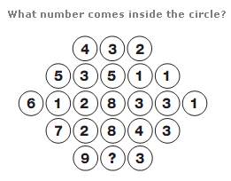
PUZZLE 1

Slide 6

ANSWER
Answer | : | 6
Explanation | : | Looking at the diagram in rows, the central circle equals half the sum of the numbers in the other circles to the left and right of the centre.

Slide 7
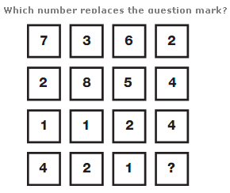
PUZZLE 2

Slide 8
ANSWER
Ans | : | 4
Expllanation | : | Working in columns, the sum of the numbers in each column is always 14.

Slide 9

Thank you for standing with my presentation.

