Slide 1
BTES
NAME : MOHAMMAD IRSHAN
COURSE : SQAM

Slide 2
PROGRAMS

Slide 3
WRITE A PROGRAM TO PRINT PYRAMID OF NUMBERS WITH ALTERNATE NUMBERS.
#include<iostream>
using namespace std;
Int main()
{
I int rows, k = 0;
cout<< “Enter number of rows: “;
cin>> rows;
for(int I = 1; I <= rows; i++)
{
for(int space = 1; space <= rows; space--)
{
cout<< “ “;
}
for(int display=1; display<=1; display++)
cout<<row ;
}
}
cout<</n;
}

Slide 4
OUTPUT 1 2 2 3 3 3 4 4 4 4

Slide 5
Write a Program to find largest among three numbers
#include <iostream>
using namespace std;
int main()
{
float n1, n2, n3;
cout << "Enter three numbers: ";
cin >> n1 >> n2 >> n3;
if(n1 >= n2 && n1 >= n3)
{
cout << "Largest number: " << n1;
}
if(n2 >= n1 && n2 >= n3)
{
cout << "Largest number: " << n2;
}
if(n3 >= n1 && n3 >= n2)
{
cout << "Largest number: " << n3;
}
return 0;
}

Slide 6
PUZZLES

Slide 7
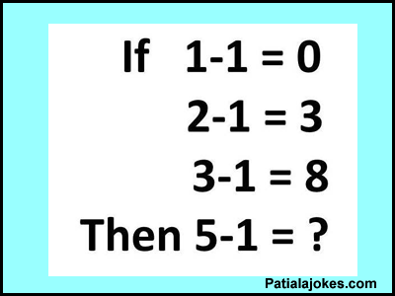

Slide 8
Find the smallest +ve mathematical number which is spelled in an alphabetical order ?

