Slide 1
BTES Bebo Technical Education Services Pvt. Ltd Chandigarh
PowerPoint Presentation Submitted by: NilimaBhardwaj Under the Guidance of Ms. Raman Bhinder Submitted in partial fulfillment of the requirement for the award of the SOFTWARE QUALITY ASSURANCE

Slide 2
Write a program to print Pyramid
#include<stdio.h> int main() { int i,j,k; For(i=1;i<=5;i++) { for(k=5;k>=i;k--) { printf(" "); } for(j=1;j<=i;j++) { printf(" %d ",i); } printf (" \n"); } }

Slide 3
Write a program to find largest among three numbers
#include<stdio.h> main() { int a=5,b=7,c=3; printf("Which one is the largest number? "); if((a>b) && (a>c)) { printf(" a is largest"); } else if ((b>a) && (b>c)) { printf ("b is largest "); } else printf(" c is largest "); }

Slide 4
PUZZLES

Slide 5
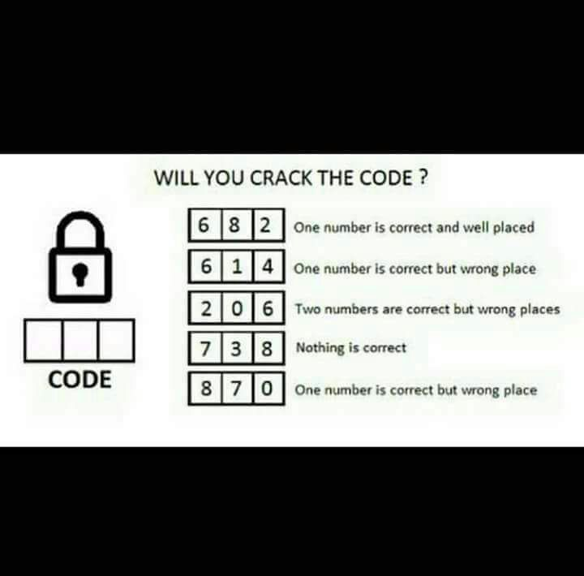

Slide 6
Solution: The code is 042

Slide 7
What comes at the place of _ _ _
_ _ _ 7 8 9 4 5 6 1 2 3

Slide 8
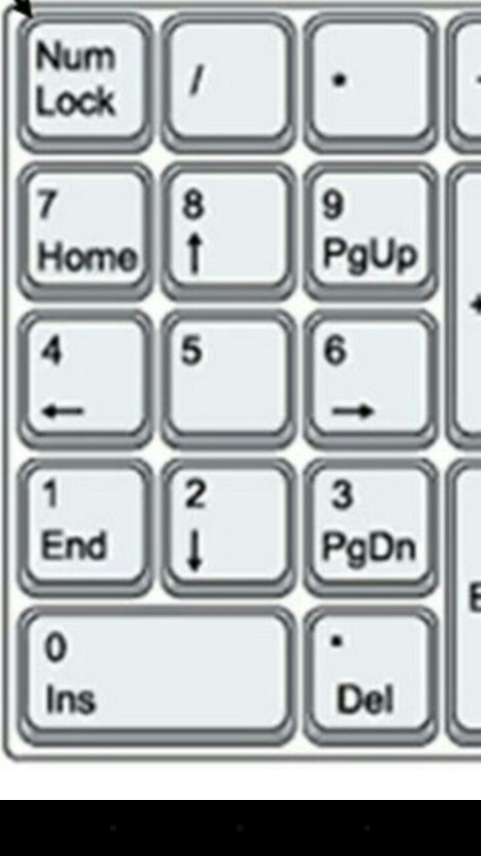

Slide 9
THANK YOU

