Slide 1
P2P - The Octopus
AHMAD, FARHAN
ALIPOURSIMAKANI, KAMRAN
ANDERSSON EKSTRÖM, MAX
BERNTSSON, FREDRIK
CHADALAPAKA, GAYATRI
IQBAL, NAYYAR
KUKKAPALLI, NAGA VYSHNAVI
NYHLÉN, JESPER
ROUTHU, VENKATA SAI KALYAN
ZAREI, KAMBIZ

Slide 2
Project description
-P2P application
-Bootstrap server
-Dark content
-GUI
-Secure communication
Notes:
Fredrik 2-6

Slide 3
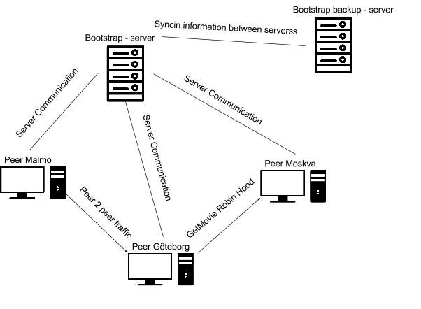
System architecture
Bootstrap server
-Backend
-Database
Clients
-GUI
-Backend
-Database

Slide 4
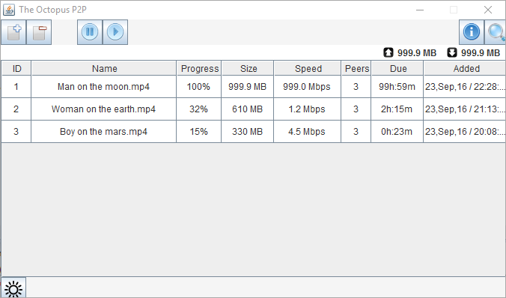
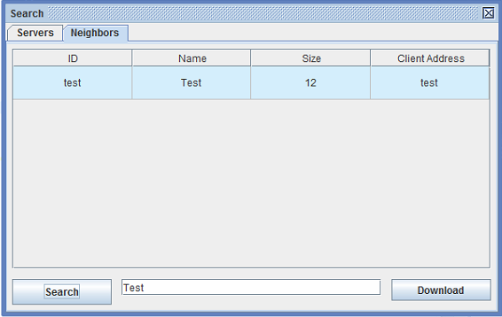
GUI

Slide 5
Technical challenges
-Java
-Integration
-Maven, build and dependency
-Threading
-Protocol

Slide 6
Working in a large groups
-Meetings
-Getting organized, sub teams
-Working effectively (Split tasks)
-Group room
Notes:
how was it to work in a large group: challenges, failures, success stories

Slide 7
Software development techniques
Agile development
Sprint based
Weekly meetings(Successes, Problem, Progress)
Notes:
Kambiz 7-10

Slide 8
Using GitLab
-Git
-Issues
-Milestones
-Readme
Notes:
how did you use of the management tools in GitLab? Did you find them helpful? If not, what was missing/difficult?

Slide 9
Experiences
-Java
-Work together
-Define modules/APIs etc earlier
-Git
Notes:
leassons learned? what would you do different?

Slide 10
Improvements for next year
-Skip Project Libre
-More regular feedback on documentation
-More teacher meetings
-Focus on documenting some parts

