Slide 1







STACK OVERFLOW DEVELOPER SURVEY-2019
BEATRIZ T. RICARDO FERRO
APRIL 2024

Slide 2


OUTLINE
Executive Summary
Introduction
Methodology
Results
Visualization – Charts
Dashboard
Discussion
Findings & Implications
Conclusion
Appendix

Slide 3
EXECUTIVE SUMMARY
Current Technology Usage
Top 10 programming languages in demand
Top 10 Database in demand
Popular Platforms
Top 10 Web Frame
Future Technology Trends
Top 10 Language Desire Next Year
Top 10 Database Desire Next Year
Popular Platforms Desire Next Year
Top 10 Web Frame Desire Next Year
Demographics
Respondent classified by Gender
Respondent Count by Countries
Respondent Count by Age
Respondent Count by Gender, classified by Formal Education Level

Slide 4
INTRODUCTION
Stack Overflow’s annual Developer Survey is the largest and most comprehensive survey of people who code around the world.
Each year, they field a survey covering everything from developers’ favorite technologies to their job preferences.
2019 marks the ninth year they have published their annual Developer Survey results, and nearly 90,000 developers took the 20-minute survey earlier this year.

Slide 5
INTRODUCTION
The Stack Overflow Developer Survey 2019 offers a complete overview of the world developer community's preferences, trends, and demographics.
The survey provides insights into current technology usage, future trends, and the diversity within the developer ecosystem
Principal aspects include top programming languages, databases, platforms, and web frameworks in use, as well as desired technologies for the upcoming year.
Additionally, the survey reveals respondent demographics, including gender distribution, country representation, age groups, and educational backgrounds.
Overall, the Stack Overflow Developer Survey 2019 serves as a valuable resource for understanding the evolving landscape of technology and development.

Slide 6

METHODOLOGY
Data Collection
Collecting Data Using APIs
Collecting Data Using Web Scraping
Exploring Data
Data Wrangling
Finding Missing Values
Determine Missing Values
Finding and Removing Duplicates
Normalizing Data
Exploratory Data Analysis
Distribution
Outliers
Correlation
Dashboard
Report is based on data from:
• Stack Overflow Developer Survey 2019;
• Job Data from GITHUB job portal;
• Average annual salary report by IBM;

Slide 7
RESULTS

Slide 8
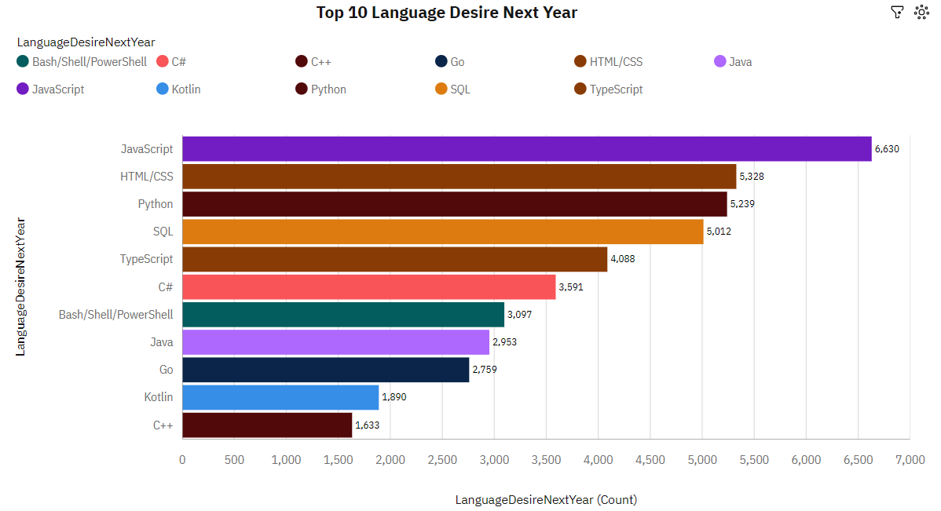
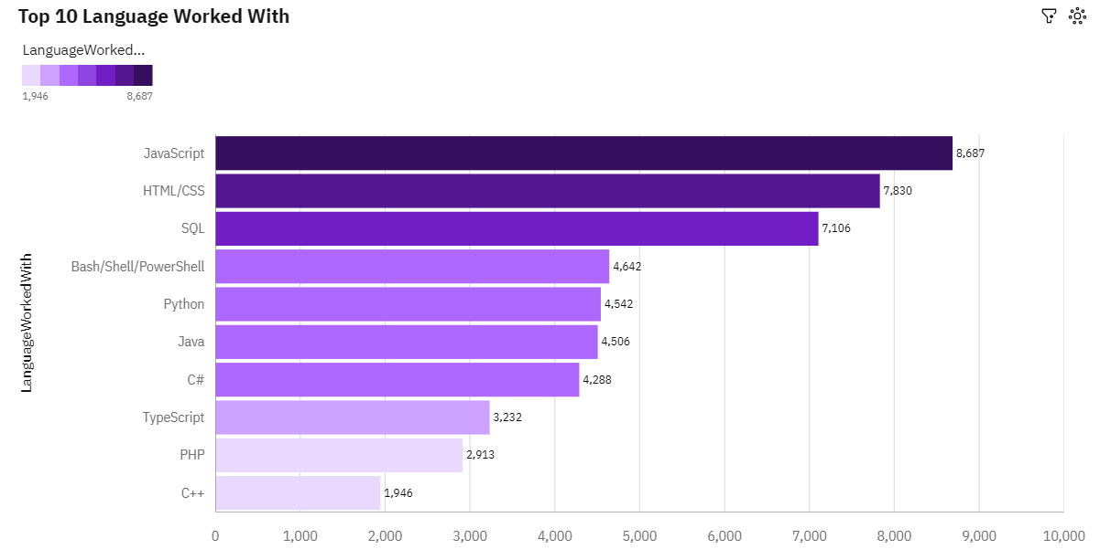
PROGRAMMING LANGUAGE TRENDS
Current Year
Next Year

Slide 9
PROGRAMMING LANGUAGE TRENDS - FINDINGS & IMPLICATIONS
Findings
JavaScript and HTML were the top programming languages in 2019 and are also highly desired for the upcoming year.
SQL continues to be the favored programming language for 2019 and the subsequent year.
Growing interest in Python and TypeScript reflects their rising popularity;
Declining interest in Bash/Shell/Power Shell.
Implications
JavaScript and HTML are expected to remain the dominant programming languages, but there could be a transition among developers moving from JavaScript to TypeScript.
The increasing popularity of Python suggests a rising demand for data science professionals in the market.
Interest among developers in Java, C#, and C++ appears to be diminishing

Slide 10
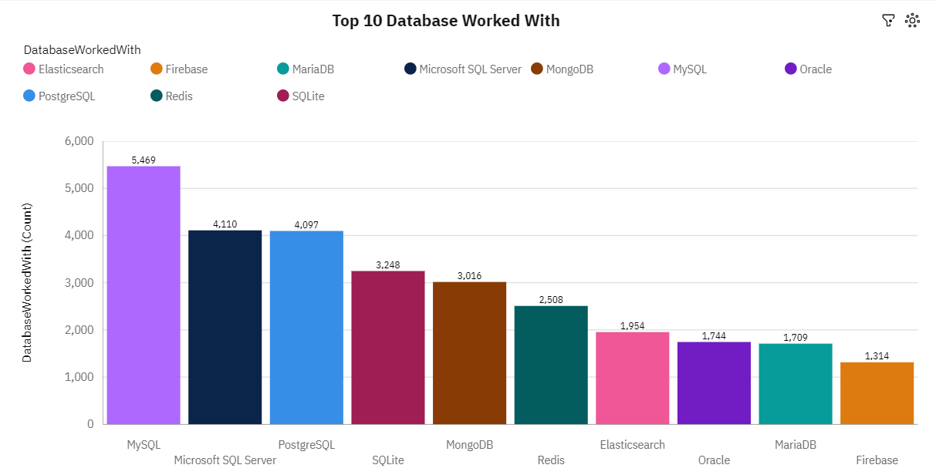
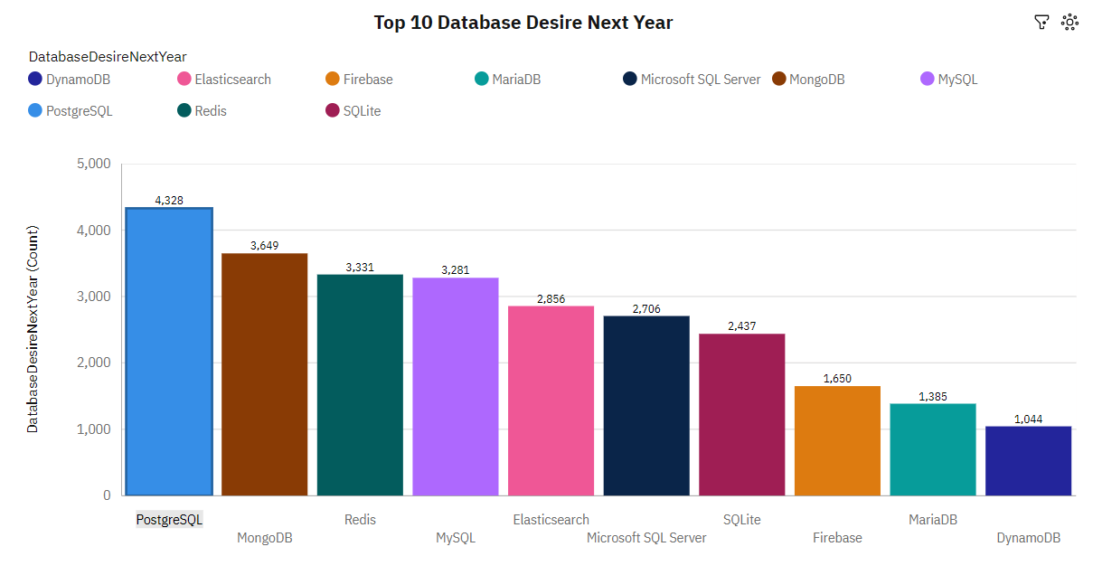
DATABASE TRENDS
Current Year
Next Year

Slide 11
DATABASE TRENDS - FINDINGS & IMPLICATIONS
Findings
SQL databases were the most used types of databases in 2019, with MySQL at the top, then Microsoft SQL Server, PostgreSQL, and SQLite.
PostgreSQL is becoming more popular compared to other SQL databases and is the most wanted database for the next year.
MongoDB, Elasticsearch, and Redis are getting more attention for the upcoming year.
Implications
Usage of database choice is changing very fast;
Professional developers seem to like using open-source databases like PostgreSQL, MongoDB, Redis, and MySQL in the future.
The growing popularity of NoSQL databases like MongoDB, Elasticsearch, and Redis shows a market trend toward using a database system that can manage large amounts of unstructured data.
Learning more than one database is promising more opportunities in the future.

Slide 12
DASHBOARD
In this section will show the static screenshots of the dashboard that summarize the following:
I. Current Technology Usage
II. Future Technology Trends
III. Demographics of Respondents
By clicking the link below you will have access to the dashboard.
https://github.com/BTRF2404/bug-free-octo-palm-tree/blob/main/Collecting_Jobs_data_Using_API-Questions.ipynb

Slide 13
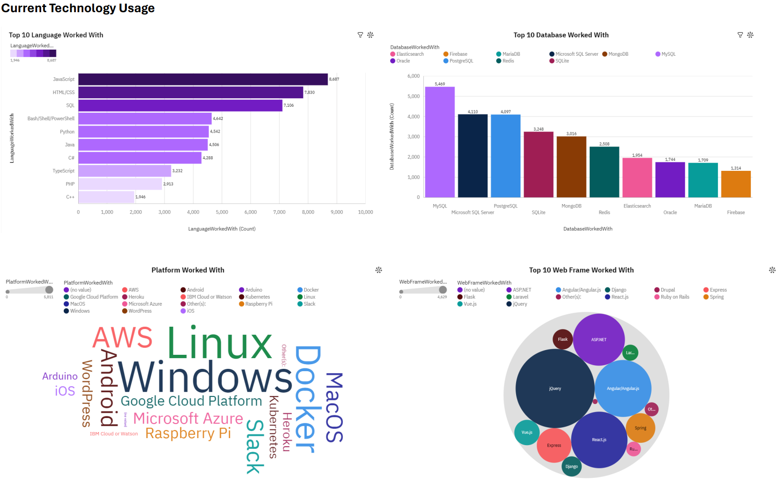
DASHBOARD TAB 1

Slide 14
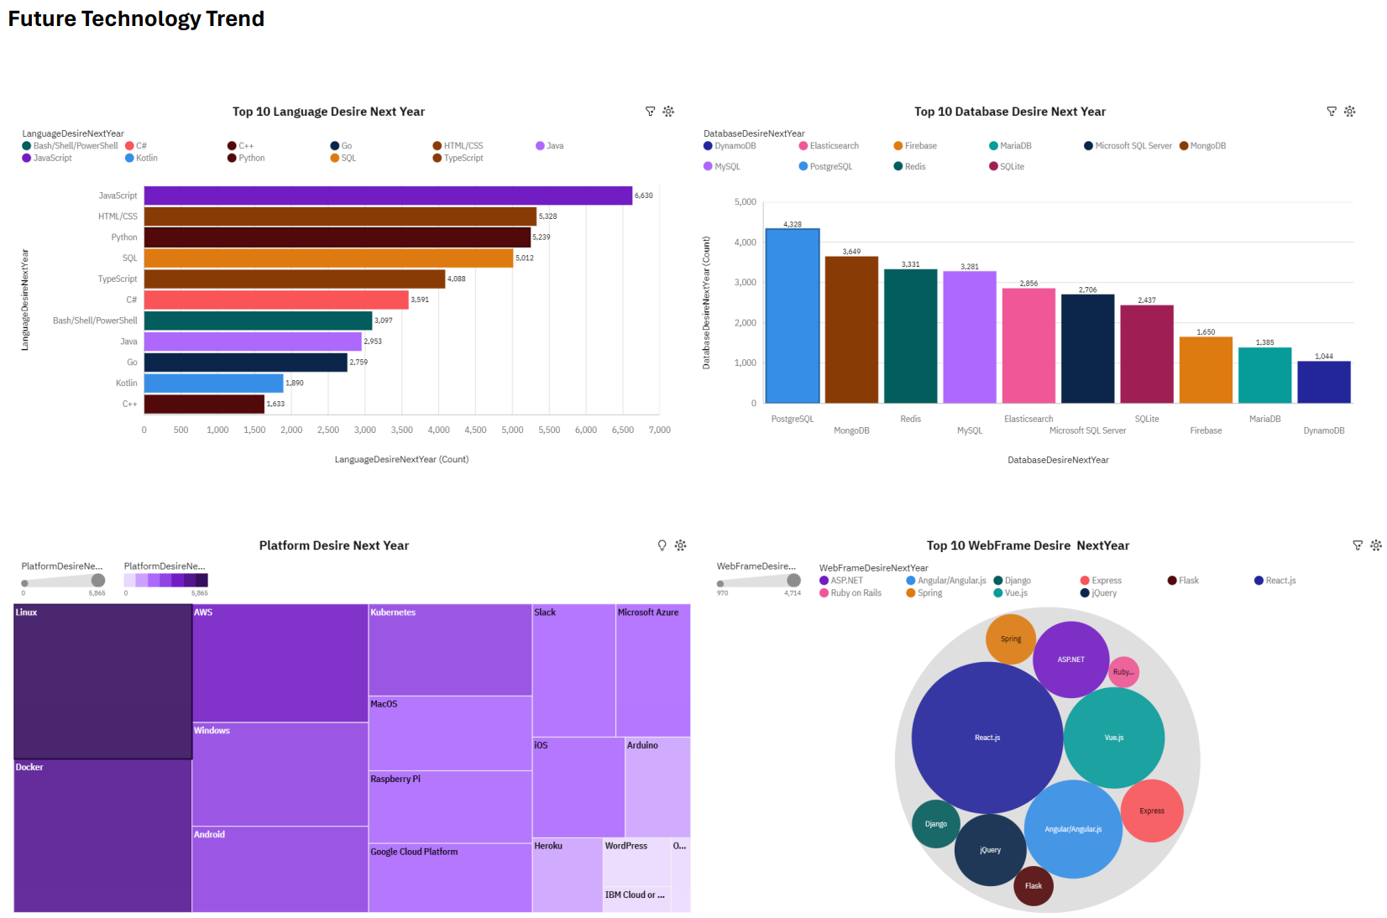
DASHBOARD TAB 2

Slide 15
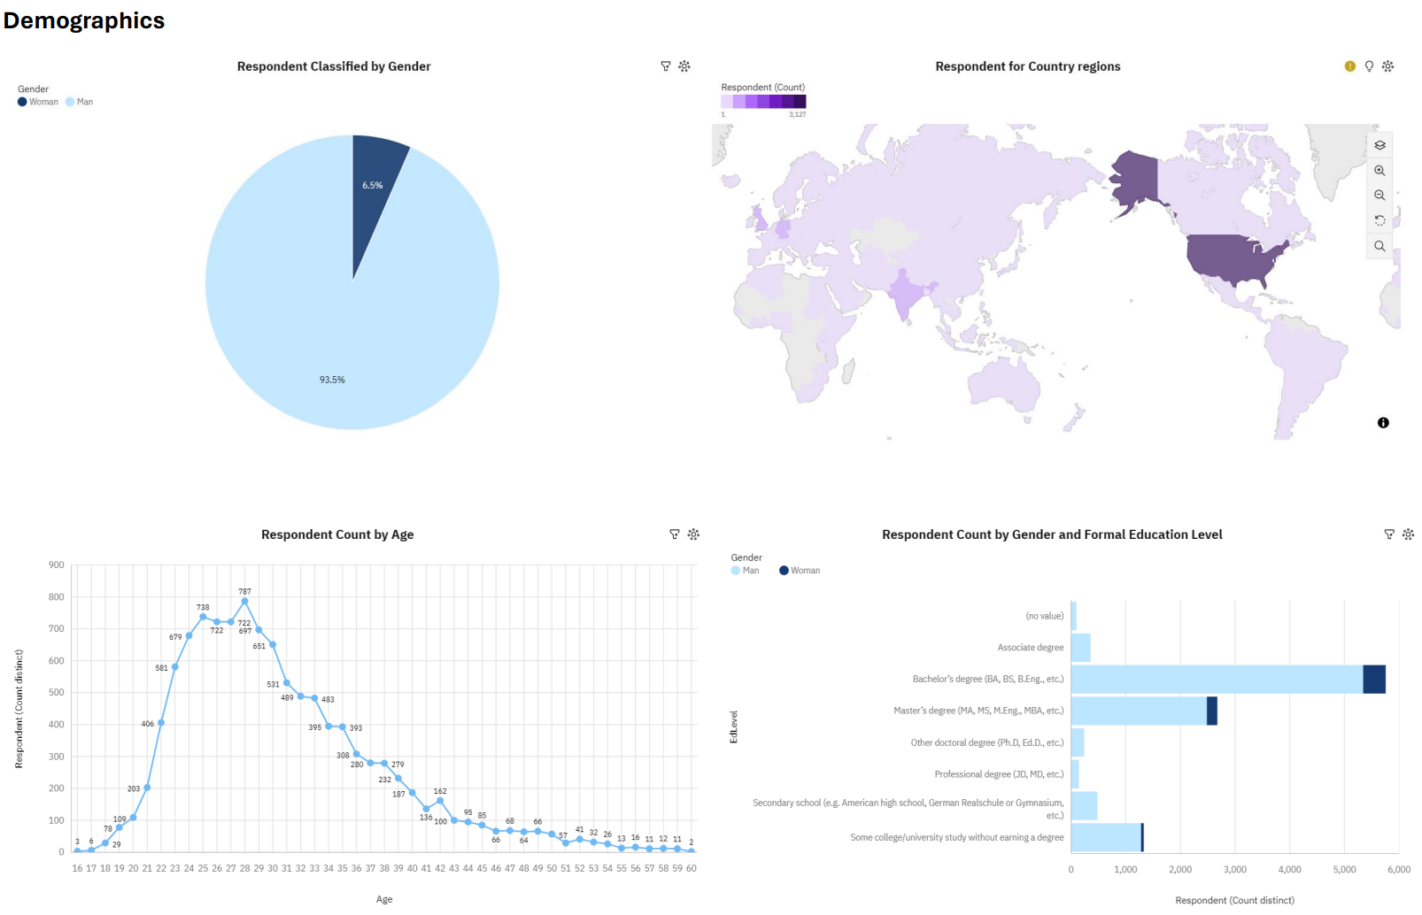
DASHBOARD TAB 3

Slide 16
DISCUSSION

Slide 17
OVERALL FINDINGS & IMPLICATIONS
Findings
JavaScript and HTML/CSS are the top-used and wanted programming languages, with TypeScript also catching developers' attention.
Python is becoming more popular with developers.
MySQL was the most used database in 2019, but PostgreSQL and MongoDB are getting more interest from developers.
Implications
There's still a big demand for skilled web developers. People learning or thinking about it should also look into TypeScript along with JavaScript and HTML/CSS.
As the demand for data experts to work with big data grows, developers should keep improving their skills in SQL and Python.
NoSQL might become more popular in the future. Developers should work on their NoSQL skills to stay competitive.

Slide 18

CONCLUSION
The Stack Overflow Developer Survey 2019 provided valuable insights into the evolving landscape of software development, helping developers and organizations understand current trends and make informed decisions.
JavaScript and HTML were the top choices for developers for the current year. Python moved up to third place as a desired programming language to work with.

Slide 19
APPENDIX

Slide 20
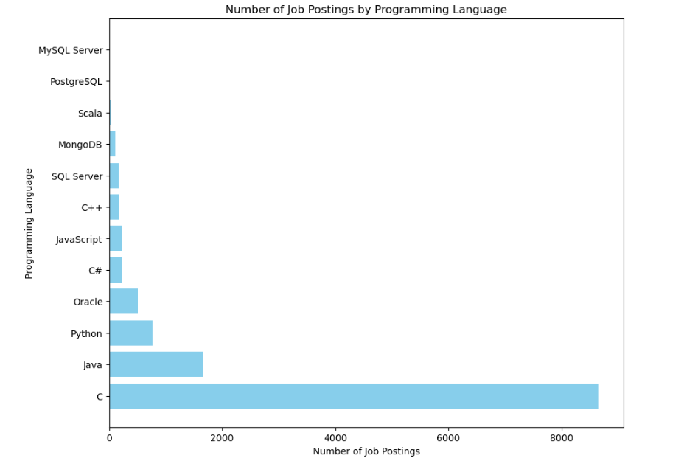
JOB POSTINGS

Slide 21
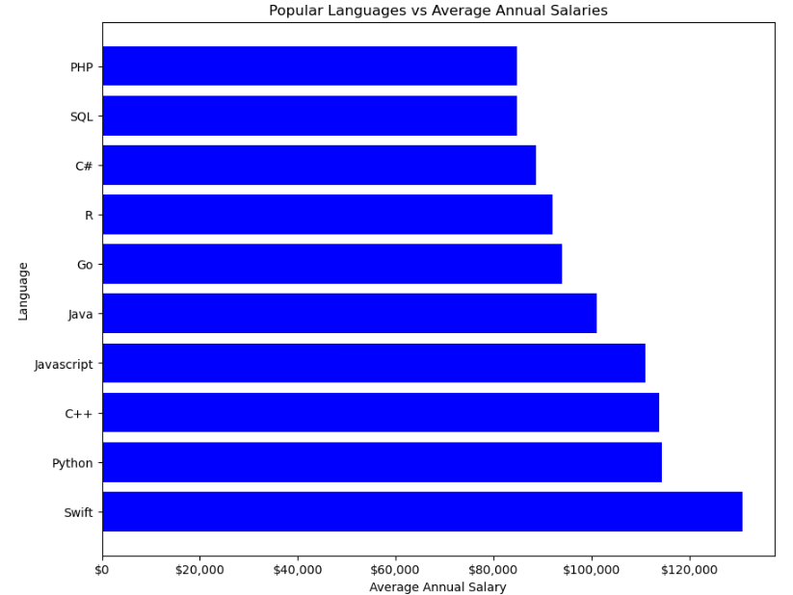
POPULAR LANGUAGES

