Slide 1
Team, here are the few changes. Everything in the PPT highlighted in yellow needs to be updated in the sim. Simple content changes, not bugs or issues with the sim.
GREAT WORK!!! THANK YOU!!
We will do one final test on Monday and send over anything that needs to be updated.

Slide 2
Digital 26 Oct 2026 - Done
Welcome to Ember (Case title…”E” in Ember was not capitalized)
Ember Group built its reputation on deep expertise, close customer relationships and an entrepreneurial culture. Specialized business units, each with its own systems, leaders and definition of success, serve customers across dozens of regional markets. That structure powered Ember’s rise with double digit growth, but now it holds the company back.
Customers demand faster, better and cheaper. AI-native challengers are eroding Ember’s competitive edge of human led subject matter expertise. Standing still is not an option.
Almost every unit has started building its own AI solution. People are excited about it, but nothing is lined up, and everything is moving fast. New use cases keep showing up before anyone can compare or fund the last ones, and every pilot is going after something different on its own schedule.
The question isn’t whether AI works; it’s whether Ember’s leaders can match AI’s pace while lifting people up rather than leaving them behind.
This moment asks you to be that leader.

Slide 3
Source Doc: Moment 1
Digital 26 Oct 2026 - Done
MOMENT 1: Prioritizing First Steps
The Chief Technology Officer has asked you to bring the executive team a recommended portfolio of three funded AI initiatives in four weeks. Your working group has surfaced twelve use cases from across Ember’s business units and functions. Each has a sponsor, and several already have polished decks.
The executive team has not provided decision criteria for the initiatives. Every sponsor believes their case belongs in the top three. Two cases share an executive sponsor who expects both to go forward. After the last session, one sponsor stayed behind: “I’ve been told this is the highest-value initiative in the portfolio. If it’s not in the top three, I need to understand why.”
You have a strong view on which three are the real initiatives worth investing in. You also know the executive team wants momentum, not another process.
What do you do?
A. Tell the working group: “Before we score anything, let’s agree how we’ll decide.” Build criteria together, then score all twelve the same way, your own three included. Tell the lobbying sponsor: “If your case is strong, criteria we all trust will show it.”
B. Meet every sponsor, including the one who stayed behind. Ask what each case needs and relies on, then share the patterns with the group before you recommend. Tell the lobbying sponsor: “Help me understand what success looks like for you.”
C. Take a view to the CTO: “I think this portfolio must prove one thing: cost, growth or capability. Which three should we pick, and is three even the right number?” Pause the working group until you and the CTO agree. Then tell the sponsor who’s been lobbying you: “I want to make sure we’re solving the right problem before I decide.”
D. Propose to the CTO: two-week trials on five or six cases, with the results choosing the top three before the deadline. Tell the lobbying sponsor: “Let’s test it. A strong result is the best argument you can bring.”

Slide 4
Source doc Moment 1
Digital 26 Oct 2026 - Done
MOMENT 1: Outcomes
A. The criteria session is uncomfortable but productive. Sponsors realize they’ve been defining “value” differently, and the agreed scorecard earns real buy-in. The cost is two of your four weeks, and the criteria misses one case that doesn’t fit any category. The shared definition holds, but the executive team asks why speed to value wasn’t weighted higher.
Team Trust: Positive | AI Velocity: Negative | Enterprise Value: Positive
B. Your sponsor conversations reveal that four cases depend on the same data foundation, and two overlap almost entirely. You merge them and your recommendation lands with the group. But sponsors were candid with you and guarded with each other, and a week of meetings leaves less time than you wanted to test the shortlist.
Team Trust: Positive | AI Velocity: Neutral | Enterprise Value: Positive
C. The CTO pushes back on “three initiatives.” The real aim is to show the board a credible AI return before year-end, which changes which cases rank. Your reframe saves weeks of debate. But the working group sat idle while you escalated, and several sponsors feel the process moved above their heads.
Team Trust: Negative | AI Velocity: Neutral | Enterprise Value: Positive
D. The trials surface a surprise. The most polished deck stalls on data quality and a modest case delivers results in ten days. The executive team backs the top three on evidence. But two weeks of trials stretched the team thin, and the cases that never got a trial slot feel overlooked.
Team Trust: Neutral | AI Velocity: Negative | Enterprise Value: Positive

Slide 5
Source Doc: Moment 2
Digital 26 Oct 2026 - Done
Moment 2: When AI innovation creates uncertainty
The CFO has named a reporting automation pilot as one of Ember’s highest-priority AI initiatives: cut manual reporting time by 35% and improve first-pass accuracy. Your direct report leads the pilot team, and eight people took it on with genuine enthusiasm.
Manual reporting time is down 14%: real progress, but short of the 35% target. The team is running at an unsustainable pace. The CFO has asked for weekly progress reports for six weeks, which the team experiences as micromanagement or even surveillance. You’ve been absorbing the pressure. When your direct report has asked how the CFO feels, you’ve said the CFO appreciates the effort, which is true but incomplete.
What you haven’t shared: the senior leadership team has discussed whether to continue the pilot or redirect resources. Two of the team’s strongest contributors are quietly weighing opportunities elsewhere in the company.
Your direct report comes to you: “The team is exhausted. I’m getting the sense the CFO isn’t just asking for updates to celebrate us. Is there something I should know?”
What do you do?
A. “Yes. There have been leadership conversations about whether to continue the pilot. Nothing is decided, but I want you to know. I’ve been shielding you and the team from those discussions so you could focus on the work. Given where we are, let’s reset milestones together and define what a meaningful win looks like in the next 60 days.”
B. Say: “I hear you. I think the team needs a fresh perspective. Let me bring in an AI implementation expert who has helped other teams through similar challenges. They’ll join your next meeting, share what’s worked elsewhere, and help the team think through where to focus.”
C. Say: “The honest answer is that this pilot has run into challenges and more runway won’t fix it. I want to recommend we document what we’ve learned, protect the team’s reputation, and redirect resources to a higher-confidence initiative. Ember learns through trial and error. I want to make sure you and the team are well positioned for what comes next.”

Slide 6
Source Doc Moment 2
Digital 26 Oct 2026 - Done
Outcomes
A. Your direct report is apprehensive. The news isn’t good, but the uncertainty is gone. You share the context with the team, own the gap between what you said and what you knew, and set two reset milestones. The two contributors considering leaving stay. One later says: “I didn’t need it to be easy. I needed to know you were telling us what was real.”
Team Trust: Neutral | AI Velocity: Positive | Enterprise Value: Positive
B. The expert is skilled, but their arrival tells the team that leadership doubts them. Your direct report asked a direct question and got outside help instead. The two contributors make their decisions, and trust in you drops. The real problem, a depleted team working without full context, goes untouched.
Team Trust: Neutral | AI Velocity: Negative | Enterprise Value: Negative
C. Your framing works, and the CFO agrees to change direction. The two contributors stay on, and the pilot wraps up with a session to capture what the team learned. Closing it out can be the right call, but it’s stronger when you’ve taken an honest look at whether a reset could have worked first. Your direct report is left wondering if a different decision would have saved the pilot.
Team Trust: Negative | AI Velocity: Positive | Enterprise Value: Neutral

Slide 7
Source Doc: Moment 3
Digital 26 Oct 2026 - Done
Moment 3: When a Team Has a Breakthrough Worth Scaling
One of Ember’s regional sales teams built an AI process that automates pipeline generation. In six months, the team cut prospecting time by half and now spends that time closing deals.
The COO wants this solution to live in every market by early next year. The other regional sales heads aren’t convinced. These three objections keep coming up:
“Our sales cycles are longer and relationship-driven.”
“Our data isn’t clean enough for this.”
“We’d have to drop tools we’ve already invested in.”
The COO has asked for your recommendation on how to scale.
What do you recommend? Brainstorm at your table.

Slide 8
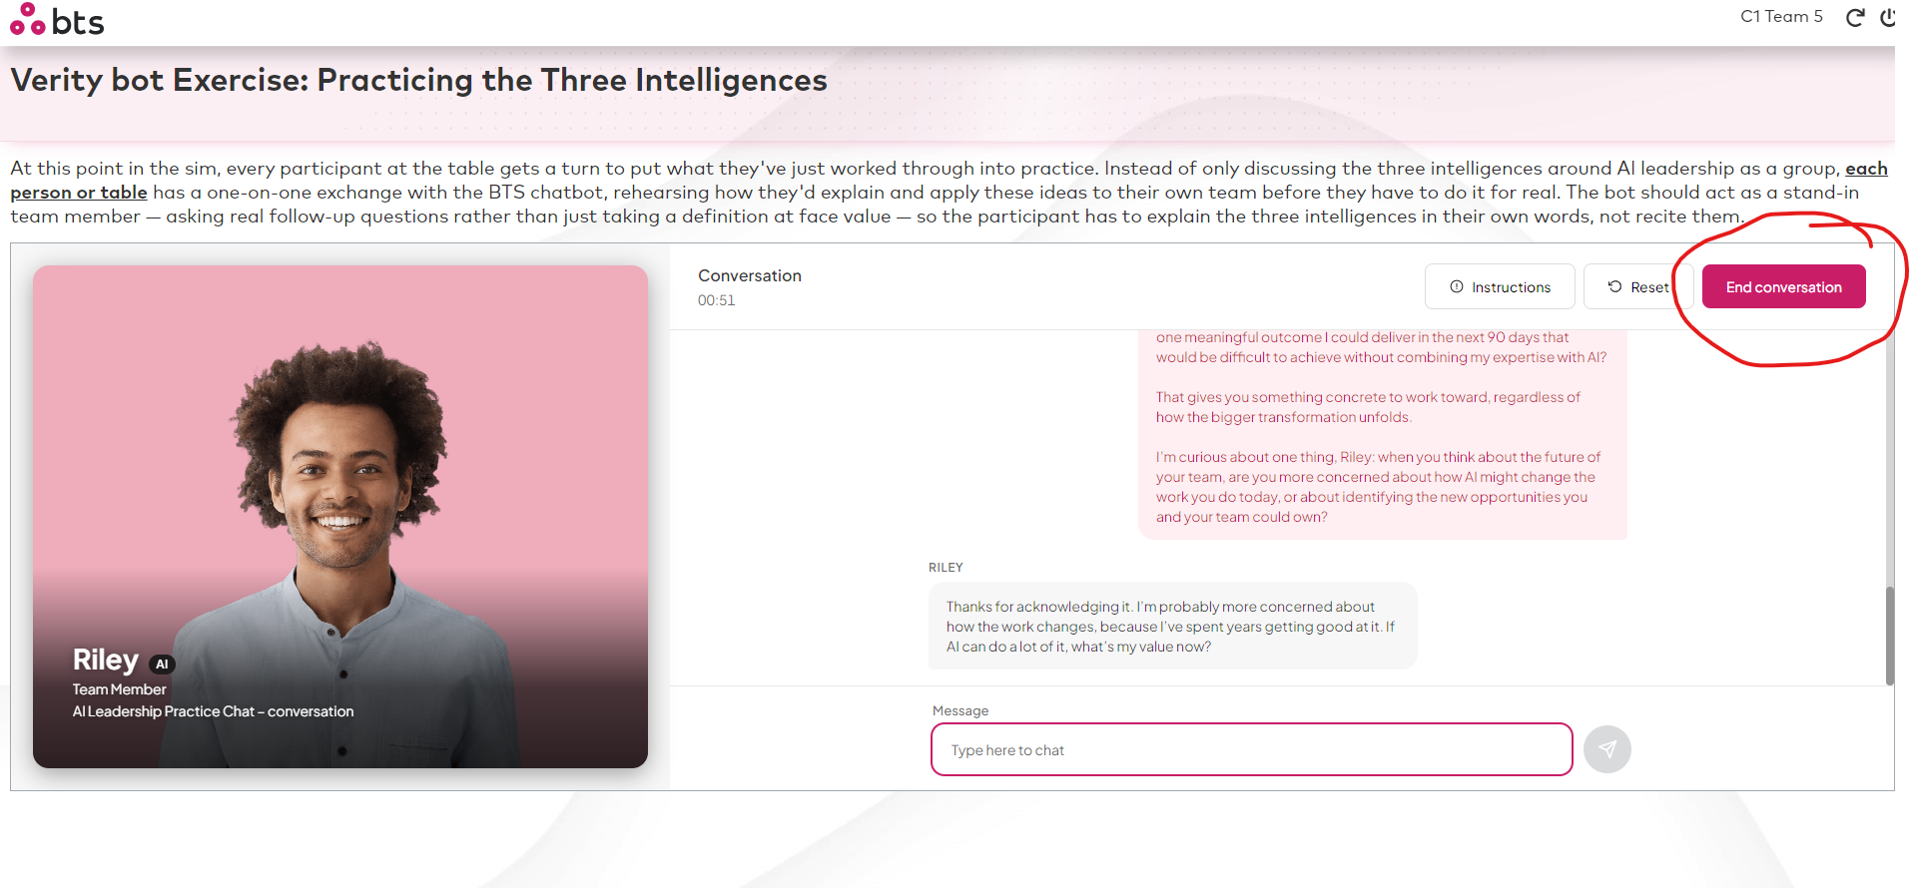
Reset the verity bot - we were seeing previous people's responses when we logged in so had to reset the conversation manually. Just in case, is there a way we can reset the verity bots on group director's end somehow? Or is that only possible on digital's side?
Digital – 26 Oct 2026: The user must click “End Conversation” to end the chat. If the user leaves without ending the conversation, the previous chat history will remain visible when they log in again.

