Slide 1
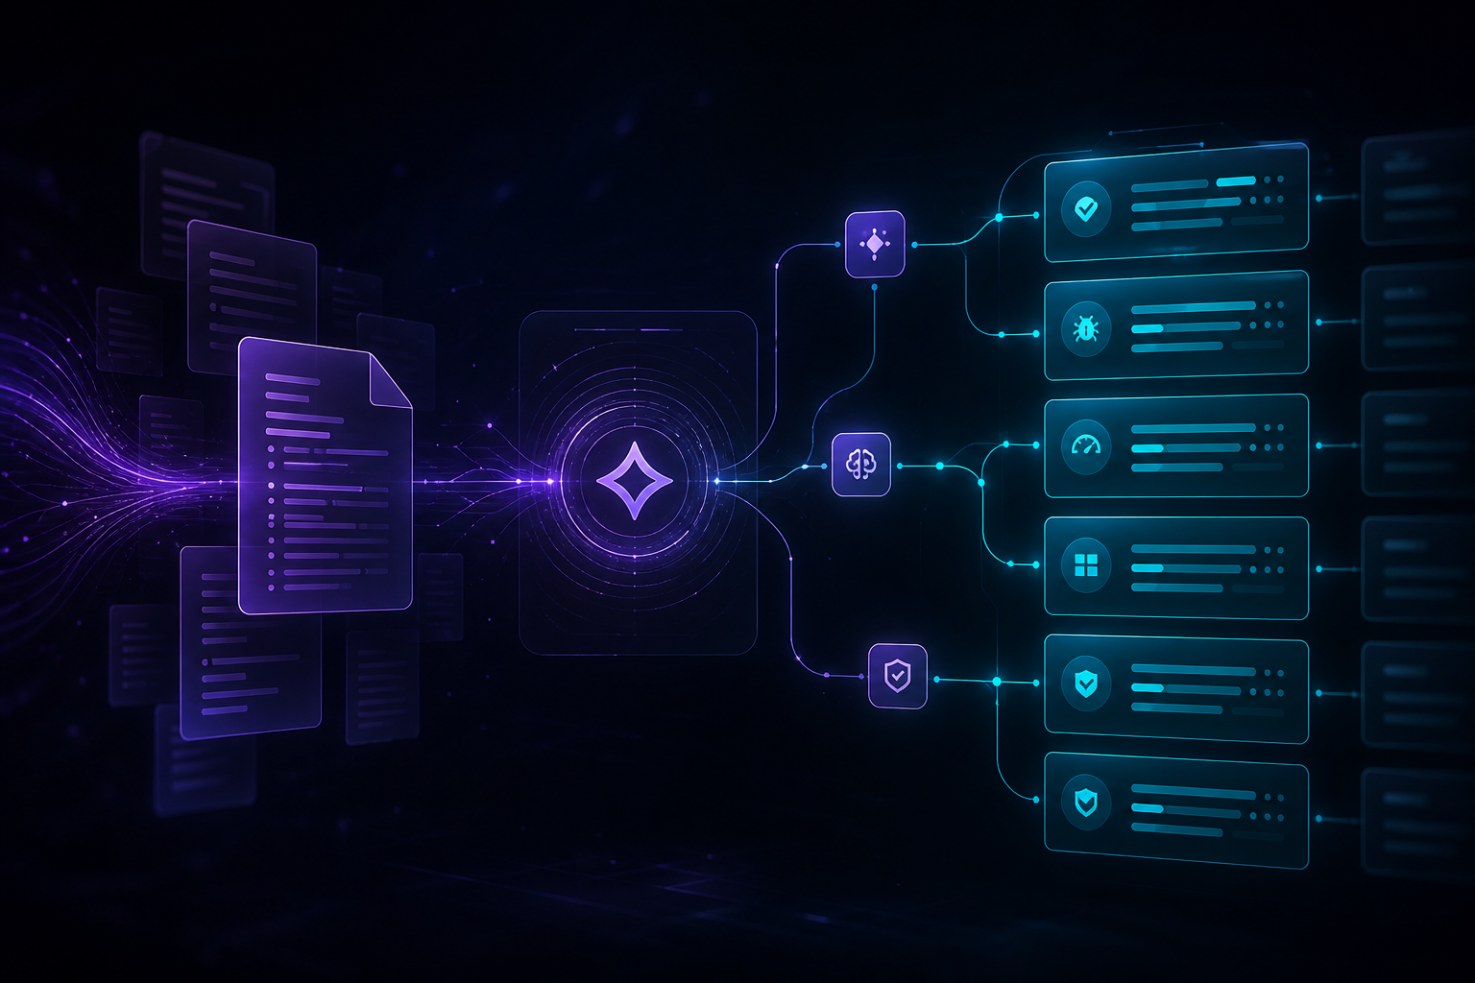
AGENTIC QA COPILOT
Agentic QA Copilot
Evidence-backed test generation powered by Graph RAG, Vector RAG, and AI agents
From software context to complete QA intelligence.
System Flow Graph
QA Knowledge
Agentic Test Generation
Coverage Closure
1 / 5

Slide 2
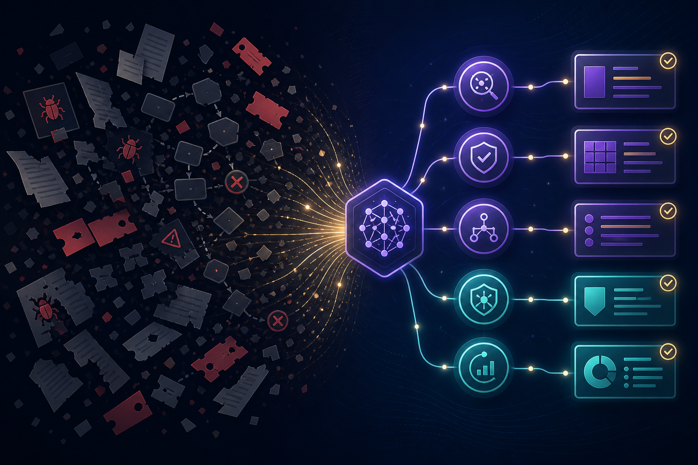
The QA Challenge
PROBLEM
Fragmented QA Reality
Requirements scattered across tickets, docs, and tribal knowledge
Generic AI produces generic test cases
SOLUTION
Agentic QA Copilot combines:
Coverage gaps are hard to detect manually
System Flow Graph
Jira / Confluence / QA documents
Regression planning is slow and inconsistent
Graph RAG + Vector RAG
Specialist QA agents
Evidence-backed outputs
2 / 5

Slide 3
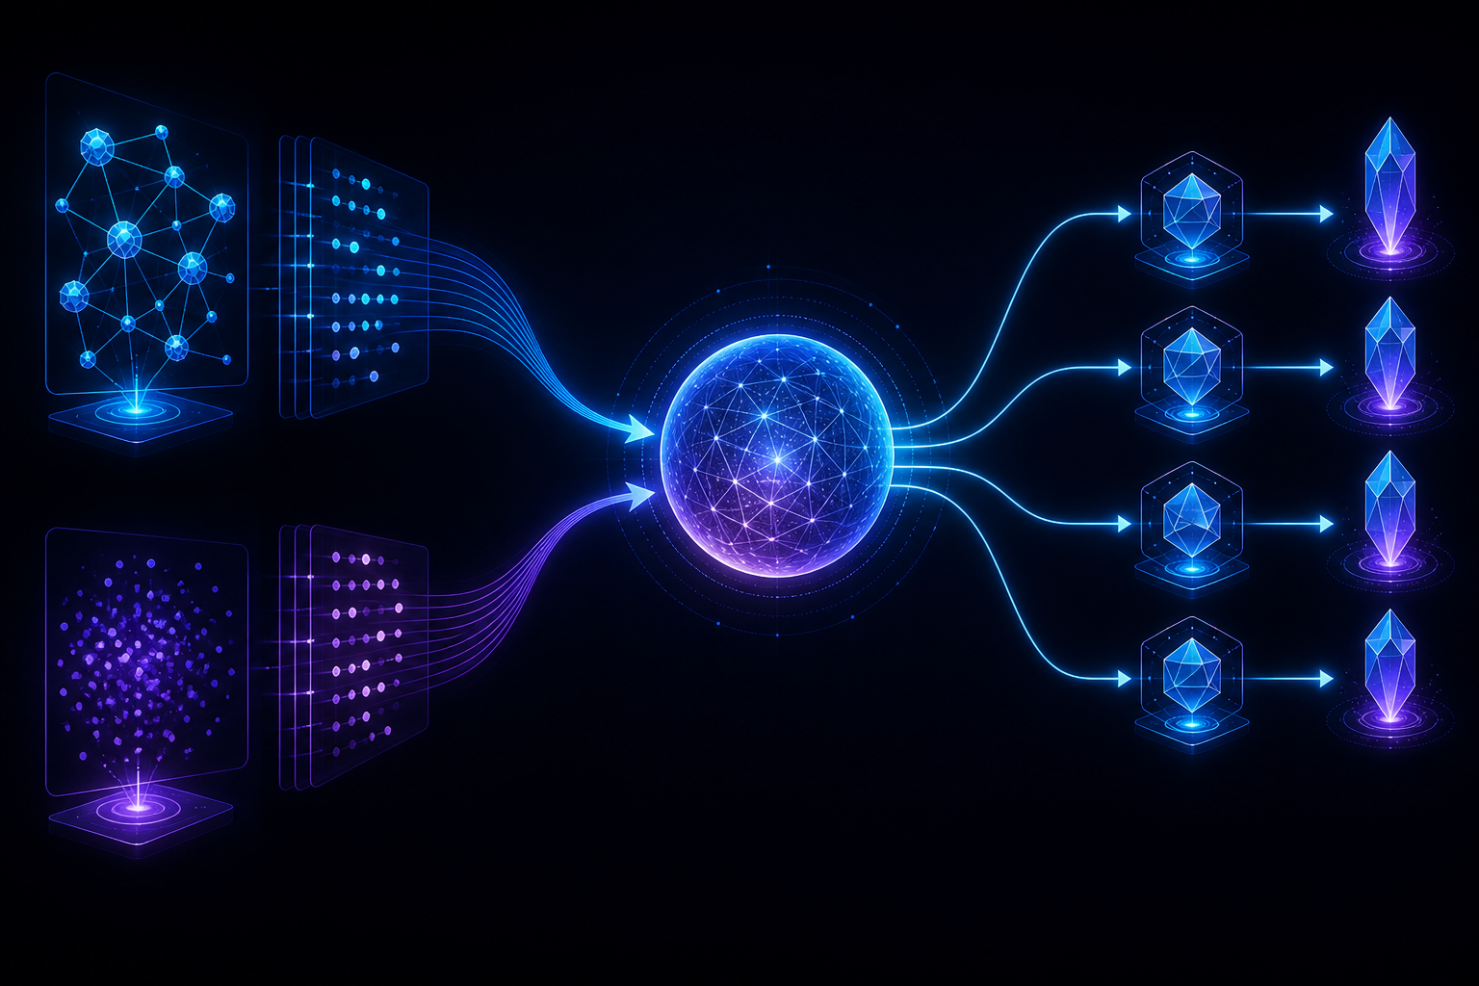
How the Copilot Works
1
2
3
4
5
6
7
8
System
Flow Graph
Knowledge
Base
Graph
RAG
Vector
RAG
Context
Fusion
QA
Agents
Review +
Coverage
Final QA
Outputs
Graph RAG
Vector RAG
Understands user journeys, branches, dependencies, and failure paths.
Retrieves relevant requirements, bugs, tickets, and documents.
Context Fusion
Agents
Combines graph structure + document evidence into one reliable prompt context.
Generate, review, improve, and explain QA artifacts.
3 / 5

Slide 4

Live Demo Journey
01
02
03
04
Create System Flow Graph
Inspect Graph Explorer
Import Knowledge
Run Agentic Analysis
05
06
07
08
Generate Test Cases / BDD
Review Validity & Automation
View Bugs, Regression, Coverage
Export BDD Scenarios
INPUT
OUTPUT
▸ Feature flow
▸ Test Cases
▸ Requirements
▸ BDD Scenarios
▸ Bugs
▸ Automation Review
▸ Tickets
▸ Bug Reports / Regression
▸ Docs
▸ Coverage Gaps & Evidence
4 / 5

Slide 5

Future Scope
From QA assistant to continuous AI QA platform
1
2
3
4
5
6
Deeper Jira +
Confluence
Test Execution
Integration
Automated Script
Generation
Release Readiness
Dashboard
Continuous QA
Monitoring
Enterprise
Governance
Auto-sync epics, stories, acceptance criteria, and product docs.
Connect Playwright, Selenium, Cypress, Postman, and CI/CD.
Convert approved BDD into runnable automation code.
Risk, coverage, automation readiness, and open QA gaps.
Re-run analysis when requirements, tickets, or flows change.
RBAC, audit logs, approval workflows, reusable QA templates.
5 / 5

