Slide 1
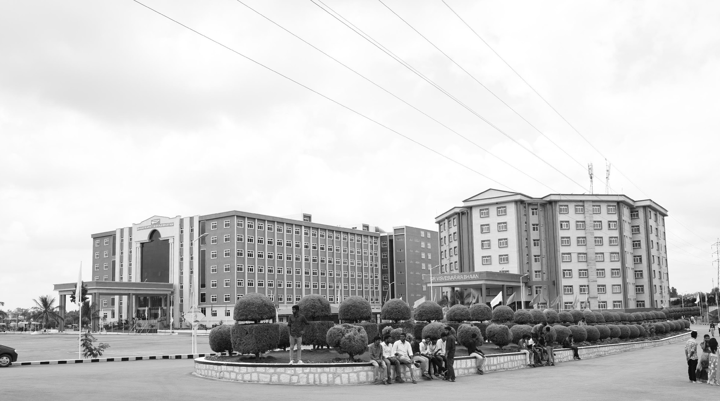

MULTIBAND REFLECTIVE POLARIZATION CONVERTER USING METASURFACE
AY 2020-24
GITAM UNIVERSITY
Major Project
A University should be a place of light, of liberty, and of learning.
Department of Electrical Electronics and Communication Engineering
Project Team:
R S S S Snigdha
K S P Mahadev
MD Akram
Project Mentor:
Dr. S Durga Padmaja Bikkuri
www.gitamedu.com

Slide 2

Project Group – Details
Photo
Track
Roll No
Name
Photo
EECE AI/ML
BU21EECE0100200
R S S S Snigdha
Photo
EECE AI/ML
BU21EECE0100097
K S P Mahadev
Photo
EECE
BU21EECE0100083
MD Akram

Slide 3
Objective and Goals
Objective
The main objectives of our project include:
Design a metasurface-based polarization convertor which can convert a linear polarized incident EM wave into circular polarized during reflection at a single frequency in 4-8 GHz range.
Extend the operation of the converter to multiple frequency.
Analyze the Polarization conversion ability of the surface from the simulated results.
Goals
Main goals
Achieve precise and efficient conversion.
Expand the metasurface capability across multiple frequencies.
Validate the performance through simulations, ensuring the results meet our expectations.

Slide 4
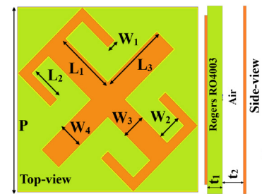
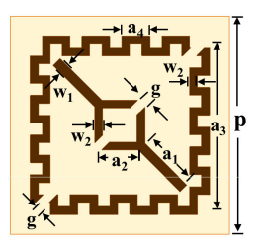
Literature Survey
TITLE | AUTHOR and YEAR | STRUCTURE | KEY FINDINGS
A Low-Profile Multifunctional Metasurface Reflector for Multiband Polarization Transformation. | Soumendu Ghosh , Jeet Ghosh , Moirangthem Santosh Kumar Singh and Abhishek Sarkhel 2023 |  | Metasurface Design: multifunctional. Broadband Polarization Conversion: Tri-Band LP-to-LP Conversion: 5.47-5.68 GHz, 7.86-8.84 GHz, and 14.68-16.83 GHz. Quad-Band LP-to-CP Conversion: 5.30-5.41 GHz, 5.77-7.58 GHz, 9.27-13.91 GHz, and 17.53-19.59 GHz. Radar Cross-Section (RCS) Reduction: 5.85-5.95 GHz, 9.2-10.3 GHz, and 16.6-18.5 GHz.
Multi-Band Multi-Functional Metasurface-Based Reflective Polarization Converter for Linear and Circular Polarizations | RAHUL DUTTA , JEET GHOSH , ZHENGBAO YANG ,AND XINGQI ZHANG, 2021 |  | Multiband Polarization Conversion:linear-to-orthogonal linear 4.3 GHz, 7.2 GHz, 12.3 GHz, and 15.15 GHz linear-to-circular and circular-to-linear: 4 GHz, 4.75–5.95 GHz, 8.35–8.8 GHz, and 14.35–14.6 GHz. Design and Resonance Mechanism: The multiband operation is attributed to multiple resonances occurring within the structure, which is based on a meandered square ring and diagonal split strip resonator.

Slide 5
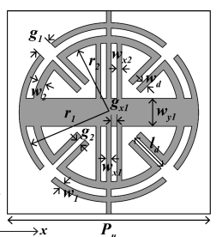
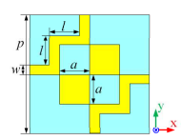
Literature Survey
TITLE | AUTHOR and YEAR | STRUCTURE | KEY FINDINGS
Ultrathin Single Layer Transmissive Dual-Band Linear to Circular Converter for Non-Adjacent Dual Orthogonal Circularly Polarized Antenna | SOUMIK DEY , SUKOMAL DEY. 2024 |  | Dual-Band Transmissive Polarizer:Designed on a single-layer, ultra-thin dielectric substrate (0.51 mm thick Taconic TLY-5). Frequency and Angle Stability:The LTCP achieves polarization conversion at 11.2 GHz and 22.75 GHz with oblique angle stability up to 35°.
Simultaneous Transmission and Reflection Mode Linear-to-Circular Polarization Conversion Using a Single Metasurface | Debidas Kundu; Dhrubajyoti Bhattacharya; Debashree Pathak 2021 |  | Dual-Mode Linear-to-Circular Polarization Conversion (LCP):The metasurface is designed to achieve linear-to-circular polarization (LCP) conversion in both transmission and reflection modes simultaneously.

Slide 6
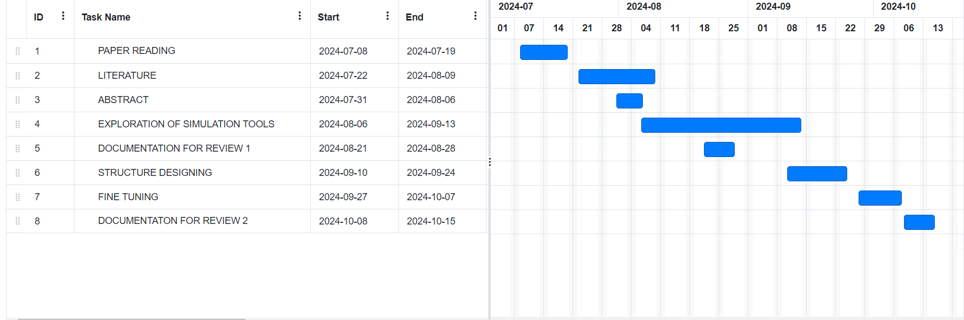

Slide 7
Analysis - SWOT
Strengths
Weaknesses
01. Wide Frequency Range
02. Enhanced Compatibility with 5G
03. Potential for Broad Impact
01. Narrow Operational Focus
02. Dependency on Metasurface Performance
Threats
Opportunities
01. Environmental Sensitivity
02. Manufacturing challenges
O1. Expanding to Multiband Systems
02. Collaboration with Industry

Slide 8
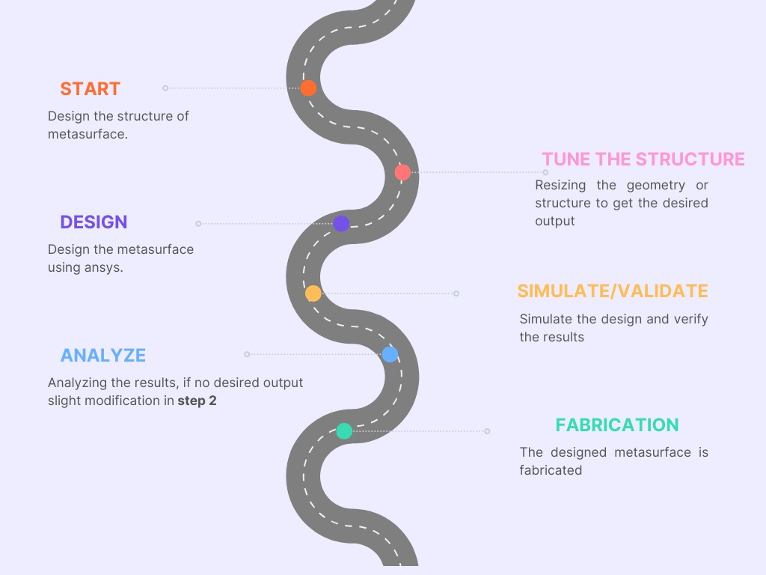
Architecture
Flow diagram

Slide 9
Analysis – 4W1H
Why: The problem of atmospheric mismatches, reflection effects, and polarization mismatches occurs in the establishment of communication links. The greatest problem among these arises due to polarization mismatches between the transmitting and receiving antennas. To overcome polarization mismatches, circularly polarized antennas are employed. However, complicated feeding techniques may not be feasible.
What: We are designing a meta surface-based polarization converter that transforms linearly polarized EM waves into circularly polarized EM waves. You also design a 5G antenna and observe the impact of the meta surface on the antenna's performance, especially concerning polarization conversion.
Where: Polarization converter's frequency band: 4-8 GHz; the frequency band of antenna design focused on the 5G communication system, We are using Ansys simulation tool, version 2024 for this project.
How: we Integrate the antenna with the meta surface as a superstrate for converting linear polarization of an incident EM wave into circular polarization, thus removing all the detrimental effects of polarization mismatching without altering feeding techniques. We discuss also how this meta surface affects other parameters of the antenna.

Slide 10
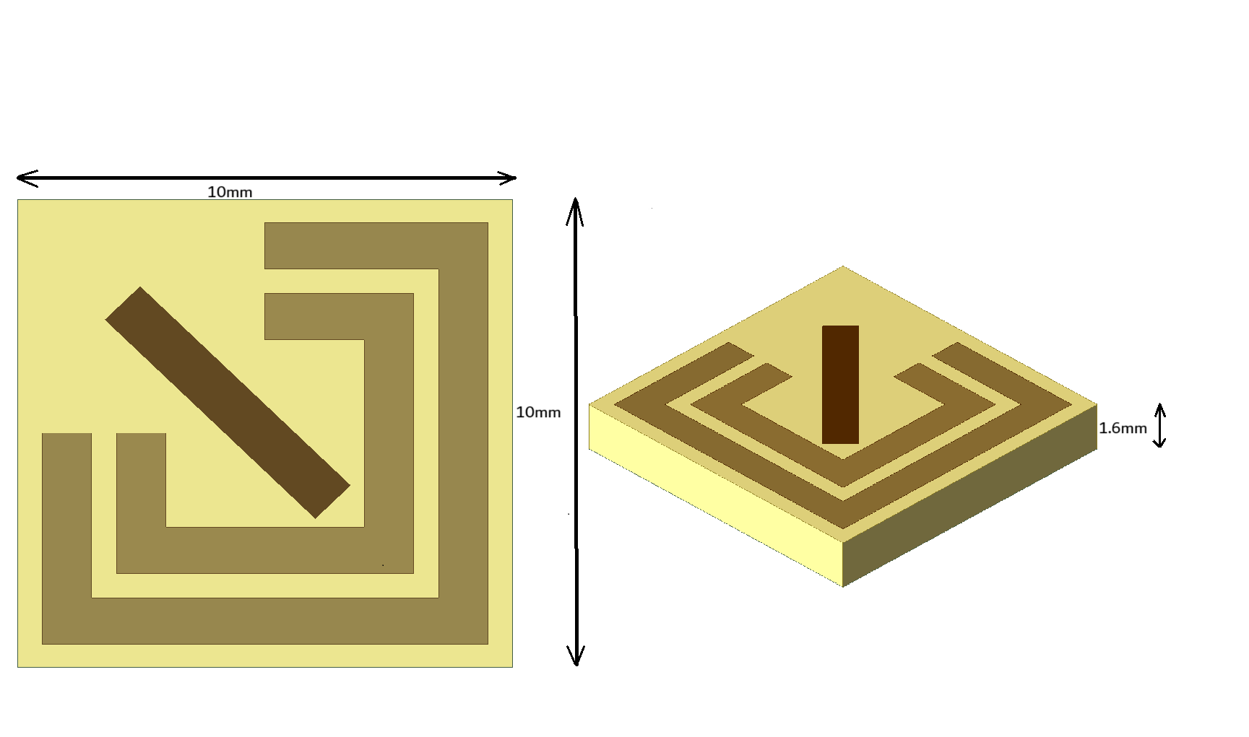
Structural Diagram

Slide 11

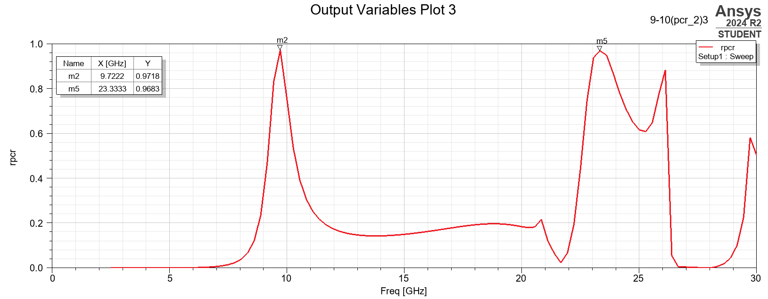
Implementation and Results – Iteration 1
Iteration 1 :

Slide 12

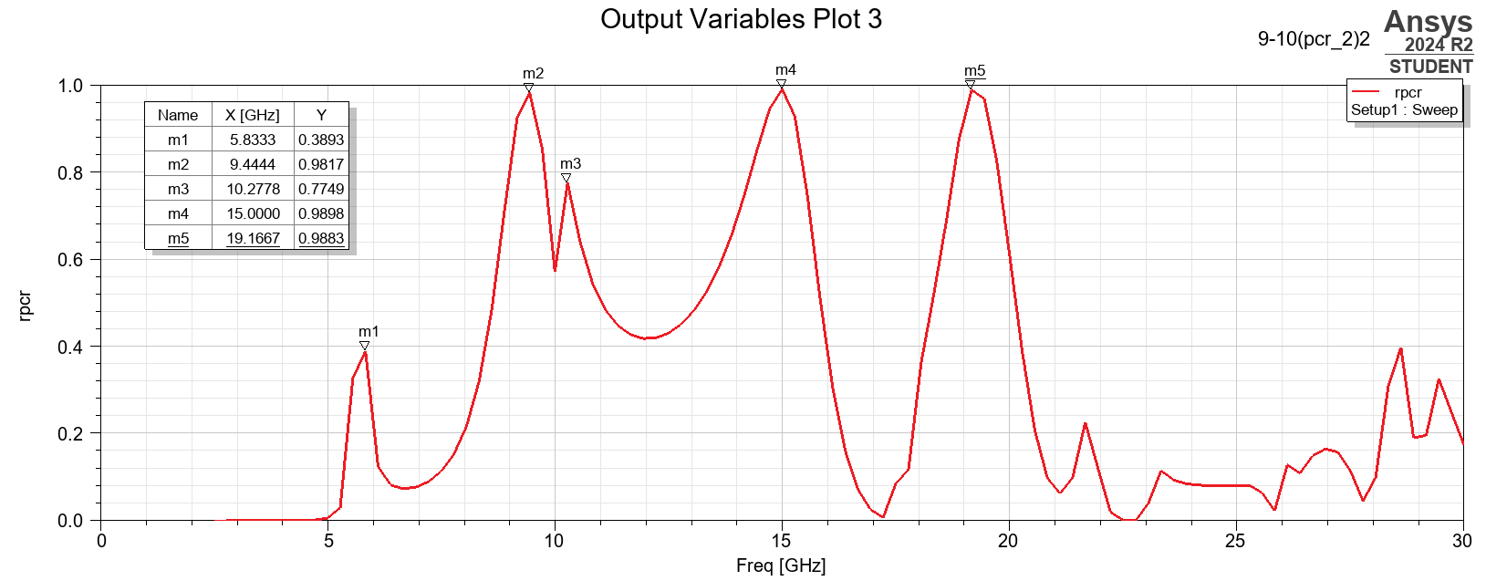
Implementation and Results – Iteration 2
Iteration 2:

Slide 13
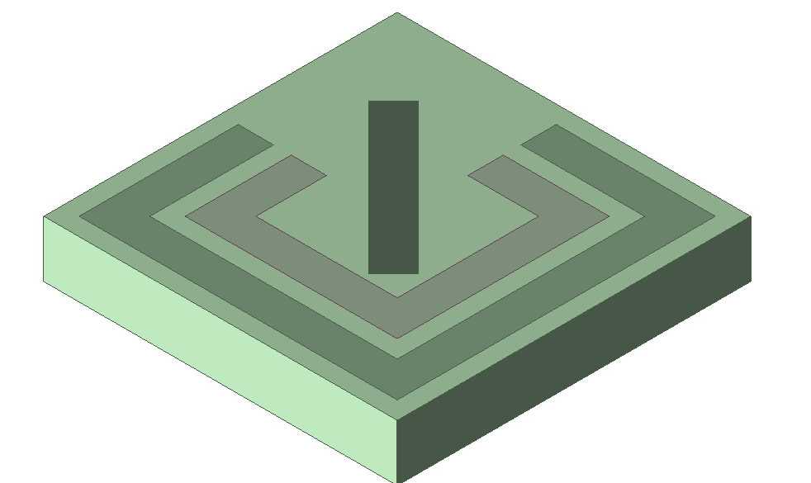
Implementation – Iteration 3
Iteration 3:

Slide 14
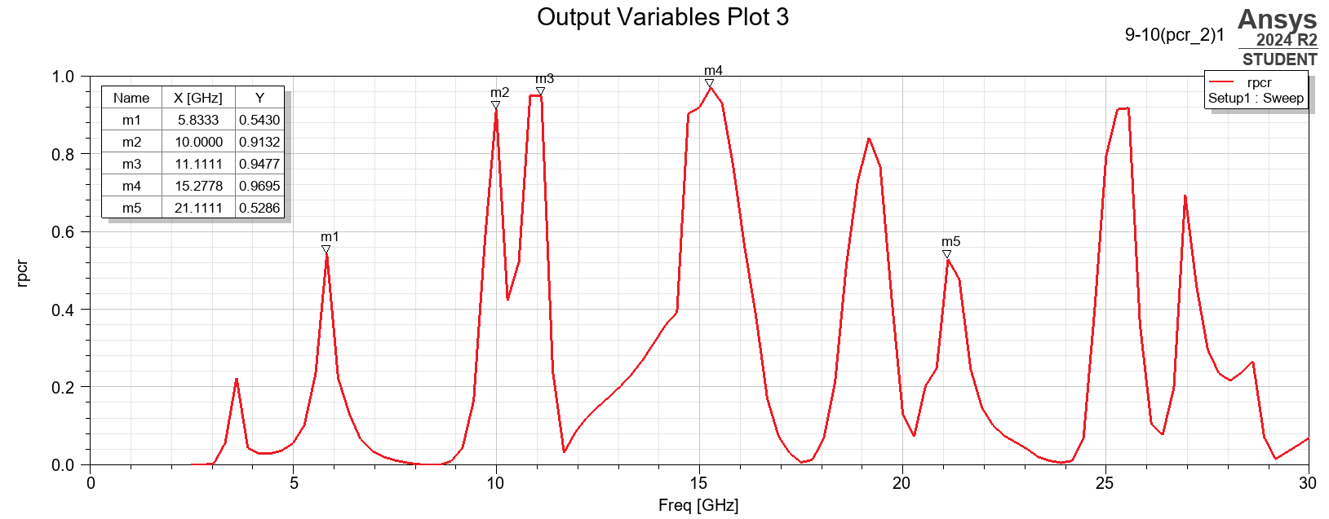
Results – Iteration 3
Iteration 3 :

Slide 15
Conclusion & Future Work
Summary and Conclusion
In our simulation using Ansys 2024, we designed a metasurface of a size 10x10 mm in width 1.6 mm. It had three distinct linear polarization bands and a near-circular polarization band. With further fine-tuning of the structure, one may obtain multiple circular polarization bands without changing the feeding technique. This is an evidence that the metasurface is very flexible in its capability to control polarization and therefore is best suited for high-level applications such as communication systems, sensors, and radar technologies.
Future Work
Future work can then be dedicated to the extension of the polarization conversion beyond a single frequency bands. The inclusion of tunable elements like varactors or diodes will allow for real-time reconfiguration. Broadband designs will have non-inefficient conversions over wider bands than those exhibited here. Finally, multi-mode polarization control along with integration with active devices will further the adaptability of the platform. Prototyping along with machine learning optimization will help validate and refine designs ready for application in IoT and other satellite communication systems.

Slide 16
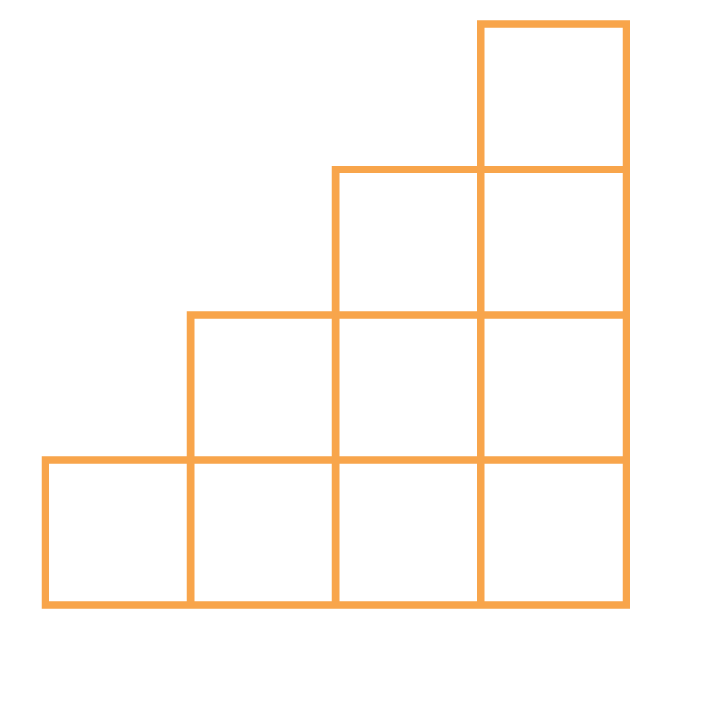
THANK YOU

