Slide 1
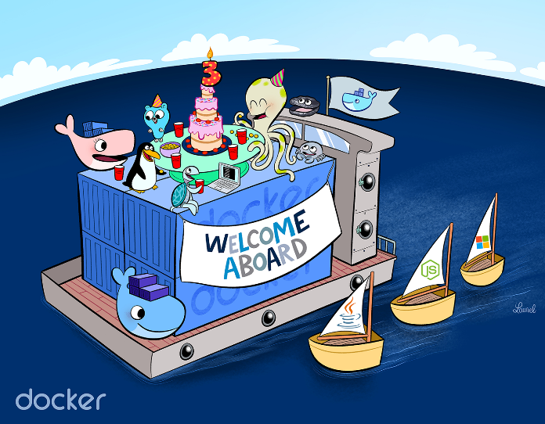
Containerization
The Next Generation Virtualization for Cloud
Prof. B. Thangaraju, IIITB.
Notes:
Test Notes

Slide 2
Agenda
Docker Theory
Docker Lab

Slide 3
Agenda –Docker Theory
Introduction to Virtualization
Virtual Machine Vs Container
Docker Internals
Docker for Lab
Spectrum of Cloud Computing Services
IaaS, CaaS, PaaS, SaaS, …
Most Popular CaaS Platforms
Recent Trends and Future Prospects
Conclusion

Slide 4
Introduction to Virtualization
Software demands more and more from operating systems to applications.
More : data, processing power, memory, network bandwidth and storage space.
Virtualization is a technology.
Create multiple simulated environments from a single, physical hardware systems.
Software called a hypervisor connects directly to the hardware.
Split one system into separate, distinct, and secure environments known as virtual machines (VMs).
Notes:
Let us discuss with some basics of virtualization.

Slide 5
Introduction to Virtualization
The term hypervisor is a variant of supervisor, a traditional term for the kernel of an operating system: the hypervisor is the supervisor of the supervisors
The hypervisor/VMM is the control system at the core of virtualization.
Acts as the control and translation system between the VMs and the hardware.
Hypervisors need OS - level components to run VMs
Memory manager, Process scheduler, I/O stack, DD, security manager and Network stack.
The physical hardware, equipped with a hypervisor is called the Host, while the many VMs that use its resources are Guests.
Notes:
The core of the operating system is kernel. It has many sub systems like process management, memory management, file system management, device drivers and Network management.
Kernel is managing all the computing resources and it is also called as supervisor. Inside a host system the guest operating system will run as a process or task and hypervisor manages these process management so it is a supervisor of the guest operating system.
Since we have many guest operating systems and hypervisor is a supervisor of the supervisors so it is called hypervisor.

Slide 6
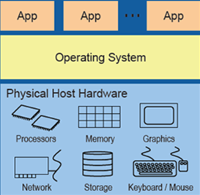
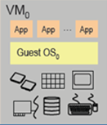
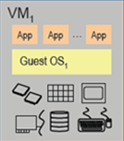


Types of Virtualization
…
…
Hypervisor (KVM)
Hypervisor (Virtual Box)
Host Operating System
Physical System
Type 1 Hypervisor
Native/Bare-Metal Architecture
Type 2 Hypervisor
Hosted Architecture

Slide 7
Benefits of Virtualization
Virtualization is being used by a growing number of organizations
Reduce power consumption and air conditioning needs (Move to be more Green-Friendly)
Trim the building space and land requirements
Reduce downtime and provides high availability for critical applications (Blue-Green model)
Simplify IT operations
Allow IT organizations to respond faster to changing business demands
Notes:
Blue – Green deployment model consists of two identical deployment platform. If one is failed using a router we can route all the request to the other deployment infrastructure. Generally, green is live and blue is backup.
Simplify IT operations: Simplified data center management with the help of Configuration Management where they use Infrastructure as Code (IaC) concept, so they can configure VM once through code and reuse the template. Faster Response: Faster provisioning of applications and resources.

Slide 8
Cloud Computing
Cloud Clients
Web browser, mobile app, thin client, terminal emulator, …
Cloud computing is a set of principles and approaches
To deliver compute, network, and storage infrastructure resources, services, platforms, and applications to users on-demand across any network.
These infrastructure resources, services, and applications are sourced from clouds, which are pools of virtual resources orchestrated by management and automation software.
Resources can be accessed by users on-demand through self-service portals supported by automatic scaling and dynamic resource allocation.
SaaS
CRM, Email, virtual desktop, communication, games, …
PaaS
Execution runtime, database, webserver, development tools, …
IaaS
Virtual machines, servers, storage, load balancers, network, …
Notes:
Virtual Desktop: Desktop virtualization is a software technology that separates the desktop environment and associated application software from the physical client device that is used to access it.
Thin Client: A thin client is a computer that runs from resources stored on a central server instead of a localized hard drive. Thin clients work by connecting remotely to a server-based computing environment where most applications, sensitive data, and memory, are stored

Slide 9
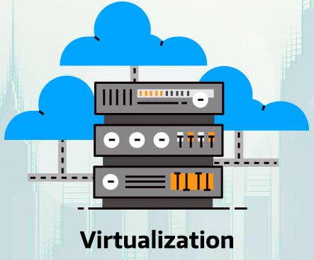
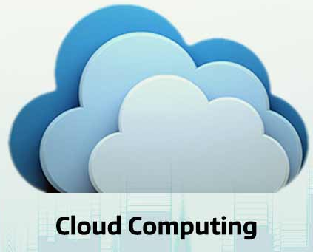
Virtualization Vs Cloud Computing
 | Virtualization | Cloud
Definition | Technology | Methodology/Environment
Purpose | Create multiple simulated environments from 1 physical hardware system | Pool and automate virtual resources for on-demand use
Configuration | Image-based | Template-based
Cost | High capital expenditures (CAPEX), low operating expenses (OPEX) | Private cloud: High CAPEX, low OPEX Public cloud: Low CAPEX, high OPEX
Other Benefits | Effective Server Utilization Easy Server Maintenance Separated Physical Infrastructure Infrastructure Cost Savings | Automated Management Scalability Self-serving Pay-As-You-Go
Interdependent but Not Interchangeable

Slide 10
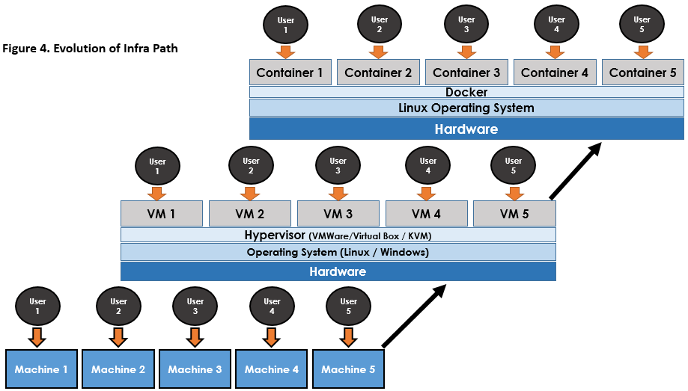
Evolution of Infra Path

Slide 11
Containerization
Containerization is a Modern Virtualization method
defined as a form of operating system virtualization.
accesses a single OS kernel to power multiple distributed applications that are each developed and run in their own container.
Application with all dependencies and libraries needed are packed as an image that can be run anywhere - desktop, traditional IT, or the cloud.
History of Container Technology
Chroot circa 1982
FreeBSD Jails circa 2000
Solaris Zones circa 2004
Meiosys - MetaClusters with Checkpoint/Restore 2004-05
Linux OpenVZ circa 2005 (not in mainstream Linux)
AIX WPARs circa 2007
LXC circa 2008
Systemd-nspawn circa 2010-2013
Docker circa 2013
built on LXC
moved to libcontainer (March 2014)
appC (CoreOS) announced (December 2014)
Open Containers standard for convergence with Docker Announced (June 2015)
moved to runC (OCF compliant) (July 2015)
… many more container formats coming?
Notes:
Chroot: Change root directory to the supplied directory newroot and executes command.
A process/command that runs in such a modified environment cannot access files outside the root directory. This modified environment is known as “chroot jail” or “jailed directory”.
Some root user and privileged process are allowed to use chroot command.
“chroot” command can be very useful:
To create a test environment.
To recover the system or password.
To reinstall the bootloader.

Slide 12
Docker –An Introduction
Docker (Dictionary meaning) – longshoreman
somebody whose job is to load and unload cargo vessels in a port.
Docker (OSS meaning)
Automates the deployment of applications inside software containers.
Licensed under the Apache 2 .
Docker CE: The core Docker platform, which Docker calls Docker Community Edition, is available for anyone to download and run free of charge.
Docker EE: Docker offers three enterprise editions of its software. Pricing starts at $750 per node per year. –Ref: https://www.docker.com/pricing
Docker source code is available at: https://github.com/docker/docker.

Slide 13
Docker –An Introduction
Docker can be run on any x64 host running a modern Linux kernel version 3.8 and later. Currently x86_64 and amd64 only and 32-bit is NOT supported. It includes:
Docker implements a high level API to provide lightweight containers that run processes in isolation.
Isolation features
namespaces and cgroup to allow independent containers to run avoiding the overhead of starting virtual machines.
By using containers, resources can be isolated, services restricted and processes provisioned to have a private view of the OS with their own PID space, file systems structure and network interface.

Slide 14
Docker –An Introduction
Docker is an open source tool that helps in the management of containers.
It was launched in 2013 by a company called dotCloud. Only a few months later, dotCloud, Inc. changed its name to Docker, Inc. as the Docker project had became so popular.
It is written in Go and uses Linux kernel features like namespaces and cgroups.
Use Cases: Application development, testing, packaging and deployment. PaaS, SaaS and Cloud Infrastructure. Application and service isolation.
Notes:
Creation and running Linux container is not user friendly, so Docker is a tool to create, start, run, stop and remove the containers with the simple commands.

Slide 15
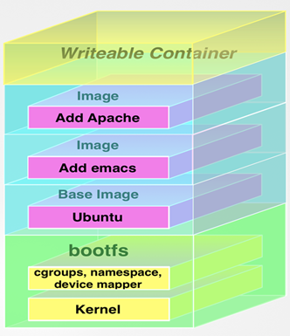
Docker Internals
Docker makes use of Linux kernel namespaces to provide the isolated workspace called the container.
When you run a container, Docker creates a set of namespaces for that container. These namespaces provide a layer of isolation.
Each aspect of a container runs in a separate namespace and its access is limited to that namespace.
Docker Engine uses the following namespaces on Linux:
PID namespace for process isolation.
NET namespace for managing network interfaces.
IPC namespace for managing access to IPC resources.
MNT namespace for managing filesystem mount points.
UTS namespace for isolating kernel and version identifiers.
Notes:
Namespaces are a feature of the Linux kernel that partitions kernel resources such that one set of processes sees one set of resources while another set of processes sees a different set of resources.
The UTS(UNIX Time Sharing) namespace is named after the data structure used to store information returned by the uname system call. Specifically, the UTS namespace isolates the hostname and the NIS domain name.
UTS namespaces provide isolation between two system identifiers: the hostname and the NIS domain name. It is used to set the hostname and the domain which are visible to running processes in that namespace.

Slide 16
Docker Internals
Control groups allow Docker Engine to share available hardware resources to containers and optionally enforce limits and constraints.
Docker Engine uses the following cgroups:
Memory cgroup for managing accounting, limits and notifications.
HugeTLB cgroup for accounting usage of huge pages by process group.
CPU group for managing user / system CPU time and usage.
CPUSet cgroup for binding a group to specific CPU. Useful for real time applications and NUMA systems with localized memory per CPU.
BlkIO cgroup for measuring & limiting amount of blckIO by group.
net_cls and net_prio cgroup for tagging the traffic control.
Devices cgroup for reading / writing access devices.
Notes:
The HugeTLB controller allows to limit the HugeTLB usage per control group and enforces the controller limit during page fault. ... This requires the application to know beforehand how much HugeTLB pages it would require for its use.
Non-Uniform Memory Access (NUMA) refers to multiprocessor systems whose memory is divided into multiple memory nodes. ... Normally, each CPU on a NUMA system has a local memory node whose contents can be accessed faster than the memory in the node local to another CPU or the memory on a bus shared by all CPUs.
The cgroups/net_cls isolator allows operators to provide network performance isolation and network segmentation for containers.
The net_prio subsystem can be used to set network priorities for processes in cgroups.

Slide 17
Docker Internals
Docker Engine combines the namespaces, control groups, etc., into a wrapper called a container format.
The default container format is libcontainer.
libcontainer library as a reference implementation for containers, and build on top of libvirt, LXC and systemd-nspawn.
libvirt is an open-source API, daemon and management tool for managing platform virtualization.
LXC -Combines kernel's cgroup and namespaces to provide an isolated environment.
Systemd-nspawn - used to run a command in light weight namesapce container.
Docker
libcontainer
libvirt
LXC
Systemd-nspawn
Linux Kernel
cgroups, namespaces, SELinux, capabilities, Netlink, …
Notes:
Netlink is used to transfer information between the kernel and user-space processes. It consists of a standard sockets-based interface for user space processes and an internal kernel API for kernel modules.
Capabilities: For the purpose of performing permission checks, traditional UNIX implementations dis- tinguish two categories of processes: privileged processes (whose effective user ID is 0, referred to as superuser or root), and unprivileged processes (whose effective UID is nonzero). Privileged processes bypass all kernel permission checks, while unprivileged processes are subject to full permission checking based on the process's credentials.
libvirt is an open-source API, daemon and management tool for managing platform virtualization. It can be used to manage KVM, Xen, VMware ESXi, QEMU and other virtualization technologies.

Slide 18
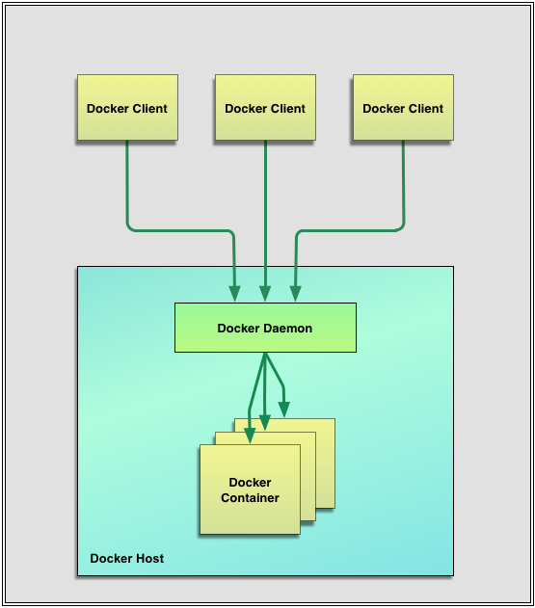
Docker Architecture
The core components that compose Docker:
The Docker client and server
Docker Images
Registries
Docker Containers
Docker is a client-server application. The Docker client talks to the Docker server or daemon, which, in turn, does all the work.

Slide 19
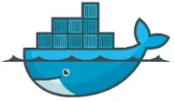




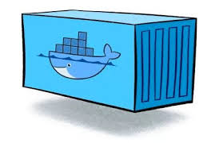

Docker Architecture
Client
Docker Host
Registry
docker build
DOCKER DAEMON
docker pull
docker run
Docker uses a client-server architecture.
The Docker client talks to the Docker daemon, which does the building, running, and distributing containers.
The Docker client and daemon can run on the same system.
The Docker client and daemon communicate using a REST API, over UNIX sockets.
An image is a read-only template with instructions for creating a Docker container.
Images
Containers
Notes:
Representational state transfer (REST) is a de-facto standard for a software architecture for interactive applications that typically use multiple Web services.
In law and government, de facto describes practices that exist in reality, even though they are not officially recognized by laws.

Slide 20
Virtualization Vs Container
Virtualization | Container
Hardware Level Virtualization | OS Level Virtualization
Typically measured by the gigabyte | Typically measured by the megabyte
Traditional IT architectures | Emerging IT practices
House traditional, legacy, and monolithic workloads | cloud-native development, CI/CD, and DevOps
All the code and dependencies in one place led to oversized VMs that experienced cascading failures and downtime when pushing updates. | Workloads are broken into the smallest possible serviceable units and packaged in containers.
Notes:
Cloud-native technologies are used to develop applications built with services packaged in containers, deployed as microservices and managed on elastic infrastructure through agile DevOps processes and continuous delivery workflows.
Cloud native is a term used to describe container-based environments.
Microservices, a complex application is broken up into a series of smaller, more specialized services, each with its own database and its own business logic. Using microservices, development teams can focus on updating specific areas of an application without impacting it as a whole, resulting in faster development, testing, and deployment.

Slide 21
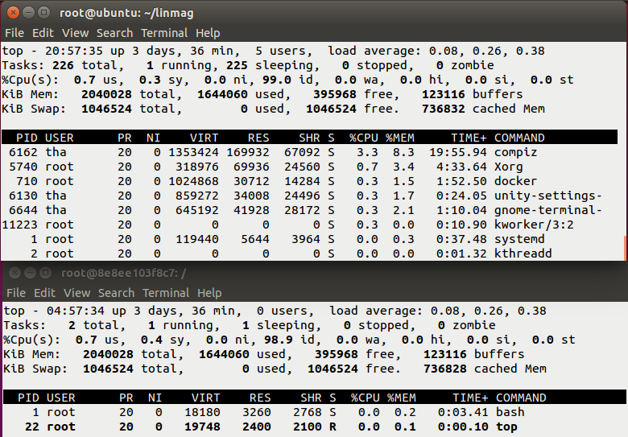
VM Vs Docker

Slide 22
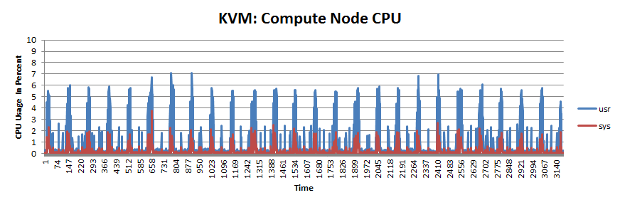
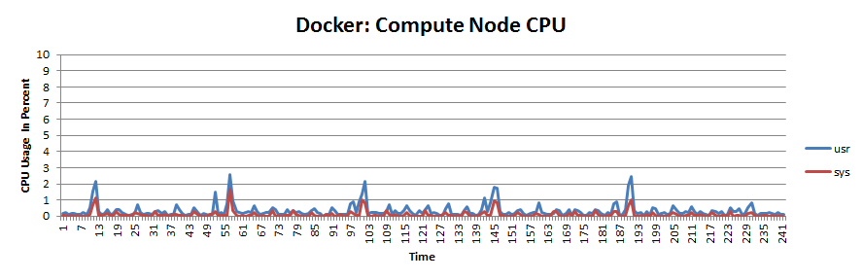
KVM Vs Docker Performance Benchmark
Container = isolated process(es).
Lower overhead than VMs – can run a full system with an init or a single service or process
Ref: Passive Benchmarking with docker LXC, KVM & OpenStack by Boden Russell, IBM Global Technology Service, Advanced Cloud Solutions & Innovation.

Slide 23
Benefits of Containerization
Portability - is portable and able to run uniformly and consistently across any platform or cloud.
Agility - Software developers can continue using agile or DevOps tools and processes for rapid application development and enhancement.
Speed - speeding up start-times as there is no operating system to boot.
Fault Isolation - The failure of one container does not affect the continued operation of any other containers.
Efficiency - containers are inherently smaller in capacity than a VM, this drives higher server efficiencies.
Ease of Management - A container orchestration platform automates the installation, scaling, and management of containerized workloads and services.
Security - security permissions can be defined to automatically block unwanted components from entering containers or limit communications with unnecessary resources.

Slide 24
CaaS
Containerization is one of the latest developments in the evolution of cloud computing, foundation of a private cloud and are becoming a game changer for many organizations.
Container-as-a-Service is a computer cluster that is available through the cloud and is used by users to upload, create, centrally manage, and run container-based applications on the cloud platform. The interaction with the cloud-based container environment takes place either through the graphical user interface (GUI) or in the form of API calls.
CaaS is a business model whereby cloud computing service providers offer container-based virtualization as a scalable online service.
CaaS typically refers to a complete container environment, including orchestration tools, an image catalog (docker registry), cluster management software, built in functionality for auto scaling and a set of developer tools and APIs.

Slide 25
Spectrum of Cloud Computing Services
CaaS falls somewhere between Infrastructure as a Service (IaaS) and Platform as a Service (PaaS).
However, CaaS is most commonly positioned as a subset of IaaS.
Applications
Applications
Container
Application, data, runtime environment and middleware
Container
Applications
Data
Applications
Applications
Data
Data
Data
Data
Runtime env
Runtime env
Runtime env
Runtime env
Runtime env
Middleware
Middleware
Middleware
Middleware
Middleware
Operating sys
Operating sys
Operating sys
Operating sys
Operating sys
Virtualization
Virtualization
Virtualization
Virtualization
Virtualization
Virtualization
Server
Server
Server
Server
Server
Server
Memory storage
Memory storage
Memory storage
Memory storage
Memory storage
Memory storage
Network
Network
Network
Network
Network
Network
On Premises
IaaS
CaaS
CaaS
PaaS
SaaS

Slide 26





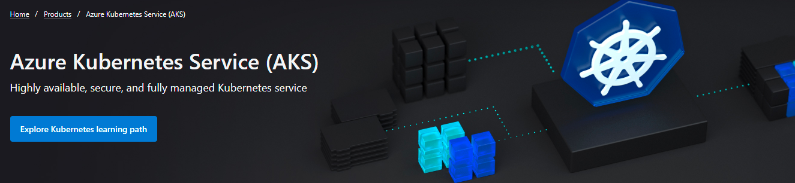

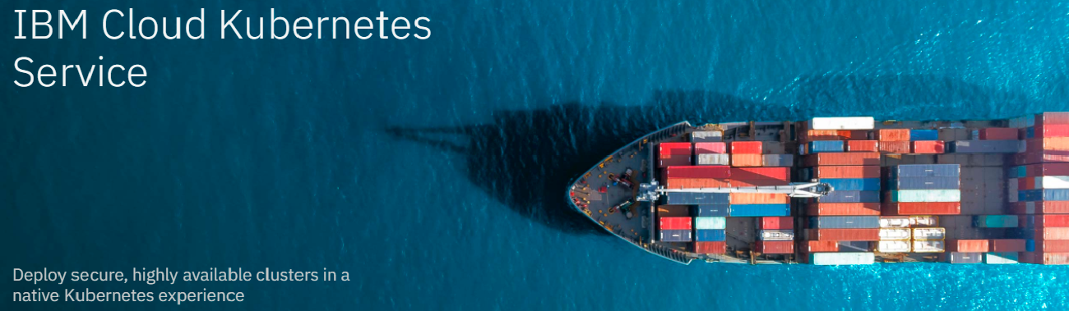
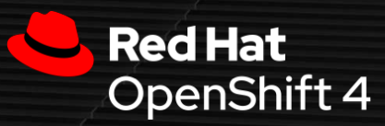
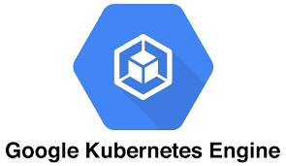

Most Popular CaaS Platforms
Containers as a Service Market is experiencing significant growth due to demand for the technology.
Cost advantages
Increasing trend in microservices.
Software firms are already in the market
Google LLC, Amazon Web Services, Inc, IBM Corporation are funding the advancement of technology.
1. Amazon EC2 Container Service (ECS),
2. Microsoft Azure Container Service (ACS).
3. Google Container Engine (GKE)
Notes:
Container management tools can be broken down into three categories: registry, orchestration, and compute.
Kubernetes, the container orchestration tool provide:
Distribution of containers across multiple hosts
Grouping containers into logical units
Container scaling
Load balancing
Storage capacity allocation
Communication interface between containers

Slide 27
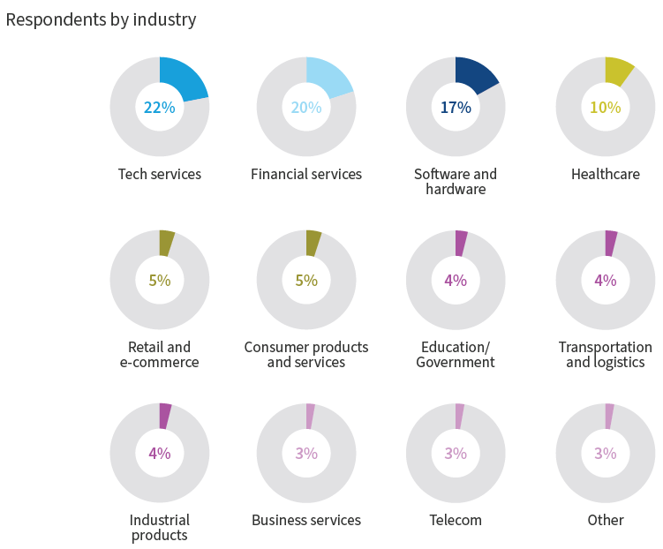

Recent Trends and Future Prospects
https://resources.flexera.com/web/pdf/Flexera-State-of-the-Cloud-Report-2022.pdf?elqTrackId=f3bb660986704d2980404386aa003141&elqaid=6925&elqat=2
Notes:
Businesses in almost all industries leverage cloud computing. This report covers a broad range of industries.

Slide 28
Top cloud initiatives for 2022 across all organizations
Containers Status Report 2022

Slide 29
Containers may be mainstream, but lack of
expertise is the top challenge
Top container challenges for all organizations are the lack of internal resources with expertise, ensuring security and migrating traditional applications to containers.
Respondents citing lack of internal resources with expertise as a significant challenge grew from 30 percent last year to 42 percent this year.
The resource challenges can be attributed to the strong uptick in the use of container technology.
Migrating traditional applications to containers is more problematic, as traditional apps aren’t implemented via microservices, which are more aligned to containerized deployment models.
Top container-related challenges for all organizations

Slide 30
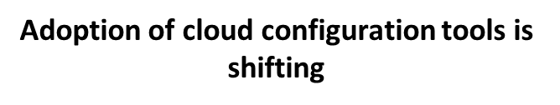
Cloud use often goes hand in hand with adopting DevOps processes.
Configuration management tools is used to standardize and automate deployment and configuration of servers and applications.
Native cloud tools are most commonly used today.
Third-party tool usage declined from last year:
Terraform dropped from 36 percent to 30 percent
Ansible dropped from 31 percent to 27 percent
Chef dropped from 27 percent to 20 percent
Puppet dropped from 27 percent to 20 percent
Salt/SaltStack dropped from twelve percent to five percent.
This may indicate that the ease and features of provider-specific tools are more enticing to organizations, despite our multi-cloud world. In comparison, it can be cumbersome to implement a third-party tool and cover all provider services.

Slide 31



























Docker Customers
https://www.docker.com/customers

Slide 32





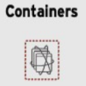


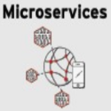


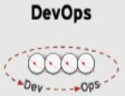
Enterprise Applications - Evolving Themes
App Infrastructure
Deployment & Packaging
Application Architecture
Development Process
Notes:
Microservices and containerization work well when used together.
If you develop Microservice within a container then you can gain all of the inherent benefits of containerization.
Containers, microservices, and cloud computing are working together to bring application development and delivery to new levels not possible with traditional methodologies and environments.
These next-generation approaches add agility, efficiency, reliability, and security to the software development lifecycle—all of which leads to faster delivery of applications and enhancements to end users and the market.

Slide 33
Docker Lab

Slide 34
Agenda –Docker Lab
Basic Docker Commands
Docker Access Through SSH
Docker Web Server
Docker Image Creation
Docker Volume
Docker Networking

Slide 35
Docker Basic Commands
Install in Ubuntu: apt-get install docker.io (Ref: https://docs.docker.com/engine/install/ubuntu/)
Check docker service status: service docker status
docker pull ubuntu - pull docker images from dockerhub
docker images - List all the docker images
Check: docker hub -https://hub.docker.com/
Check image repositories:
ex: $sudo cat /var/lib/docker/image/overlay2/repositories.json | python3 -mjson.tool
$sudo docker inspect ubuntu /* Display low lever information about image */

Slide 36
Docker Basic Commands
docker create ubuntu
docker create --name test ubuntu
docker create -i -t --name user1 ubuntu /bin/bash
docker start user1
docker attach user1
docker stop user1
$docker start ‑a ‑i user1 (it will start and attach)

Slide 37
Docker Basic Commands
Demo : create_100.sh; delete_100.sh; create_10.sh; start-10.sh
docker stats /* Monitor Running Container like top command */
docker stats <container name>
docker logs <running container id>
docker logs -f <running container id> /* Real Time */
docker info
docker history <image name>
docker search <image name>
Remove all the containers: docker rm $(docker ps -a -q)
Remove docker images: docker rmi <id>

Slide 38
Docker Basic Commands
copy file from host to docker viceversa:
docker cp user.txt user1:<path>/user.txt (host to docker (user1))
docker cp user1:user.txt /home/raju/user.txt (docker to host)
Run Container as background process:
docker run -d -it --name user3 ubuntu /bin/bash
docker attach user3 (if you want to get access)
Check Running Container information:
/var/lib/docker/containers /* List all the running containers */
Check log file for a specific container.

Slide 39
Docker Access through SSH
create user account : adduser user1
set password for user1
create user1 as sudo user: usermod -aG sudo user1
create user1 container
Modify /home/user1/.profile file as:
sudo docker start -a -i user1; exit
ssh to <ip address> login as user1 and you will get user1 container shell.

Slide 40
Docker Web Server
run user1 docker container
apt-get update
apt-get install -y apache2
apt-get install -y apache2-utils
apt-get install vim
vim /var/www/html/index.html
change line number 208:
service apache2 start
elinks <container ip address>

Slide 41
Docker Web Server
Execute webserver:
docker pull thangaraju/webserver_test
docker run -i -t -p 9999:80 thangaraju/webserver_test /bin/bash
service apache2 start
go to host system and execute in a browser:
<host ip address:9999>

Slide 42
Docker Image Creation
Docker image creation and move to docker hub
docker commit -a <Author Name> <container id> <image name>
docker tag <image id> <username/image name:latest>
$docker commit -a "Dr B Thangaraju" <container id> <container image name>
$docker tag <old name> <new name>
ex: docker tag jenkins_slave iiitb/jenkins_slave:latest
docker login (iiitb)
docker push <username/image name>
dockerhub.com - edit and verify

Slide 43
Docker Volume
1. Create docker volume
sudo docker volume create <volume_name>
ex: sudo docker volume create devtest
2. List docker volume
sudo docker volume list
3. Inspecting docker volume
ex: sudo docker volume inspect devtest
4. Mounting docker volume:
sudo docker run −−mount source=<name of volume>,destination=<path of a directory in container>,<readonly> <image_name>
ex: sudo docker run −it −−mount source=devtest,destination=/usr/src/app/ ubuntu /bin/bash

Slide 44
Docker Volume
After successful exection of the above command, you will get docker shell prompt
cd /usr/src/app /* store all the files, which you want to keep it in the volume */
ex: touch abc{1..100}.txt /* all 100 files will be stored in docker volume. */; exit.
5. Now any container can connect to the volume and access the 100 files.
ex: sudo docker run −it −−name=container1 −−mount source=devtest,destination=/app ubuntu
After successful execution of the above command, you will get docker shell prompt.
cd /app; $ls /*you can see all the 100 files. so any container can connect the volume and access the files*/
6. Deleting docker volume:
sudo docker rm <name of volume>
ex: sudo docker volume rm devtest

Slide 45
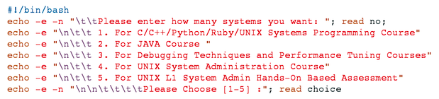
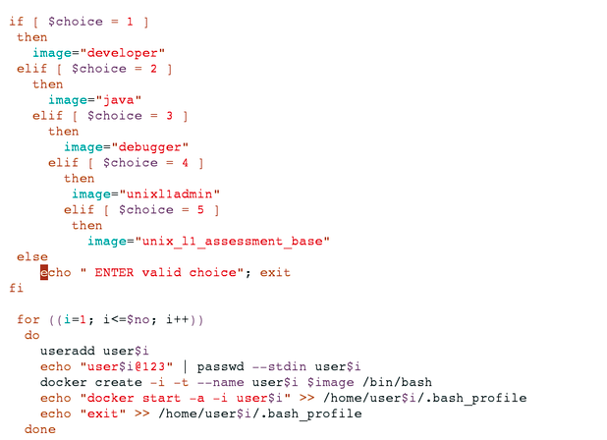
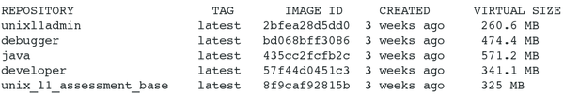
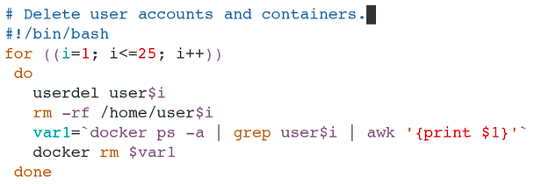
Docker for Lab

Slide 46
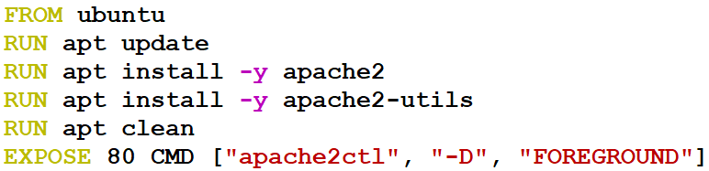
Dockerfile
vim Dockerfile
sudo docker build -t mywebserver:0.1 .
http://ipaddress

Slide 49
THANK YOU

