Slide 1
A) OptiClust
Full Data Set
Cluster OTUs with OptiClust
100x
Randomly split
80% train/20% test
80%
Train & Validate
20%
Test
Preprocess
Apply preprocessing
100x
80%
Train
20%
validate
Train model with highest performing H
Classify test set
H x
Validate model for each hyperparameter setting
Train with different hyperparameter settings
test AUC for split
cvAUC
Mean cvAUC per H
H = hyperparameter settings
Mean test AUC

Slide 2
B) OptiFit
Full Data Set
100x
Randomly split
80% train/20% test
80%
Train & Validate
20%
Test
OptiClust
Reference OTUs
OptiFit
Preprocess
Apply preprocessing
100x
80%
Train
20%
validate
Train model with highest performing H
Classify test set
H x
Validate model for each hyperparameter setting
Train with different hyperparameter settings
test AUC for split
cvAUC
Mean cvAUC per H
H = hyperparameter settings
Mean test AUC

Slide 3
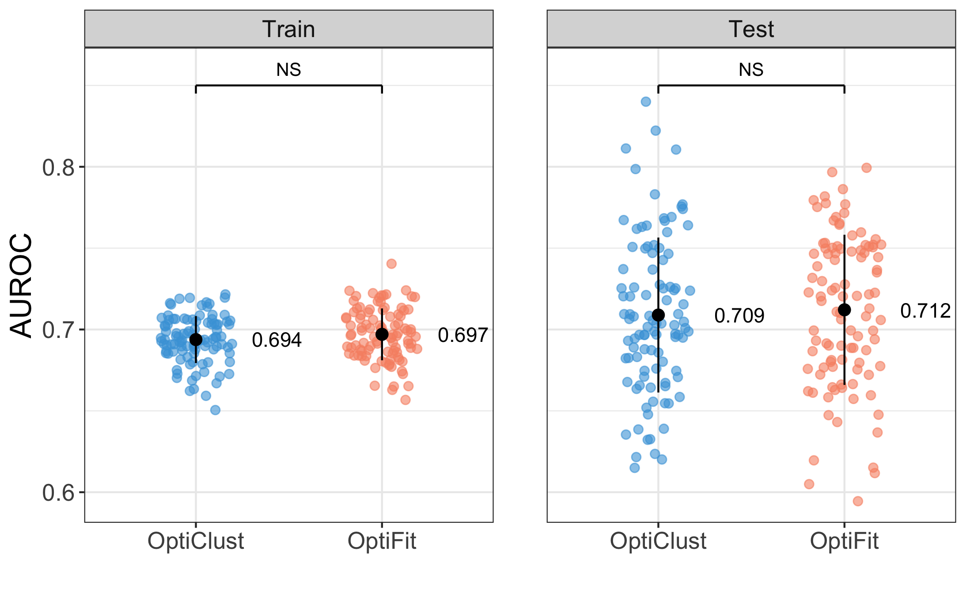
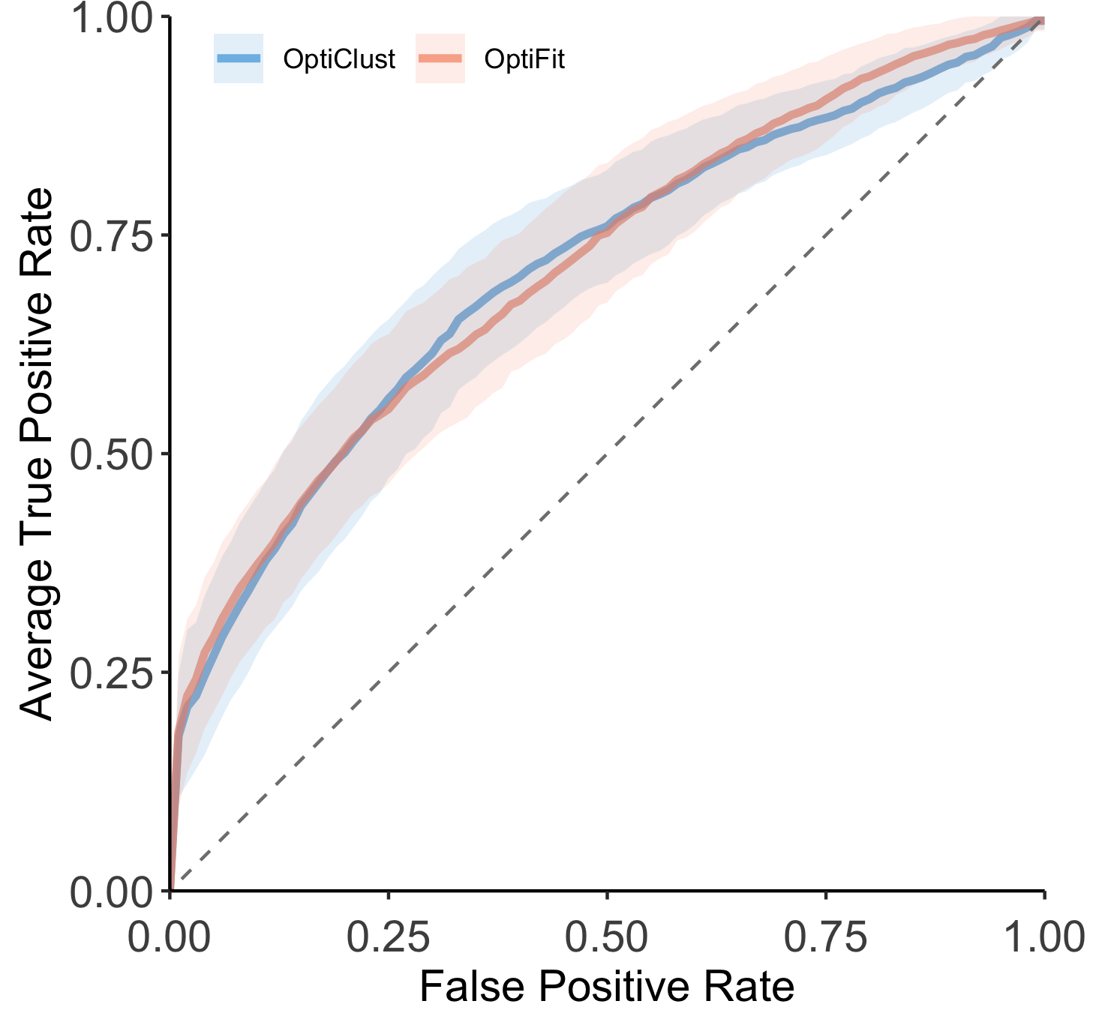
A
B
C

Slide 4
A) OptiClust
Full Data Set
Cluster OTUs with OptiClust
MCC score
100x
Randomly split
80% train/20% test
80%
Train & Validate
20%
Test
Preprocess
Apply preprocessing
100x
80%
Train
20%
validate
Train model with highest performing H
Classify test set
H x
Validate model for each hyperparameter setting
Train with different hyperparameter settings
CV AUC for split
test AUC for split
CV AUC
Mean CV AUC per H
H = hyperparameter settings
Mean CV AUC
Mean test AUC

Slide 5
A) OptiClust
Full Data Set
Cluster OTUs with OptiClust
MCC score
100x
Randomly split
80% train/20% test
80%
Train & Validate
20%
Test
Preprocess
Apply preprocessing
100x
80%
Train
20%
validate
Train model with highest performing H
Classify test set
H x
Train with different H
Validate model for each H
CV AUC for split
test AUC for split
cvAUC
Mean cvAUC per H
H = hyperparameter settings
Mean CV AUC
Mean test AUC

Slide 6
B) OptiFit
Full Data Set
100x
Randomly split
80% train/20% test
80%
Train & Validate
20%
Test
MCC score for split
Mean MCC score
OptiClust
Reference OTUs
OptiFit
Preprocess
Apply preprocessing
100x
80%
Train
20%
validate
Train model with highest performing H
Classify test set
H x
Train with different H
Validate model for each H
CV AUC for split
test AUC for split
cvAUC
Mean cvAUC per H
H = hyperparameter settings
Mean CV AUC
Mean test AUC

