Slide 1
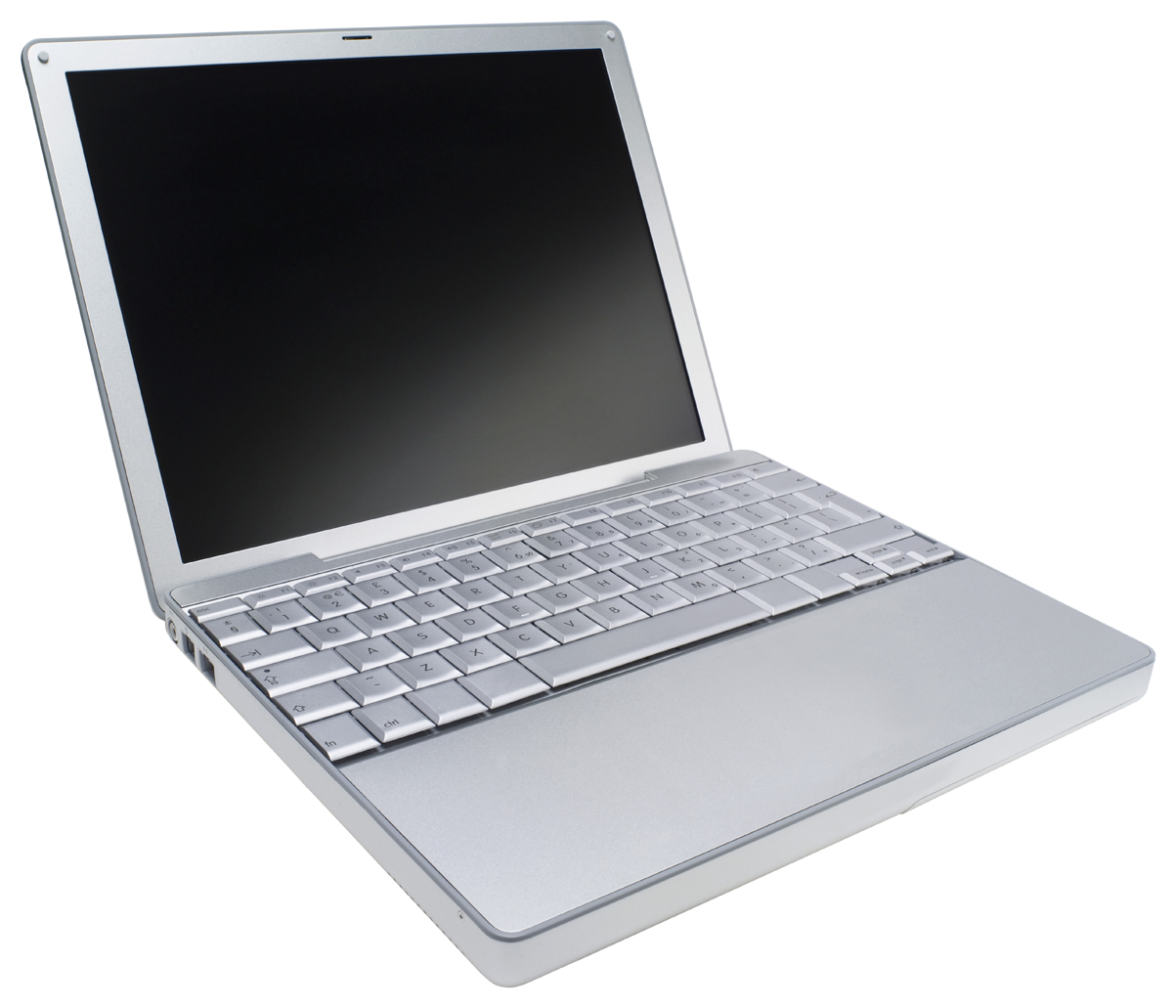
Head Node
Job 1
Compute
Node 1
Compute
Node 2
Compute
Node 3
Compute
Node 4
Compute
Node 5
Job 3
Compute
Node 6
Compute
Node 7
Compute
Node 8
Compute
Node 9
Compute
Node 10
Job 2
Compute
Node 11
Compute
Node 12
Compute
Node 13
Compute
Node …
Compute
Node 1000

