Slide 1
Networking inside of Kubernetes
Mentors: Anish Gupta, Bowen Song
Team: Alexander Trinh, Fuyao Wang, Zhe Deng,
Geng Song, Zhou Shen

Slide 2
Introduction
Problem: Etcd’s RAFT protocol performs poorly on large cluster writes
What we plan to do:
Implement and benchmark Gossip using CPISync and Go
Maintain major Etcd design choices (e.g. key-value, logs, etc.)
What we DON’T plan to do:
Replace RAFT with Gossip
Store large amounts of data
Notes:
Etcd = “distributed etc”, etc used for config and metadata in Unix systems
Background: Kubernetes uses Etcd (key-value storage written in Golang) for metadata and synchronization. Etcd uses RAFT which does not perform well on writes for large clusters (>>1000 nodes).
Example of keeping design: keep WALs so that there is a chance of recovery from dead node
Some data still needs strong consistency, therefore still use RAFT for it
Do not plan on storing > current Etcd limit of 8GB

Slide 3
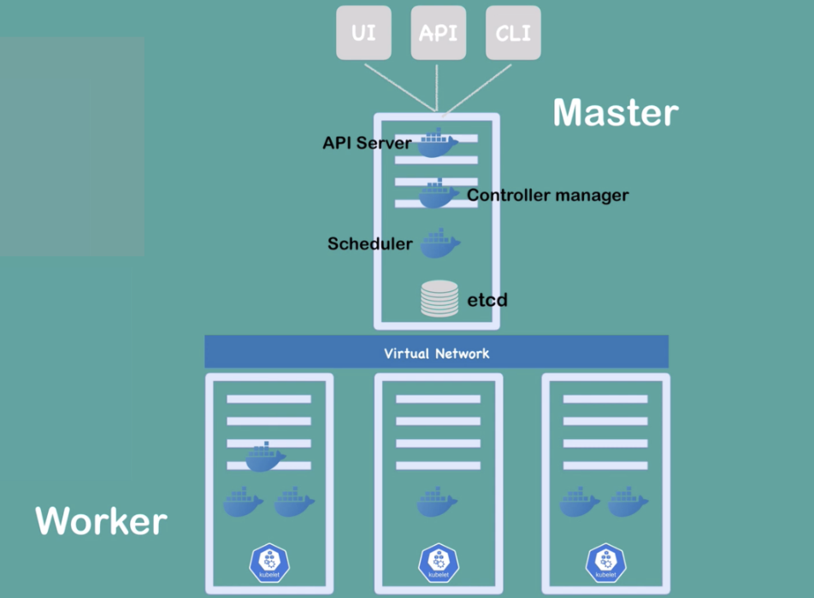
Kubernetes
Manage containerized application in different environments
Worker Nodes execute some tasks
Master Node manages the cluster work properly
Virtual Network let them talk to each other

Slide 4

ECTD
Is a distributed key-value store
PUT, GET, DEL
Kubernetes stores metadata about its nodes
Also stores node metadata
create_revision
mod_revision
version
lease

Slide 5
ECTD
Multiple servers may run the same instance of ECTD
Highly available and strongly consistent
Able to read from any node
Writes are only processed at the master node
Uses RAFT protocol

Slide 6

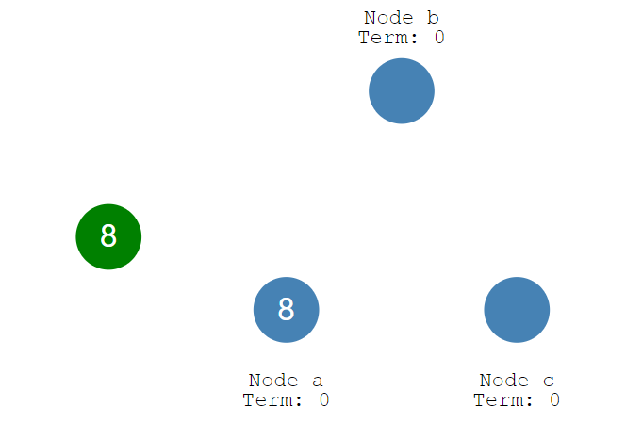
RAFT
Is a distributed consensus algorithm
Leader election

Slide 7
RAFT
Log replication
Pros and Cons of having a leader
Uses Gossip protocol

Slide 8
Gossip
What is Gossip protocol?
Also called Epidemic Protocol
Spread periodically
Only spread to unsent nodes
Never go back
Professor Trachtenberg’s repo:
https://github.com/trachten/cpisync

Slide 9
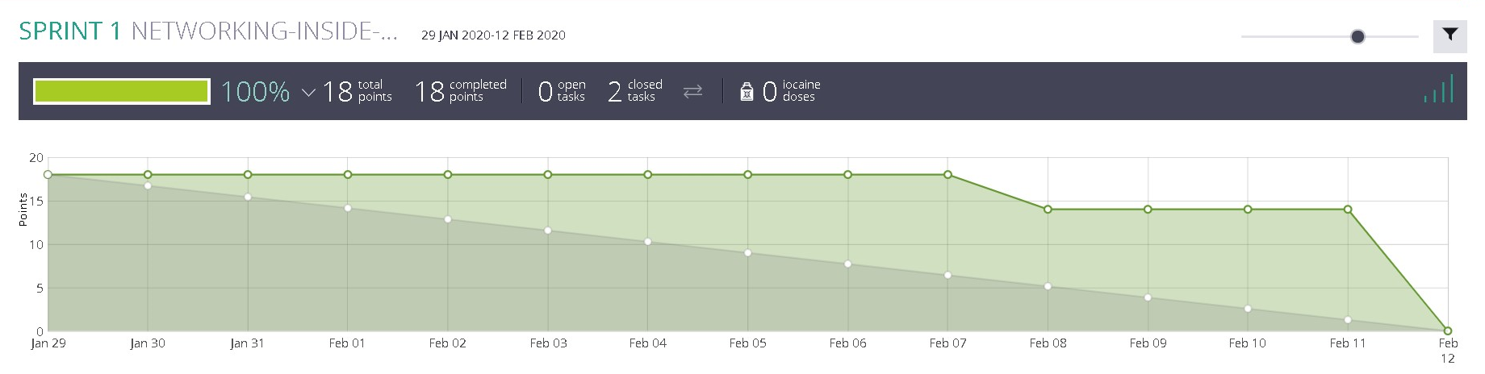
SPRINT 1
Goals for next sprint:
Modifying Etcd operators
Implementing Gossip for minikube

