Slide 1
What’s Eat App
Group presentation – Iteration 3
Member: Bowen Jiang, Huaze Sang, Chenyang Li, Fengbo Gao, He Yu

Slide 2
Overview
An app designed to solve food selection difficulty when guys are hungry.
Also provides recommendation based on desirable calorie intake for healthy lifestyle!

Slide 3
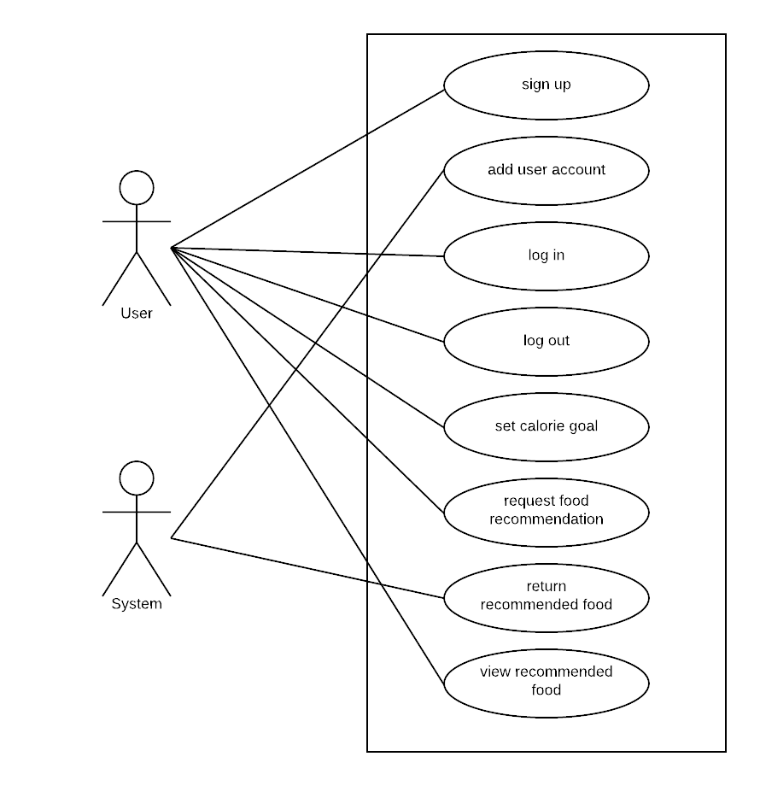
Requirement Analysis -Use Case

Slide 4
Requirement Analysis
User Stories | Status
Calorie Calculation | Accepted
Login and password | Accepted
Registration | Accepted
Pick food | Accepted
Set calorie goal | Accepted
Food tag | Accepted
Good-looking UI interface | Accepted
Quick response | Accepted
Contact for advice | Accepted
Logout | Accepted
Modify personal figure | Accepted
Change size of character | Icebox
Thumbs up/down | Icebox
Food search Bar | Icebox
History list | Icebox
Cuisine Selection | Icebox

Slide 5
Requirement Analysis
Functional
Nonfunctional
quick response
easy to access and register
good UI design

Slide 6
Requirement analysis
user stories complete rate
total #: 18
Accepted #: 11
Icebox #: 5
Discard #: 2
Tracking method: Pivotal tracker

Slide 7
Design
Architecture
Framework
Algorithms
Database and file structure

Slide 8


Design - Framework
Language:
Front-end: JavaScript, HTML, CSS, Ajax, jQuery
Back-end: Java
Framework: Spring
Design pattern: MVC
Server: Apache Tomcat 7
Database: MySQL
IDE: Intellij

Slide 9
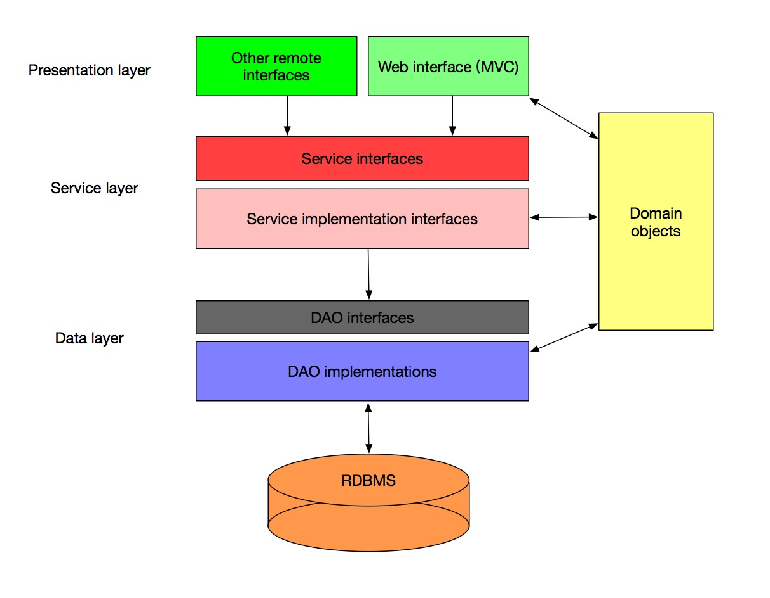
Design - Architecture
- 3 Layers
- interact with
each interface
changes updated
in each interface

Slide 10
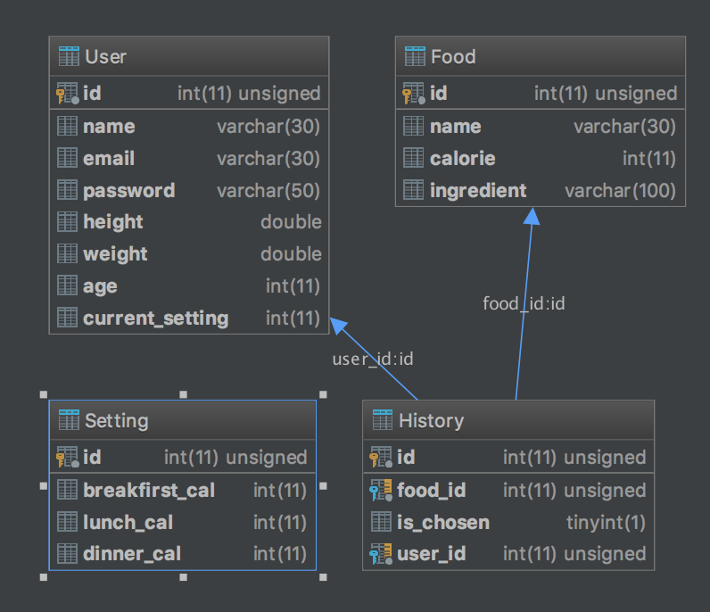
Design- Database and file structure
├── main
│ ├── controller
│ │ ├── MainPageController.java
│ │ └── UserPageController.java
│ ├── dao
│ │ ├── FoodDao.java
│ │ ├── FoodDaoImpl
│ │ │ └── JDBCFoodDao.java
│ │ ├── UserDao.java
│ │ └── UserDaoImpl
│ │ └── JDBCUserDao.java
│ ├── model
│ │ ├── Food.java
│ │ ├── History.java
│ │ ├── Setting.java
│ │ └── User.java
│ ├── service
│ │ ├── FoodService.java
│ │ ├── FoodServiceImpl
│ │ │ └── FoodServiceImpl.java
│ │ ├── UserService.java
│ │ └── UserServiceImpl
│ │ └── UserServiceImpl.java
│ └── util
│ └── Response.java
├── spring-mvc.xml
└── test

Slide 11
Design - Process
Food Recommendation Algorithm:
Given user has requested food recommendation and sets his/her calorie goal:
// set calorie goal
setCalorie();
Temp_calorie = getCalorie();
// user has already set their preferences to food when they first sign up
Food_tag = user.getPrefer();
while(TRUE){
Random Food_id = new Random().nextInt(max);
food temp = getfood(food_id);
if(food.tag == Food_tag && food.calorie ≤ temp_calorie)
Return food;
break;
Else continue;
}

Slide 12
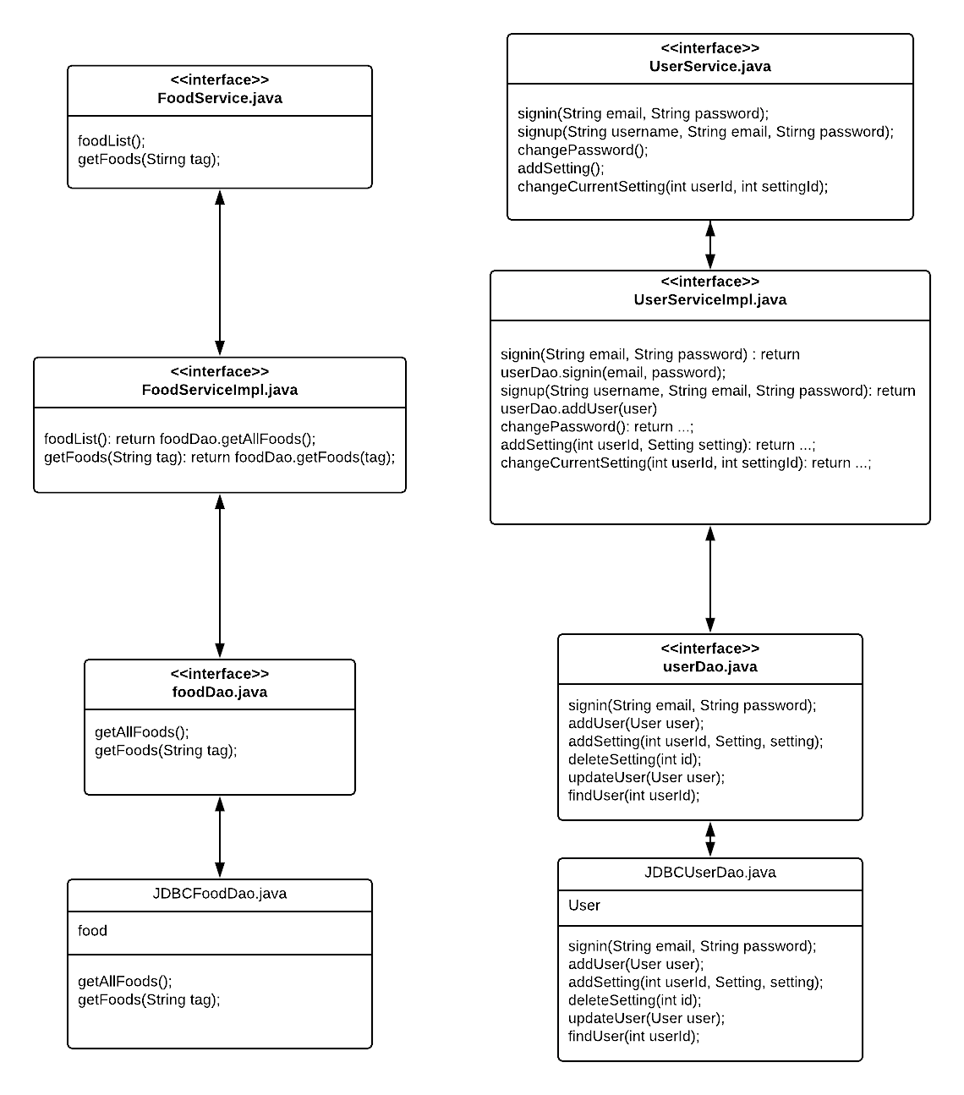
Implementation

Slide 13
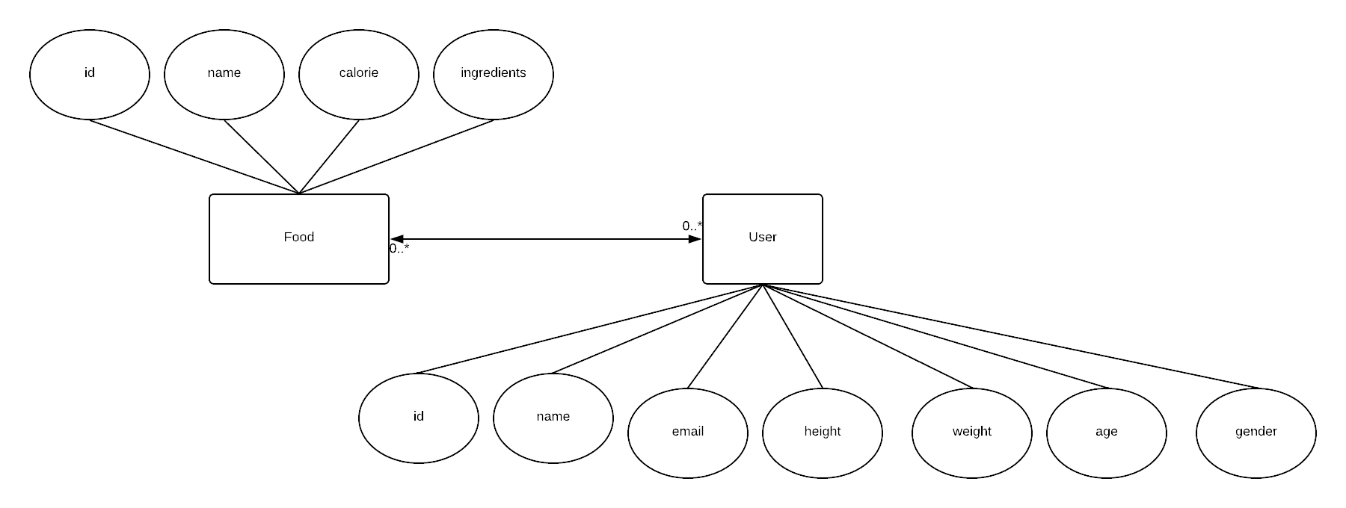
Implementation- data structure

Slide 14
Testing
Methods:
JUnit;
Selenium integration test:
Katalon automation recorder(IDE)

Slide 15
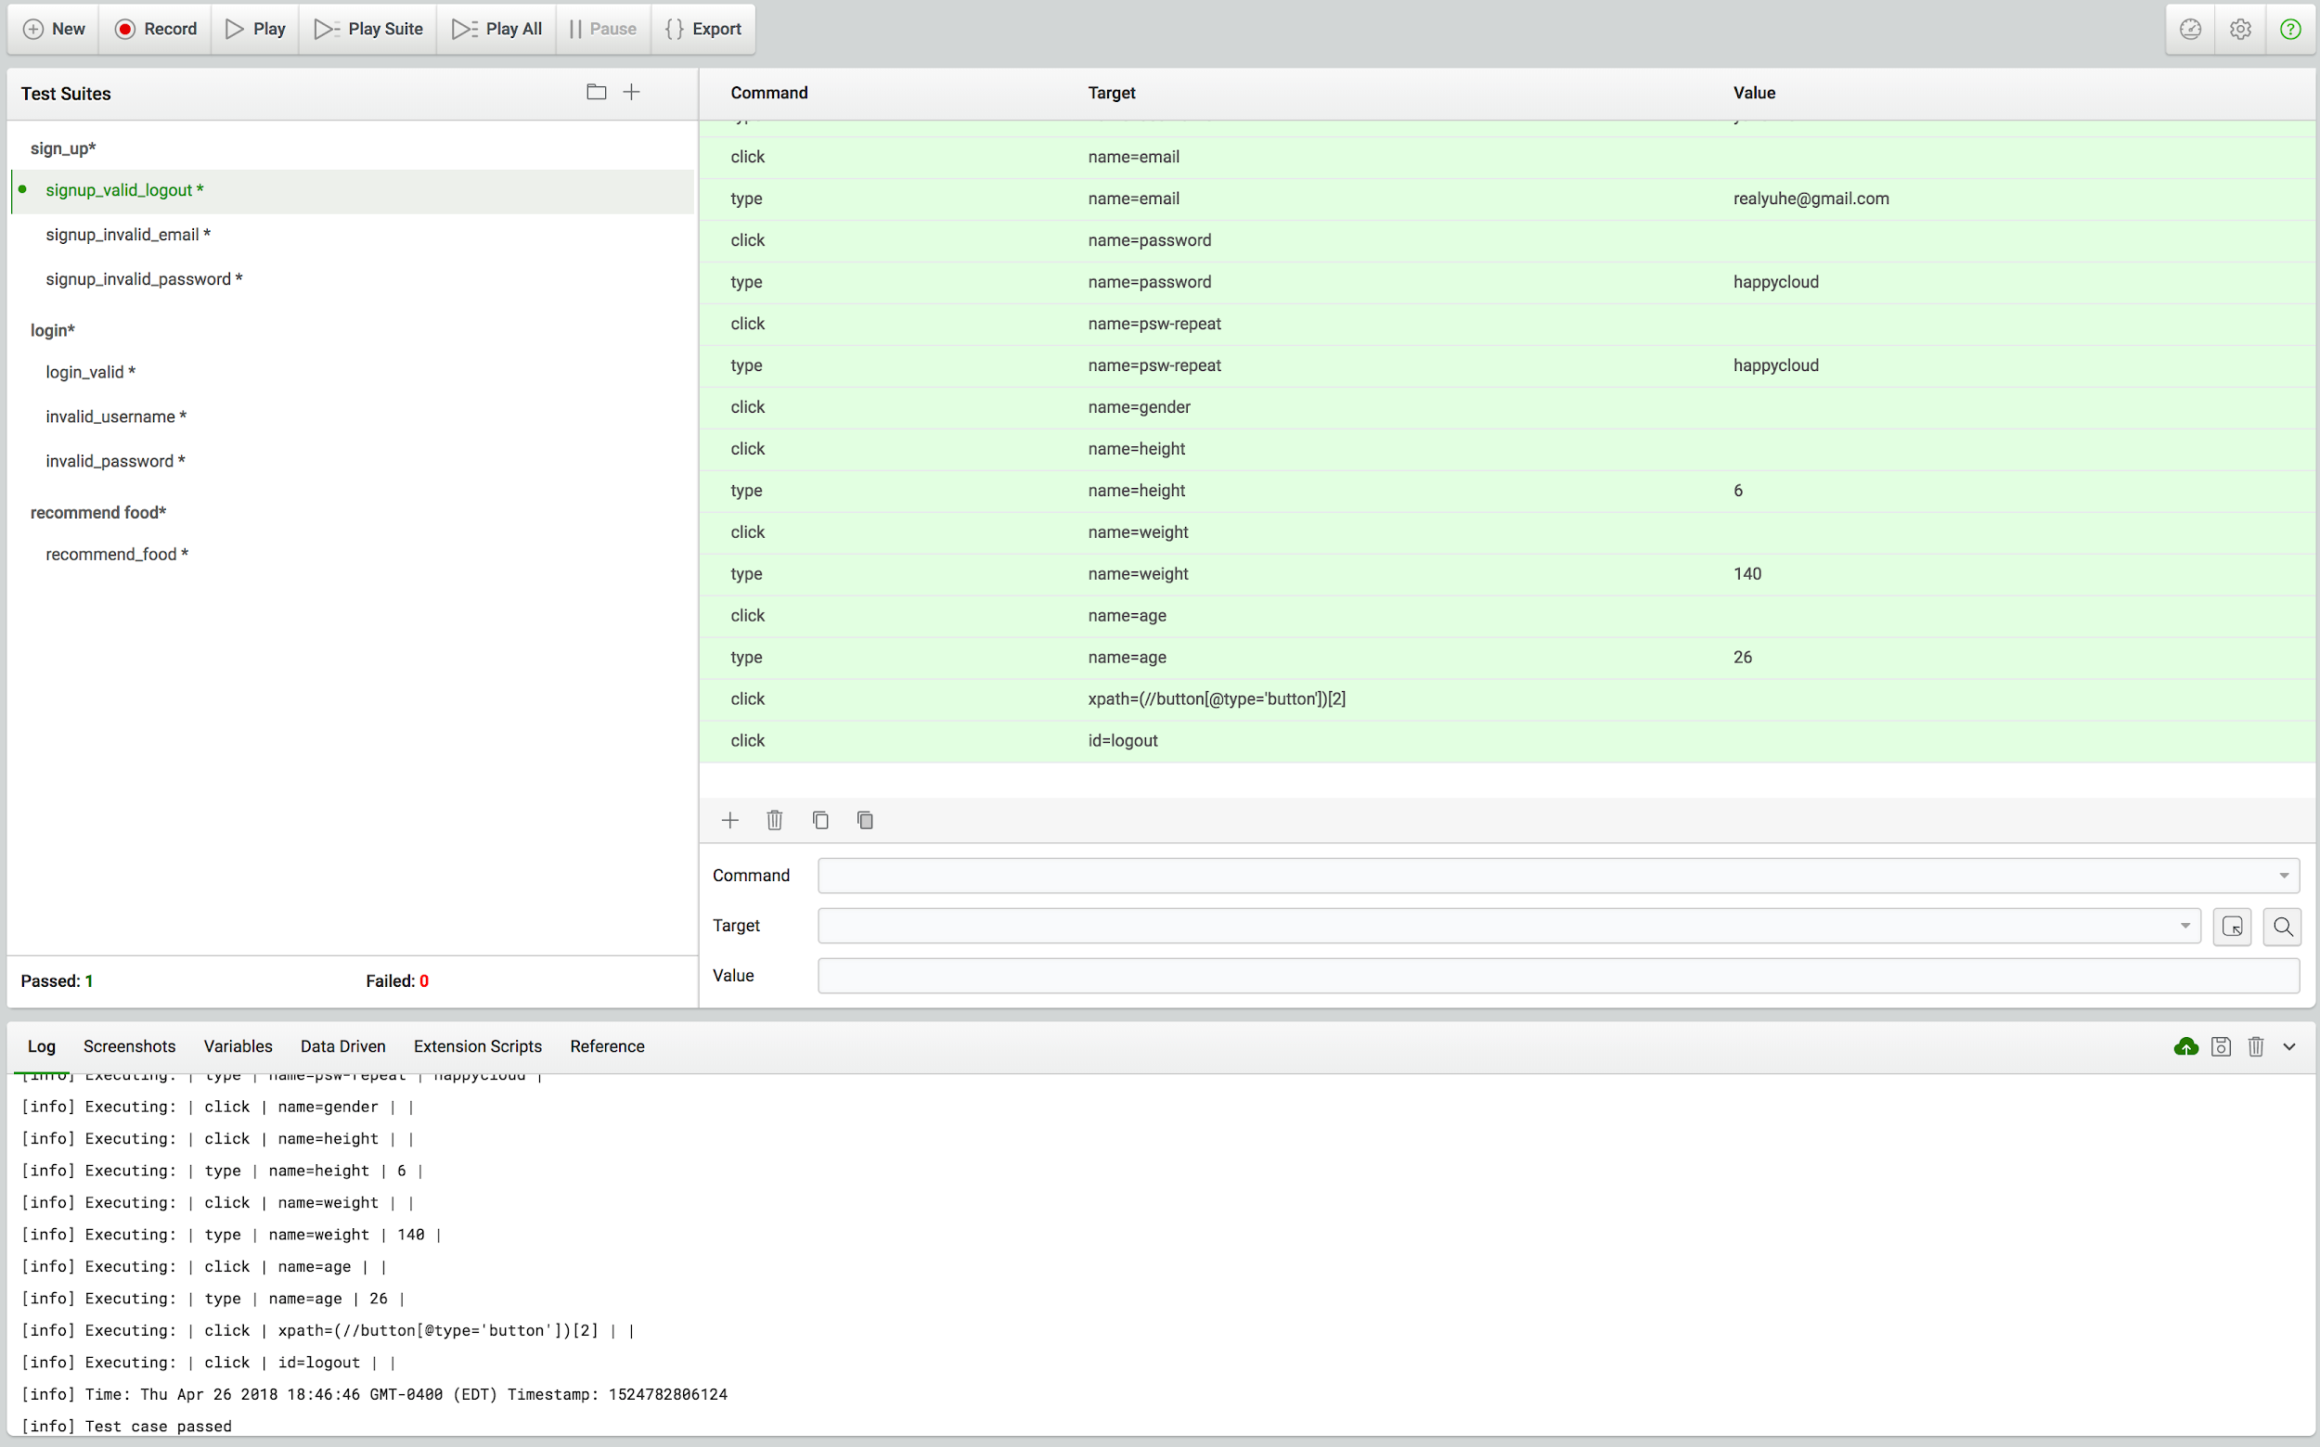
Katalon Recorder

Slide 16
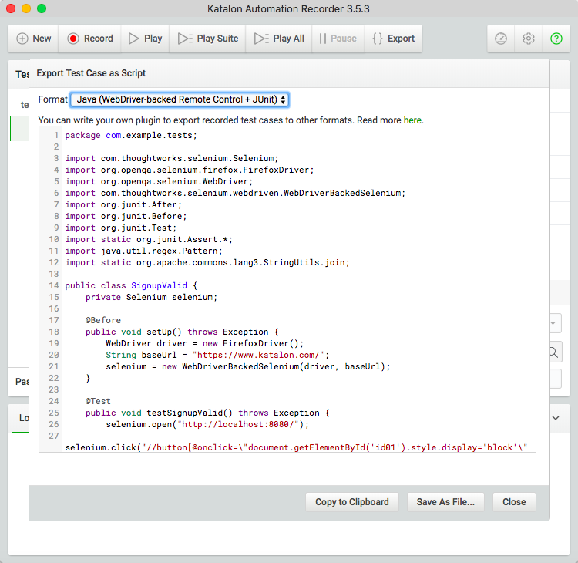
Katalong- export code

Slide 17
Security
Cryptographic hash function: MD5.
Every password is hashed uniquely like a “fingerprint”
Can hash large information into small-bits hash.
Collision rarely happens

Slide 18
MD5
Information 0~511 bit 64 bit
L mod 512 = 448
L mod 512 = 0

Slide 19
F( X ,Y ,Z ) = ( X & Y ) | ( (~X) & Z )
G( X ,Y ,Z ) = ( X & Z ) | ( Y & (~Z) )
H( X ,Y ,Z ) =X ^ Y ^ Z
I( X ,Y ,Z ) =Y ^ ( X | (~Z) )
FF(a ,b ,c ,d ,Mj ,s ,ti ) a = b + ( (a + F(b,c,d) + Mj + ti) << s)
GG(a ,b ,c ,d ,Mj ,s ,ti ) a = b + ( (a + G(b,c,d) + Mj + ti) << s)
HH(a ,b ,c ,d ,Mj ,s ,ti) a = b + ( (a + H(b,c,d) + Mj + ti) << s)
II(a ,b ,c ,d ,Mj ,s ,ti) a = b + ( (a + I(b,c,d) + Mj + ti) << s)

Slide 20
Project Management
Role assignment
Risk management
Quality management

Slide 21
Role assignment
Team Member | Role
Bowen Jiang | Team Leader
Huaze Sang | Tech Leader
He Yu | Document/QA Leader
Chenyang LI | Front design leader
Fengbo Gao | Security leader

Slide 22
Risk Management
Risk | Occurrence (1-5) | Impact (1-5) | Retirement Cost | Priority | Complete date
Team communicate | 3 | 3 | 9 | 2 | 2/1
Feature design | 4 | 4 | 16 | 1 | 2/8
Large Datasets | 4 | 3 | 12 | 2 | 3/8
Connect back-end and front-end | 5 | 4 | 20 | 1 | 3/20
Web page refresh | 4 | 2 | 8 | 3 | 3/20
Testing issue | 4 | 5 | 20 | 1 | 4/20
Deployment rush | 4 | 5 | 20 | 1 | 4/27

Slide 23
Demo

Slide 24
Project review
Achievements of the project
Challenges in the project
Things to improve

Slide 25
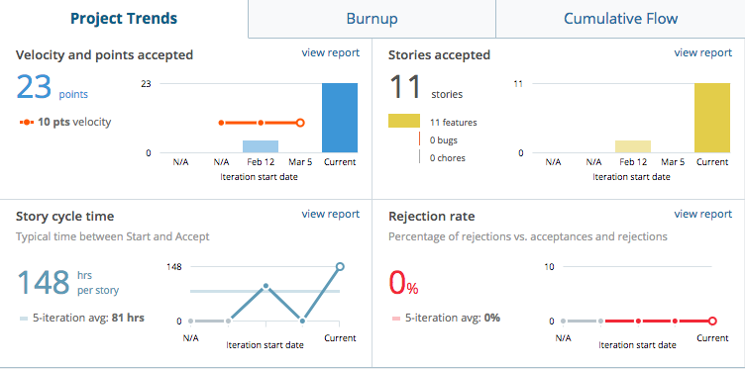
Achievements

Slide 26
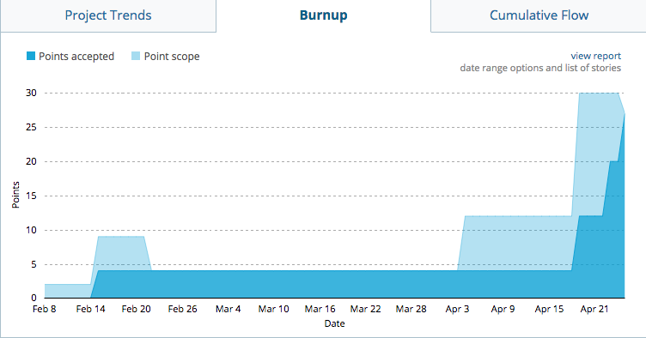
Achievements

Slide 27
Challenges & Things to improve
Testing
Deployment
Development process: Scrum vs. FDD

Slide 28
Qustions?

Slide 29
Thank you!

