Slide 1
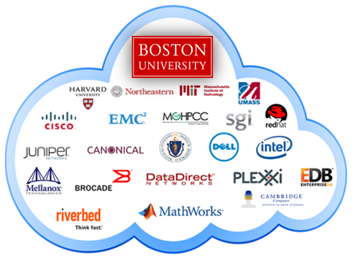
Team Members: Dana Aljawder, Lama AlSuwayan, Everett Carson, Igibek Koishybayev, Hung Vong Project Mentor: Jon Bell
Plugin Architecture for The Massachusetts Open Cloud GUI
(MOC)
EC 500-A1: Cloud Computing

Slide 2
Outline
Concepts
MOC-UI
HaaS
Tools
Django (Python, HTML, Javascript)
Sprint 1 – Demo
What’s next

Slide 3

MOC-UI
Massachusetts Open Cloud
Customizable approach to Cloud Computing
User Interface
A web app to manage and maintain
projects and clusters on the MOC

Slide 4
HaaS
Hardware as a Service
Components:
Project: create/delete
Headnode: load base image, start/stop
Node: attach/detach
Networks: create/delete, set access

Slide 5
Django
Python Web Application Framework
Uses MVC architectural pattern:
Model: models.py
View: HTML templates
Controller: view.py (confusingly!)
Why Django?
Free/open source
Efficient
Modularized:
Allows separation of concerns/parallel development

Slide 6
Sprint 1
Learned about HaaS
How to use django
Designed UI
Implemented UI without HaaS integration
[DEMO]

Slide 7
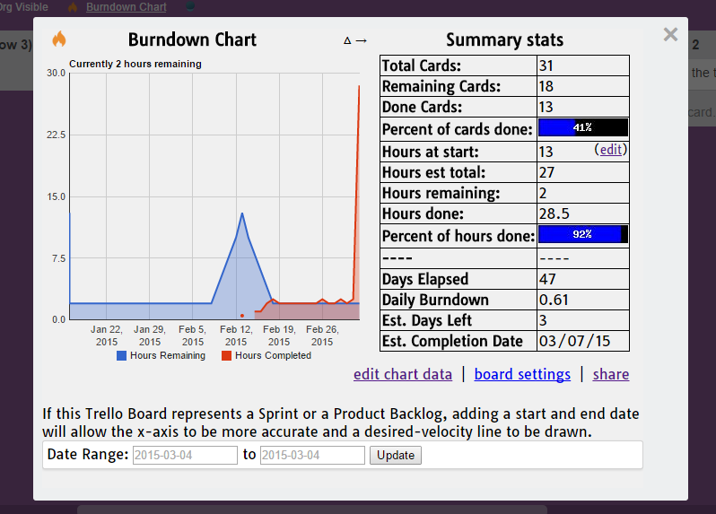
Sprint 1 – Cont’d

Slide 8
What’s Next
Complete the UI
Run development server of HaaS
Integrate HaaS API calls

Slide 9
Q & A!

