Slide 1

Team Members: Dana Aljawder, Lama AlSuwayan, Everett Carson, Igibek Koishybayev, Hung Vong Project Mentor: Jonathan Bell
Plugin Architecture for The Massachusetts Open Cloud GUI
(MOC GUI)
EC 500-A1: Cloud Computing

Slide 2
Project Overview
Plugin for MOC-UI
Allow external web apps to be integrated into MOC-UI
HaaS
Test case: implement a web app to manage projects using HaaS
Integration of HaaS app into MOC-UI

Slide 3

Integration Strategy
HaaS Server
MOC-UI
<Header>
Add to list
<Market>
iFrame
Name, URL
<Footer>
HaaS Services
External Services

Slide 4
Last Sprint
Set up instances of HaaS server
Created HaaS API (List all Projects)
Integrated HaaS API calls into web app
create/delete projects
Get all free nodes
Get all projects
List project nodes/networks
Extended UI (Django templates, CSS & JavaScript)

Slide 5
Sprint 3
Created HaaS APIs:
(4) View All Nodes [3]
(2) View All Networks [.5]
Integrated HaaS API calls into web app:
(6) Attach Headnode to Project [10]
(2) Show Node Details[4]
(2) Attach/Detach Nodes [1.5]
(1) View All Nodes/Networks [0.5]
(5) Enhanced UI (Django templates, CSS & JavaScript)[9]

Slide 6
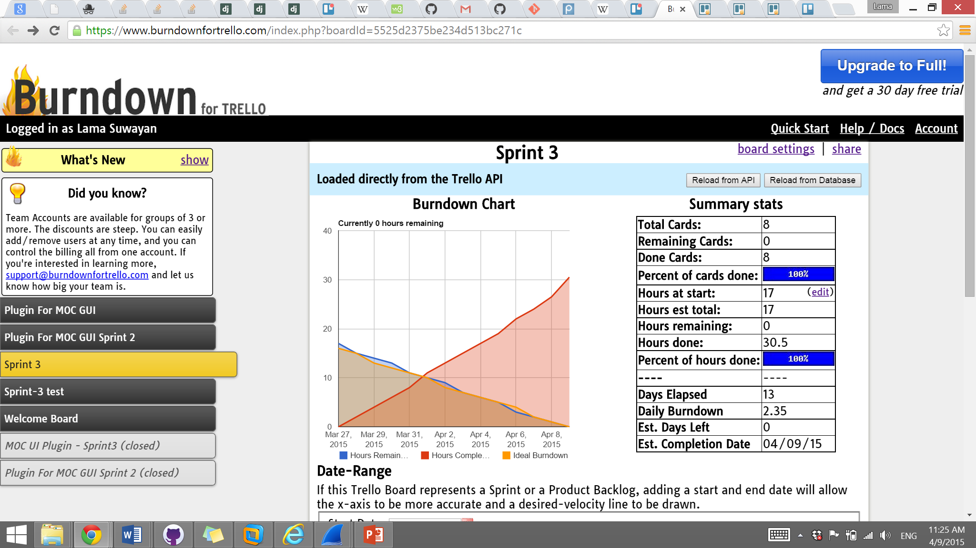
Burndown

Slide 7
DeMO

Slide 8
What’s Next For Sprint 4
Work on CSS
Implement HaaS API calls:
Detach Network from Project
Integrate HaaS API calls into the app:
Connect Project Network
Detach Project Network
Detach Headnode
(Strech) Manage NICS

Slide 9
Overall Status
Under Estimated Sprint2 Goals, Over Estimated Sprint3 Goals
iFrame Integration (Sprint 5)
Depends on MOC UI group

Slide 10
Q & A!

