Slide 1
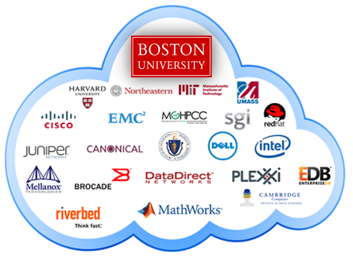
Team Members: Dana Aljawder, Lama AlSuwayan, Everett Carson, Igibek Koishybayev, Hung Vong Project Mentor: Jon Bell
Plugin Architecture for The Massachusetts Open Cloud GUI
(MOC)
EC 500-A1: Cloud Computing

Slide 2
Outline
Concepts
MOC-UI
HaaS
Tools
Django (Python, HTML, Javascript)
Sprint 1 – Demo
What’s next

Slide 3

MOC-UI
Massachusetts Open Cloud
Customizable approach to Cloud Computing
User Interface
A web app to manage and maintain
projects and clusters on the MOC

Slide 4
HaaS
Hardware as a Service
Components:
Project: create/delete
Headnode: load base image, start/stop
Node: attach/detach
Networks: create/delete, set access

Slide 5
Django
Web Framework
Python
HTML
Javascript
Uses MVC architectural pattern

Slide 6
Sprint 1
Learned about HaaS
How to use django
Designed UI
Implemented UI without HaaS integration
[DEMO]

Slide 7
Sprint 2
Integrate API calls (create/delete project)

Slide 8
Q & A!

