Slide 1

Team Members: Dana Aljawder, Lama AlSuwayan, Everett Carson, Igibek Koishybayev, Hung Vong Project Mentor: Jonathan Bell
Plugin Architecture for The Massachusetts Open Cloud GUI
(MOC)
EC 500-A1: Cloud Computing

Slide 2
Project Overview
Plugin for MOC-UI
Allow external web apps to be integrated into MOC-UI
HaaS
Test case: implement a web app to manage projects using HaaS
Integration of HaaS app into MOC-UI

Slide 3

Integration Strategy
HaaS Server
MOC-UI
<Header>
Add to list
<Market>
iFrame
Name, URL
<Footer>
HaaS Services
External Services

Slide 4
Sprint 1
Learned web tools (Django)
Studied HaaS API
Developed initial UI for app
Did not use Trello properly

Slide 5
Sprint 2
(4) Set up instances of HaaS server [3]
(Stretch)Created HaaS API (List all Projects) [5]
Integrated HaaS API calls into web app
(4) create/delete projects [4]
(Stretch)Get all free nodes [1]
(Stretch)Get all projects [0.5]
(Stretch)List project nodes/networks[2]
(8) Extended UI (Django templates, CSS & JavaScript)[7]

Slide 6
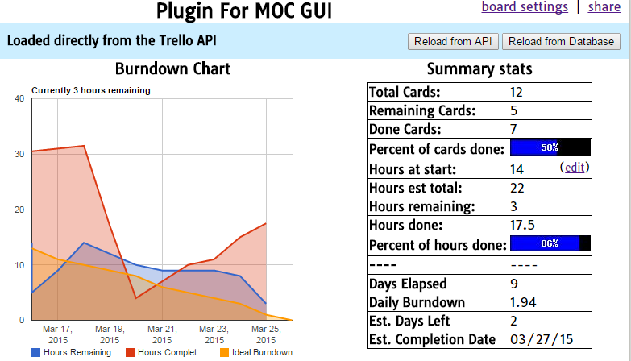
Burndown – Bad Chart

Slide 7
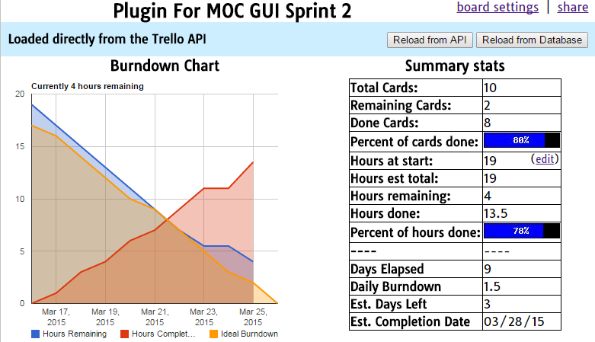
Burndown – Corrected

Slide 8
What’s Next For Sprint 3
Finalize the web app UI:
Navigation
Node details
Implement forms to process data:
Assign headnode
Detach node
Integrate HaaS API calls into the app
Detach nodes
Assign headnode

Slide 9
Overall Status
Almost done with initial goals
iFrame Integration (Sprint 4 & 5)
Depends on MOC UI group
Could work on stretch goals in the meantime
Authorization for HaaS

Slide 10
Q & A!

