Slide 1
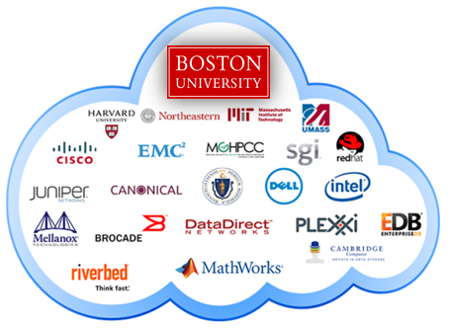
Team Members: Dana Aljawder, Lama AlSuwayan, Everett Carson, Igibek Koishybayev, Hung Vong Project Mentor: Jon Bell
Plugin Architecture for The Massachusetts Open Cloud GUI
(MOC)
EC 500-A1: Cloud Computing

Slide 2
Project Overview
Plugin for MOC-UI
Allow external web apps to be integrated into MOC-UI
HaaS
Test case: implement a web app to manage projects using HaaS
Integration of HaaS app into MOC-UI

Slide 3
Previous Sprint
Created HaaS API calls:
View All Nodes
View All Networks
Integrated HaaS API calls into web app:
Show Node Details
Attach/Detach Nodes
View All Nodes/Networks
Enahnced UI (Django templates, CSS & JavaScript)

Slide 4
Current Sprint
Integrate HaaS API Calls:
Nodes:
(4) Add NIC/ Delete NIC [2.5]
(2) Power Cycle [1]
(2) Delete Node [3]
Headnode:
(4) Add/Delete HNIC [2.5]
Start/Stop Headnode
Delete Headnode
Networks:
(3) Create Network [13]

Slide 5
Current Sprint - Cont’d
Refactor the app:
(13) Redesign Use Cases [8]
(13) File Structure and URLS [8]
(8) Forms and Tables [5]
(13) Redesign Node Details [30]
(Stretch) Unit Testing for Previous Sprint Calls:
List All Projects
List All Networks
All Node

Slide 6
Current Sprint – Not Done
Manage VLANS
Connect/Disconnect HNICs to Networks

Slide 7
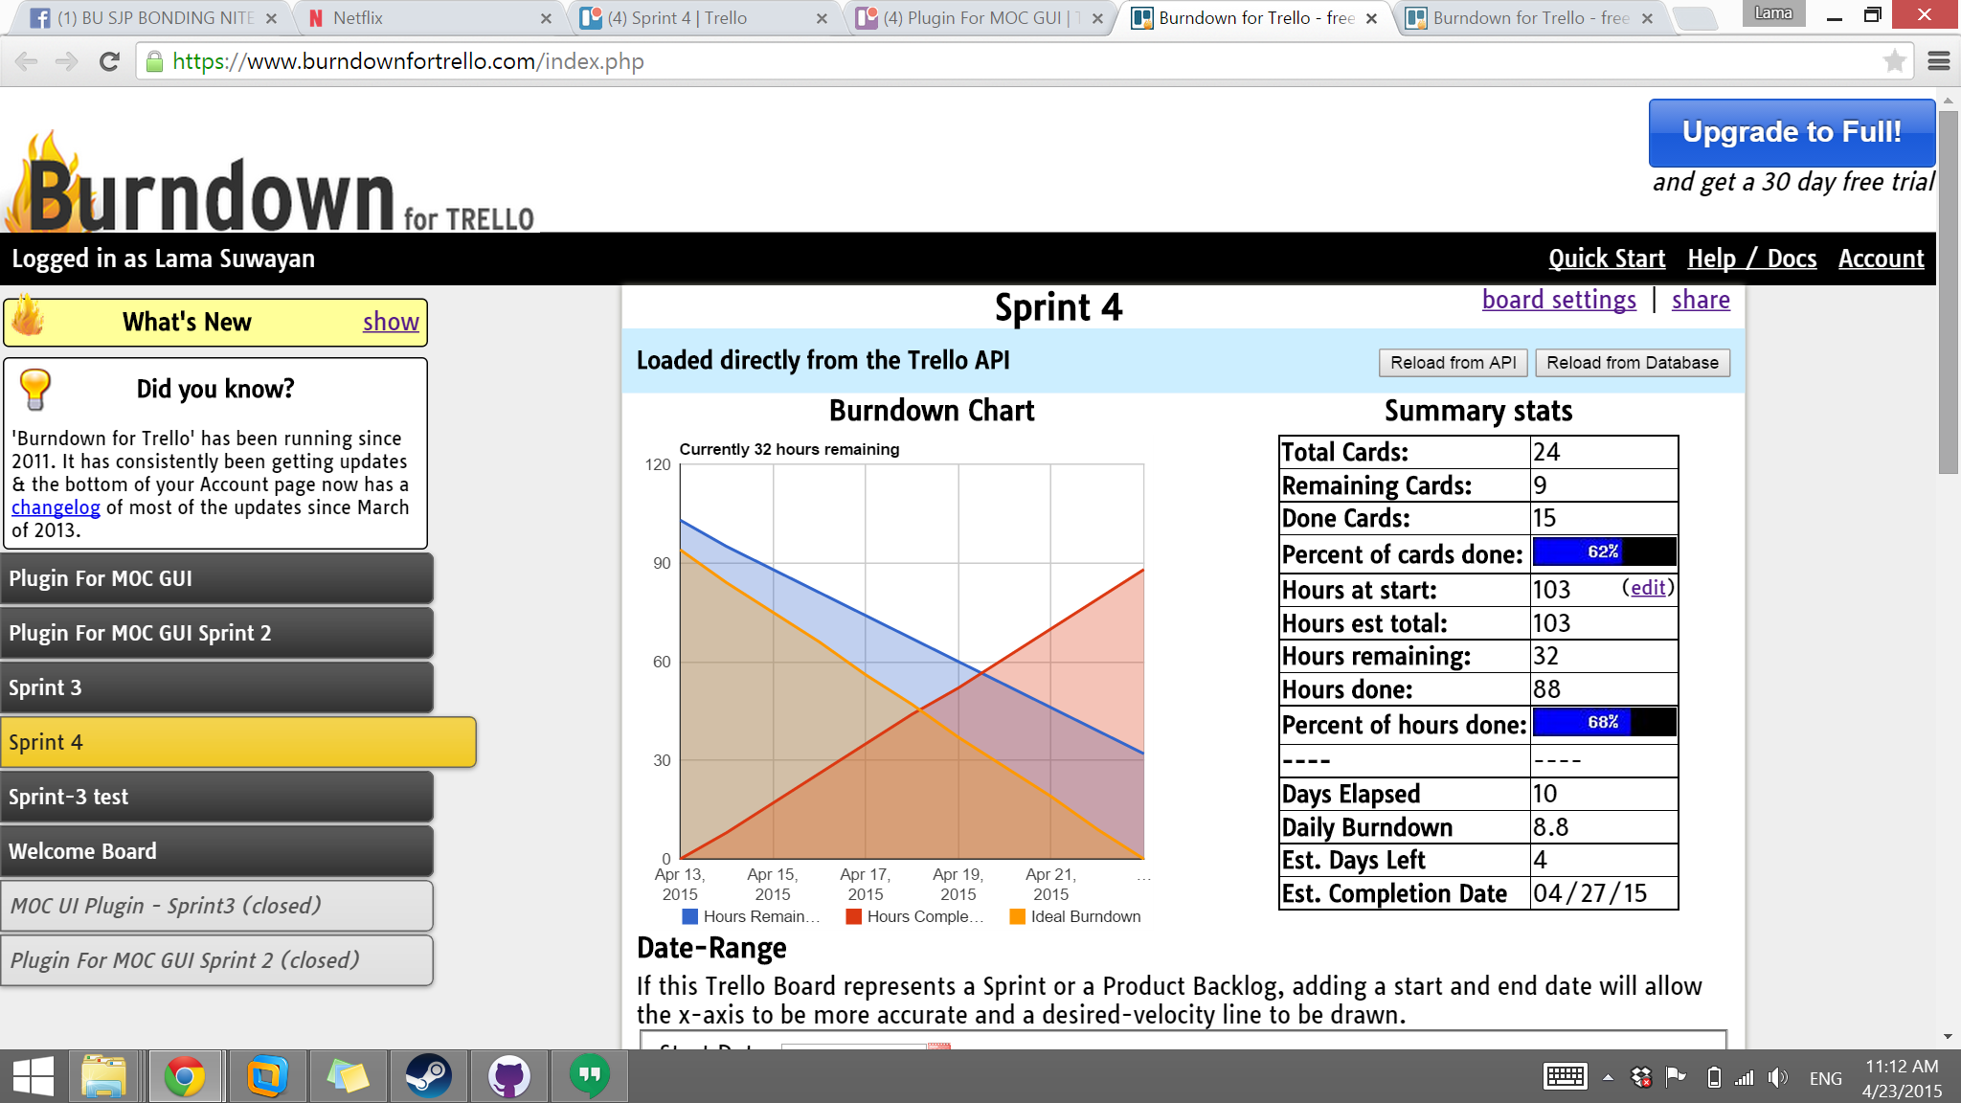
Burndown

Slide 8
Refactoring – App Structure and URLS
MOC UI Plugin
MOC UI
Projects
/projects
Nodes
/nodes
Networks
/networks

Slide 9
Refactoring – App Structure and URLS
MOC UI Plugin
MOC UI
Projects
/projects
Networks
/networks
Network Details
/networks/{{name}}
Project Details
/projects/{{name}}
Node Details
/nodes/{{name}}
Nodes
/nodes

Slide 10
Refactoring – App Structure and URLS
MOC UI Plugin
MOC UI
Projects
/projects
Headnode
Nodes
/nodes
Node Details
/nodes/{{name}}
Networks
/networks
Network Details
/networks/{{name}}
Project Details
/projects/{{name}}
Nodes
Networks
Availability
NICs
Networks
Project
HNICs and NICs
Creator
Project

Slide 11
DEMO

Slide 12
Challenges: HaaS Database Schema

Slide 13
Overall Status
Initial Project Requirements Stretched
Initial: Integration of Existing Calls
Stretch: Writing new API calls
Main Goal of Integration of iFrame Pushed Back as a Result

Slide 14
Q & A!

