Slide 1
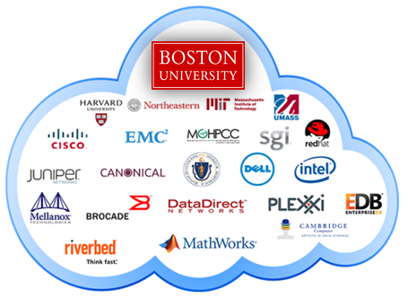
Team Members: Dana Aljawder, Lama AlSuwayan, Everett Carson, Igibek Koishybayev, Hung Vong Project Mentor: Jon Bell
Plugin Architecture for The Massachusetts Open Cloud GUI
(MOC)
EC 500-A1: Cloud Computing

Slide 2
Outline
Concepts
MOC-UI
HaaS
Tools
Django (Python, HTML, Javascript)
Sprint 1 – Demo
What’s next

Slide 3

MOC-UI
Massachusetts Open Cloud
Open Cloud eXchange (OCX)
Customizable approach to Cloud Computing
User Interface
Simpler for researchers and developers
Web app to manage and maintain
projects and clusters on the MOC
Plugin architecture

Slide 4
HaaS
Hardware as a Service
Components:
Project: create/delete
Headnode: load base image, start/stop
Node: attach/detach
Networks: create/delete, set access

Slide 5
Django
Python Web Application Framework
Uses MVC architectural pattern:
Why Django?
Free/open source
Efficient
Modularized:
Allows separation of concerns/parallel development

Slide 6
Sprint 1
Learned about HaaS (~7 hours)
How to use django (~5 hours)
Designed UI and Templates (~4 hours)
Implemented UI without HaaS integration (~12 hours)
[DEMO]

Slide 7
What’s Next
Complete the UI
Run development server of HaaS
Integrate HaaS API calls

Slide 8
Q & A!

