Slide 1

Team Members: Dana Aljawder, Lama AlSuwayan, Everett Carson, Igibek Koishybayev, Hung Vong Project Mentor: Jon Bell
Plugin Architecture for The Massachusetts Open Cloud GUI
(MOC)
EC 500-A1: Cloud Computing

Slide 2
Project Overview
Plugin for MOC-UI
Allow external web apps to be integrated into MOC-UI
HaaS
Test case: implement a web app to manage projects using HaaS
Integration of HaaS app into MOC-UI

Slide 3
Integration Strategy (use diagrams)
MOC-UI

Slide 4
Sprint 1
Learned web tools (django)
Studied HaaS API
Developed initial UI for app
Did not use Trello

Slide 5
Sprint 2
(4) Set up instances of HaaS server [3]
Integrated HaaS API calls into web app
(4) create/delete projects [3]
(2) create/delete nodes ?? [hours]
(8) Finished UI (Django templates, CSS & JavaScript)[7]

Slide 6
Sprint 2 – Cont’d
Stretch – added API call to HaaS
Http://192.168.32.133:8000 [DEMO]

Slide 7
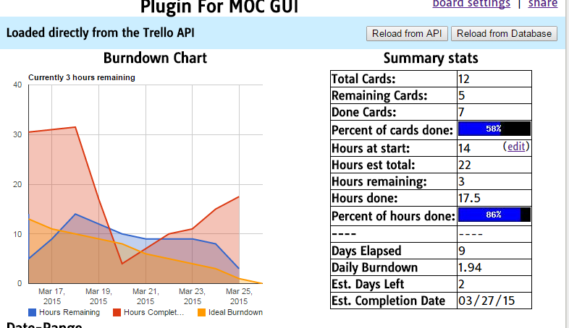
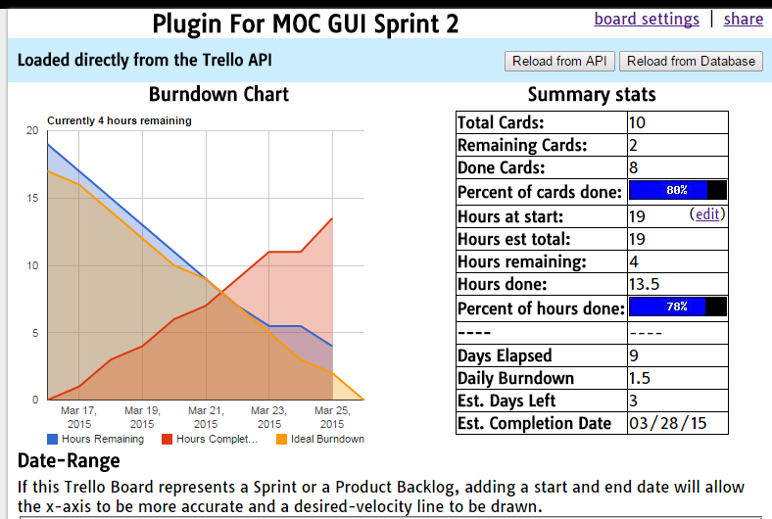
Burndown (and our mistakes!)

Slide 8
What’s Next For Sprint 3
(15) Complete HaaS API
(15) Integrate API calls

Slide 9
Q & A!

