Slide 1

Team Members: Dana Aljawder, Lama AlSuwayan, Everett Carson, Igibek Koishybayev, Hung Vong Project Mentor: Jon Bell
Plugin Architecture for The Massachusetts Open Cloud GUI
(MOC)
EC 500-A1: Cloud Computing

Slide 2

MOC-UI Plugin Review
Presented web tools used for project
Talked about HaaS
Gave hardcoded DEMO
Planned on finishing some HaaS API calls

Slide 3
Integration Strategy (use diagrams)

Slide 4
Learning Experience
Trello is a bad to-do list
Set better stretch goals
Etc… add more

Slide 5
Sprint 2
(4) Set up HaaS server for testing [3]
Integrated some HaaS APIs
(4) create/delete projects [3]
(2) create/delete nodes ?? [hours]
(8) Django templates, CSS & JavaScript fixes [7]

Slide 6
Sprint 2 – Cont’d
[DEMO]

Slide 7
Burndown
Insert Trello burndown chart here after we fix Trello board

Slide 8
What’s Next For Sprint 3
(15) Complete integration of all remaining HaaS API calls
(15) Set up authentication service
How?
(15) Set up topology visualization
Grab JSON data and use AJAX
(20) Load balance for end-users

Slide 9
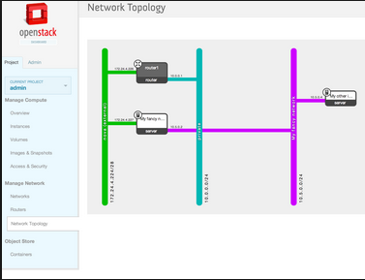
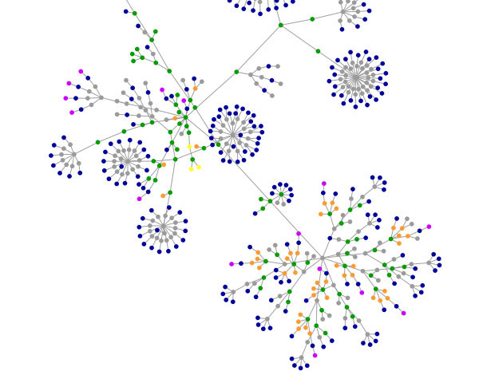
What Visualization Might Look Like

Slide 10
Q & A!

