Slide 1
RAG_StormX
Boston University
Yigong Hu
EC528
2026/02/25
Distributed KV Store for RAG in the Cloud
Darwin Quizhpi, Selina Yan, Zhakhangir, Jiafei, Nanyu
1.
Notes:
Today we’re presenting our integration of TiKV as a distributed backend for SPTAG to support RAG workloads in cloud environments.

Slide 2
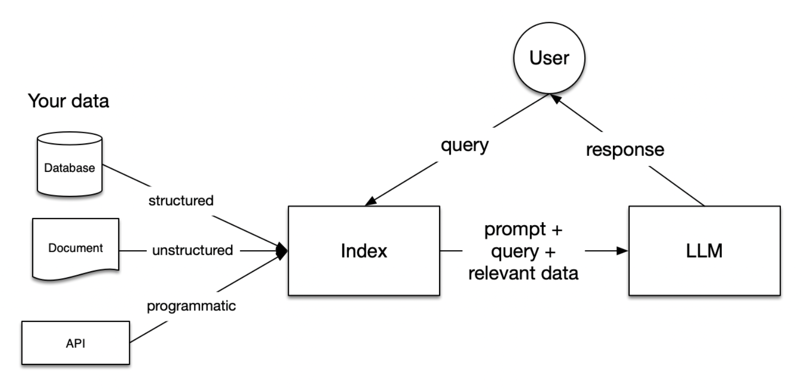
Background
Vector Database:
Index Type:
Stores, indexes, and manages high-dimensional vector embeddings (numerical representations of data)
This enable fast semantic search, rather than relying on exact keyword matches
Graph-based (e.g. HNSW Hierarchical Navigable Small World Graph)
Clustered-based (What is used in SPTAG)
RAG:
ANN search:
Approximate nearest neighbor search and a technique used in vector databases
Finds data points closest to a given query point
Trading correctness for availability
2.
Notes:
A vector database stores, indexes, and manages high-dimensional vector embeddings (numerical representations of data) to enable fast semantic search,, rather than relying on exact keyword matches. By clustering similar data points together in a vector space, they allow AI applications to find relevant information based on meaning, crucial for retrieval-augmented generation (RAG) and AI memory graph-based and cluster-based (inverted-file / centroid-partition) indexes are the two most common families you’ll see in vector databases for approximate nearest neighbor (ANN) search. Cluster-based indexes group vectors based on their similarity. As a result, the search space is reduced to only the cluster(s) that is most likely to contain the nearest neighbors. Their search accuracy (recall and precision) may generally be lower than graph-based indexes, but they can be more memory-efficient.

Slide 3
Why are we doing this?
RAG Requirements:
Challenge:
Goal:
Extremely high read throughput
Low tail latency (p95 / p99 critical)
Horizontal scalability
Cloud-native availability
Existing KV stores are general-purpose
Vector retrieval workloads have different access patterns
Build an optimized distributed KV backend for RAG that is able to use SPTAG and TIKV as a baseline for optimization.
3.

Slide 4
High level system Architecture
SPTAG
(c++ engine)
Go Sidecar
(SPTAG - TiKV go client adapter)
Unix Domain Socket - UDS
RawKV API
PD
Placement Driver
TIKV Cluster
(contains Nodes)
What's Happening?
SPTAG handles vector search
Sidecar allows SPTAG to talk to TiKV
TiKV is a distributed DB that store metadata that SPTAG needs
PD manages region placement and leaders
4.

Slide 5
Implementation Status & Supported Operations
Sidecar–TiKV Integration Verified
Next Steps:
Successfully executed Put / Get operations
Verified Batch Get functionality
Confirmed TiKV routing via PD
Validated data integrity through gRPC boundary
Integrate the TiKV go client sidecar into SPTAG
Add TiKV as a backend storage
Perform full SPTAG-level validation
full KeyValueIO compatibility, (Delete, Merge, Scan, Range Delete, Stats, Compaction)
Pivot to focus on the designing our own RAG-optimized Distributed DB
5.

Slide 6
How we plan to Optimize TIKV (Baseline -> RAG-KV)
Cache Addition:
Prefetch:
To speed things up, we can add cache in front of the TIKV that can keep the “hot” cluster data in memory. This way repeated queries don't have to hit TiKV every time.
We also plan to prefetch neighboring clusters when one cluster is requested. Because queries tend to revisit nearby regions. This should rise the cache hit rate and reduce latency. Its similar to how CPU caches work in HPC systems.
6.

Slide 7
Thank you for listening!
Any questions?
7.

Slide 8
Quiz Question!
We are building Distributed DB that is focused on:
Optimizing for average and slowest read speeds
Optimizing for average and slowest write speeds
Is optimized for extreme correctness (always giving the closest point possible, not approximate)
All of the above
7.

