Slide 1
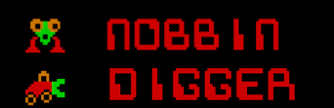
EC551 Project—Digger Game
Group Name: Kiss Goodbye
Group members:
Yenai Ma, Yinan Liu,
Xiangchao Huang, Siwan Yang
swyang@bu.edu
Notes:
This is the presentation given by group “Kiss Goodbye”. Are you guys all familiar with the kiss-goodbye story, which was told by the professor during class? For this project, we are going to implement a classical video game on FPGA.

Slide 2
Abstract
Abstract
Goal and Motivation
Functionality
Specification
Detailed Functionality & Block Diagram
Verilog Example
Success & Failure Analysis
Design Tradeoff Discussion

Slide 3
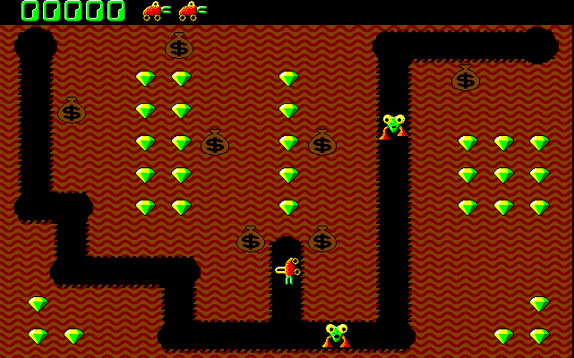


Goal and Motivation

Slide 4
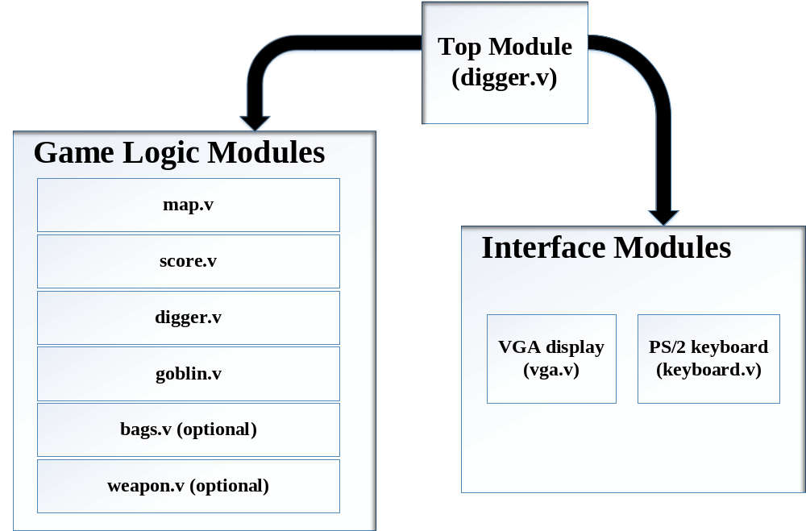



Functionality
Yenai&Yinan
Xiangchao&Siwan

Slide 5
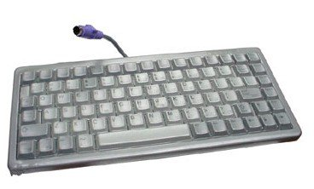
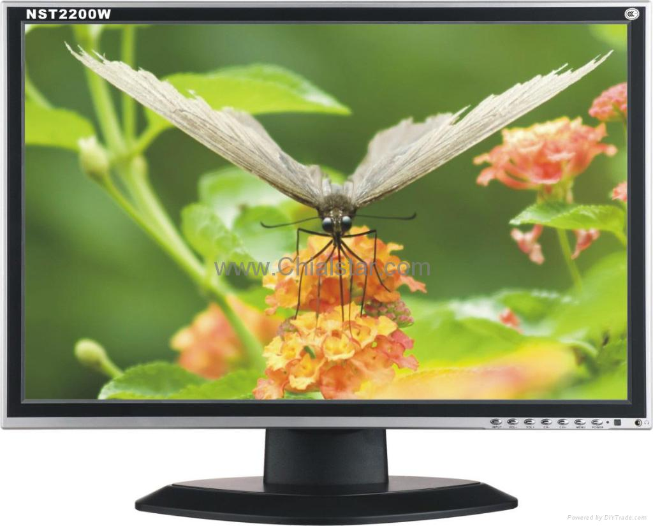
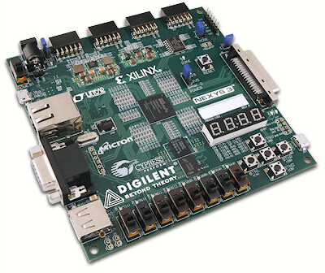
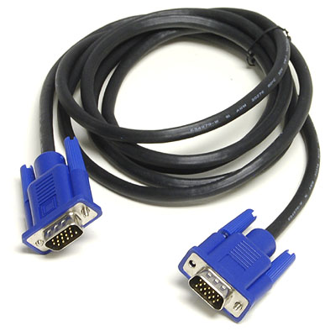
Specification
What we need
  Xilinx Spartan6 XC6LX16-CS324
  A VGA cable
  A VGA display
  A PS2 keyboard
Implement Basic Functions
  Generating game interface
  Recognizing keyboard inputs and responding correctly and fast.
  Implementing basic functions, such as collecting diamonds, killing goblins, calculating the score, etc.

Slide 6
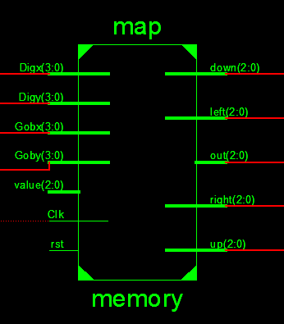
Map.v
Map Module stores the map data at each location and performs Read and Write operations.
Write Mode:
  EnWr=1
  data at location (row,col) will be written to the value.
Read Mode:
  EnWr=0
  Output will be the map data at location (row,col)
Notes:
There are several worries we have. We might have the broken hardware that might influence our schedule. We might also run out of resources on our board. Another problem is that we cannot meet the time constrain of the hardware and the software part. Such as the slow response.

Slide 7





Map.v
0
1
2
3
4
5
6
7
Path
the only way for gobblins right now
Unidirection Paths
created by digger
(not implemented yet)
Crushed money bag
Logical Boundary

Slide 8
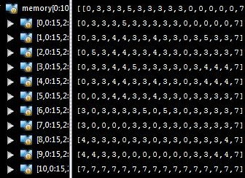
Map.v
Notes:
So we will directly play the game to demo our system. Our system should include several important things. Firstly we will have the game interface. As we mentioned before, we will have a VGA display to present our game to the users. Then we will have the keyboard for the users to play the game. They should be able to control the digger. Also our game need to have the basic functions: for example, the digger should be able to collect the diamonds, if the digger collect all the diamonds without hitting the goblin, the user wins. And the digger should also be able to dig the tunnel and use the money bag to kill the goblins. Also the system should be able to calculate the scores.

Slide 9
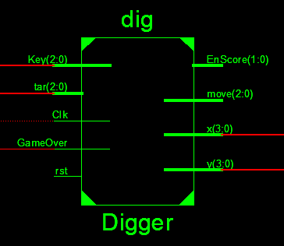
Digger.v
Digger will move under control of the Key signals
  0:hold; 1:up; 2:down; 3:left; 4:right
Digger location (x,y) will feed to the Gobblin Module
The Map data of the location (x,y) will be update to 0
EnScore will be sent out to the Score Module if Digger hits diamond and crushed money bag
Move signal sends to the VGA
Notes:
There are several worries we have. We might have the broken hardware that might influence our schedule. We might also run out of resources on our board. Another problem is that we cannot meet the time constrain of the hardware and the software part. Such as the slow response.

Slide 10
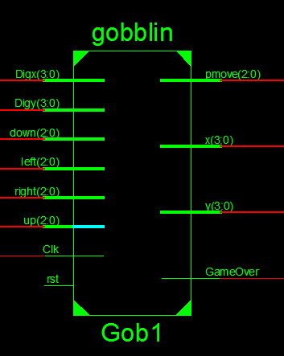
Gobblin.v
Location of digger (Digx,Digy) is the target position of gobblin
Location of gobblin (x,y) goes to the money bag module (coming soon)
Pmove feeds to VGA
GameOver if the gobblin catches the digger
  (Digx, Digy) = (x, y)
Notes:
There are several worries we have. We might have the broken hardware that might influence our schedule. We might also run out of resources on our board. Another problem is that we cannot meet the time constrain of the hardware and the software part. Such as the slow response.

Slide 11
Gobblin.v AI
The moving decision is made based on the previous direction and map data of 4 neighbour nodes.
Preference
  Previous direction available && Reduce distance
  Turning available && Reduce distance
  Previous direction available
  Turning available
  Return
Notes:
There are several worries we have. We might have the broken hardware that might influence our schedule. We might also run out of resources on our board. Another problem is that we cannot meet the time constrain of the hardware and the software part. Such as the slow response.

Slide 12
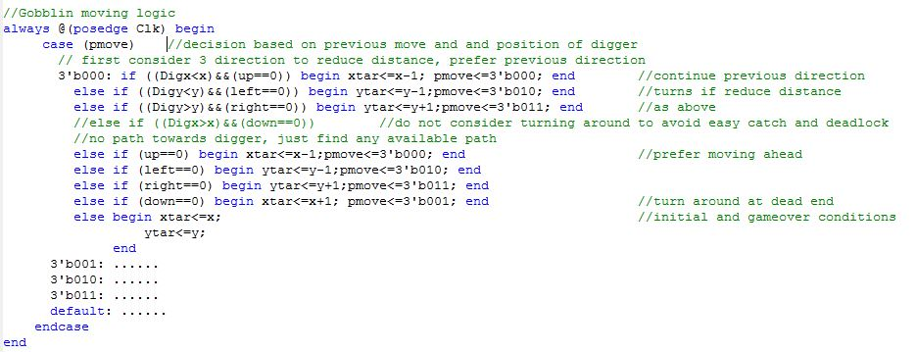
Verilog Code example

Slide 13
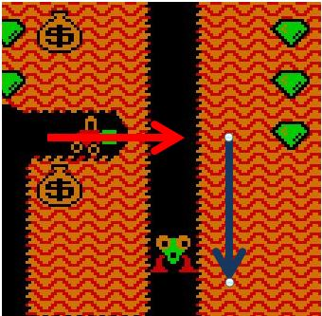
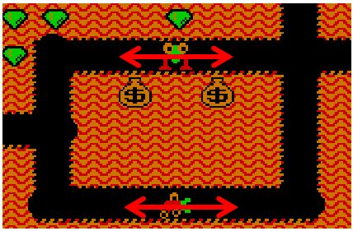
Gobblin.v AI
Deadlock
Easy Catch

Slide 14
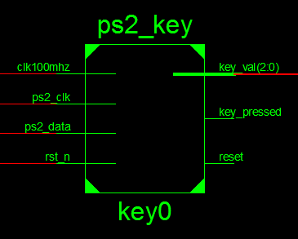
ps2_key.v
Control the movement of digger
Use the “r” key to reset the game

Slide 15
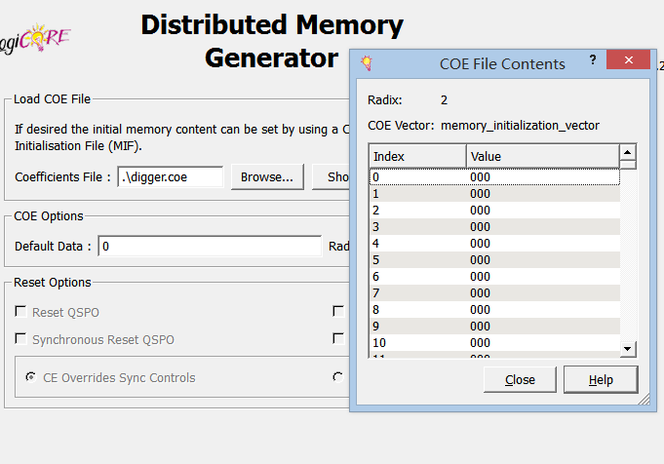
vgacontroller.v
We used the Xilinx ROM IP core to store the bmp of the digger and goblins, currently, we can only get the address of the pictures from the ROM and display on the screen.
Notes:
We get the address of the picture in the ROM, and display it using the VGA interface. We will combine the movement with the game logic later and make the graph move according to the game control unit.

Slide 16
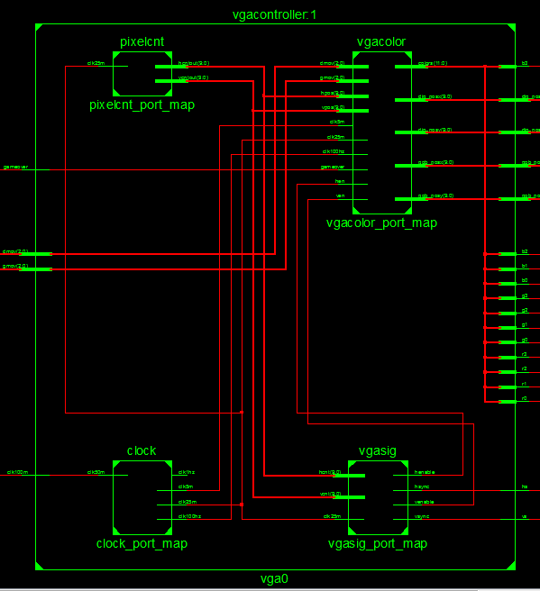
vgacontroller.v
Four small modules
  Pixelcnt
  Clock
  Vgacolor
  Vgasig

Slide 17
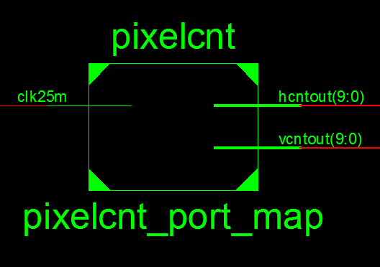
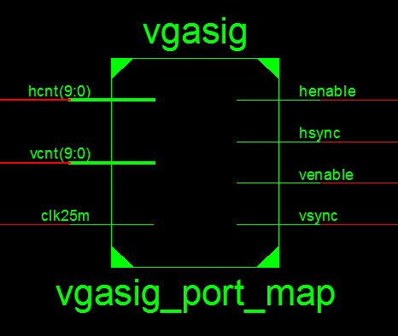
vgacontroller.v
The pixelcnt module generates the position of the pixels and synchronizes with the vgasig module.
The vgasig module generates the hsync and the vsync to the VGA display.

Slide 18
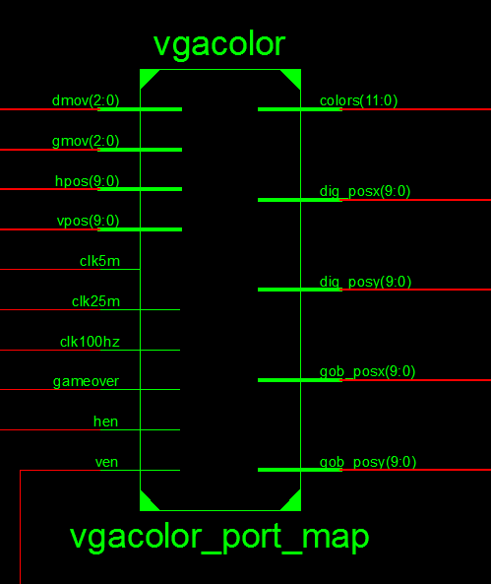
vgacontroller.v

Slide 19
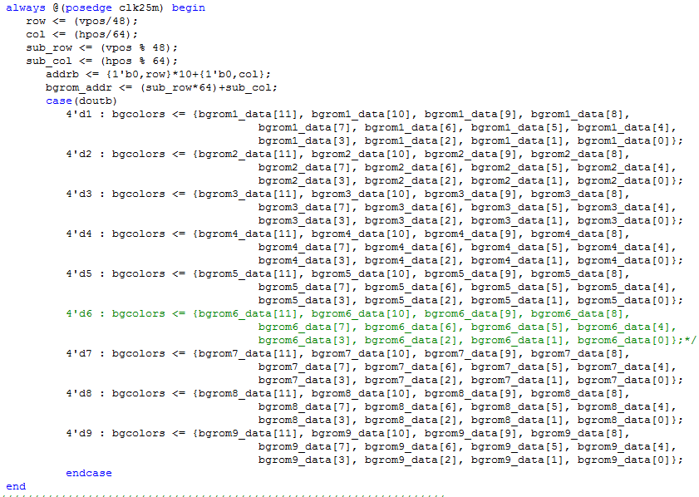
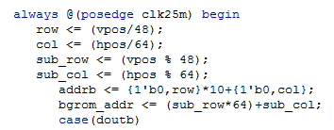

Slide 20
Success Analysis
The modules are working well separately
  Score
  Digger
  Goblin
  VGA
  Keyboard
Verified by either VGA display or simulation

Slide 21
Failure Analysis
Trustees Presentation
Duplex Memory Instantiation
  We instance several memory without realizing they are different!!!
  Read and write operations on different memory!!!
  Solution: eliminate all redundant memory, increase number of I/O ports of the surviving memory, and correct wire connections.
New Problem: memory module doesn’t support simultaneous multiple read operations.
  Solution: using arbiter: increase the frequency of read operation and perform read requests one by one.
Still have small bugs on combining display and logic
  Solution: We will debug very soon.

Slide 22
Design Tradeoff Discussion
Money bag module:
  Solution 1:
    Treat one money bag as a single moving object.
    7 money bags need 7 instantiations
    Advantage : easy!!!
  Solution 2:
    Using only one module to process all money bags
    Advantage : resources saving; flexible numbers of money bags for different levels
Tradeoff : Resource vs. Complexity

Slide 23

Design Tradeoff Discussion
ROM size for storing pictures:
  Solution 1:
    Stores full size of display blocks
    Advantage : easy!!!
  Solution 2:
    Stores part of display blocks, taking advantages of symmetry.
    Advantage : resources saving.
Tradeoff : Resource vs. Complexity

Slide 24
Schedule
Currently we are addressing on:
  Debug on the top module
  Implement money bag module
  Implement weapon module
Future Work:
  More levels
  Multiple goblins
  Multiple lives

Slide 25

Video
Notes:
There are several worries we have. We might have the broken hardware that might influence our schedule. We might also run out of resources on our board. Another problem is that we cannot meet the time constrain of the hardware and the software part. Such as the slow response.

Slide 26

Thank you !

